Slide 1
Dynamics of NFL Games Project
By
Osaid Khan
Maheswara Rao Dollu
Kanishk Devda

Slide 2
Introduction

Slide 3
In this presentation, we will explore the dynamics of NFL games by analyzing various datasets that capture game statistics, player information, and play-by-play details. Understanding these datasets allows us to identify patterns and insights that can enhance our comprehension of player performance and team strategies.

Slide 4
Data analytics has transformed sports by providing insights into player performance, team strategies, and game outcomes.
Coaches, analysts, and teams utilize data to make informed decisions, improving competitive advantage.
This presentation aims to analyze various datasets related to NFL plays, focusing on identifying patterns and insights.
The analysis will cover exploratory data analysis (EDA), including visualizations, to illustrate findings.
Coaches and teams can refine strategies based on performance data.

Slide 5
Problem Definition

Slide 6
1.⁠ ⁠Impact of Player Performance:
How do individual player statistics (e.g., passing yards, rushing attempts) correlate with game outcomes, and do certain player positions (e.g., quarterbacks versus running backs) have a more pronounced effect on scoring?
2.⁠ ⁠Trends Over Time:
Are there observable trends in player performance metrics across different seasons or weeks, and how do these trends correlate with team success or failure?

Slide 7
3.⁠ ⁠Play Strategy Analysis:
What types of plays (e.g., rushes, passes, scrambles) are most effective in gaining yards and scoring?
How do different offensive formations influence the success of plays?
4.⁠ ⁠Team Dynamics:
How do team attributes (e.g., win probability, pre-snap scores) affect the likelihood of scoring during a game, and are there specific matchups between teams that lead to consistently higher or lower scores?

Slide 8
Dataset Overview

Slide 9
Game data: Contains details about each game, including the season, week, date, teams involved, and final scores. The key variable is gameId.
Graph Types: Histograms, scatter-plots
Season Performance: A line graph showing scores over different weeks can highlight performance trends, showing how teams improve or decline as the season progresses.

Slide 10
2.⁠ ⁠Plays Dataset: The plays.csv file contains Provides information on players such as their physical attributes, birthdates, college affiliations, and positions. The keyvariables are gameId and playId.
Graph Types: Histograms, box plots
Key Insights:
Distribution of Yards Gained: A histogram displaying yards gained per play can illustrate the most common outcomes. If the distribution is heavily skewed to the right, it indicates many successful plays gaining significant yardage.
Quarterly Performance: Box plots for yards gained across different quarters can show variations in performance. If late-game plays tend to gain more yards, it might suggest teams perform better under pressure

Slide 11
3.⁠ ⁠Players Dataset: The players.csv file contains player-level information from players that participated in any of the tracking data files. The key variable is nflId. Captures individual player actions during games, detailing rushing attempts, passing yards, and other key performance metrics.
Graph Types: Scatter plots, histograms
Key Insights:
Height vs. Weight: A scatter plot can help identify any correlation between player height and weight. If most players cluster along a line indicating a consistent ratio, it suggests a typical body type for players in certain positions.
Position Frequency: A bar chart displaying the number of players by position can show which positions are most common. If certain positions have significantly more players, it may reflect team strategies or player availability.

Slide 12
4.⁠ ⁠Player_Play Dataset: The file contains player-level stats for each game and play. The key variables are gameId, playId, and nflId.
Graph Types: Heatmaps, scatter-plots
Key Insights:
Team Performance by Play Type: A heatmap can illustrate the success rate of different play types (e.g., rush vs. pass) across teams. Darker colors may indicate higher success rates, allowing for quick identification of effective strategies.
Performance Over Time: A line graph showing average yards gained by play type over the season can reveal trends in play effectiveness. If passing plays show increasing effectiveness while rushing plays decline, it may indicate a shift in team strategy.

Slide 13
EDA

Slide 14
Theoretical Explanation of Key Metrics and Features
Theoretical Explanation of Key Metrics and Features
Aggregate Metrics Calculation:
Grouping Data: The dataset is grouped by player identifiers (e.g., nflId) to summarize individual player performance metrics. This allows for a comprehensive view of each player's contributions in terms of rushing and passing yards, as well as the total number of plays they participated in.

Slide 15
Aggregation Functions: Common aggregation functions such as sum and count are employed to compute total yards and total plays, which are critical for evaluating player effectiveness.
Play Counts Per Game:
Counting Plays: By aggregating data based on gameId, the number of plays in each game is calculated. This is essential for understanding the volume of gameplay and can inform analyses related to game pacing and player involvement.

Slide 16
Merging Data:
Data Integration: Merging the play counts back into the main dataset enhances the context for each play. This integration allows for the calculation of derived metrics, such as average yards gained per play, which is vital for performance evaluation.
Average Yards Gained:
Performance Metrics: Calculating average yards gained provides insight into the efficiency of plays. This metric helps identify effective offensive strategies and can highlight individual player performance.

Slide 17
Handling Division by Zero:
Data Cleaning: Replacing infinite values that arise from division by zero ensures the dataset remains usable and prevents errors in subsequent analyses. This step is crucial for maintaining data integrity.
Total Scores Calculation:
Game Outcomes: Aggregating final scores for home and visitor teams allows for a clearer understanding of game results. These scores are critical for analyzing the relationship between player performance and game outcomes.

Slide 18
Renaming Columns:
Avoiding Conflicts: Renaming columns during the merging process prevents confusion and potential errors in data manipulation. Clear and distinct naming conventions are essential for maintaining clarity in a dataset.

Slide 19
Final Outputs:
Data Inspection: Displaying the first few rows of the calculated metrics and combined dataset enables quick verification of the results. This step is important for ensuring the validity of the calculations and for identifying any anomalies.

Slide 20
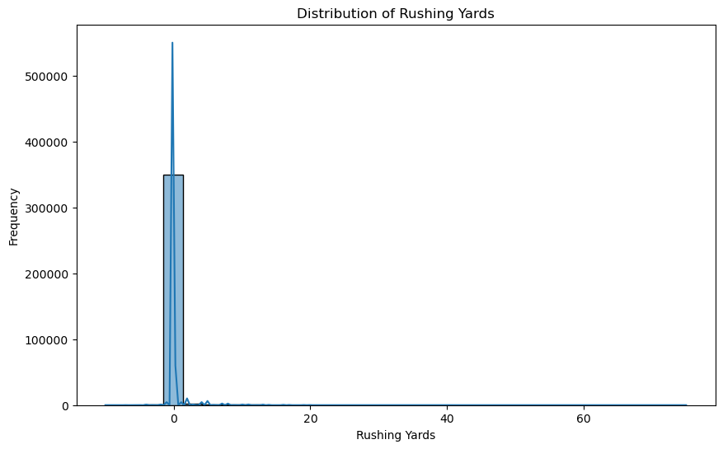
1.⁠ ⁠plotDistributionOfRushingYards
Purpose: This function plots the distribution of rushing yards across all players in the dataset.
Graph Type: Histogram with a Kernel Density Estimate (KDE).
Interpretation: The histogram shows how rushing yards are distributed, indicating the frequency of different yard totals.
Peaks in the graph can signify common rushing yard totals, while the KDE line provides a smooth estimate of the distribution.

Slide 21
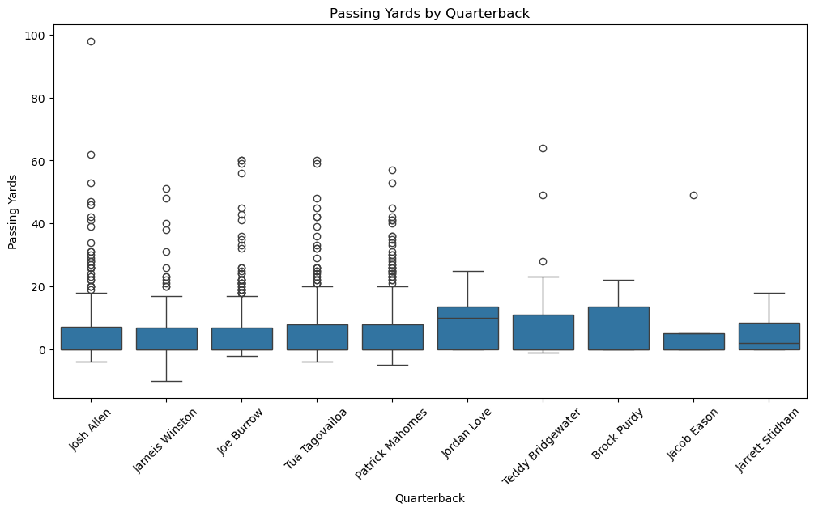
2.⁠ ⁠plotTop10QBPassingYards
Purpose: This function identifies and visualizes the passing yards of the top 10 quarterbacks based on their average passing yards.
Graph Type: Box plot.
Interpretation: The box plot displays the distribution of passing yards for the top 10 quarterbacks. The box represents the interquartile range (IQR), with the line inside the box indicating the median.
Whiskers extend to the range of data, highlighting outliers. This visualization helps compare quarterback performance and identify any significant differences in their passing yards.

Slide 22
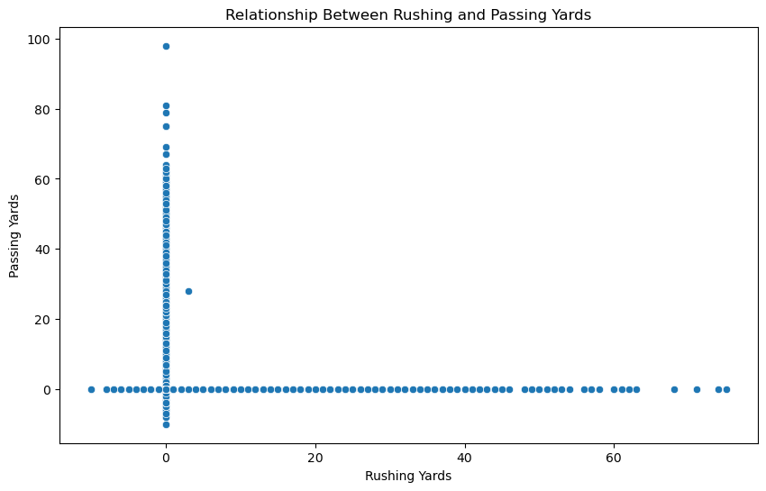
3.⁠ ⁠plotRelationShipBetweenRushingYardAndPassingYards
Purpose: This function explores the relationship between rushing yards and passing yards for players.
Graph Type: Scatter plot.
Interpretation: The scatter plot shows individual data points representing players’ rushing yards on the x-axis and their passing yards on the y-axis. A trend or correlation can be observed from the clustering of points.
For example, if most points are concentrated along a diagonal line, it may indicate a positive relationship where higher rushing yards correlate with higher passing yards.

Slide 23
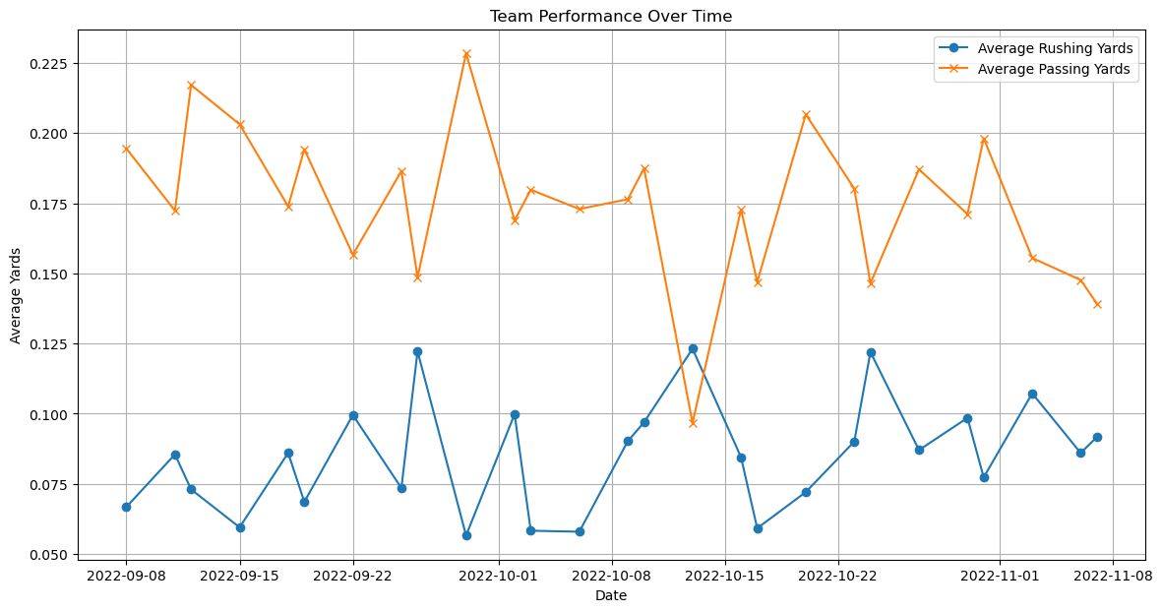
4.⁠ ⁠plotTeamPerformanceOverTime
Purpose: This function analyzes how team performance (in terms of average rushing and passing yards) changes over time.
Graph Type: Line plot.
Interpretation: The line plot displays average rushing and passing yards over time.
Two lines represent the average values for rushing and passing yards, allowing for easy comparison of trends. Observing these trends can help identify periods of improvement or decline in performance, and correlate them with specific games or seasons.

Slide 24
Results & Conclusion

Slide 25
Impact of Player Performance:
Individual player statistics such as passing yards and rushing attempts are expected to correlate positively with game outcomes, particularly in terms of scoring.
Certain player positions, like quarterbacks, are likely to have a more pronounced effect on scoring compared to others, such as running backs.
Trends Over Time:
Observable trends in player performance metrics can be analyzed across different seasons or weeks by examining the datasets. The notebook suggests that these metrics may show variations that could correlate with team success or failure.

Slide 26
Play Strategy Analysis:
The effectiveness of different types of plays (rushes, passes, scrambles) can be evaluated by analyzing the yards gained and scoring efficiency within the dataset.
Different offensive formations are likely to influence the success of plays, which can be investigated through the available play data.
Team Dynamics:
Team attributes such as win probability and pre-snap scores are expected to significantly affect the likelihood of scoring during a game.
Specific matchups between teams can be analyzed to identify patterns that lead to consistently higher or lower scores.

Slide 27
Conclusion

Slide 28
The analysis indicates a strong positive correlation between individual player statistics, such as passing yards and rushing attempts, and game outcomes, particularly in scoring. Quarterbacks have a more significant impact on scoring than other positions, emphasizing their strategic importance. Trends in player performance metrics across seasons can guide teams in adapting their strategies for success. Evaluating play types reveals which strategies are most effective for gaining yards and scoring, while the influence of offensive formations can further enhance scoring opportunities. Additionally, key team attributes like win probability significantly affect scoring likelihood, and understanding team matchups can help identify patterns for more effective game preparation.

Slide 29

Thank you

