Slide 1
Restaurant Rating Prediction System
Presented by:
Aditya Pandey
Karishma Gaikwad
Shubham Pawar

Slide 2
Introduction
A machine learning project to predict restaurant ratings based on multiple features.
Helps restaurant owners, food aggregators, and investors make data-driven decisions.
Trained on real restaurant data to provide accurate rating predictions.

Slide 3
Problem Statement
Restaurant ratings impact customer choices and business success.
Manual rating assessments are subjective and inconsistent.
Need for an automated system to predict ratings based on key features.

Slide 4
Dataset
Source: Kaggle dataset on restaurant details.
Key Features:
Cuisine types
Cost per person
City
Number of bestsellers and varieties
Menu and delivery availability
Target Variable: Rating

Slide 5
Machine Learning Model
Model Used: Random Forest Regressor
Why Random Forest?
- Handles non-linear relationships well
- Reduces overfitting by using multiple decision trees
Evaluation Metrics:
- Mean Absolute Error (MAE): 0.1026
- Mean Squared Error (MSE): 0.0403
- Root Mean Squared Error (RMSE): 0.2007
- R² Score: 0.7865 (Good model performance)

Slide 6
System Architecture
Frontend: HTML UI with dropdowns and input fields.
Backend: Flask handles user input and communicates with the model.
Process Flow:
1. User inputs details in the web app.
2. Data is processed and sent to the model.
3. Model predicts the rating.
4. Result is displayed as a popup.

Slide 7
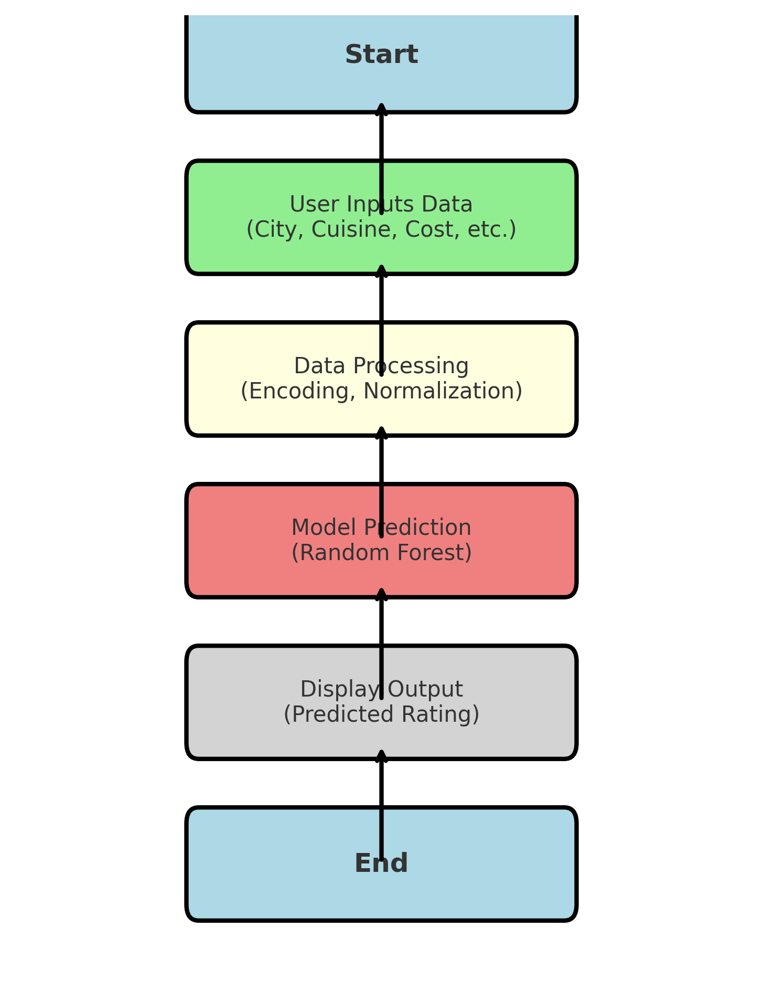
Flowchart

Slide 8
Web Application
User Interface: Simple HTML-based form with dropdowns and input fields.
Functionality:
- Users select City, Cuisine, Cost Per Person, Menu, Delivery, and Bestsellers.
- Clicks 'Predict Rating' to get the result.
- Predicted rating appears in a popup.
Backend: Flask processes inputs, calls the trained model, and returns predictions.

Slide 9
Features
⏳ Real-time restaurant rating predictions.
🖥️ User-friendly interface.
⚠️ Error handling for invalid inputs.
📊 Efficient model with reliable predictions.

Slide 10
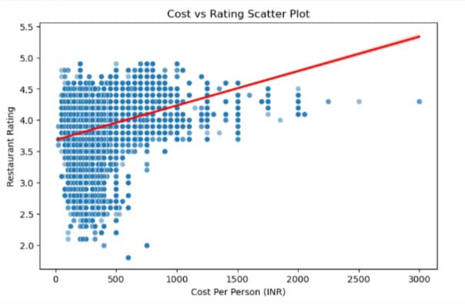
Scatter plot of Cost Per Person vs Rating

Slide 11
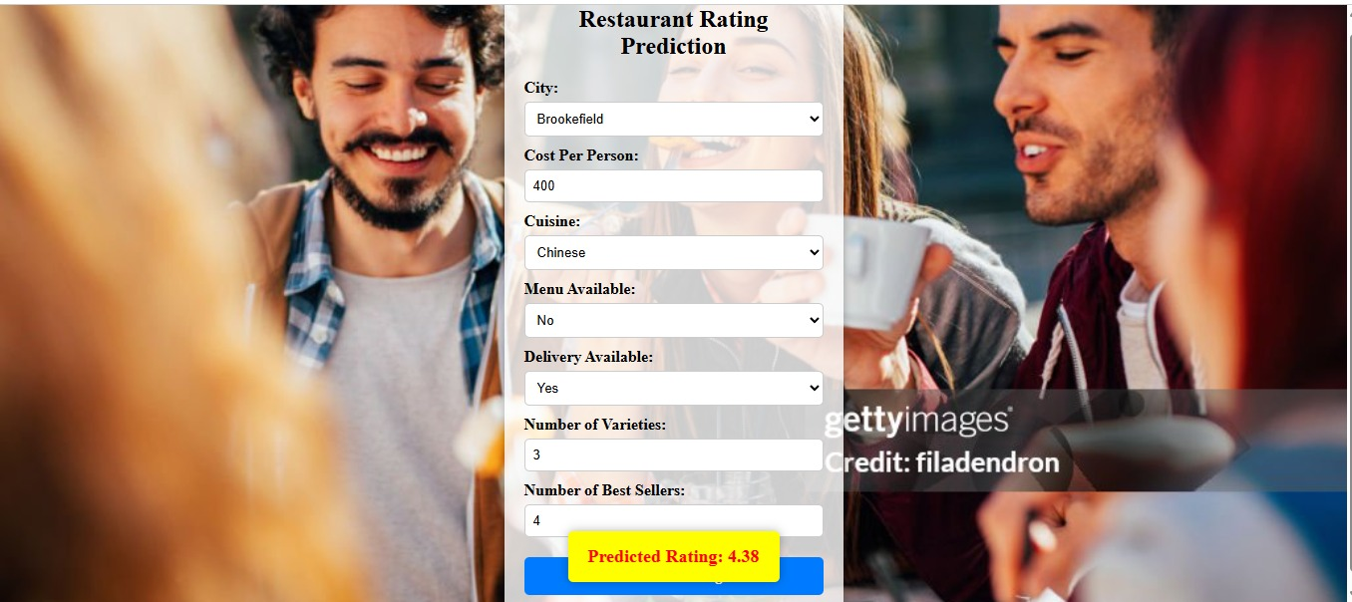
Output

Slide 12
Results & Accuracy
Model Performance:
- Low error rates indicate reliable predictions.
- R² Score of 0.7865 shows a strong correlation.
Future Improvements:
- Can consider using NLP-based sentiment analysis from customer reviews.
- Can Experiment with ensemble models for better performance.

Slide 13
Conclusion & Future Scope
Conclusion:
- Our model accurately predicts restaurant ratings with an R² score of 0.7865.
- Can be integrated into food aggregator platforms for better recommendations.
Future Scope:
- Optimize pricing for restaurants based on predicted ratings.
- Analyze restaurant trends and market performance for investors.
- Extend model capabilities by including customer review sentiment analysis.

Slide 14
Thank You

