Slide 1
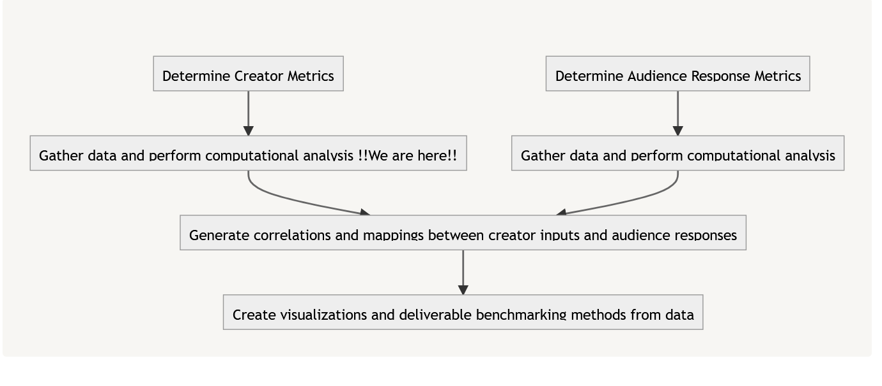
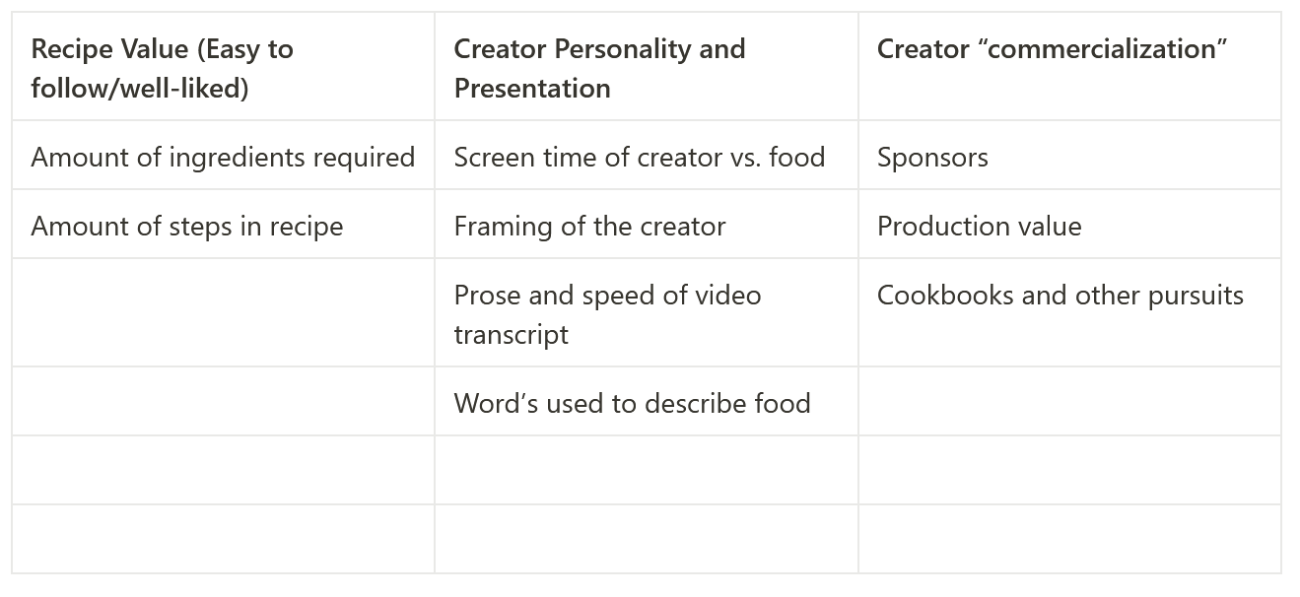
Current Happenings at P-Yum (Visible)

Slide 2


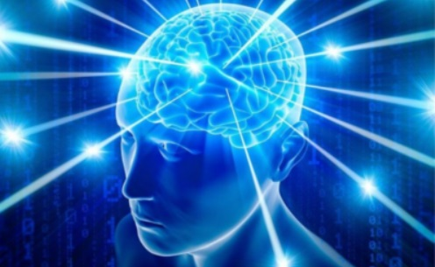
Current Happenings at P-Yum (Abstract)
Team Member

