Slide 1
Jewelry Price Optimization Using Machine Learning Patience Alaita-Jerome

Slide 2
Business Problem & Motivation
Pricing jewelry is complex (materials, gems, brand, season, customer).
Suboptimal pricing means lost revenue or unsold inventory.
Goal: Use machine learning to set better prices and identify key value drivers.

Slide 3
Data Overview
100,000+ sales/order records from jewelry e-commerce.
Features include:
Product attributes (gem, metal, color, category, gender)
Order info (date, price, user)
Target: Price in USD

Slide 4
Data Exploration (EDA)
Checked for missing values, outliers, invariant columns.
Found skewed price distribution and high kurtosis (heavy tails).
Top correlated features: log_price_usd, price_tier, main gem, main metal, category

Slide 5
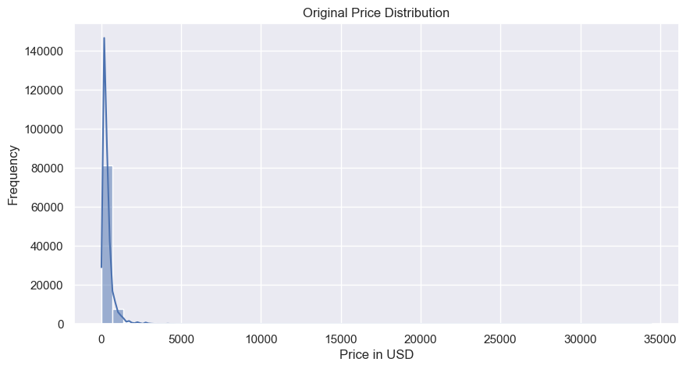
EDA -Price Histogram

Slide 6
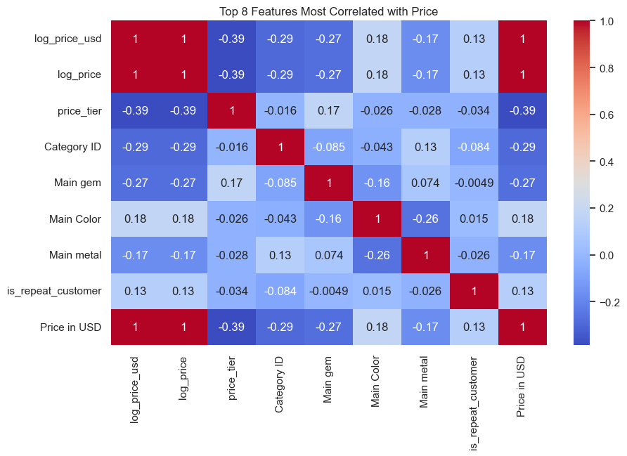
EDA-Feature Correlation Heatmap

Slide 7
Feature Engineering & Data Processing
Created features:
Log of price to reduce skew
Order month, weekday, year
Repeat customer flags, weekend flag
Encoded categoricals, dropped IDs.
Imputed missing values.

Slide 8
Modeling Approach
Pipelines: Preprocessing + Model in one object
Models compared:
Linear Regression (baseline)
Random Forest Regressor
XGBoost Regressor
Metrics: RMSE, MAE, R²

Slide 9
MLflow Tracking & Artifact Management
MLflow tracks all model runs and metrics.
Parameters, metrics, artifacts (pipelines, plots) auto-logged.
Easy model comparison & audit trail.

Slide 10
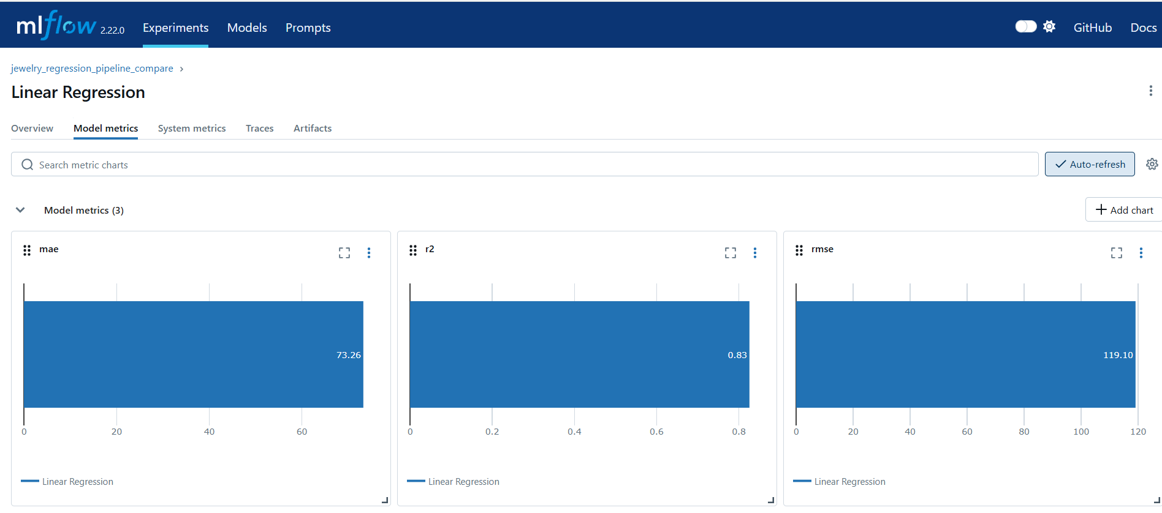
Screenshot of MLflow UI with experiment runs.

Slide 11
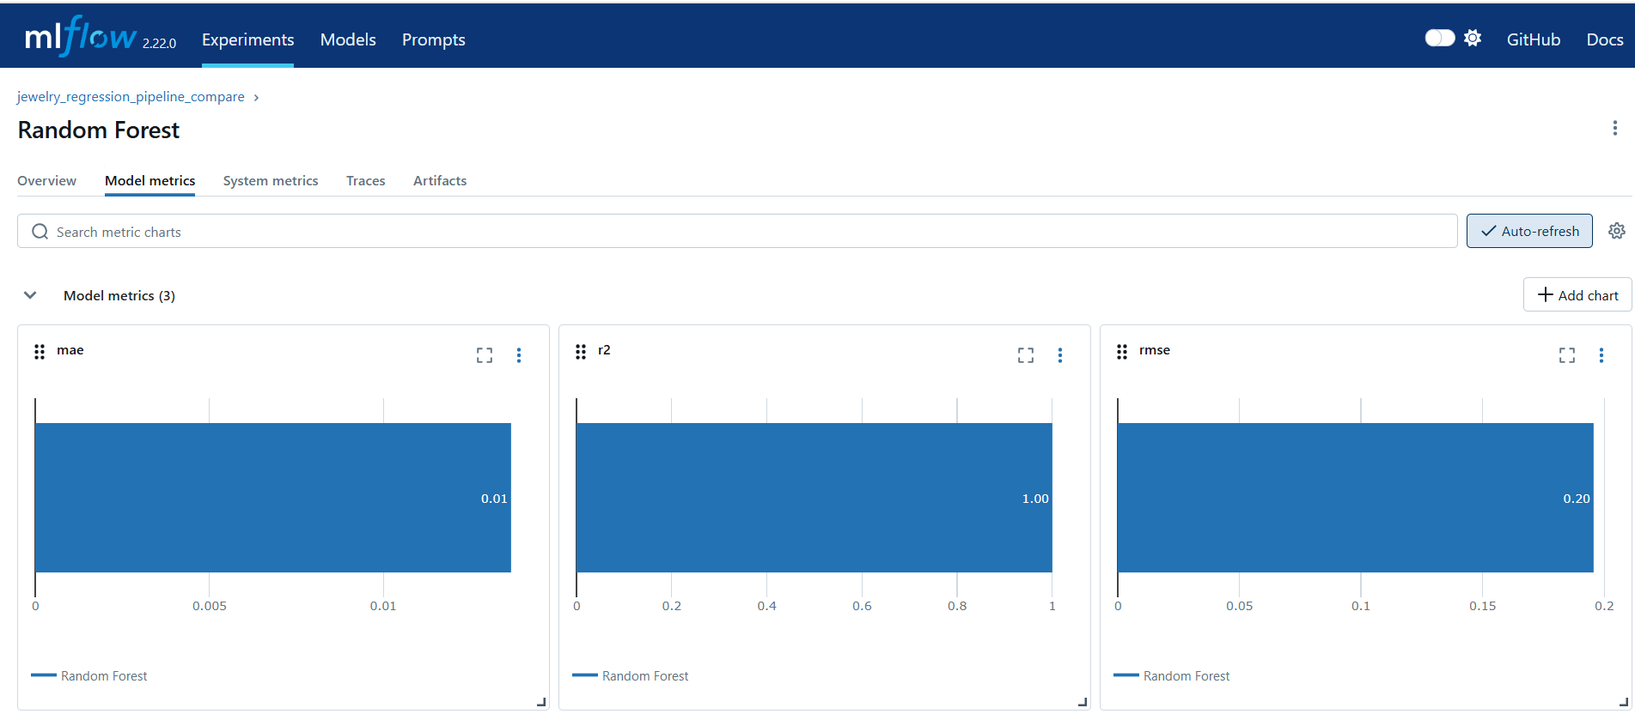
Screenshot of Random Forest Run & Metrics

Slide 12
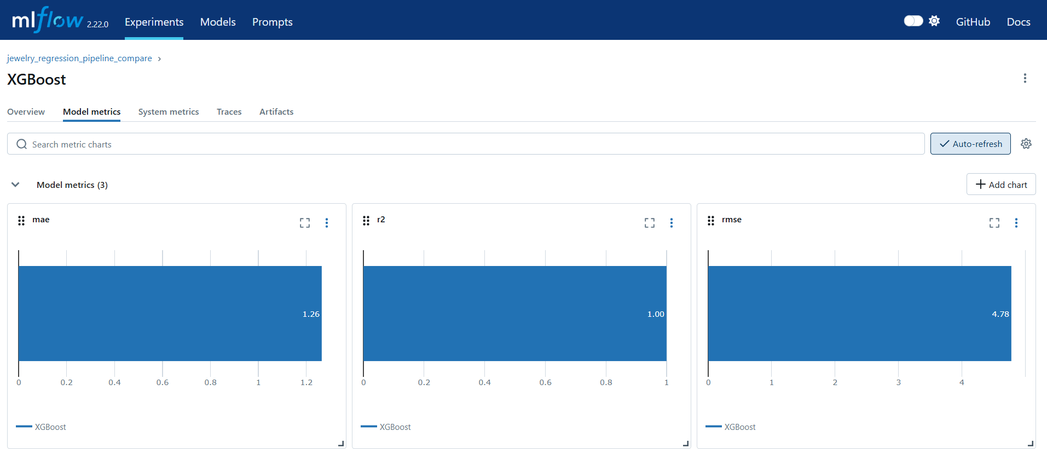
Screenshot of XGBoost Run & Metrics

Slide 13
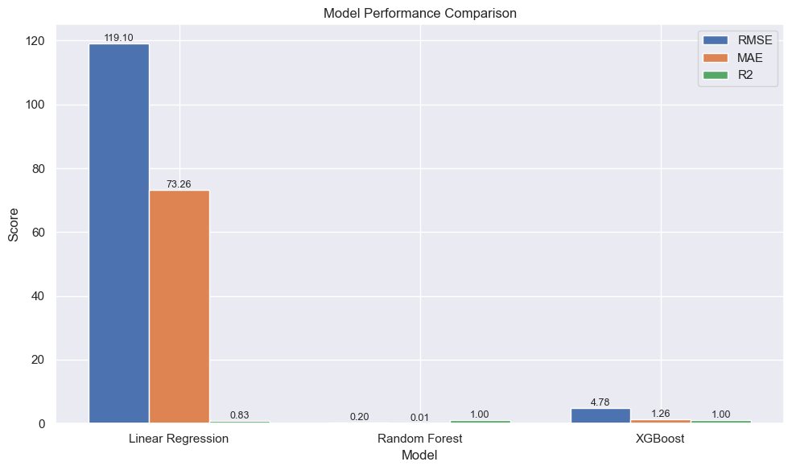
Model Performance Comparison

Slide 14
Key Insights & Recommendations
Top price drivers: Gem, metal, product category, price tier.
Dynamic pricing strategies for high-value segments.
Inventory focus on most profitable categories/gems.
Continuous retraining as market trends shift.

Slide 15
Business Recommendations
1. Focus on High-Value Product Segments
Insight: Features such as main gem, main metal, and product category have strong correlations with price.
Recommendation:
Increase inventory and marketing investment in categories and gems/metals with the highest price elasticity and customer demand (e.g., diamond rings, gold chains).
Promote and upsell premium categories through targeted campaigns.

Slide 16
Business Recommendations
2. Implement Dynamic Pricing Strategies
Insight: Advanced models (Random Forest, XGBoost) predict prices far more accurately than simple baselines, indicating nuanced price drivers.
Recommendation:
Use the best-performing ML model to set data-driven, dynamic prices that respond to changes in demand, seasonality, and inventory.
Run A/B tests to compare ML-based pricing with current strategies.

Slide 17
Business Recommendations
3. Leverage Customer Segmentation
Insight: Features like is_repeat_customer and order timing (weekend, holiday, season) have a measurable effect on pricing and sales.
Recommendation:
Offer loyalty discounts or special pricing to repeat buyers.
Run targeted promotions on weekends, holidays, and special occasions based on customer purchase history.

Slide 18
Business Recommendations
4. Reduce Inventory Risk with Predictive Analytics
Reduce Inventory Risk with Predictive Analytics
Insight: Outliers and rarely-purchased items were found in the data (via EDA).
Recommendation:
Use price prediction to reprice or phase out slow-moving inventory.
Focus replenishment on fast-selling, high-margin products.

Slide 19
Business Recommendations
5. Transparent Reporting & Continuous Improvement
Insight: MLflow enables complete tracking of experiments, model versions, and pricing logic.
Recommendation:
Adopt a culture of experiment tracking and reproducibility for all pricing updates.
Schedule regular model retraining as new sales data comes in.
Share dashboards with business and product teams for ongoing transparency.

Slide 20
Business Recommendations
6. Streamline Product Launch & Promotion
Insight: Early price signals from the model can guide launch decisions for new products.
Recommendation:
Simulate prices for new product lines before launch to gauge competitiveness.
Align initial pricing with predicted values and adjust quickly based on early sales.

Slide 21
Business Recommendations
7. Monitor and Mitigate Overpricing/Underpricing
Insight: High price skewness and kurtosis suggest the risk of outliers.
Recommendation:
Regularly monitor and adjust prices for products that are far above or below predicted market value.
Flag such products for review to prevent lost sales or margin erosion.

Slide 22
Business Recommendations
8. Drive Data Literacy and Collaboration
Insight: The project highlights the value of cross-team collaboration (data science, marketing, supply chain).
Recommendation:
Train relevant teams to interpret ML pricing outputs and take action.
Involve business stakeholders in the feature engineering and validation process for greater buy-in.

Slide 23
Q&A
Thank you! Questions and feedback welcome.

