Slide 1

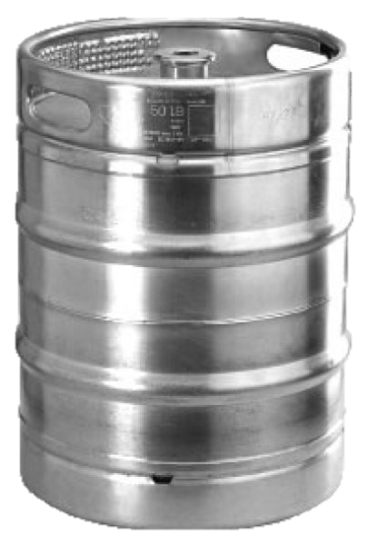
Phase 2

Slide 2
Project Specifications

Slide 3

Goals
“Keggers strives to enable an efficient and reliable service between consumers and local liquor storeowners.”
“Keggers will follow a lean startup methodology…Genchi Genbetsu – Toyota Principle”
“To achieve efficiency, the Keggers Development team will have to follow a strict guideline….This phase will require an iterative programming methodology”
Notes:
Talk about how the company expects to do the following

Slide 4
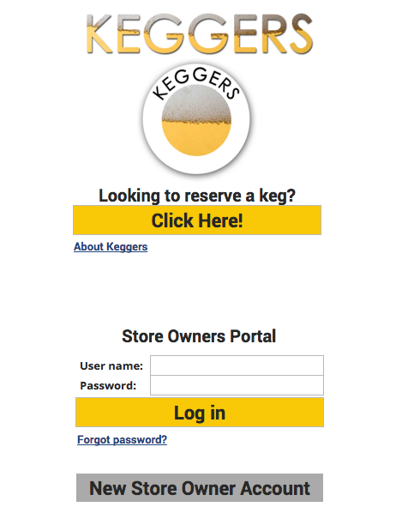
Customer User Interface
Log-in Page: “Click Here!”
Home page - location, size, vendor brew, and search buttons
08901 → ¼ Keg → Blue Moon → Search Button
Notes:
Briefly cover customer UI

Slide 5
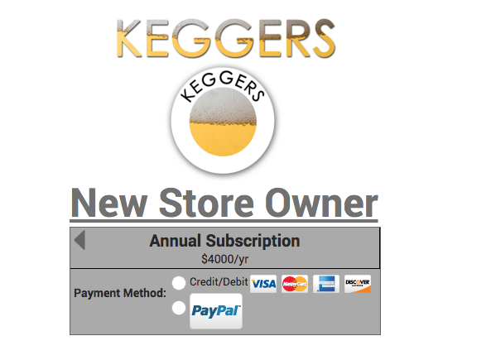
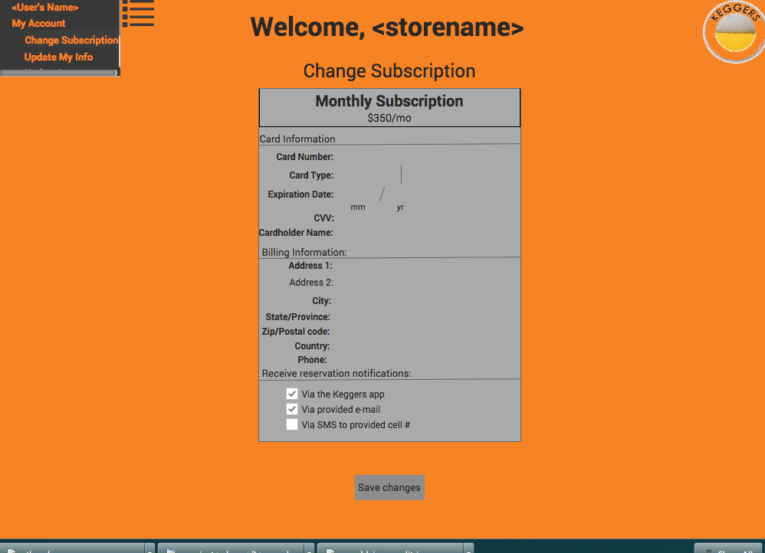
Store Owner User Interface
New Account: Basic Personal Information → Subscription Plan → Payment Method
Requires Log-In Authentication
Store Owner Menu: My Account → Change Subscription, Update Info/Inventory, Log Out
Notes:
Briefly cover store owner UI

Slide 6
Web App. Software Specs
Browser Type: All Modern Browsers (Chrome, Firefox, Safari, Edge)
Framework: Bootstrap
Input Field Validation: Jquery/Javascript
Back-end: PHP
Data Storage: MySQL

Slide 7
Database Information
Tables: customers, stores, kegs, store_keg, and reservations
Customers: id, first name, last name, telephone and email
Stores: id, name, telephone number, and email
Kegs: id, vendor, brew, and size
Store_keg: id, two foreign keys, boolean (availability)
Reservations: id, and two foreign keys

Slide 8

Hosting/Transactions
Google’s App Engine: Database hosting/security, and Pay-for-use service ( ~ $400.56 monthly)
Based off Oracle’s Capacity Planning Guide
Worst Case Scenario: Required TPS is ~40,000 (reflect Rutger’s student population)
Complexity Factor =1
Traffic Handling: More than sufficient

Slide 9
Interactive Mockup
Link: googledrive.com/host/0B-CNTkqYFAwMTXhSOWZEUHU2WDQ/index.html
Notes:
Go through interactive mockup and talk about each page

Slide 10
Release Timeline

Slide 11
Testing Plan
1. Functionality Testing
Check for Broken Links
Sample Liquor Store Location Data
Cross Reference Keggers Zip Code Search with Google Search
2. Browser Compatibility
- Chrome - Firefox - Internet Explorer 7, 8, 9
- Safari - Microsoft Edge - Opera (Gaming Consoles)
3. Mobile Compatibility
- IOS - Android - Windows

Slide 12

Keggers Phases
1. Build-Measure-Learn Loop – Assessing the problem, and developing an MVP – 1 year prior to product release
2. Customer Development – Establishing customers in niche market, college demographic – 6 months
3. Final Development – Collection of data (such certain spikes in transactions in certain months) – 6 months

