Slide 1
Habit Reinforcement Learning
Petros Christodoulou

Slide 2
Motivation
Habit Reinforcement Learning
Algorithms
Results
Conclusion

Slide 3
Motivation
Habit Reinforcement Learning
Algorithms
Results
Conclusion

Slide 4

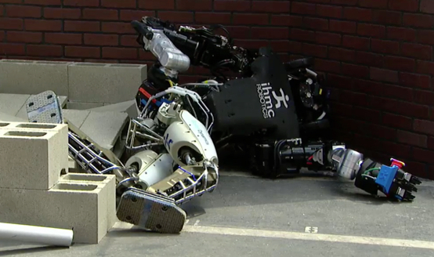
Reinforcement Learning (RL) has made great progress in recent years...
Source
...But real world applications of RL have been limited by poor sample complexity
Source

Slide 5
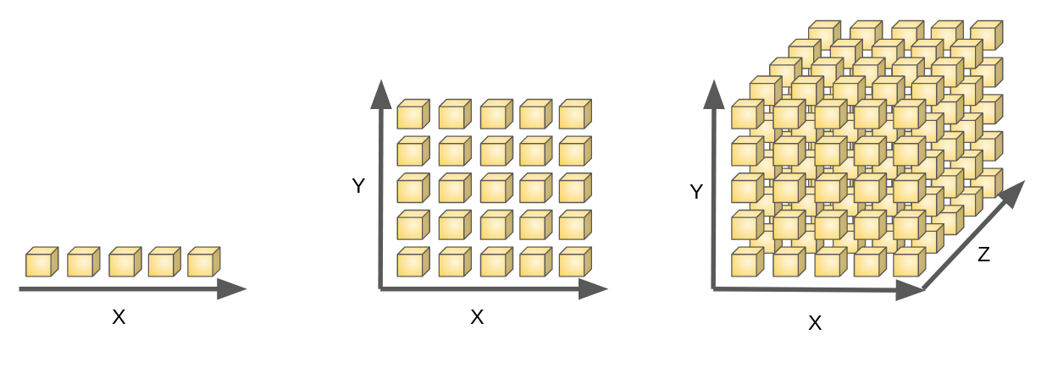
RL has poor sample complexity because of the Curse of Dimensionality
Source

Slide 6
Deep learning suffers from the curse but has combatted it by introducing extra inductive biases
Informative inductive biases help by making the learning algorithm less flexible in an informative way
= Hypothesis space
Extra inductive bias imposed
= Good solutions
Notes:
Informative in that they remove proportionally more bad than good solutions

Slide 7
e.g. RNNs enforce the inductive bias of weight sharing
W₂
W₂
W₂
s₀
s₁
s₂
s₃
W₁
W₁
W₁
x₁
x₂
x₃
Notes:
MENTION: Convolutional layer less flexible than a fully connected layer but better at visual tasks // RNN for sequential tasks
RNN layer less flexible than a fully connected layer
Hypothesis space = set of functions that the learning algorithm is allowed to select as being the solution.

Slide 8
So we want a new inductive bias for RL that can solve its sample complexity problem

Slide 9
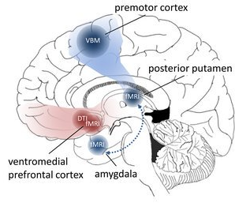
Habits
Goal-Directed
Habitual
Reward-related actions arise out of interaction and competition of 2 systems¹:
Goal-Directed
Habitual
Some estimate that up to 50% of behaviour is Habitual²
The brain also physically adapts to make repetition of habits easier³
Actions
Source
¹ Dezfouli, A. and B. Balleine (2010). “Human and Rodent Homologies in Action Control: Corticostriatal Determinants of Goal-Directed and Habitual Action”
² Wood, W., J. Quinn, and D. Kashy (2002). “Habits in Everyday Life: Thought, Emotion, and Action”
³ Lewis, M. (2016). “Addiction and the Brain: Development, Not Disease”
Notes:
Interesting question why habits are so important to the brain
If you asked a neuroscientist they would say its because if we are going to repeat the same behaviour often it makes sense for the brain to restructure itself to reduce the energy required to repeat the action.
So they see the benefit of habits being Increased energy efficiency and they say the COST is reduced flexibility…
But ML knows that reduced flexibility isn’t really a cost
In the language of ML… Habits are merely an inductive bias towards the past

Slide 10
Habits are merely an inductive bias towards the past
Habits make us less flexible in a potentially informative way that speeds up learning
= Hypothesis space
= Hypothesis space
Having Habits
= Good solutions
= Good solutions

Slide 11
Therefore Habits are important and could explain a large part of how humans learn so fast
Yet so far there has been almost no mention of habits in the field RL
Notes:
E.g. Q-Learning agents pick actions to maximise rewards not to execute habits

Slide 12
Motivation
Habit Reinforcement Learning
Algorithm
Results
Conclusion

Slide 13
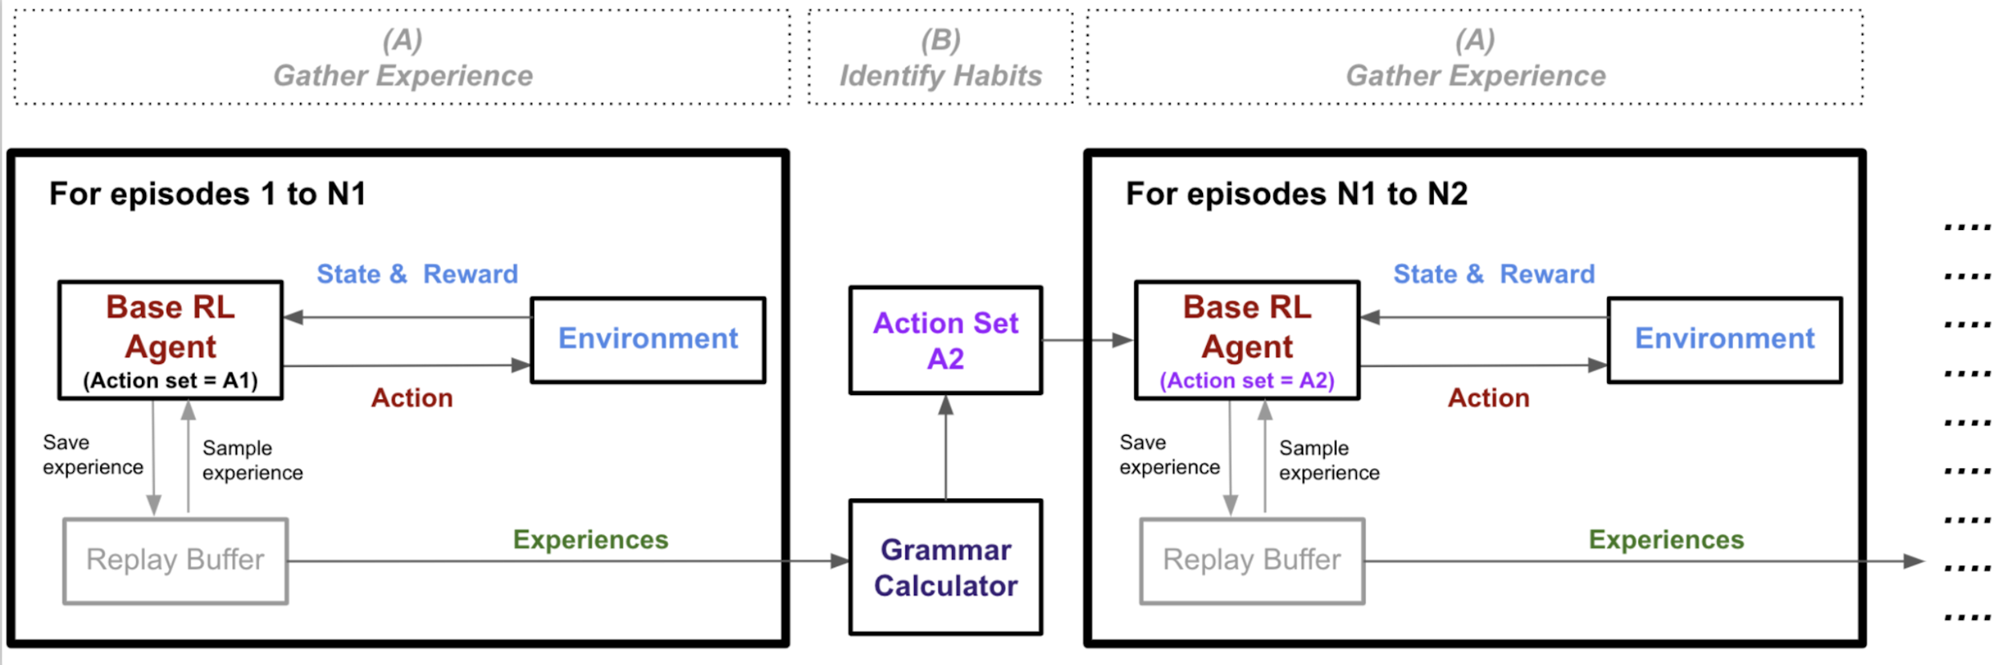
Habit Reinforcement Learning - High Level Steps
(A) Gather Experience: base RL agent plays episodes and stores experiences
(B) Identify Habits: experiences used to identify habits. Habits then appended to action set as macro-actions

Slide 14
1. Grammar Calculators
Sequitur-k: k=2
Start Sequence:
a a a a b a b b a a b a b a a
(A)
Sequitur-k¹
b b
b
c
c
d
c
d
c
b b
b
c
e
e
c
cebbebc
Encoded Sequence:
(B) Information-Greedy Grammar Inference (IGGI)²
Similar to Sequitur-k but rather than only taking frequency of repetition into account it replaces sequences to minimise a cost function
¹ Stout, D., A. Chaminade, A. Thomik, J. Apel, and A. Faisal (2018). “Grammars of Action in Human Behavior and Evolution”
² Schoenhense and Faisal (2017) “Data-Efficient Inference of Hierarchical Structure in Sequential Data by Information-Greedy Grammar Inference”

Slide 15
2. Adding a Habit: Transfer Learning
Q-Network
Q-Network
a
a
Macro-action “c” introduced
b
b
c: {abab}

Slide 16
3. Hindsight Action Replay (HAR)
Problem: often not enough experiences to learn from, especially for long macro-actions
HAR maximises information efficiency by reimagining the actions that were taken to create new experiences in 2 ways:
If we play a macro-action then we also store the experiences as if we had played the sequence of primitive actions individually
If we play a sequence of primitive actions that matches an existing macro-action then we also store the experiences as if we had played the macro-action
e.g. for action set A = {a, b, c: {abab}}
aababab
7
acab
Replay Buffer
acab and aabc
2
Notes:
Improved information efficiency by 125% (4 to 9) in this example
Works in any setting with macro-actions, not just specific to Habit-RL

Slide 17
4. Abandon Ship
Problem: often we want to pull out of a macro-action before the end e.g. if environment changes
During the execution of a macro-action, Abandon Ship involves us comparing the q-value of the primitive action we are about to take with the highest q-value primitive action. If the difference is too great then we abandon the macro-action and return control to the policy
E.g. Say we are conducting macro-action aaa:
 | t=1 | t=2 | t=3
Q-value of “a” | 1.0 | 1.0 | 1.0
Q-value of “b” | 1.1 | 1.1 | 5.0
Abandon Ship? | No | No | Yes
Action Taken | a | a | TBD by Policy
Notes:
Lets us use really long macro-actions (over length 100 sometimes)
Works in any setting with macro-actions, not just specific to Habit-RL
E.G. brushing teeth at 11pm and someone starts banging on your door… you stop your habit

Slide 18
Habit Reinforcement Learning - High Level Steps
(A) Gather Experience: base RL agent plays episodes and stores experiences
(B) Identify Habits: experiences used to identify habits. Habits then appended to action set as macro-actions
Transfer Learning
Abandon Ship
HAR
IGGI

Slide 19
Habit-RL vs. Closest Alternatives
 | Habit Reinforcement Learning | Macro Deep Q Learning with CFG Production Rules (Lange and Faisal 2019) | Macro Q Learning with CFG Production Rules (Lange and Faisal 2018)
Iterates Between Gathering Experience and Grammar/Habit Learning | Yes | Yes
Base RL Algorithm | DDQN and SAC | Deep Q-Learning | Tabular Q-Learning
No-Exploration Episodes to Infer Grammar/Habits From | Best performing | Any
Grammar Calculator | IGGI | Sequitur | Sequitur & G-Lexis
Max Macro-Actions Added at a Time | Unlimited | 2 | Unlimited
Transfer Learning | All layers | Only layers before final layer | None
Use of Hindsight to Store Experiences | Both to convert macro-actions to primitive actions and vice versa | Only to convert macro-actions to primitive actions | No
Abandon Ship | Yes | No
Replay Buffer | Action Balanced Replay Buffer | Ordinary Replay Buffer
Demonstrates Improvement in... | 27/28 Atari game settings | 0/1 simple games | 2/4 simple games
Notes:
Only mention some of them (e.g. the 4 we went through) PLUS results

Slide 20
Motivation
Habit Reinforcement Learning
Algorithms
Results
Conclusion

Slide 21
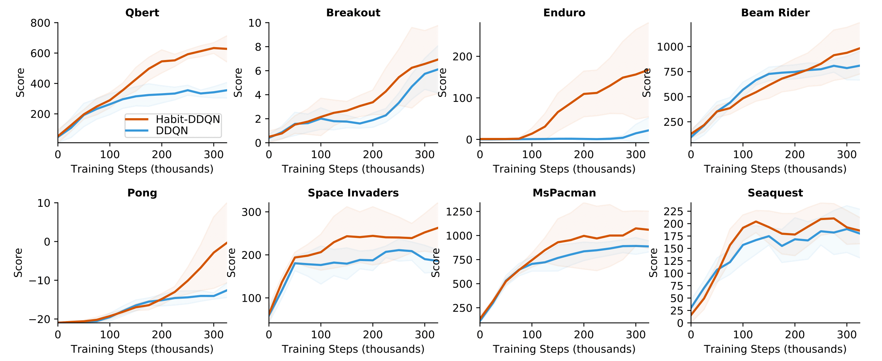
Habit-DDQN Results
Almost no hyperparameter tuning done
Habit-DDQN improves DDQN in
8 out of 8 games, median improvement 31%, maximum improvement 668%

Slide 22
ASIDE: SAC with Discrete Actions
Wanted to use Soft Actor-Critic (SAC)¹ as a base algorithm but SAC is only applicable for continuous actions
So we derived a discrete action version of Soft Actor-Critic
Then we showed it is competitive with Rainbow² which is the model-free state-of-the-art for sample efficiency
¹ Haarnoja, T. et al. (2018). “Soft Actor-Critic: Off-Policy Maximum Entropy Deep Reinforcement Learning with a Stochastic Actor”
² Hessel, M. et al. (2017). “Rainbow: Combining Improvements in Deep Reinforcement Learning”

Slide 23
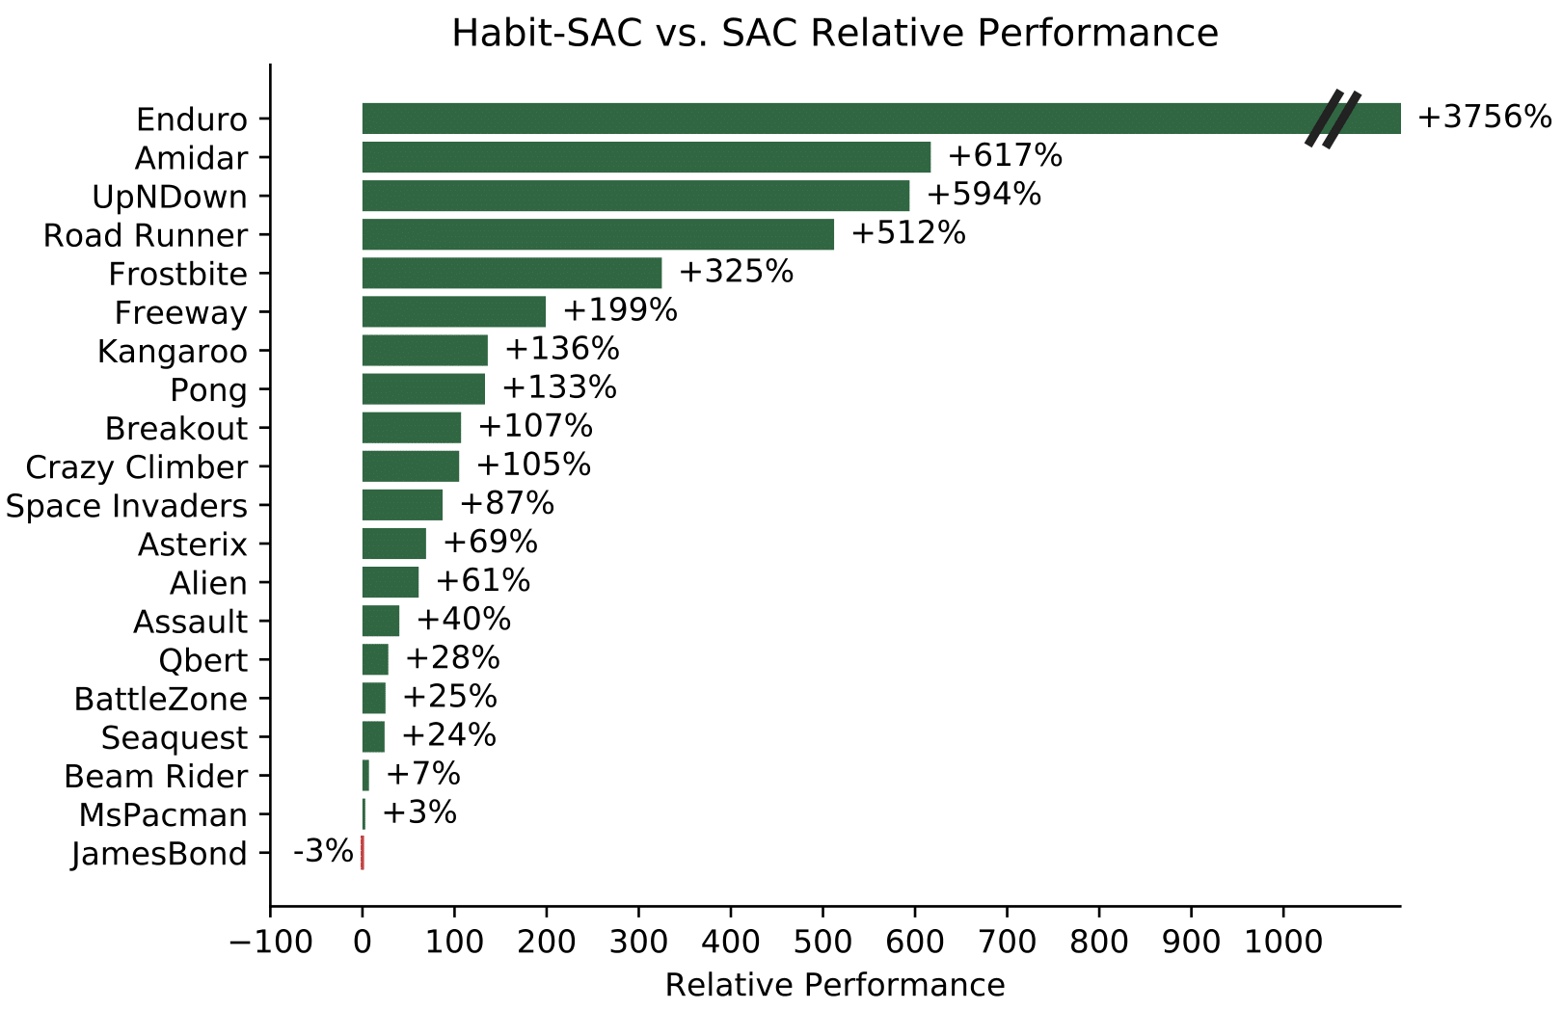
Habit-SAC Results
Habit-SAC improves SAC in
19 out of 20 games, median improvement 96%, maximum improvement 3756%
Almost no hyperparameter tuning done

Slide 24
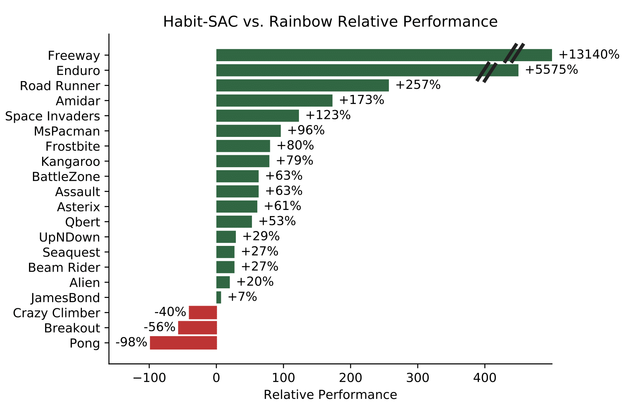
Habit-SAC beats state-of-the-art Rainbow in 17 out of 20 games
Almost no hyperparameter tuning done

Slide 25
Motivation
Habit Reinforcement Learning
Algorithms
Results
Conclusion

Slide 26
Main Novel Contributions of the Project
Habit Reinforcement Learning framework: works with any off-policy RL algorithm
Habit-DDQN: improved sample efficiency in 8 out of 8 Atari games with a median improvement of 31% and maximum improvement of 668% even without substantive hyperparameter tuning
Habit-SAC: improved sample efficiency in 19 out of 20 Atari games with a median improvement of 96% and maximum improvement of 3756%. We also show that Habit-SAC is the model-free state-of-the-art in terms of sample efficiency in 17 out of 20 Atari games, all even without substantive hyperparameter tuning
Hindsight Action Replay: can improve information efficiency by 125%+
Abandon Ship: allows us to train very long macro-actions of over length 100
Soft Actor-Critic for discrete actions: competitive with state-of-the-art Rainbow
Overall evidence that habits could be the key to much faster learning in RL
Notes:
OVERALL and on higher-level provide evidence that habits are good for learning. We think there are many ways to incorporate the ideas of habits into RL and this was just 1 attempt… there could be many other ways of doing it

Slide 27
Questions

Slide 28
Appendix

Slide 29
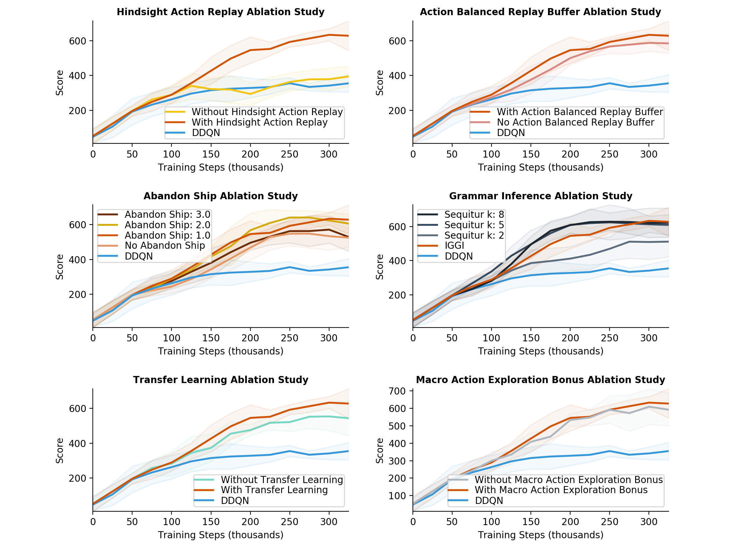
Ablation
Study

Slide 30
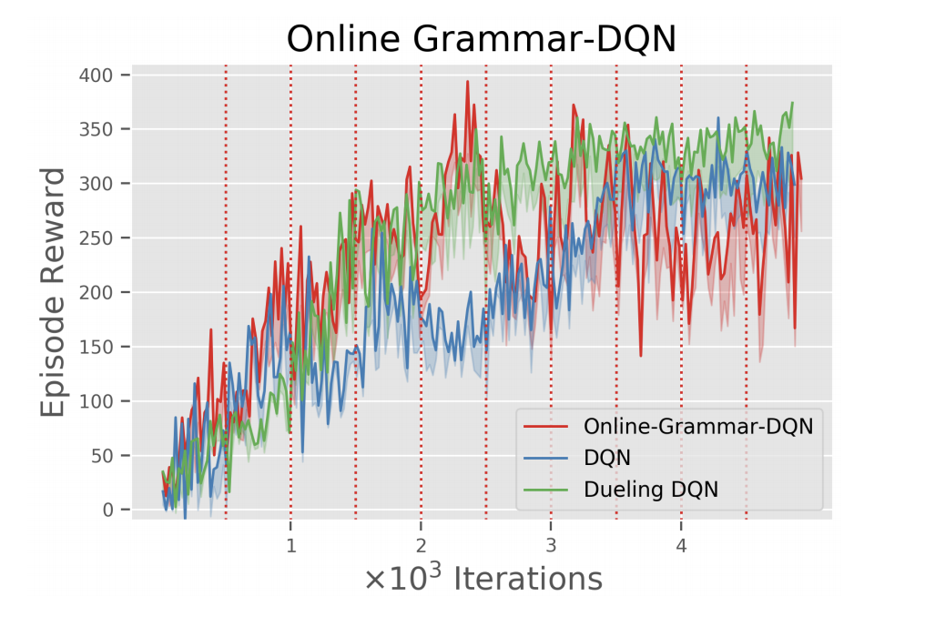
Results from Lange and Faisal (2019)

Slide 31
Toy Example
Action = {a, b}
Timesteps = 50
State = Timestep
Action Set | Hypothesis Space Size
{a, b} | 2⁵⁰
{aa, ab, ba, bb} | 4²⁵ = 2⁽²⁾⁽²⁵⁾ = 2⁵⁰
{aa, ab, bb} | 3²⁵
99% reduction
Notes:
Example is about habits specifically

Slide 32
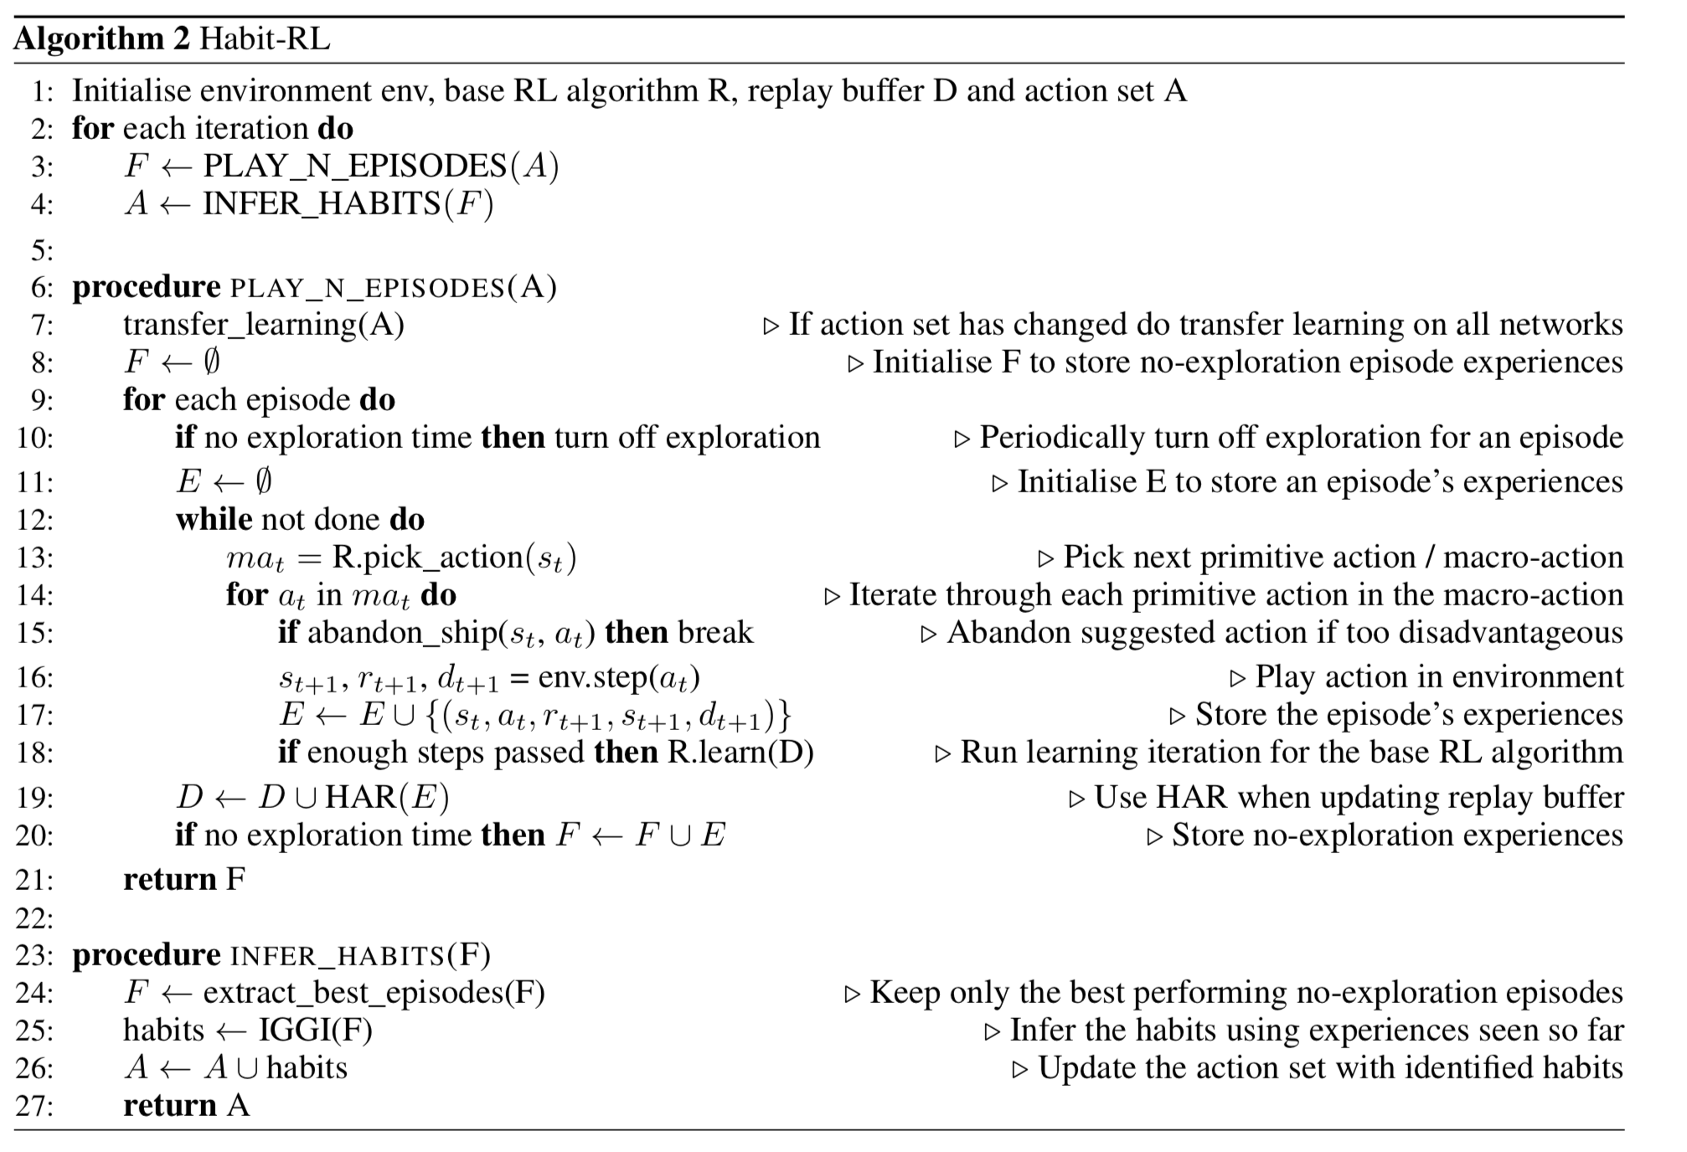
Habit-RL
Algorithm

