Slide 1
SNTP Client & Server
Paul Davis
Notes:
I’m going to be talking about my first assignment of 2nd year in my Computer Networks and Operating Systems module

Slide 2
Assignment Specification
Part A
Complete 4 network programming tasks
Gain knowledge of TCP and UDP implementations in C
Part B
Develop an RFC compliant SNTP client & server
Print response according to example SNTP output:
Submit design, test plan and results
Notes:
The assignment was made up of two parts.
For part A we were required to complete 4 network programming tasks, this:
Helped me get to grips with unix socket programming
and provided a good basis for the main part of the assignment
For Part B we were given an RFC describing version 4 of the Simple Network Time Protocol, SNTP
From this we had to developed an SNTP client and server that complied with the RFC
I was given an example response that was to be generated and printed to the terminal ^^^^
A bit overwhelming to begin with, but with that goal and the network programming basics I had learnt in Part A

Slide 3
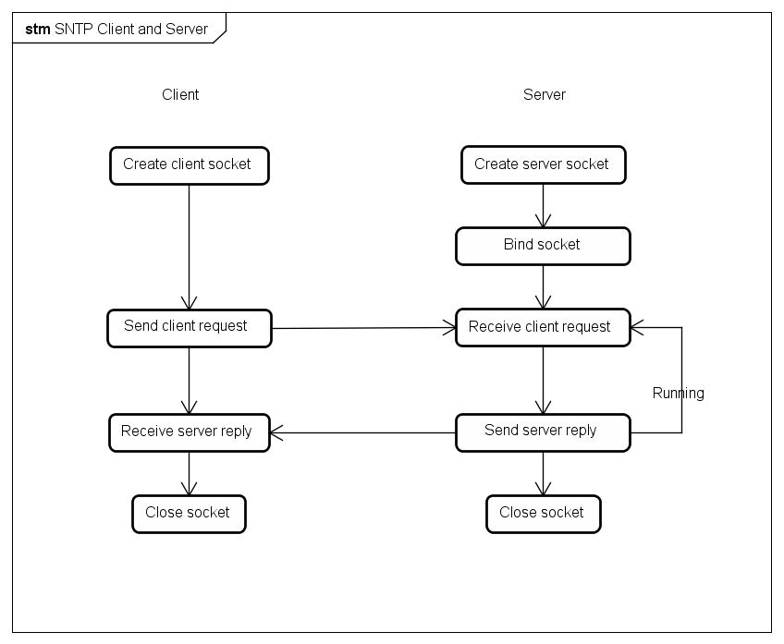
State Diagram
Notes:
Here is a very simple state diagram displaying the client-server operations and communication with each other.
In unicast mode:
The client sends an NTP message request to the server
Server then looks at the request and sets up its own NTP message reply
Once the client receives the reply and checks that it is valid, the SNTP output is displayed and the client closes
Server remains running until the user closes it

Slide 4
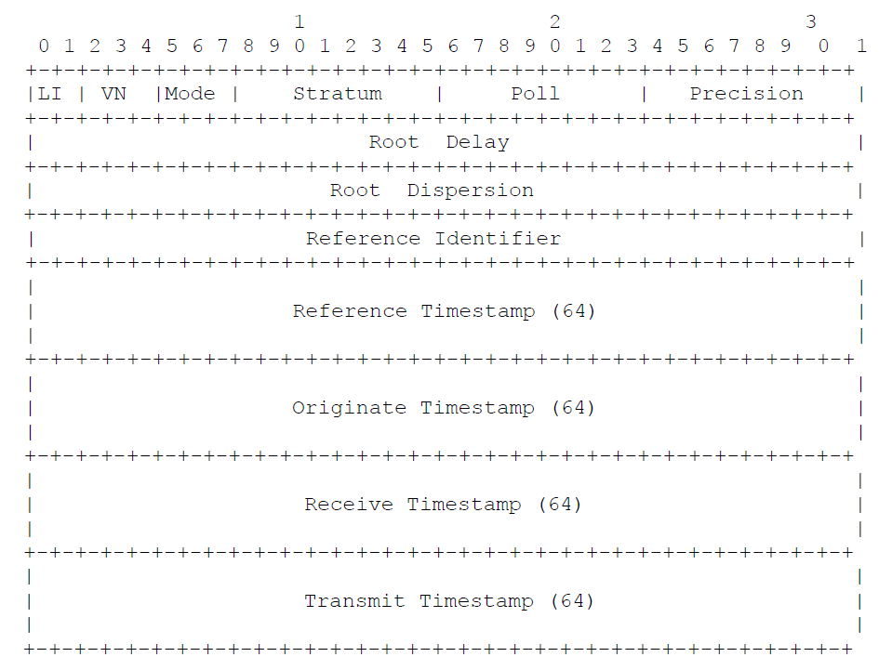
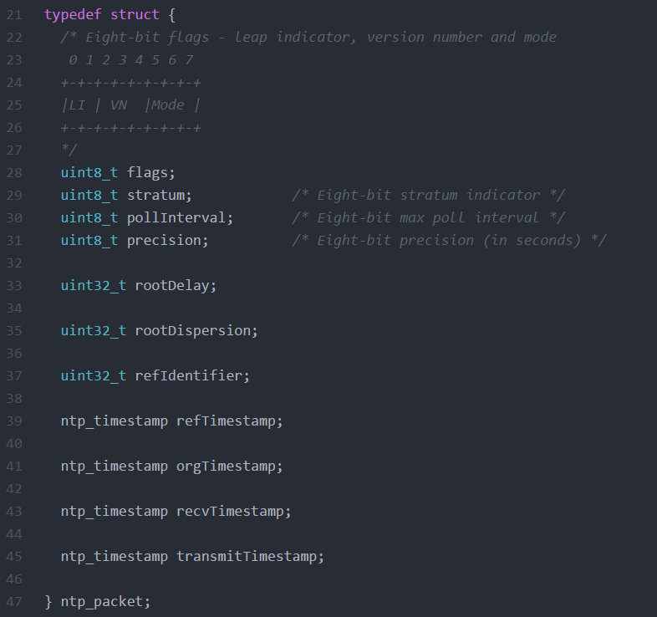
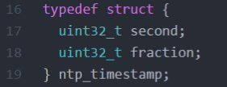
SNTP Message Structure
Notes:
Here is the NTP packet structure, as defined in the RFC:
2 bit li
3 bit vn
3 bit mode
Stratum to tell the receive

Slide 5
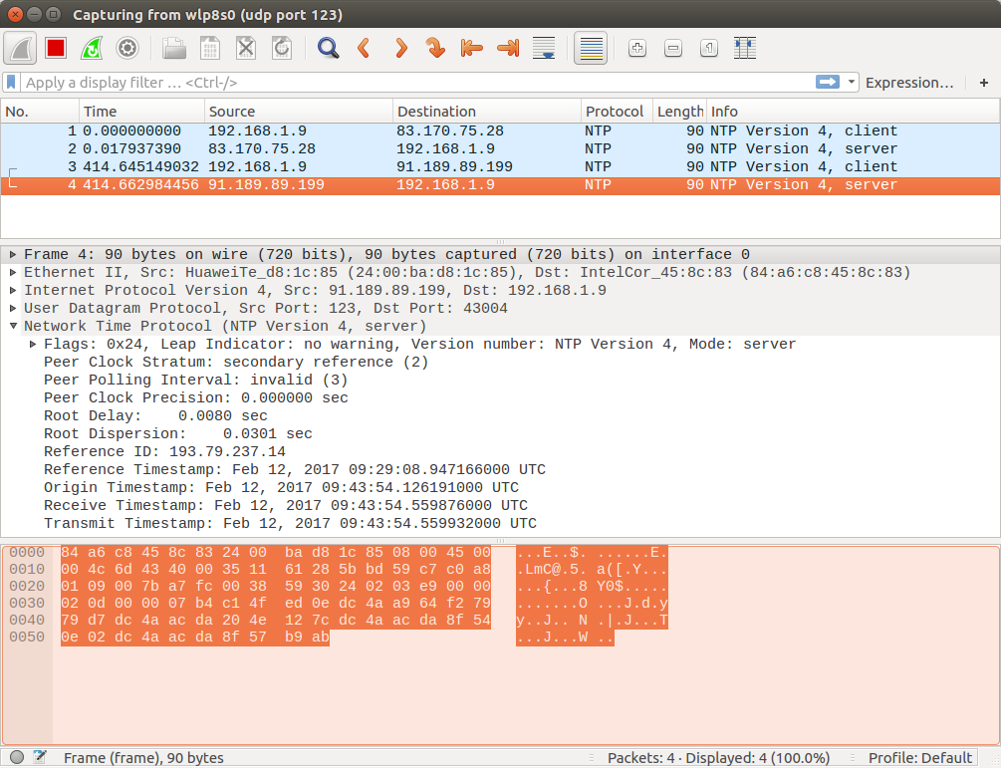
Client
Create and initialise NTP packet
Set transmit timestamp to client time of day
Send packet to NTP server
Notes:
Firstly,

Slide 6
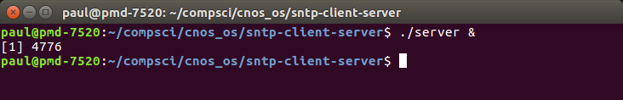
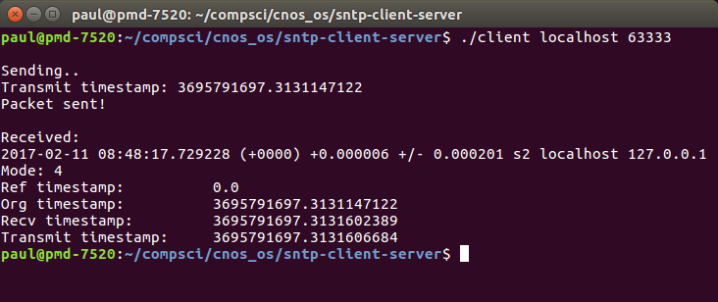
Server
Receive client request
Set up the server reply correctly
Send reply to client
Notes:
Firstly,

Slide 7
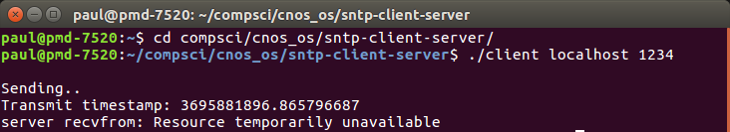
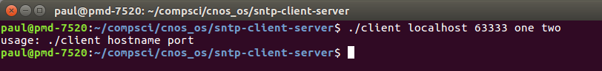
Testing
10 second timeout of client recvfrom function
Successfully returns error
Client error if too many arguments are passed
Notes:
The final part of the assignment was to identify situations where the code would fail and implement tests.
Examples…

Slide 8
Result & Learning Outcomes
Improved C programming skills
Unix network programming
Identifying system requirements
Notes:
Here’s what the finished display looked like when connecting to my localhost SNTP server

