Slide 1

DeepGaze: A Visionary Perspective on Diabetic Retinopathy Image Processing
21AIE312 – Deep Learning
TEAM-22
CH.EN.U4AIE21037 - Pula Geethika Naidu
CH.EN.U4AIE21057 - T Bashpika
Affiliation: Amrita School of Computing, Department of Computer Science and Engineering, AIE
Amrita Vishwa Vidyapeetham, Chennai Campus.

Slide 2
Aim
Improve early detection of diabetic retention.
Apply Deep learning models in order to early diagnosis for quick treatment action.
Enhance accuracy of diabetic retention diagnosis through retinal image analysis.
Evaluate performance metrics (accuracy, sensitivity, specificity) of SVM, KNN, CNN (ResNet), and DenseNet in retinal image-based diabetic retention detection.
Comparative analysis to choose optimum model

Slide 3
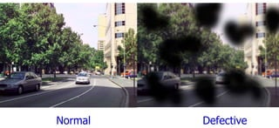
Introduction
Diabetic retinopathy (DR): Damage to retina blood vessels due to diabetes.
Types: Non-proliferative (NPDR) - early stage; Proliferative (PDR) - advanced stage.
Fundus imaging: Captures detailed retina images using specialized cameras.
Diagnosis: Identifies abnormalities like microaneurysms, haemorrhages, neovascularization.

Slide 4
Existing work
Paper Name | Algorithm Used | Accuracy (%) | Key Findings/Remarks | Faults/Limitations
Automated detection of diabetic retinopathy using traditional techniques | Decision trees, logistic regression | 77 | Provides comprehensive overview of traditional methods for diabetic retinopathy detection. | Blurred dataset of fundus images
Comparison of deep learning approaches for diabetic retinopathy detection from fundus images | CNN (VGG-16, Resnet-50) | 87.5 | Demonstrates effectiveness of CNN architecture, highlighting VGG’s superior performance. | Small dataset size may not fully represent real-world variability.
Detection of diabetic retinopathy using deep convolutional neural networks in retinal fundus images | CNN (ResNet) | 92.3 | Shows high accuracy in diabetic retinopathy detection, emphasizing the potential of deep learning methods. | Limited validation on diverse datasets.
A review on the recent advances in computer-aided diabetic retinopathy detection systems | Various (Review Paper) | N/A | Summarizes recent advancements in computer-aided diabetic retinopathy detection systems, providing insights for further research. | Relies on existing studies, may lack novel insights.
Deep learning-based detection of diabetic retinopathy on smartphone-based retinal images | CNN (MobileNet) | 83.7 | Successfully applies deep learning techniques for diabetic retinopathy detection on smartphone-captured retinal images. | Limited evaluation on larger and more diverse datasets.

Slide 5
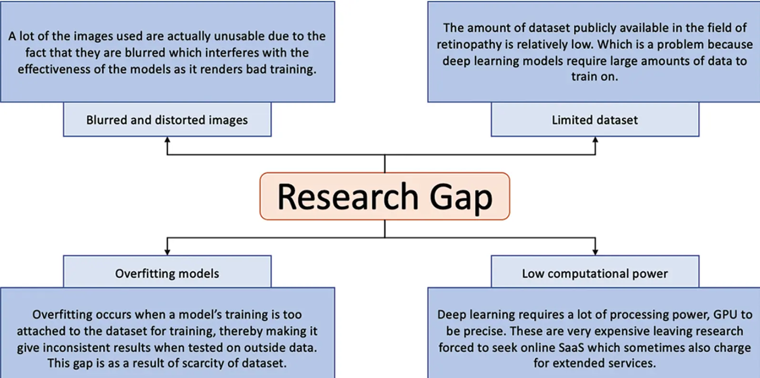
Research Gap

Slide 6
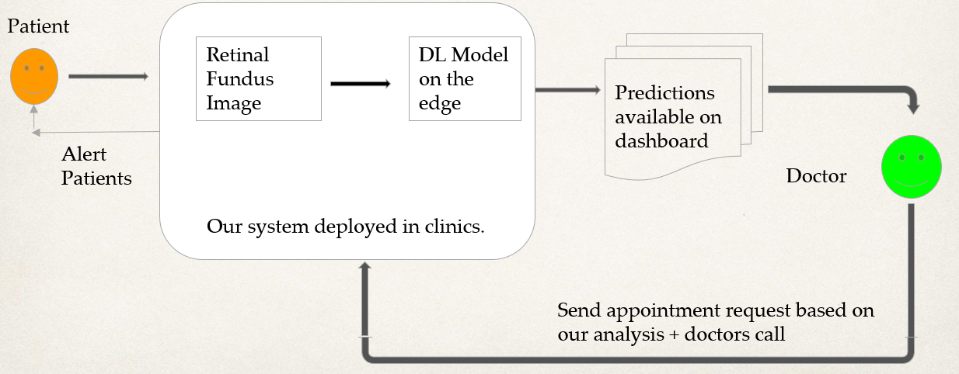
Architecture

Slide 7
Methodology
SVM & KNN:
Read and preprocess images: Convert to grayscale and apply histogram equalization.
Flatten pre-processed images and store in immatrix.
Apply Discrete Wavelet Transform (DWT) to enhance features, storing transformed images in imm_dwt.
Generate Gaussian matched filter kernel and create bank of matched filters.
Apply matched filter bank to DWT transformed images, storing filtered images in imm_gauss.
Create bank of Gabor filters and apply to DWT transformed images, storing results in imm_gauss2.
Perform k-means clustering on filtered images (imm_gauss2) to extract features.
Reshape clustered images, convert to uint8 for further processing.
Train Support Vector Classifier (SVC) using clustered images (imm_kmean) as input data and labels (Y) as targets.
Predict labels for entire dataset using trained classifier.
Select subset of images for training and extend training data to include additional images.
Retrain classifier with extended training data to improve performance.
Predict labels for entire dataset using retrained classifier for final results.

Slide 8
Methodology
CNN:
Preprocess images by resizing them to a standard size and normalizing pixel values.
Split the dataset into training, validation, and testing sets.
Implement DenseNet architecture for the CNN model.
Configure the number of DenseNet blocks and growth rate parameters.
Define the number of classes for diabetic retinopathy classification.
Apply data augmentation techniques such as rotation, horizontal/vertical flipping, and random cropping to increase the diversity of training samples.
Augment training dataset to mitigate overfitting and improve model generalization.
Initialize the DenseNet model with pretrained weights on ImageNet or train from scratch.
Compile the model with appropriate loss function (e.g., categorical cross-entropy) and optimizer (e.g., Adam).
Train the model on the training dataset using mini-batch gradient descent.
Monitor training progress with metrics such as accuracy and loss on the validation set.
Evaluate accuracy metric

Slide 9
Methodology
ResNet - 50:
Read image file paths and labels from a CSV file.
Preprocess data, including shuffling and binary label conversion.
Apply transformations to the images for data augmentation.
Create a convolutional neural network (CNN) using a ResNet-50 architecture.
Find the optimal learning rate and train the model using one cycle training.
Fine-tune the model by unfreezing and training for additional epochs.
Evaluate the trained model using validation data.
Calculate accuracy, error rate, area under the ROC curve (AUC), specificity, and sensitivity.
Plot top losses and confusion matrix for further analysisSave the trained model for future use.
DenseNet: Connects all layers directly to each other through concatenation.
ResNet: Performs an element-wise addition to pass the output to the next layer or block.

Slide 10
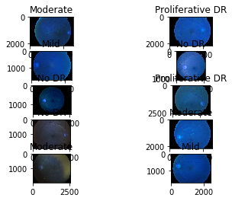
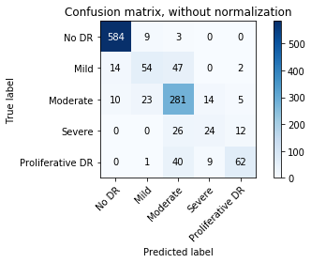
Results
CNN

Slide 11
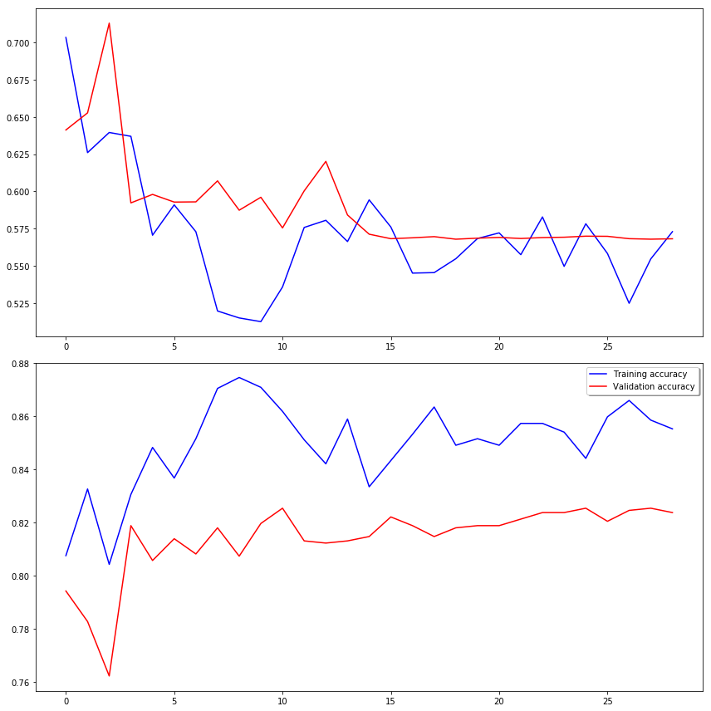
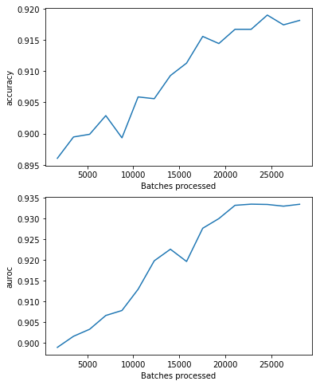
Results
Densenet
Resnet-50

Slide 12
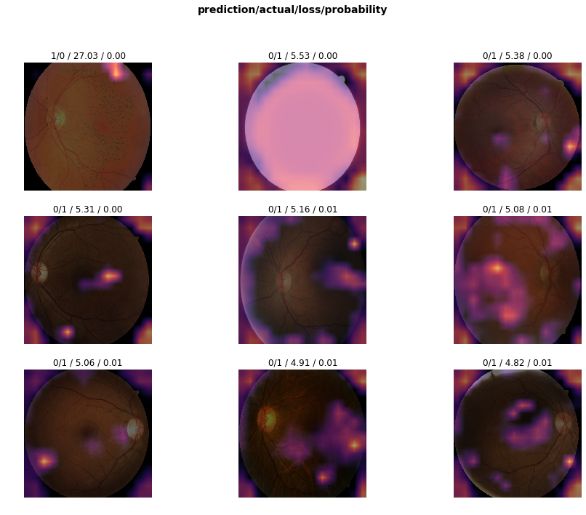
Results
SVM, KNN

Slide 13
Conclusion
We found that ResNet-50 is the best model for finding the severity of retinopathy as it gave the maximum accuracy for images enhanced by adjusting brightness, color, and contrast.
Algorithm | Accuracy (%) | Sensitivity (%) | Specificity (%) | Precision (%) | F1 Score (%)
SVM | 80.2 | 85.6 | 76.3 | 81.4 | 83.3
KNN | 78.9 | 82.3 | 75.2 | 79.1 | 80.5
ResNet | 92.7 | 94.5 | 91.2 | 93.2 | 93.8
DenseNet | 91.5 | 93.2 | 90.1 | 92.1 | 92.6

Slide 14
Future scope
Real-Time Notification: Implement a feature that sends real-time notifications to doctors via SMS when a patient's retinal image analysis indicates signs of diabetic retinopathy, ensuring timely follow-up and intervention.
Artificial Intelligence (AI) Chatbots: Develop AI-powered chatbots or virtual assistants that can engage with patients, answer questions about diabetic retinopathy, and provide personalized recommendations for screening and follow-up care
Mobile Application Integration: Develop mobile applications that allow users to capture retinal images using smartphone cameras and perform automated diabetic retinopathy screening on-the-go, providing convenient access to screening services for patients.

Slide 15


