Slide 1
Co-Operative Society Management System
Integrity makes the quality

Slide 2
Introduction
It is easy to maintain and review record details about the Co-Operative Society, analytics on insights of sales. It aides in assigning the task to all the department work members. Maintains the account details about the expenditure and also total number of products and services in the system database. It provides billing and online ordering facility to the end users.

Slide 3
Existing System
Maintaining all type of information in ledgers.
It is difficult to maintain older records.
High chance for loss of data
Difficult to handle huge information as it is paperwork.

Slide 4
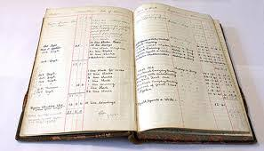
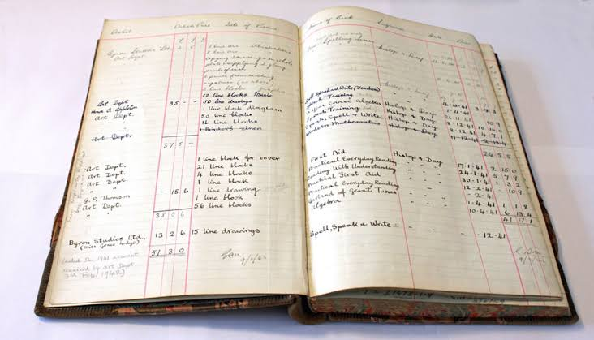
Current data maintaining

Slide 5
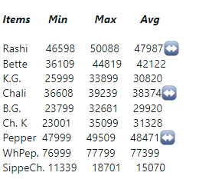
Currently the sales information is being displayed in the following manner

Slide 6
Objectives
Maintaining all the information systematically in database.
To provide the searching facility based on various factors such as products, sales, purchases.
To handle the billing system.
Providing sales analysis.

Slide 7
Input of the project
Farmer information
Product information
Customer information
Sales information

Slide 8
Output of the project
Sales report
Purchase report
Customer report
Stock report
Invoice report
Graphical representation

Slide 9
Main Modules
Admin
Customer

Slide 10
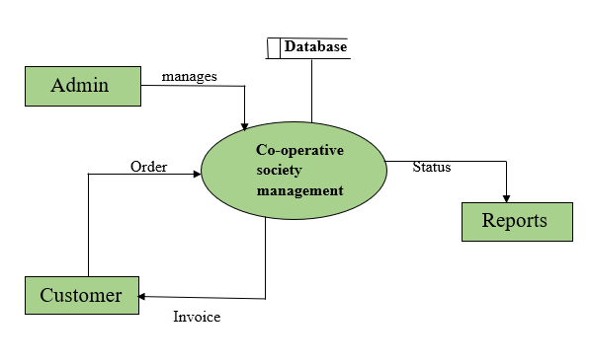
Data flow diagram

Slide 11
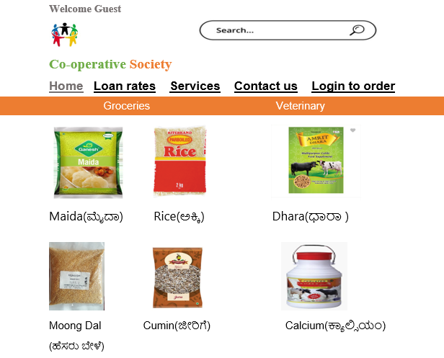
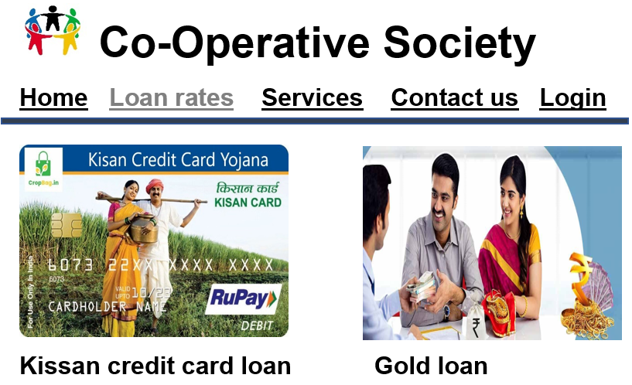
Mockups

Slide 12
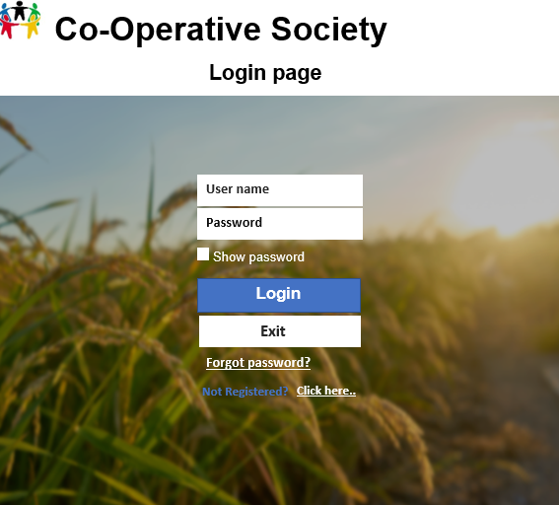
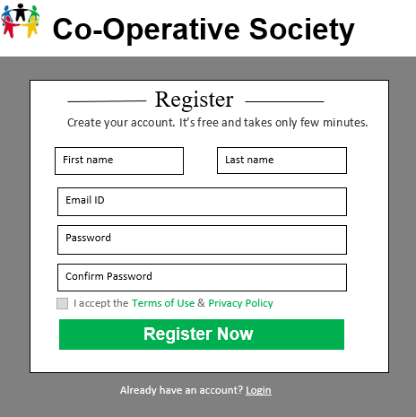

Slide 13
Tools/Platforms, Languages to be used
Hardware requirements
Processor: Core i3 intel processor
RAM : 1GB and more
Hard Disk : 200 GB or above
OS :Windows XP or higher

Slide 14
Software/language Requirements
Front End : Html, CSS
Middleware : PHP
Scripting : Java script
Backend : MYSQL
Server : Wamp Server

Slide 15
Limitations of the Project
Live tracking of order is not possible.
Bar code scanning is not provided.

Slide 16
Scope or Future application
Mobile application can be developed.
Bar code scanning can be provided.
Home delivery can be provided.

Slide 17
Thank you..

