Slide 1
COFFEE SHOP SALES
AN EXCEL PROJECT

Slide 2

PROJECT OBJECTIVE :
To analyze coffee shop sales trends using Excel, identifying peak sales periods, top-selling products, and store performance across different locations. The goal is to derive actionable insights that optimize inventory management, pricing strategies, and promotional efforts.

Slide 3
STEPS INVOLVED :
Data Gathering
Data Importation
Data Transformation : Power query editor, Power pivot
Data Modeling : Pivot tables
Insights & Reporting
Optimization & Recommendations

Slide 4
Measures used to calculate KPI’s :
Total_revenue : SUM([Total_sales])
Footfall : DISTINCTCOUNT(Transactions[transaction_id])
Average order/person : [Sum of transaction_qty]/DISTINCTCOUNT(Transactions[transaction_id])
Average bill/person : [Total_revenue]/[Footfall]

Slide 5
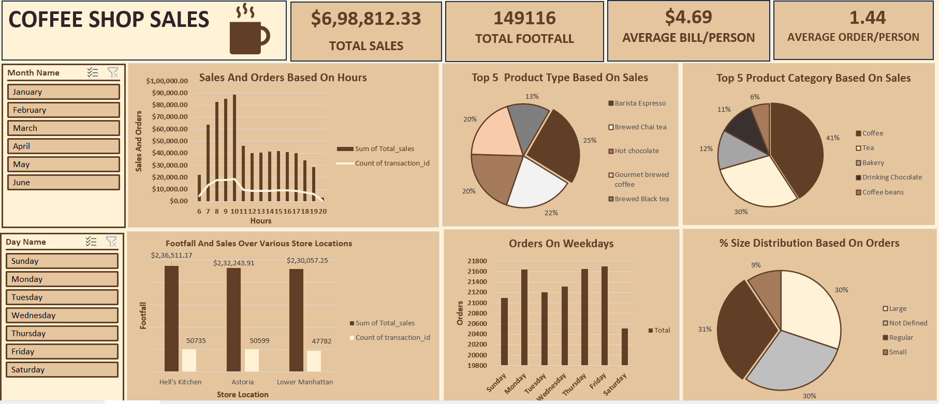

Slide 6
KEY INSIGHTS :
Peak hours for sales is from 7-10 AM.
Among product sizes Regular is most ordered and Large generating more revenue.
Among stores Hell’s Kitchen surpasses other two in terms of footfall and sales.
Thursday and Friday being the busiest days of the week.
Barista Espresso and Brewed chai tea among top 5 products in terms of sales

Slide 7
RECOMMENDATIONS :
Peak Hour Promotions (7-10 AM)
Introduce Happy Hour Discounts (e.g., Buy 1 Get 1, 10% off on Large sizes).
Implement a Loyalty Program.
Product Size Strategy
Promote Large Size Upsells by offering discounts on upgrades.
Introduce Limited Edition Flavors in Large sizes to encourage higher spending.
Location-Based Promotions
a. Given Hell’s Kitchen has the highest footfall, consider Exclusive Offers for frequent visitors (e.g., “Hell’s Kitchen Special Wednesdays” with discounts).
Introduce Referral Discounts where customers bring friends for discounts on their next visit.
Weekly Promotions for Busiest Days (Thursday & Friday)
Offer Pre-Order Discounts to manage high footfall efficiently and avoid long wait times.
Launch a "Weekend Kickoff" Special.
Product-Focused Campaigns
a. Feature these drinks in Limited-Time Seasonal Variants (e.g., holiday spice chai, caramel espresso)

Slide 8
Overall Potential Growth :
By implementing all strategies effectively, the business could see a 15-30% overall increase in revenue and higher customer retention rates.

