Slide 1
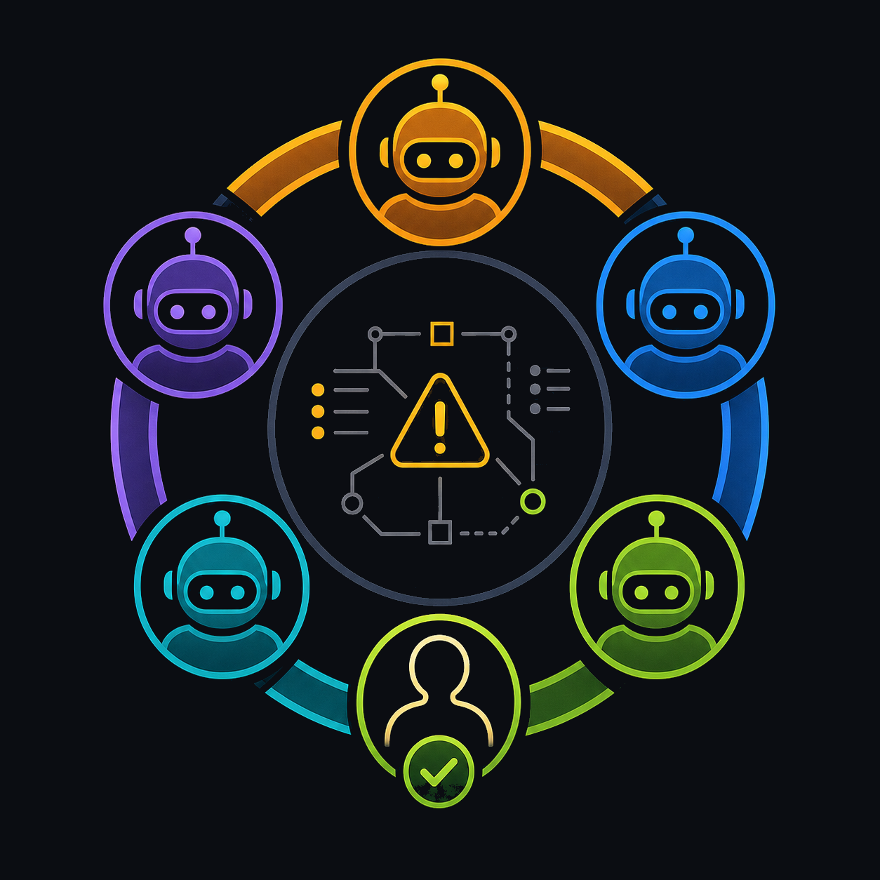
QUORUM
A room of agents for on-call.
Specialist agents convene in your Discord Server and Telegram group, debate the fix out loud, and ship only when you approve by voice.
Incident Response · Multi-agent · In Discord and Telegram

Slide 2
THE PROBLEM
On-call shouldn't be
a 3 a.m. lookup table.
Today's on-call bot maps an error code to one branch — rollback or escalate. It can't read your trace or your service. Quorum convenes a room of specialists that actually reason about the incident, right in your group chat.
TODAY
QUORUM
→
one bot · one if/else branch
five specialists · one verdict

Slide 3
THE CAST
Five specialists. One shared blackboard.
Each agent has a distinct job and a distinct voice — and they all read and write one shared session object.
Orchestrator
RootCause
Coder
Critic
Project Manager
Runs the room, hands off by name
Reads the stack trace, posts a hypothesis
Drafts the patch
Production-ready? Verdict + confidence
Files the ticket, then steps back
mid
smart
smart
smart
cheap

Slide 4
WHAT WINS THE ROOM
Argued out loud.
Shipped only when you sound sure.
AUDIBLE DEBATE
EMOTION-GATED APPROVAL
Distinct voices argue the fix to a verdict you can hear — not a silent autoscaler guess.
You approve out loud. If your voice wavers, the gate holds — “You don't sound sure. Hold?”
confidence 0.78
hold
→
ship

Slide 5
Bring the whole room
into your on-call.
It lives in Discord and Telegram — no dashboard to learn.
Quorum · built for on-call

Slide 6
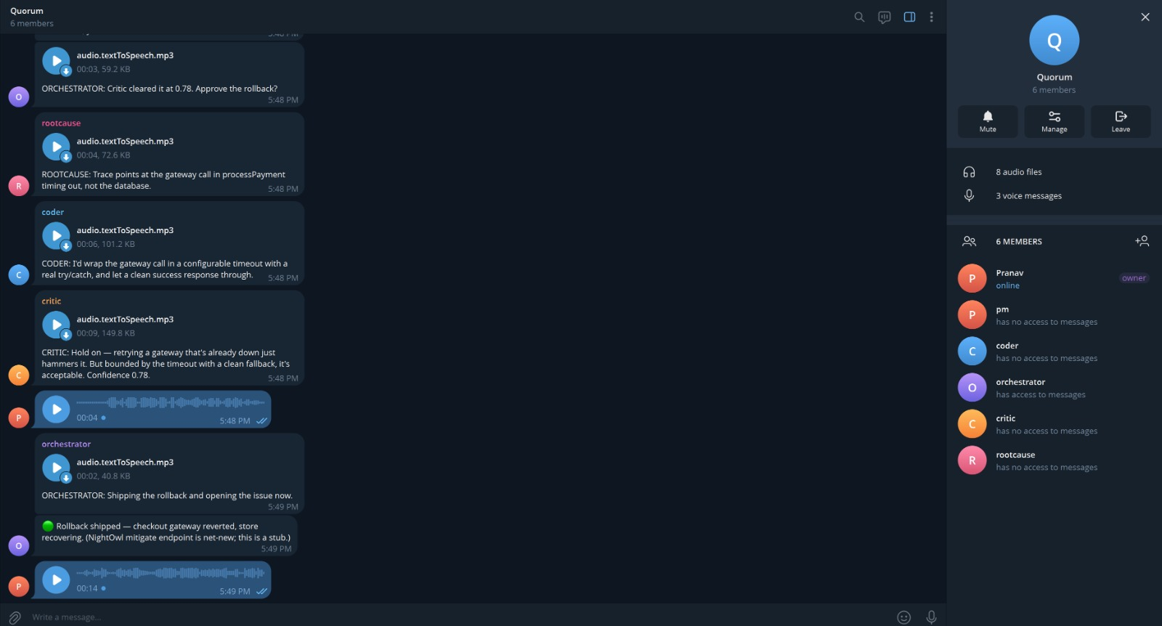

Slide 7
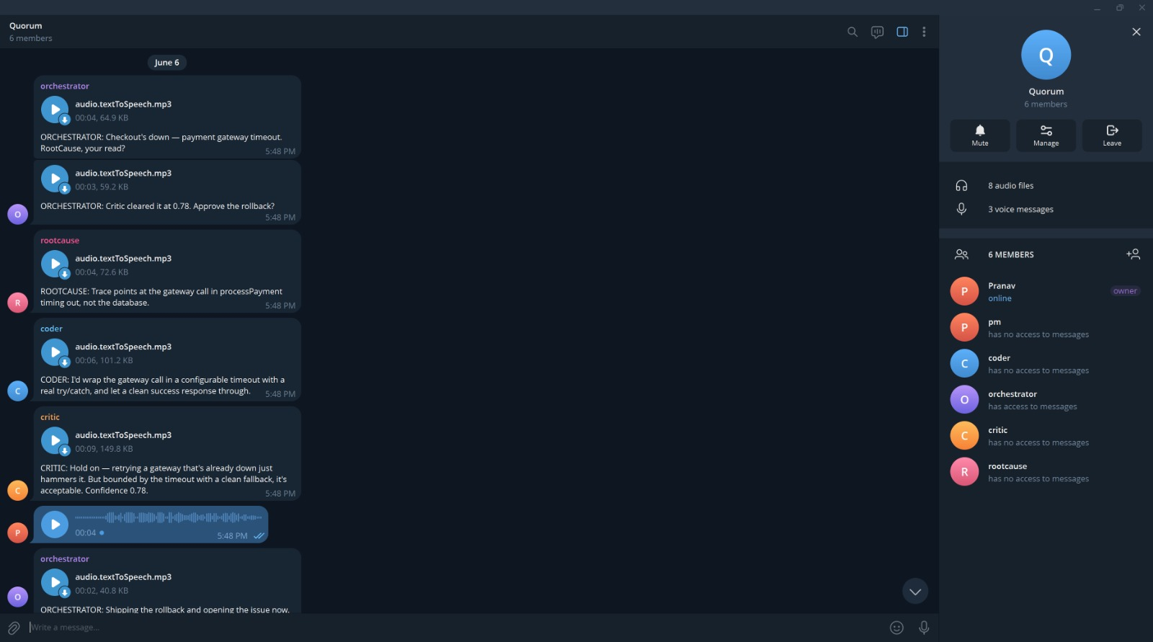

Slide 8
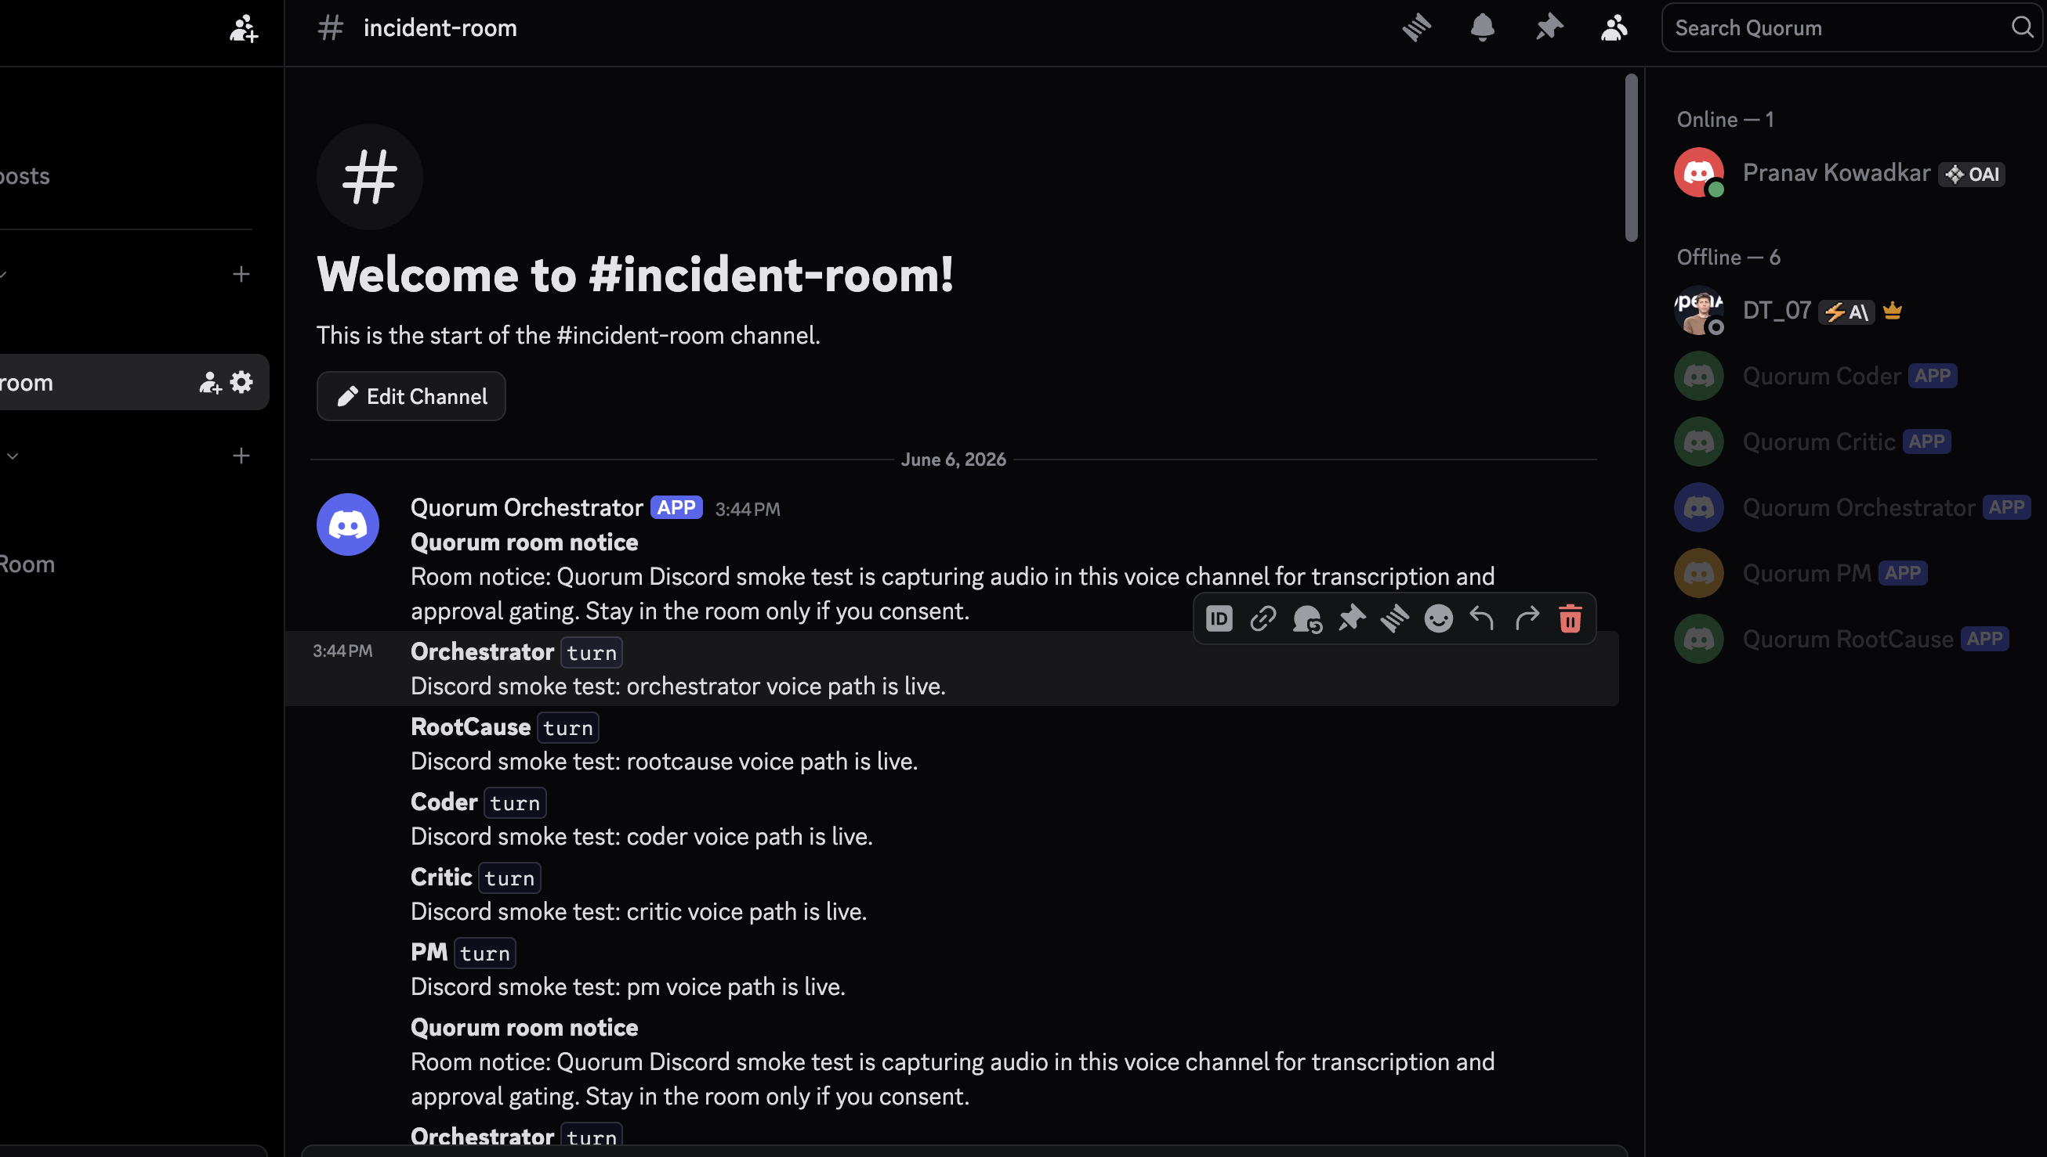

Slide 9
