Slide 1
Big Mountain Resort Pricing Recommendations

Slide 2
Big Mountain Resort Problem Statement
How to select a better value for ticket price and increase the revenue in order to cover the
Additional operating costs due to additional chair lift?
H
1
Context
4
Constraints within solution space
Big Mountain Resort, located in Montana, offers spectacular views of Glacier National Park and Flathead National Forest and access to 105 trails. It has 11 lifts, 2 T-bars, and 1 magic carpet for novice skiers. The longest run is named Hellfire and is 3.3 miles in length. The base elevation is 4,464 ft, and the summit is 6,817 ft with a vertical drop of 2,353 ft.
Big Mountain Resort has recently installed an additional chair lift to help increase the distribution of visitors across the mountain. This additional chair increases their operating costs by $1,540,000 this season.
The business wants some guidance on how to select a better value for their ticket price. They are also considering a number of changes that they hope will either cut costs without undermining the ticket price or will support an even higher ticket price.
Charging the premium price above average price of resorts in same market segment has limitations.
Charging the same price as market average does not provide the business with a good sense of how important some facilities are compared to others and therefore hampers investment strategy
5
Stakeholders to provide key insight
Jimmy Blackburn - Director of Operations
Alesha Eisen - Database Manager
2
Criteria for success
Increase the revenue to compensate for increase in operating costs by $1,540,000 due to additional chair lift. It could be either by cutting the costs or by increasing the ticket price to an extent which is justifiable by the facilities provided by Big Mountain resort as compared to the resorts in same market segment.
6
Key data sources
SQL Database or S3 bucket (Data provided in CSV File) – Contains information about 330 resorts in the US that are part of the same market share including the data for Big Mountain Resort.
3
Scope of solution space
The scope of solution will be focused on determining the better value for ticket price based on facilities provided by Big Mountain resort as compared to the resorts in same market segment.
H
D
E
I
P
Notes:
Hypothesis: Create a Hypothesis with an emphasis on SMART principles. (S – Specific, M – Measurable, A – Achievable, R – Realistic, T – Timebound). If you cannot do this, you do not have a good grasp on the business problem.
Context: With context, we have clearly identified the problem at hand and have elucidated on how our initiative may solve this problem, alongside the commercial implications this will have on the business.
Criteria for Success: Clearly defining the criteria for success ensures that the scope of your work is clearly defined and understood. Otherwise, if this isn’t defined – your work will never end which will result in mismatched expectations.
Scope of Solution Space: Scoping out the solution space ensures that the business initiative is SPECIFIC for a certain segment or area. This prevents solutions that have been developed being scaled and applied for all other business units that the solution may not be responsible or scalable for.
Constraints within Solution Space: Looking forward, what are the foreseeable problems we are likely to encounter? Could this be stakeholder resistance? Could this be we don’t have access to the right data?
Stakeholders to provide key insight: Who are the people I need to speak to, to get the answers I need for my data analysis?
What key data sources are required?
Based off my discussions with the key stakeholders – can we clearly list out all the data sources we need so we can make a highly targeted request as opposed to a scatter-gun approach where we ask for a bit of everything?

Slide 3
Pricing recommendation and key findings
Pricing for weekend ticket:
Current price : $81
Modelled price : $95.87
Mean absolute error : $10.39
Suggested price range after considering the mean absolute error is $85.48 to $95.87
Additional operating costs of $1,540,000 translates to price increase of $0.88 per ticket.
Top 4 features that are valued by visitors:
vertical_drop
Snow Making_ac
total_chairs
fastQuads

Slide 4
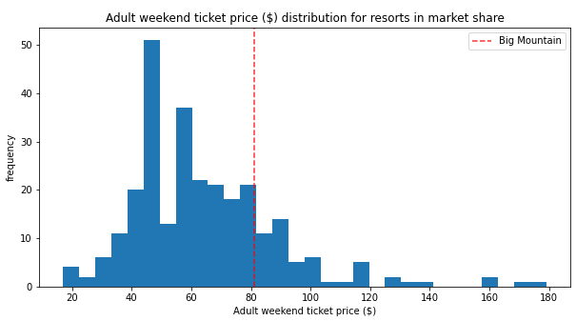
Modelling results and analysis
Adult weekend pricing
Big Mountain resort charges $81 per ticket
The plot shows majority of resorts charge $80 or less and Big Mountain is just sitting there.
Big Mountain is not among high charging resorts (right tail) and many resorts are charging more than Big Mountain.

Slide 5
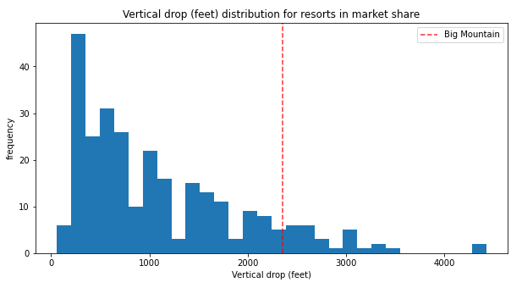
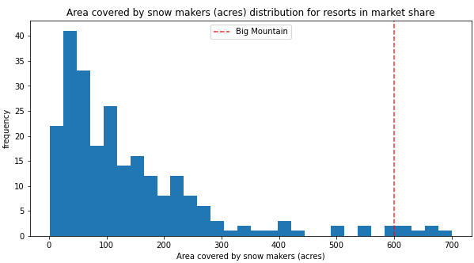
Modelling results and analysis - continued
Vertical Drop
Vertical drop is most valued feature by visitors.
Most resorts have vertical drop of less than 1000 feet.
Big Mountain resort does well with 2353 feet and is on the right tail of distribution.
Snow making
Snow making is second most valued feature by visitors.
Big Big Mountain is among the top resorts in the list with 600 acres of snow making

Slide 6
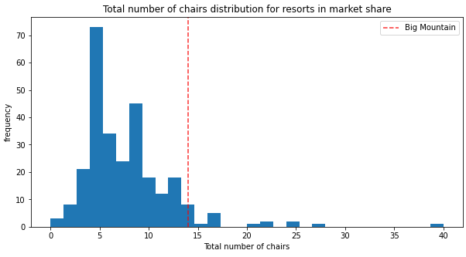
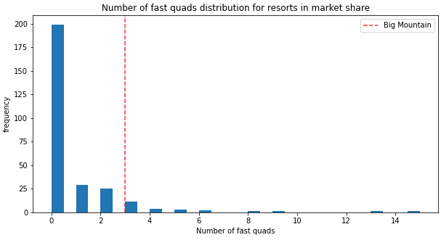
Modelling results and analysis - continued
Total chairs
Big Mountain has amongst the highest number of total chairs
Majority of resorts have less than 10 chairs whereas Big Mountain has 14 of them.
Fast Quads
Most of the resorts have no Fast Quads.
With Big Mountain having 3 of them, it is among the top 10% resorts.

Slide 7
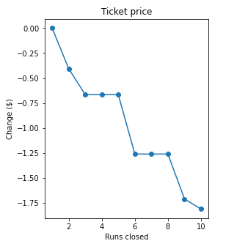
Modelling results and analysis – Other scenarios
Closing the runs.
Closing 1 run does not impact ticket price.
Closing 2 or 3 reduces support for ticket price by same amount.
Closing 10 runs reduces the support for ticket price by $1.75 per ticket.
Increase vertical drop
Increase the vertical drop by 150 feet and installing an additional chair lift increases support for ticket price by $1.99.
It can translate into additional revenue of $3474638 for next season.
Other scenarios
Adding 2 acres of snow making cover is too small to make any difference in support for ticket price.
Increase the longest run by 0.2 mile to and an additional snow making coverage of 4 acres does not make in difference in support for ticket price.

Slide 8
Summary and conclusion
In the distribution of important features Big Mountain resort is on the right tail (among the top) but not in average price distribution which indicates it is under charging for facilities it provides.
With modelled price as 95.87, even with expected mean absolute error of $10.39, there is room for price increase since the current price is $81.
Additional operating costs of $1,540,000 due to additional chair lift translates to price increase of $0.88 per ticket and can easily if recovered by suggested price increase.
Investing in the features valued by visitors like vertical drop, Snow Making, total chairs etc. can increase the support for ticket price and provides quick ROI.
Decreasing/closing some of the features which are less valued by visitors like Skiable Terrain, Runs, Longest Runs may save some operating costs.

