Slide 1
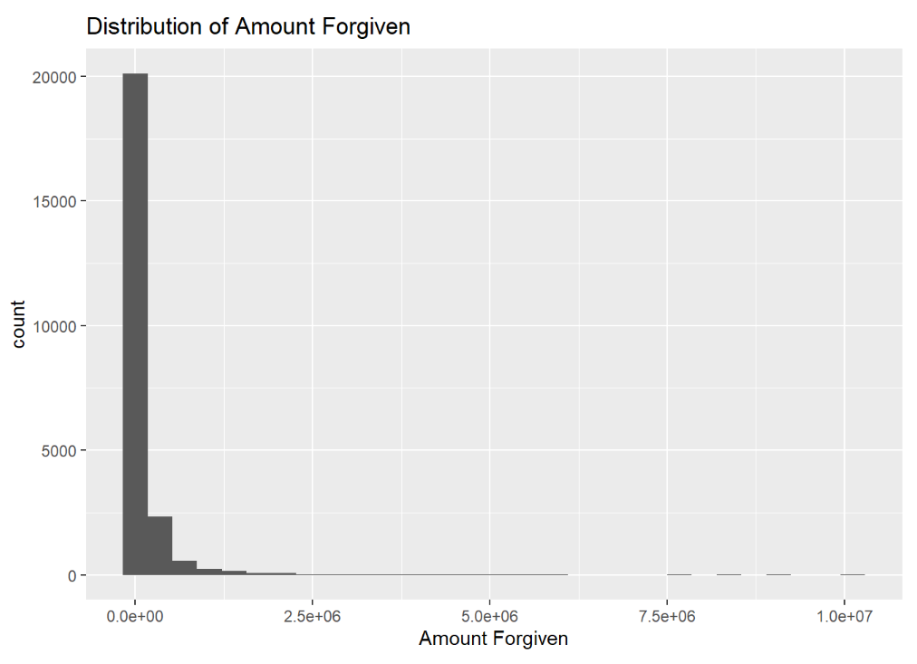
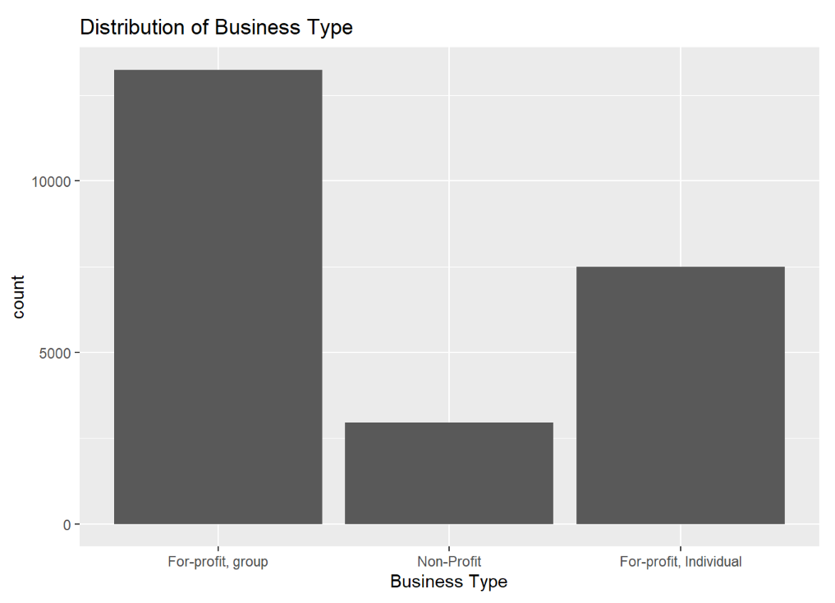
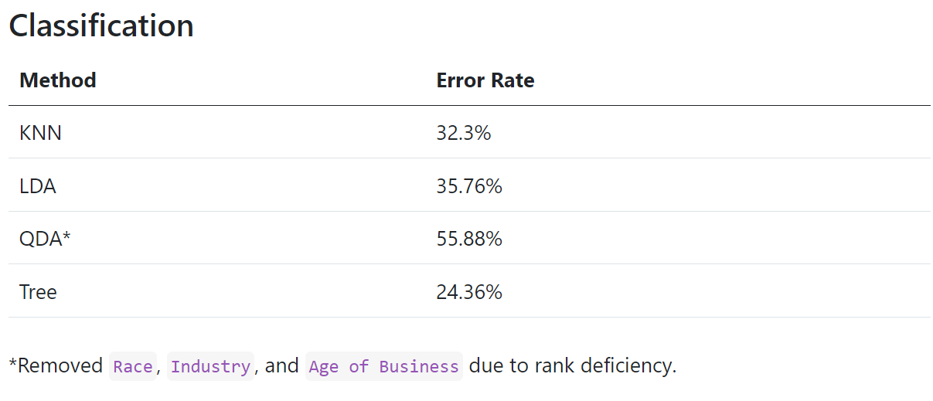
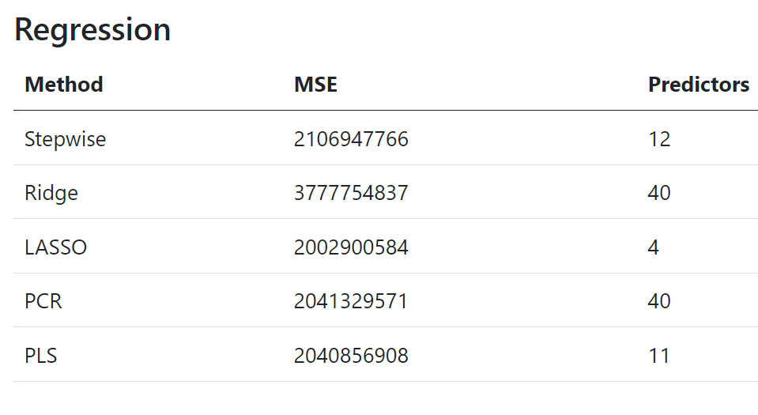
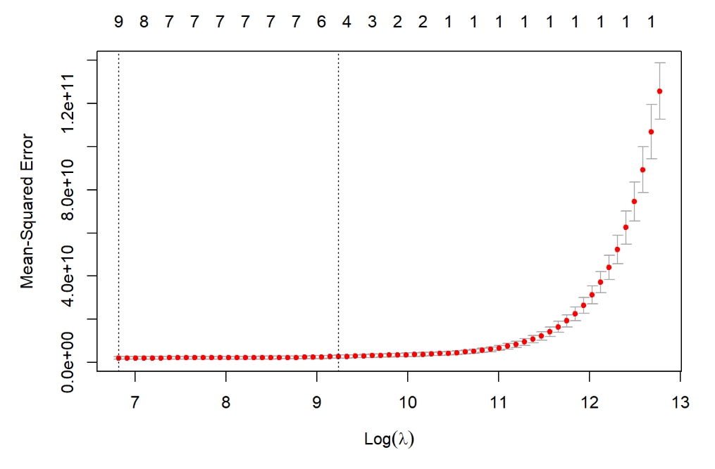


4844.5337598
10260.3
ML methods fail to adequately predict PPP loan forgiveness but succeed at classifying business based on their legal status.
Tree and LASSO as Best Models
Results/Implications
Most regression models suffer from high MSE that makes useful predictions impractical.
The variables that were important between the two approaches differed (e.g., minority owned business, etc.)
Using models to help build better loan forgiveness requirements
Using our models to predict on more recent PPP loan forgiveness
Understanding the Data
Most Business fall under For-profit, particularly for-profit group
Michael Lewis, Peter Magee, Ethan Wong, Margaret Willis
American University
Introduction/Context
$525 Billion was disbursed as part of the federal government’s Paycheck Protection Program (PPP) (cite). Some of these loans have been met with allegations of fraud. Today, the vast majority of the loans have been forgiven (cite)
Regression:
How can we assess the relationship between Amount forgiven and other variables?
Classification:
How can we best predict the Business Type?
Strong right skew
Mostly smaller amounts forgiven
Best Models
Best models selected by having the lowest of their respective comparison. LASSO for Regression and Trees for Classification.
Assumptions/Limitations/ or Secondary Results
Assumed that the data collected by the SBA Is accurate for all loans
Limited Data Availability
Results not generalizable beyond D.C.
Assumed Proxies were accurate representations of the enterprises
Inherent barriers in filing for PPP forgiveness
Selected Models
Classification Table
Yhat | For-profit, group | Non-profit | For-profit, individual
For-profit, group | 4566 | 477 | 268
Non-profit | 527 | 903 | 27
For-profit, individual | 1494 | 91 | 3486
Tree
Cross validated error rates are the lowest in trees with nodes 3 and up.
Tree had 3 nodes which made decisions based on jobs reported and industry.
Random first of 500 trees resulted in OOB error rate of 24.36%.
Data
PPP loan information for DC businesses
Size/Scale ~23,000 rows
Lacks categorical variable to meaningfully predict business type
Addressed by creating `Business Type` variable
Cross Validation Curve along the λ Sequence
LASSO
The Lambda.1se was 10260.3.
Model has four predictors not including the intercept which are Payroll, Rent, Utilities, and Mortgage Interest.
LASSO regression increases the accuracy of our predictions which is useful as our goal for this model is prediction.
Approach
Using KNN, LDA, QDA, and trees to predict business type.
Using PCR, PLS, ridge, stepwise, and LASSO to predict the amount forgiven
Primary References
House, The White. 2022. “FACT SHEET: New Data Show Progress on Biden-Harris Commitment to Equity in Emergency Small Business Relief.” The White House. https://www.whitehouse.gov/briefing-room/statements- releases/2022/03/11/fact-sheetnew-data-show-progress-on-biden-harris- commitment-to-equity-in-emergency-smallbusiness-relief/.
Pfeiffer, Sacha, and Austin Fast. 2023. “How the Paycheck Protection Program Went from Good Intentions to a Huge Free-for-All.” NPR, January. https://www.npr.org/2023/01/ 09/1145040599/ppp-loan-forgiveness. 3 “Some Firms Thrived During Covid and Then Got Their PPP Covid Relief Loans Forgiven.” 2021. NBC News. https://www.nbcnews.com/news/firms-thrived- covid-got-ppp-covidrelief-loans-forgiven-rcna5697.
Notes:
General Guidance
Limit poster to < 1000 words – it is a summary of your work so focus on the most important ideas and results.
Spellcheck and then have someone else proofread it.
Use titles on graphs to summarize the main interpretation or takeaway from the graph or map
Annotate with arrows and callout boxes so the viewer is visually led through how hypothesis is addressed.
Help readers understand the logic behind your conclusions without you needing to be there.
Keep font size of all text (even graph labels) as big or bigger than in rest of poster

