Slide 1

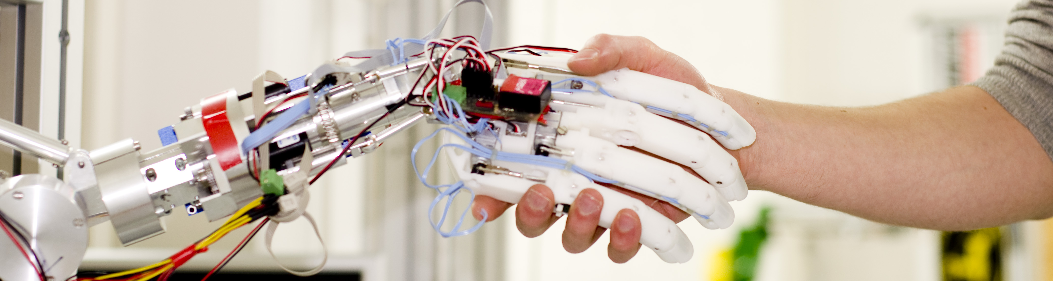
Project: Mobile Robot – Group 2
Moses Mutabazi, Piotr Meller, Mateusz Kociszewski, Łukasz Owsianny, Paul Dornhof
Robotics Research Lab
Department of Computer Science
University of Kaiserslautern, Germany

Slide 2
Agenda
Structure Overview
Overview object detection
Detailed view of modules
Overview navigation
Detailed view of modules
Issues

Slide 3
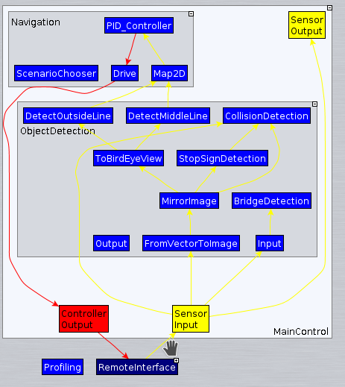
Structure Overview
Just two groups
ObjectDetection
Navigation

Slide 4
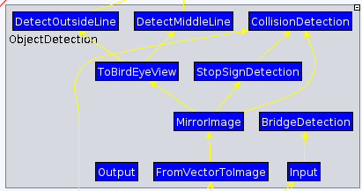
Detailed Overview – Object Detection

Slide 5
Detailed Overview – Bridge Detection
Input: point-cloud
Rotate point-cloud with an angle of slope of bridge
Filter ground
If counts enough point , then there is a bridge

Slide 6
Detailed Overview -Stop Sign Detection
Open-cv with Cascade-classifier

Slide 7
Detailded Overview – Line Detection
Input Xtion RGB-Camera
First mirror image
Open-cv

Slide 8
Detailed Overview – Collision Detection
Input ultrasonic-sensor and point-cloud
Validate ultrasonic-data with point-cloud

Slide 9
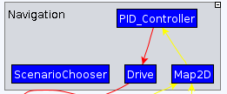
Detailed Overview - Navigation

Slide 10
Detailed Overview - Map2D
Calculate distance to points of interests

Slide 11
Detailed Overview - Drive

Slide 12
Detailed Overview – PID-Controller
Standard controller from rrlib
All parameter selected by a lot of tests

Slide 13
Issues
Xtion camera crashes very often
Wheel sensors gave unreliable data
Imu – unit unusable too
Infrared sensors – unusable data
Input lag from all cameras
Pylon detection – color similar to side line

Slide 14
Thanks for your kind attention !

