Slide 1




withdraw request
read bank balance
Client
success or failed
current bank balance
withdraw request
update bank balance
Bank Server
Database
success or failed
Bank
Client
Client Server

Slide 2

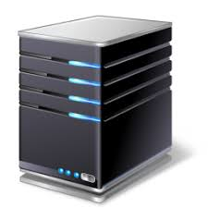
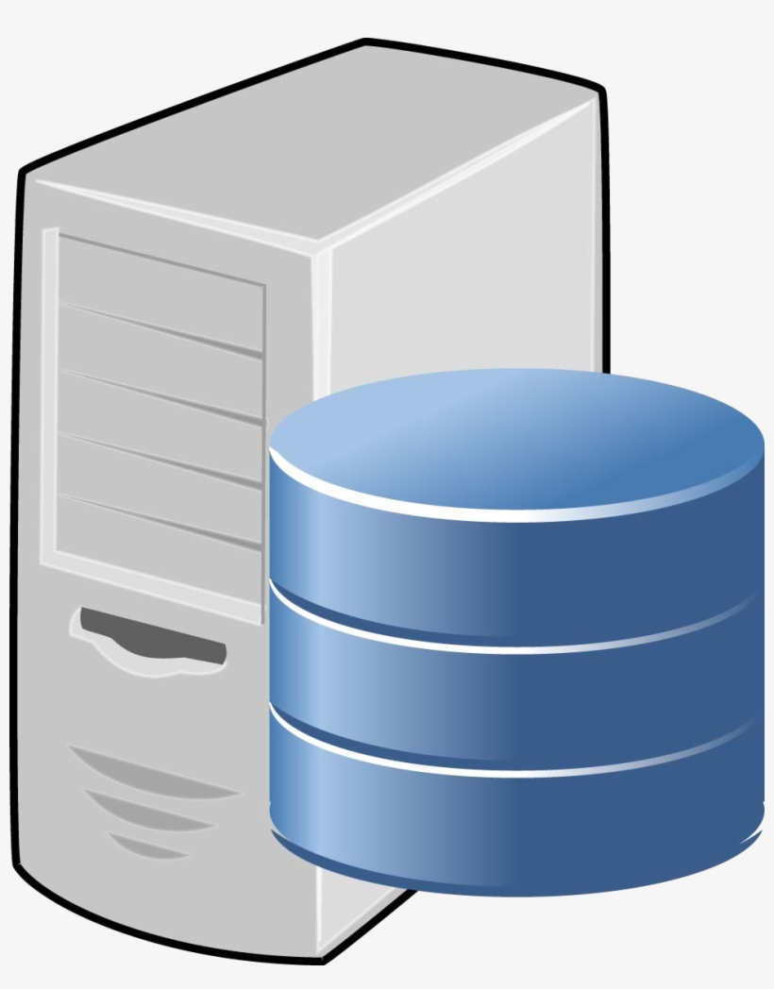
Client
Client
write transaction
write transaction response
success or failure
Coordinator
Coordinator
prepare
commit or abort
commit or abort
prepare
commit or abort
success or failure
prepare
success or failure
Participant
Participant
Participant
Participant
Participant
Participant
Phase 1
Phase 2

Slide 3
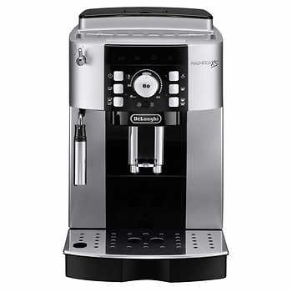
Reset
Error Message
Control Panel
Espresso
Steamer ON/OFF
Grounds
Espresso Machine

Slide 4

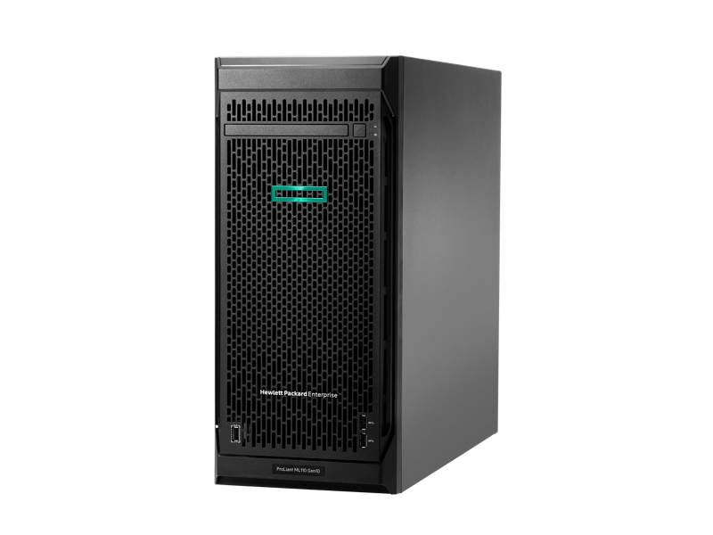
Client
notify failed replicas
Failure Detector
ping
fail replica
ping
pong
ping
pong
Failure Injector
Replica
Replica
Replica
Failure Detector

