Slide 1
Safe Asynchronous Programming: Methodology, Language, and Tools
Safety testing of Asynchronous Programs
PLDI 2019

Slide 2
Fault-Tolerant Distributed Services
State machine replication is a general method for implementing a fault-tolerant service by replicating logs.
Transaction Commit Service
Two Phase Commit
State Machine Replication (SMR)
State Machine Replication (SMR)
Multi Paxos based SMR
Chain Replication based SMR
Multi Paxos
Chain Replication
OR
Leader Election
(with view membership)
Fault Detector
Master Protocol
(with view membership)
Operating system and other services
Timer
Storage
Network
Software stack of a fault-tolerant distributed application
Notes:
Fault tolerant distributed systems are complex and programming them is challenging.
Lets say I want to build a transaction commit service that using two phase commit protocol but by default the 2pc system is not fault tolerant …
The point, I wanted to make using this example is that in general even when building system a simple system like two phase commit sysem and providing feature like fault tolerance leads to a software stack that consist of 10 different complex protocols composed together.

Slide 3
Testing Distributed Systems is Challenging
Popular approach: Random Testing [Jepsen, QuickCheck], Search Prioritization [P, P#]
Combinatorial explosion, no adequate test coverage.
Monolithic Testing does not scale.
No re-use of the systematic testing effort.
Transaction Commit Service
Two Phase Commit
Multi Paxos based SMR
Chain Replication based SMR
Multi Paxos
Chain Replication
Leader Election
Fault Detector
View Membership
Master Protocol
(with view membership)
Operating system and other services
Notes:
Testing distributed system is equally challenging. This is because the system in itself is severely complex.
Popular approaches are Random Testing using tools like jepsen and quickcheck. How many of you have heard of this tool? You should check it out, its become a standard for distributed systems.
The way these techniques work is they create an instance of the system and then explore execitions of the system by random schedules and failures like network partitions.
But they consider the system as a monolithic application and event a simple system consist.

Slide 4
Overview
Systematic Testing using Search Prioritization and Random Testing.
Compositional Testing using Principles of Assume-Guarantee reasoning for “Test-Amplification”.

Slide 5
Systematic Testing of Concurrent Program
Pioneered by tools like Verisoft, CHESS, JavaPathFinder, ..
Enumerate executions of the closed program.
Exploration of the (nondeterministic) operational semantics
Explicit choice ($, $$) (environment model)
Implicit scheduling choice
Exploration is unlikely to finish under reasonable bounds

Slide 6













Standard view of the state transition graph
$${ S}_{0}$$
$${ S}_{1}$$
$${ S}_{2}$$
$${ S}_{3}$$
$${ S}_{4}$$
$${ S}_{5}$$
$${ S}_{6}$$
$${ S}_{7}$$
$${ S}_{8}$$
$${ S}_{9}$$
$${ S}_{10}$$
$${ S}_{11}$$
$${ S}_{12}$$

Slide 7
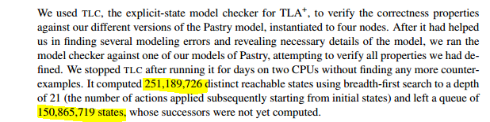
Formal Analysis of Distributed Systems.
Most popular framework is TLA+ by Leslie Lamport.
Scalability Issues with TLA+ (TLC Model Checker).
Scalable Verification or Testing of Distributed Systems is Hard because of the large search space.

Slide 8
Traditional Depth First Search
Space-efficient
Implemented in many model checkers
SPIN, Murphi, JPF, TLC, …
For example, Zing (https://github.com/ZingModelChecker/)
Iterative depth-first search with state deltas
efficient state fingerprinting
parallel search
Fails to find deep bugs !

Slide 9
How to find deep bugs ?
Using search prioritization
Different prioritization strategies S1 and S2.

Slide 10
Alternate view
S1
S2
$${ S}_{0}$$
$${ S}_{1}$$
$${ S}_{2}$$
$${ S}_{3}$$
$${ S}_{4}$$
$${ S}_{5}$$
$${ S}_{6}$$
$${ S}_{7}$$
$${ S}_{8}$$
$${ S}_{9}$$
$${ S}_{10}$$
$${ S}_{11}$$
$${ S}_{12}$$
Prioritize schedule S1 over S2.

Slide 11
Delay Bounding [POPL, 2001]
Delay bounding: best prioritization technique for shared memory concurrent programs. [PPoPP, 2014]
Deterministic Scheduler with ‘delay’ operation.
Deterministic round-robin scheduler
0 delay budget: 1 deterministic schedule.
1 delay budget : set of schedules that deviate from deterministic schedule only once.
Large delay : all schedules in the system.
T1
T2
T3
T1
T2
T3
T1
T2
T3
Delay
T1
T2
T3
T1
T2
T3

Slide 12
Delaying Explorer
Concurrent program being tested (state S)
Compose with program a scheduler (state D) with three operations
Next: S × D → S × D
Delay: D → D
Step: S × D → D
e.g., round-robin scheduler
D is a queue of process identifiers
Next executes the process at head of queue until it blocks and is removed
Created/enabled processes added at tail
Delay moves the process from head to tail

Slide 13
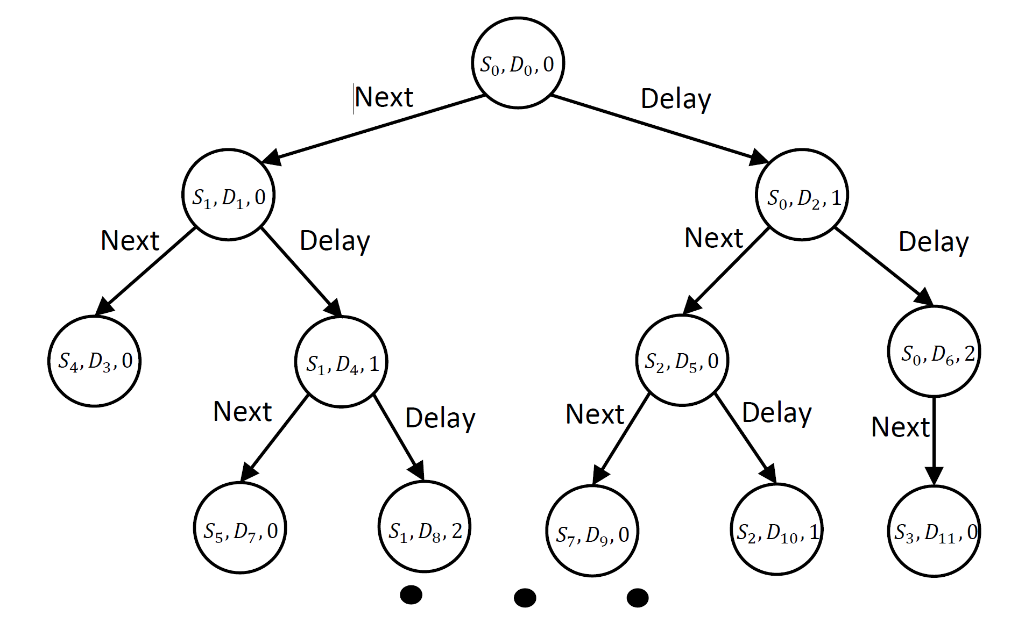
State Space Exploration using Delaying Explorer

Slide 14
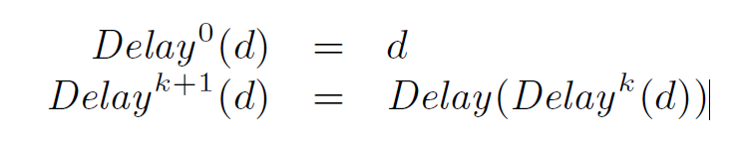
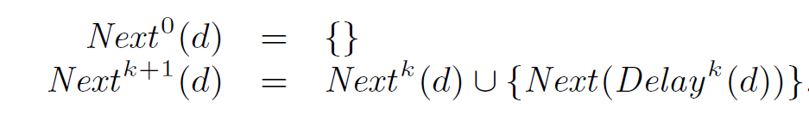
Soundness of Delaying Scheduler
This property states that all nondeterministic choices in a state are covered through iterative application of the Delay operation composed with Next.

Slide 15
Stratified Exhaustive Search (SES)
Execution with 0 delay
0
0
L-1
Executions with 1 delay
0
L-1
0
L-1
Executions with 2 delays
db
Executions(db) = L^{db}

Slide 16
Searching with a delaying scheduler
Execution with 0 delay
0
L-1
Executions with 1 delay
Executions with 2 delays
Store frontier states after each iteration (states with unexplored successors).
Efficient state-caching to avoid redundant exploration.

Slide 17
Random walk on state graph
Probability of hitting hard-to-find bugs at large depth becomes vanishingly low

Slide 18
Random walk on stratified execution graph
Execution with 0 delay
0
L-1
Executions with 1 delay
0
L-1
0
L-1
Executions with 2 delays
Probability of hitting a bug with db delays is at least 1/L^{db}

Slide 19
Schedulers
We implemented three delaying schedulers:
Round-Robin scheduler: Cycles through the processes in process creation order.
Run-to-Completion scheduler: Follows the causal sequence of events, giving priority to the receiver of the most recently sent event.
Probabilistic RR scheduler: Instead of inserting a newly-created process at the tail of queue, insert it at a random position.

Slide 20
Evaluation
Compared Stratified Exhaustive Search strategy with iterative preemption bounding.
Compared Stratified Sampling with
Random Sampling,
Iterative Random Sampling with respect to depth,
and PCT (probabilistic concurrency testing).
Evaluated the performance of SES and SS across different delaying schedulers.
Considered real-world implementations of distributed protocols like Paxos, State Replication Protocols, Transaction management systems, etc.

Slide 21
Results for SES
Programs | Stratified Exhaustive Search
 | Number of States Explored
 | PB | Delaying Explorer
 |  | RR | RTC | PRR
2pc_1 | 7934221 | 88451 | 6571 | 6512
2pc_2 | * | * | 17690 | 9090
2pc_3 | 48321 | 1898 | 1123 | 2189
2pc_4 | * | * | 5101 | 77212
ChainRep_1 | * | 92178 | 9913 | 936
ChainRep_2 | 74231 | 32166 | 8821 | 88732
ChainRep_3 | * | 19731 | 3452 | 8981
ChainRep_4 | 59234 | 672 | 5441 | 11742
ChainRep_5 | * | 3973 | 521 | 6652
ChainRep_6 | * | 78443 | 44331 | 54981
ChainRep_7 | * | * | 3538 | *
ChainRep_8 | 8342 | 9791 | * | 8218
ChainRep_9 | * | 37222 | 7812 | 37213
ChainRep_10 | 812561 | 5431 | 1944 | 1781
MultiPaxos_1 | * | 82114 | 89341 | 88129
MultiPaxos_2 | * | 15563 | 9983 | 1934
Multipaxos_3 | * | 18831 | 8923 | 1198
Paxos_1 | 3320 | 2233 | 1098 | 4312
Paxos_2 | 77834 | 4912 | 833 | 8831
Paxos_3 | * | * | 14832 | *
TMS_1 | 553 | 2220 | 660 | 8965
TMS_2 | * | * | 44832 | *
OSR_1 | 5532 | 4421 | 683 | 55392
OSR_2 | 12864 | 12931 | 1634 | 3212
Delaying explorer performs better than preemption bounding.
Large variance across schedulers.

Slide 22
Results for SS
Programs | Stratified Sampling
 | Number of Schedules Explored
 | Random Sampling | Iterative Random Sampling | PCT | Delaying Explorer
 |  |  |  | RR | RTC | PRR
2pc_1 | 9842 | 1891 | 1983 | 781 | 331 | 816
2pc_2 | * | * | * | 10943 | 6378 | 6300
2pc_3 | * | 2966 | 9835 | 1823 | 1018 | 4109
2pc_4 | * | 7629 | * | * | 3321 | *
ChainRep_1 | 9655 | 652 | 9832 | 5607 | 9999 | 1985
ChainRep_2 | * | * | * | 34034 | 7829 | 28221
ChainRep_3 | * | * | 13283 | 2032 | 1711 | 6093
ChainRep_4 | 4213 | 313 | 4439 | 3452 | 4249 | 1238
ChainRep_5 | 196 | 77 | 55 | 53 | 110 | 101
ChainRep_8 | * | 4561 | * | 5513 | * | 2201
ChainRep_9 | * | * | * | 66381 | 9425 | 16559
ChainRep_10 | 782 | 159 | 74 | 129 | 331 | 888
MultiPaxos_1 | * | 5211 | 9934 | 7821 | 765 | 5819
MultiPaxos_2 | * | * | * | 9872 | 8873 | 11239
Multipaxos_3 | * | * | * | * | 15023 | 9589
Paxos_1 | 229 | 86 | 592 | 122 | 53 | 233
Paxos_2 | * | 2211 | * | 9563 | 831 | 1874
TMS_1 | 224 | 64 | 227 | 12 | 305 | 34
TMS_3 | * | * | * | * | * | 3009214
TMS_4 | * | * | * | * | 5530042 | *
OSR_1 | 435 | 122 | 332 | 75 | 122 | 1009
OSR_2 | 756 | 78 | 131 | 115 | 66 | 224
Delaying explorer performs better than random sampling and Iterative random sampling.
Large variance across schedulers.

Slide 23
Encoding Different Constrains as External Scheduler

