Slide 1
Safe Asynchronous Programming: Methodology, Language, and Tools
Compositional safety testing
PLDI 2019 Tutorials

Slide 2
Characteristics of Distributed Systems
Actor model of computation.
Collection of concurrently executing processes.
Processes communicate by asynchronously sending messages or events to each other.
Processes can be created dynamically.
Communication topology changes dynamically.
Notes:
In the context of this talk, the class of event-driven systems we consider are those where: (1) processes run concurrently and communicate with each-other by exchanging messages and no shared memory.
Most of the event-driven systems are reactive in nature, in the sense they continuously interact with a non-deterministic environment.

Slide 3
Fault-Tolerant Distributed Services
State machine replication is a general method for implementing a fault-tolerant service by replicating logs.
Transaction Commit Service
Two Phase Commit
State Machine Replication (SMR)
State Machine Replication (SMR)
Multi Paxos based SMR
Chain Replication based SMR
Multi Paxos
Chain Replication
OR
Leader Election
(with view membership)
Fault Detector
Master Protocol
(with view membership)
Operating system and other services
Timer
Storage
Network
Software stack of a fault-tolerant distributed application
Notes:
Fault tolerant distributed systems are complex and programming them is challenging.
Lets say I want to build a transaction commit service that using two phase commit protocol but by default the 2pc system is not fault tolerant …
The point, I wanted to make using this example is that in general even when building system a simple system like two phase commit sysem and providing feature like fault tolerance leads to a software stack that consist of 10 different complex protocols composed together.

Slide 4
Testing Distributed Systems is Challenging
Popular approach: Random Testing [Jepsen, QuickCheck], Search Prioritization [P, P#]
Combinatorial explosion, no adequate test coverage.
Monolithic Testing does not scale.
No re-use of the systematic testing effort.
Transaction Commit Service
Two Phase Commit
Multi Paxos based SMR
Chain Replication based SMR
Multi Paxos
Chain Replication
Leader Election
Fault Detector
View Membership
Master Protocol
(with view membership)
Operating system and other services
Notes:
Testing distributed system is equally challenging. This is because the system in itself is severely complex.
Popular approaches are Random Testing using tools like jepsen and quickcheck. How many of you have heard of this tool? You should check it out, its become a standard for distributed systems.
The way these techniques work is they create an instance of the system and then explore execitions of the system by random schedules and failures like network partitions.
But they consider the system as a monolithic application and event a simple system consist.

Slide 5


Abstraction based Decomposition
Two Phase Commit
SMR Abstraction
$$⊨$$
Atomicity
Multi-Paxos SMR
SMR Client
$$⊨$$
Linearizability
Notes:
The solution is to perform abstraction based decomposition. This is a well known idea in testing called mocking, it simply means that when testing a component you use the abstraction of mocks other components.
For example, we test each protocol in isolation by using abstractions of the other protocols. Hence, in asynchronous systems unlike sequential programs the abstractions are themselves protocols implementing the abstraction.
This is great, and provides orders of magnitude amplication in test-coverage and I will also demonstrate why it provides orders of magnitude coverage benefits when I show the evaluation.
This is good for increasing coverage as the components are tested in isolation, but fails to provide any guarantees about the system level properties.
The solution is again the well-known approach of assume guarantee compositional reasoning, in which you first check that the abstractions are sound and then use the properties of composition to conclude that the system level properties are satisfied.
To enable this type of assume-guarantee style compositional reasoning, there are 4 fundamental requirements: 1) We need to deifne a notion of a module which is the unit of composition in the framework and the module must be modeled as an open system, I will explain what I mean by an open system. The second requirement is define a set of module constructors to enable building complex systems out of individual modules operators like hide, rename and composition.
There has a lot of work in the past for compositional reasoning, in particular hardware verification tools like SMV by Ken Mcmillan and Mocha by henzinger and Alur was built on similar principles but the challenges in our case is to enable this 4 characteristics for a dynamic programming language like P which is the main contribution of our work.

Slide 6
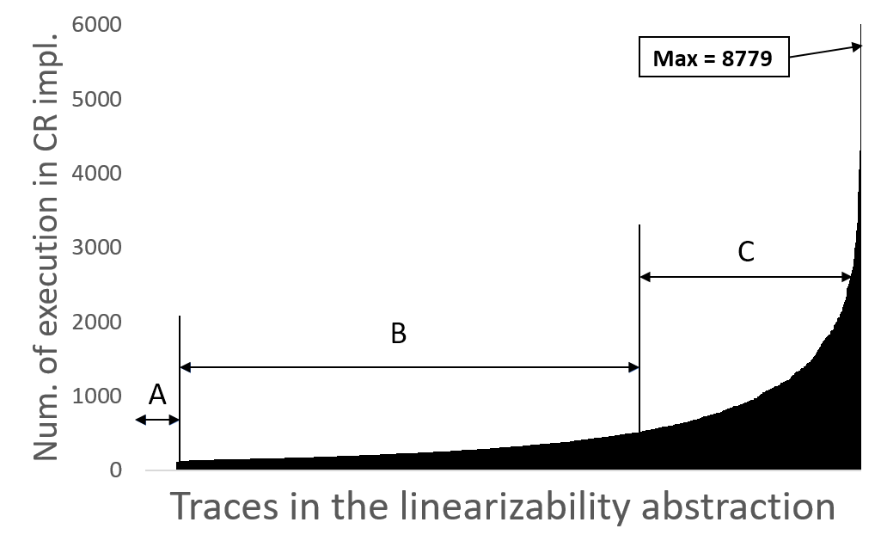
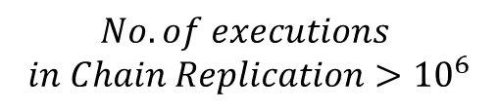
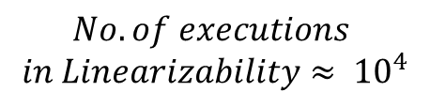
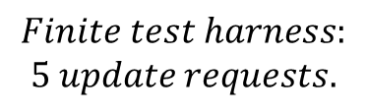

Coverage Amplification
$$ChainReplication≤Linearizability$$
$$Finite test harness:$$
$$5 update requests.$$
$$No. of executions$$
$$in Linearizability≈ {10}^{4}$$
$$No. of executions$$
$$in Chain Replication>{10}^{6}$$
Hard to find executions (or false positives)
Low probability executions
High probability executions

Slide 7
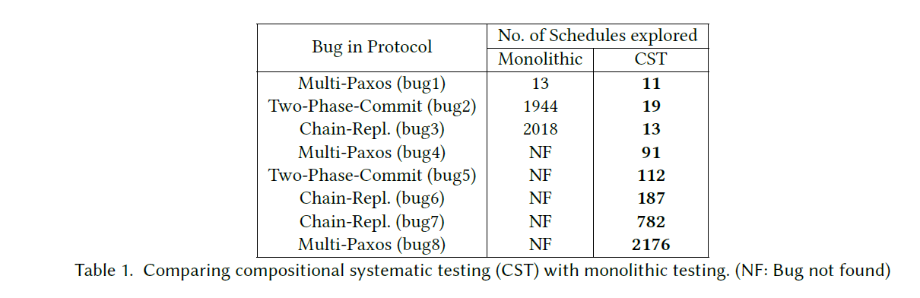
Monolithic vs Compositional
Prioritized Random Search:
Faster Bug Finding
Symbolic Execution:
For a finite test-harness, we were able to explore all possible execution
of the decomposed system in 1.3 hours where as it could not finish on the
Monolithic (mono) test even after 10 hours.
Coverage Amplification
Notes:
There is a huge value of using compositional testing as we uncover more bugs.

Slide 8

Abstraction based Decomposition
Substitution
Two Phase Commit
SMR Abstraction
$$⊨$$
Atomicity
Multi-Paxos SMR
SMR Client
$$⊨$$
Linearizability
Refinement
Multi-Paxos SMR
refines
SMR Abstraction
Two Phase Commit
refines
SMR Client
Module as Open System
Two Phase Commit
Multi-Paxos SMR
$$⊨$$
Atomicity
Module Constructors
[Mocha, SMV, IOA]
Notes:
The solution is to perform abstraction based decomposition. This is a well known idea in testing called mocking, it simply means that when testing a component you use the abstraction of mocks other components.
For example, we test each protocol in isolation by using abstractions of the other protocols. Hence, in asynchronous systems unlike sequential programs the abstractions are themselves protocols implementing the abstraction.
This is great, and provides orders of magnitude amplication in test-coverage and I will also demonstrate why it provides orders of magnitude coverage benefits when I show the evaluation.
This is good for increasing coverage as the components are tested in isolation, but fails to provide any guarantees about the system level properties.
The solution is again the well-known approach of assume guarantee compositional reasoning, in which you first check that the abstractions are sound and then use the properties of composition to conclude that the system level properties are satisfied.
To enable this type of assume-guarantee style compositional reasoning, there are 4 fundamental requirements: 1) We need to deifne a notion of a module which is the unit of composition in the framework and the module must be modeled as an open system, I will explain what I mean by an open system. The second requirement is define a set of module constructors to enable building complex systems out of individual modules operators like hide, rename and composition.
There has a lot of work in the past for compositional reasoning, in particular hardware verification tools like SMV by Ken Mcmillan and Mocha by henzinger and Alur was built on similar principles but the challenges in our case is to enable this 4 characteristics for a dynamic programming language like P which is the main contribution of our work.

Slide 9

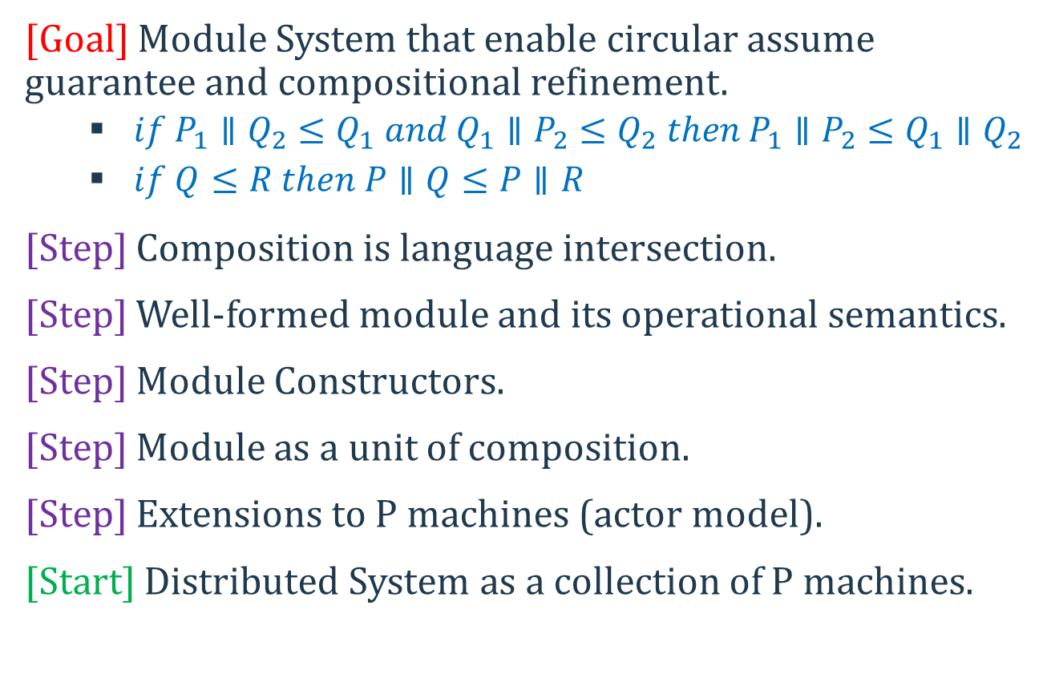
Road Map
[Goal] Module System that enable circular assume guarantee and compositional refinement.
$if P_{1}∥Q_{2}≤Q_{1} and Q_{1}∥P_{2}≤Q_{2} then P_{1}∥P_{2}≤Q_{1}∥Q_{2}$
$if Q≤R then P∥Q≤P∥R$
[Step] Composition is language intersection.
[Step] Well-formed module and its operational semantics.
[Step] Module Constructors.
[Step] Module as a unit of composition.
[Step] Extensions to P machines (actor model).
[Start] Distributed System as a collection of P machines.
Notes:
Add flag image

Slide 10
/* Events */
event eRequest : RequestType;
event eResponse: ResponseType;
/* Interfaces */
interface iServerToClient receives eRequest;
interface iClient receives eResponse;
interface iHelper receives eProcessReq;
/*Client Machine*/
machine ClientImpl
receives eResponse;
sends eRequest;
creates iServerToClient;
{
var server : iServerToClient;
start state Init {
entry {
server = new iServerToClient;
goto StartPumpingRequests;
}
}
state StartPumpingRequests {
entry {
send server, eRequest, payload;
}
}
on eResponse do (payload: ResponseType) {
…..
goto StartPumpingRequests;
}
}
}
/* Server Machine */
machine ServerImpl
sends eResponse, eProcessReq;
receives eRequest, eReqSuccess, eReqFail;
creates iHelper;
{
var helper: iHelper;
start state Init {
entry {
helper = new iHelper;
goto WaitForRequests;
}
}
….
}
/* Helper Machine */
machine HelperImpl
receives eProcessReq;
sends eReqSuccess, eReqFail, ..;
creates .. ;
{ /* body */ }

Slide 11
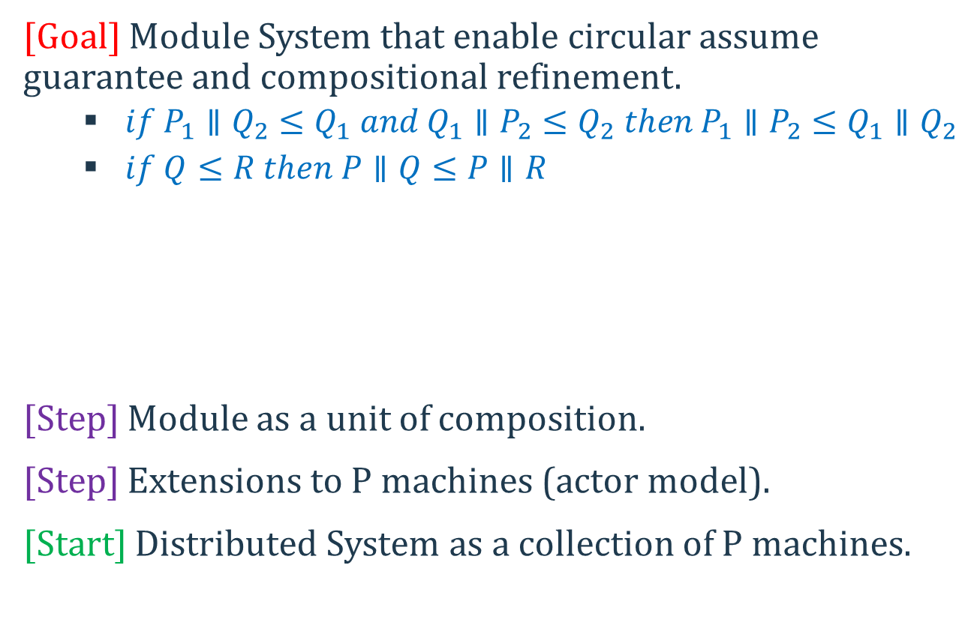
Road Map
[Goal] Module System that enable circular assume guarantee and compositional refinement.
$if P_{1}∥Q_{2}≤Q_{1} and Q_{1}∥P_{2}≤Q_{2} then P_{1}∥P_{2}≤Q_{1}∥Q_{2}$
$if Q≤R then P∥Q≤P∥R$
[Step] Module as a unit of composition.
[Step] Extensions to P machines (actor model).
[Start] Distributed System as a collection of P machines.
Notes:
Add flag image

Slide 12
ModP Module
module ClientModule = { iClient $→$ ClientImpl };
module ServerModule = { iServerToClient $→$ ServerImpl, iHelper $→$ HelperImpl };
module System = ClientModule $∥$ ServerModule
module AbstractModule = { iServerToClient $→$ ServerAbs, iHelper $→$ HelperImpl };
module System = ClientModule $∥$ AbstractModule;
Notes:
Ignoring private events and interfaces in this slide.
There are three things: (semantics of modules, refinement, composition)

Slide 13
Abstraction based Decomposition
spec ReqIdsAreMonotonic
observes eRequest
{ … }
spec RespIdsAreMonotonic
observes eResponse
{ … }
//check: ClientModule.
check c0: (assert ReqIdsAreMonoInc in ClientModule) || AbstractServerModule;
//check: ServerModule.
check c1: (assert ResIdsAreMonoInc in ServerModule) || AbstractClientModule;

Slide 14
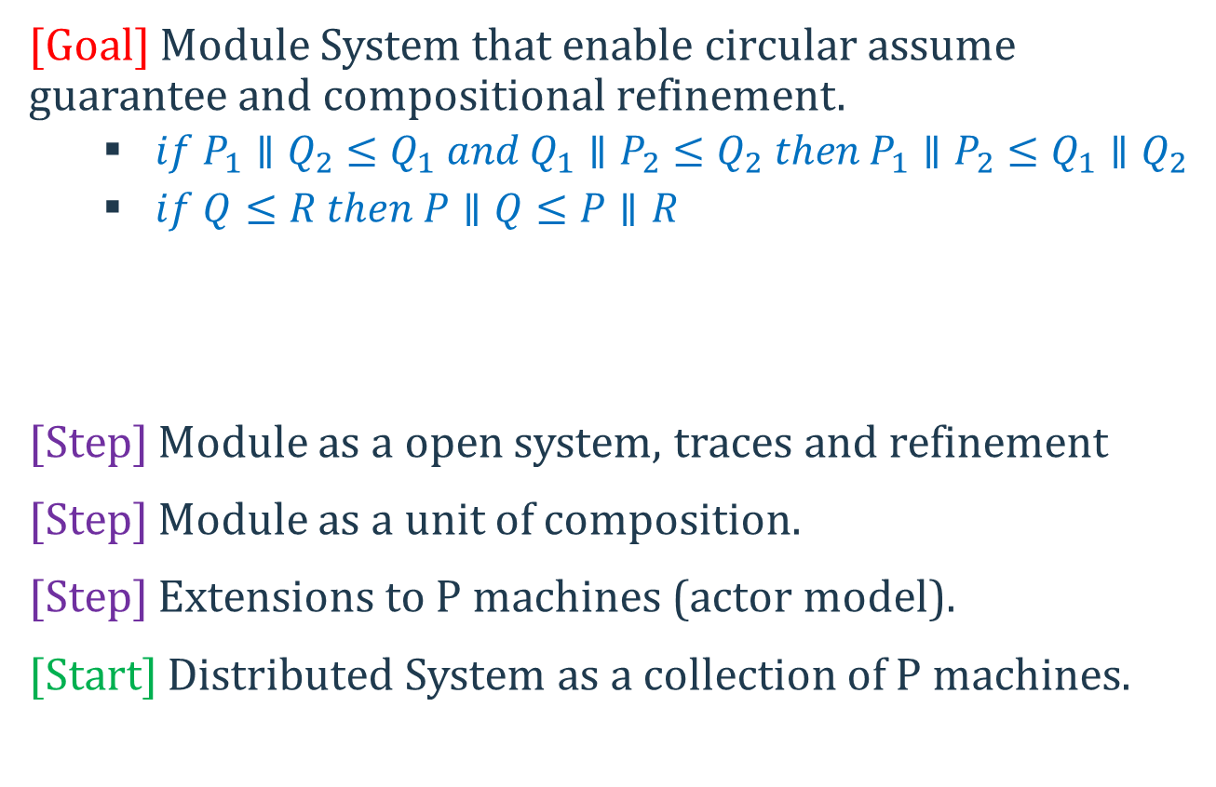
Road Map
[Goal] Module System that enable circular assume guarantee and compositional refinement.
$if P_{1}∥Q_{2}≤Q_{1} and Q_{1}∥P_{2}≤Q_{2} then P_{1}∥P_{2}≤Q_{1}∥Q_{2}$
$if Q≤R then P∥Q≤P∥R$
[Step] Module as a open system, traces and refinement
[Step] Module as a unit of composition.
[Step] Extensions to P machines (actor model).
[Start] Distributed System as a collection of P machines.
Notes:
Add flag image

Slide 15
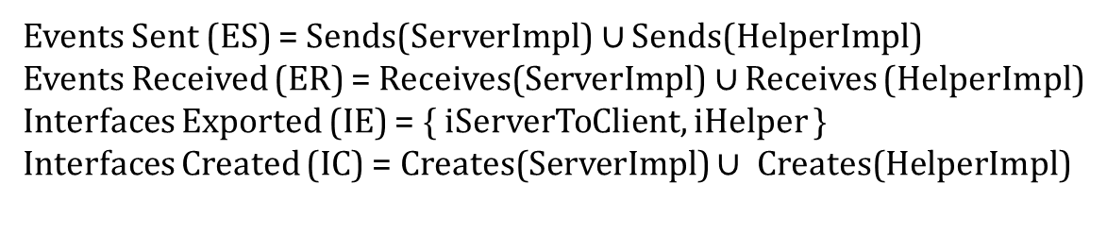
ModP Module
module ServerModule = { iServerToClient $→$ ServerImpl, iHelper $→$ HelperImpl };
ER
ServerModule
ES
IE
IC
Visible Actions:
Events Sent (ES) = Sends(ServerImpl) $∪$ Sends(HelperImpl)
Events Received (ER) = Receives(ServerImpl) $∪$ Receives (HelperImpl)
Interfaces Exported (IE) = { iServerToClient, iHelper }
Interfaces Created (IC) = Creates(ServerImpl) $∪$ Creates(HelperImpl)
Notes:
Ignoring private events and interfaces in this slide.
There are three things: (semantics of modules, refinement, composition)

Slide 16
Traces and Refinement
Trace is a sequence of visible actions of the module.
[X refines Y]: Each trace of X is a trace of Y when projected on vocabulary of Y
Notes:
Add the example of serverAbs and ServerImpl here.
Also, say that we automatically check this using model checking.

Slide 17
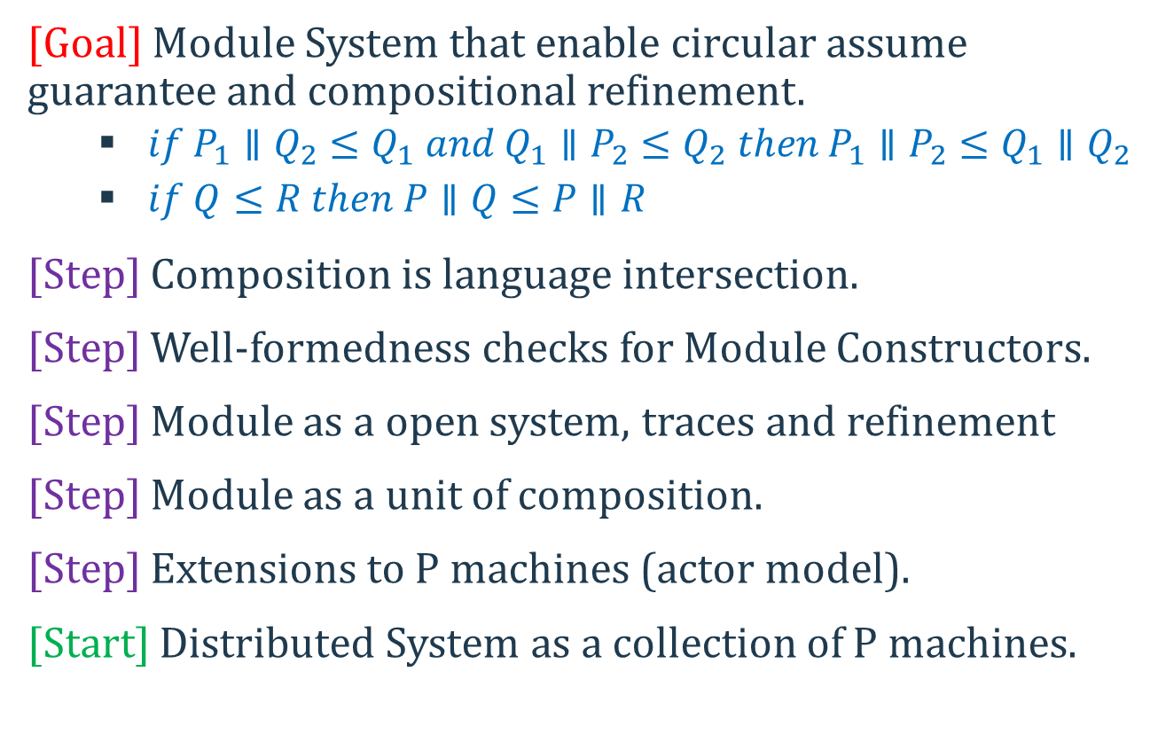
Road Map
[Goal] Module System that enable circular assume guarantee and compositional refinement.
$if P_{1}∥Q_{2}≤Q_{1} and Q_{1}∥P_{2}≤Q_{2} then P_{1}∥P_{2}≤Q_{1}∥Q_{2}$
$if Q≤R then P∥Q≤P∥R$
[Step] Composition is language intersection.
[Step] Well-formedness checks for Module Constructors.
[Step] Module as a open system, traces and refinement
[Step] Module as a unit of composition.
[Step] Extensions to P machines (actor model).
[Start] Distributed System as a collection of P machines.
Notes:
Add flag image

Slide 18
Composition is Intersection
The fundamental theorem for enabling compositional reasoning:
Theorem [Composition is Intersection]:
For composable modules P and Q, a trace t belong to module P || Q iff t[P] is a trace of P and t[Q] is a trace of Q.
Module Constructors: Composition, Hide, Rename.

Slide 19
Module Composition
Module Composition requires output disjointness [Reactive Module, IOA]:
Created interfaces are disjoint
Sent events are disjoint

Slide 20
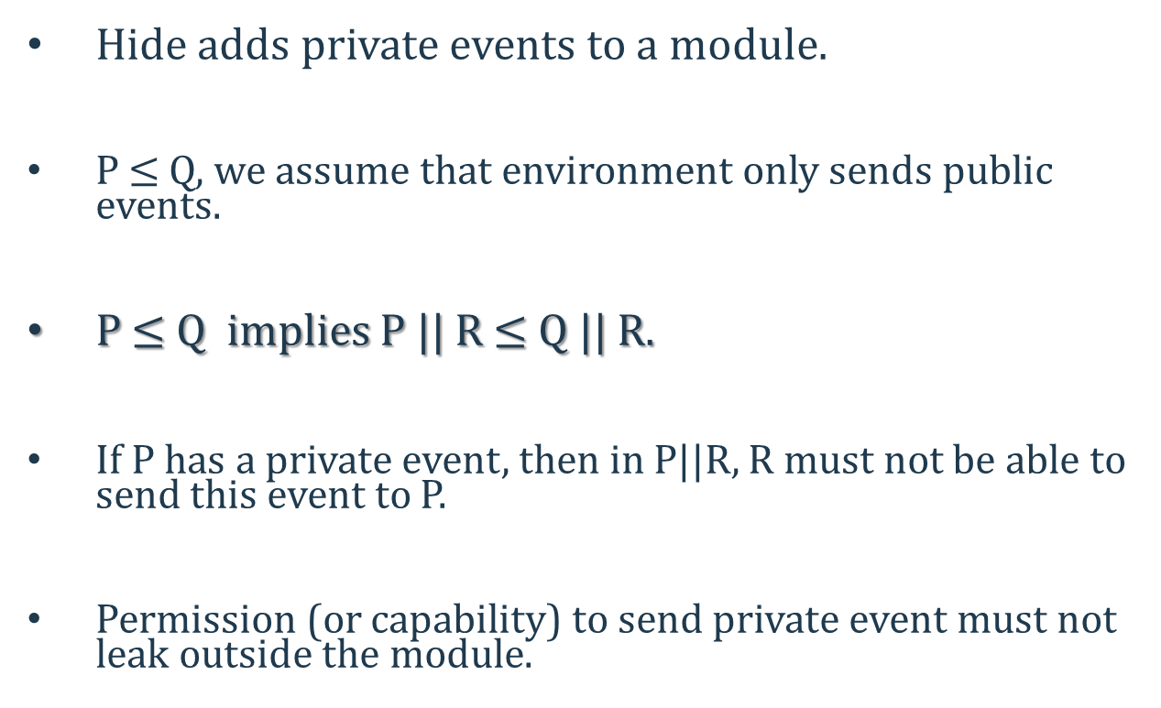
Hiding Events
Hide adds private events to a module.
P $≤$ Q, we assume that environment only sends public events.
P $≤$ Q implies P || R $≤$ Q || R.
If P has a private event, then in P||R, R must not be able to send this event to P.
Permission (or capability) to send private event must not leak outside the module.

Slide 21
Permissioned machine identifiers
Machine identifier is extended with permissions.
Permission is a set of events that can be sent to target machine using the identifier.
Identifier i, permissions is perm(i)
A(e): annotation on event e (capabilities).
permission of identifier embedded in payload of e must be contained in A(e).
If identifier i is embedded in the payload of event e then perm(i) $⊆$A(e).
Notes:
Read about capabilities annotation on channels

Slide 22
Hiding events soundly
Dynamic enforcement of send t, e, v
If e ∈ ES then for each identifier i embedded in v: perm(i) ⊆ A(e).
e is in perm(t).
Static enforcement of hide e in P
after hiding e, no input or output event x has e in A(x).
Permission to send a private event will not cross module boundary

Slide 23
Compositional Testing the Software Stack
//monolithic testing of software stack
check mono: (assert Atomicity in 2PC) || MultiPaxosSMR || OSServAbs;
/* Compositional Safety Theorem */
check t1: (assert Atomicity in 2PC) || SMRLinearizAbs || OSServAbs;
check t2: SMRClientAbs || MultiPaxosSMR || OSServAbs;
/* Circular Assume-Guarantee Theorem*/
check t3: SMRClientAbs || MultiPaxosSMR || OSServAbs
refines SMRClientAbs || SMRLinearizAbs || OSServAbs;
check t4: 2PC || SMRLinearizAbs || OSServAbs
refines SMRClientAbs || SMRLinearizAbs || OSServAbs;

Slide 24
Discharging Test Obligations
For safety tests, programmer provides a “test harness” module to “close” the module
systematic testing backend explores the closed module
For refinement tests, test harness is provided for both left (L) and right (R) modules
generate executions of R and store them in a cache
generate executions of L
for each execution, attempt to match with some trace in cache

Slide 25
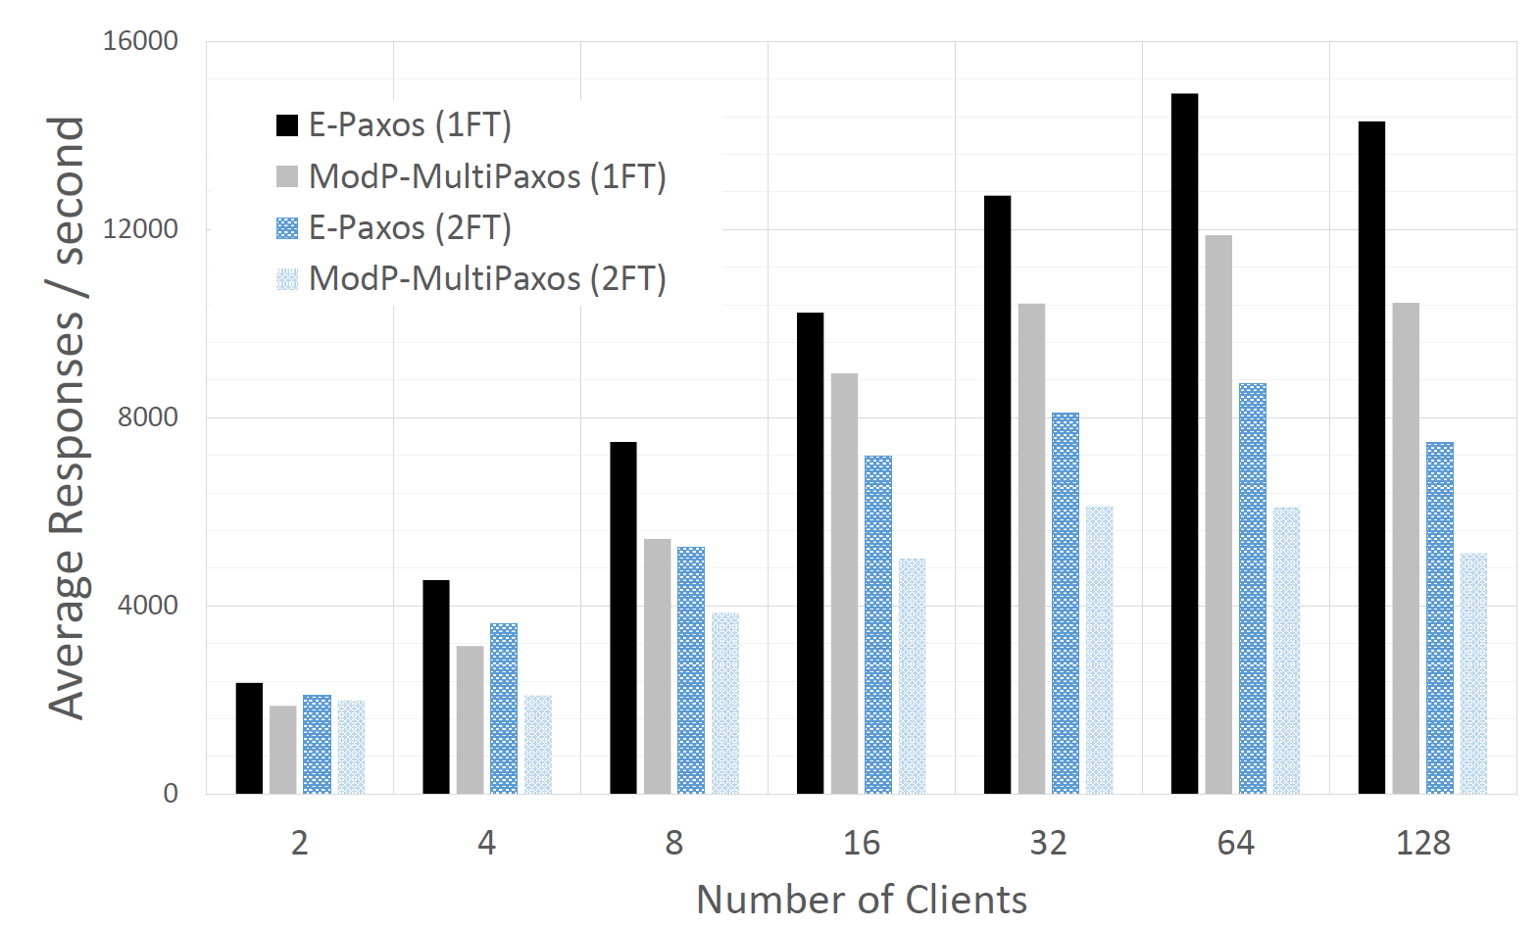
Performance of ModP Services
ModP implementation achieves between 72% (2FT, 64 clients) to 80% (1FT, 64 clients) of peak throughput of the open source EPaxos [Moraru et al. 2013] implementation in Go.

Slide 26

Conclusion!
Building reliable systems is difficult and unpleasant for programmers.
A pinch of programming language design with a dash of automated reasoning can go a long way in bringing joy back

