Slide 1
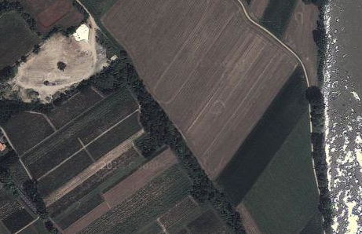
Source Zone
River (h=10 m)
Old River Channel
k = 25 m/d)
Western Boundary (h = 11 m)
120 m
Extraction Well
k = 10 m/d
250 m

