Slide 1
AAI-521 Final Project Team-2
Paul Parks, Bin Lu, Eyoha Girma, Jeremy Cryer

Slide 2
Overview

Slide 3
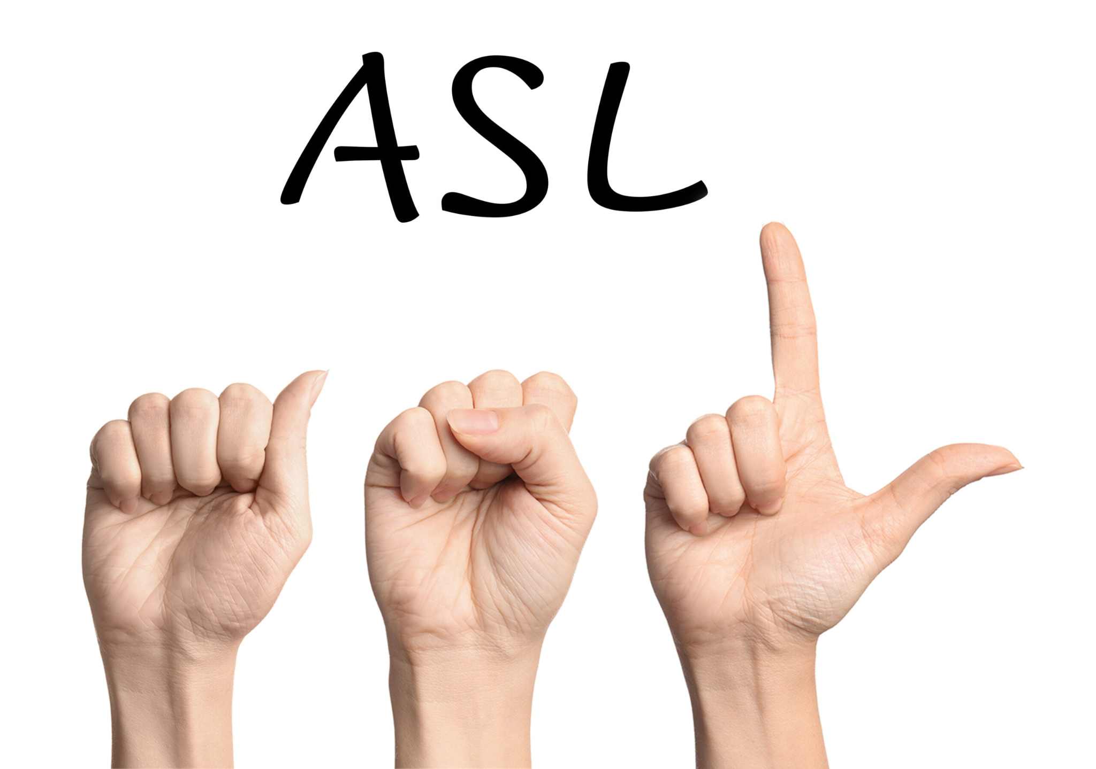
Problem Statement
The GOAL
According to google over 466 million people are hearing-impaired with a need to use American Sign Language (ASL).
However, only ~0.5 Million people actually know how to use ASL.
s
Create a model that can translate ASL to text.

Slide 4
Dataset

Slide 5
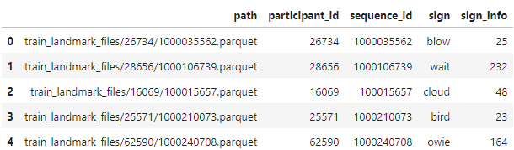
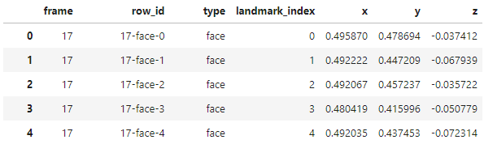
Google - Isolated Sign Language Recognition
URL:
https://www.kaggle.com/competitions/asl-signs/data
Data Contents:
Multiple Parquet files full of the spatial coordinates of each frame of a raw video.
A training file matching the parquet files to the sign being performed.
Training File
Parquet File

Slide 6
EDA

Slide 7
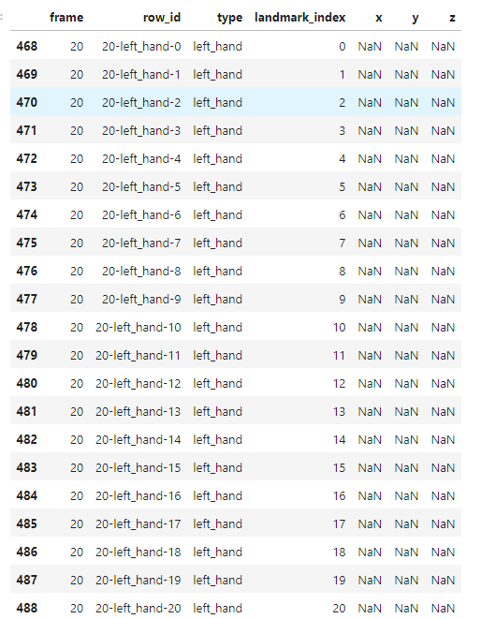
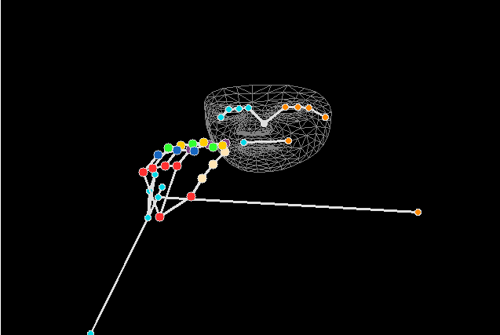
EDA
EDA revealed each Parquet file has landmarks broken down by multiple frames of a raw video of ASL being performed.
If not inputted correctly, each instance of a frame can be treated as one point turning the example photo into a single point.
If a hand isn't used for the signing, the data will be null.

Slide 8
Model - LSTM

Slide 9
Data Pre-Processing
Utilizes OpenCV and MediaPipe for processing and extracting key landmarks from ASL sign language datasets.
Converts extracted keypoints into numpy arrays, saving them in an organized structure based on sign labels.
Implements a system to identify and use the first 10 consecutive frames containing consistent left or right hand movements.

Slide 10
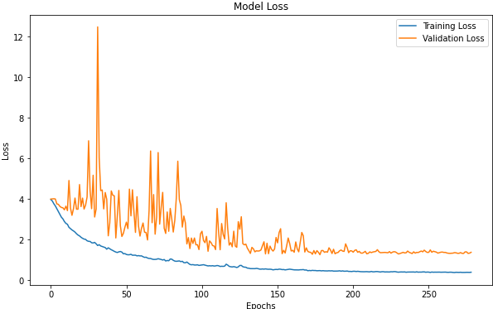
Model LSTM
LSTM model with two layers, the first with 128 neurons and the second with 256 neurons, both using ReLU activation.
Incorporates Dropout and BatchNormalization layers for regularization and to prevent overfitting.
Utilizes a Dense layer with softmax activation for multi-class classification of ASL signs.
Employs an Adam optimizer with learning rate adjustments and callbacks like EarlyStopping and ReduceLROnPlateau for efficient training.

Slide 11
Model LSTM - Results
Model Name | Trained Signs | Accuracy | Precision | Recall | F1
All Signs | 250 | 0.48 | 0.49 | 0.48 | 0.48
Removed Low Performing Signs | 65 | 0.76 | 0.77 | 0.76 | 0.76
Top 15 | 15 | 0.88 | 0.89 | 0.88 | 0.88

Slide 12
Model - LSTM Bidirectional

Slide 13
Introduction to Advanced LSTM Variants
LSTM and its Importance: Long Short-Term Memory models and their role in sequence data processing.
Project Context: Need for advanced models in ASL recognition.
Focus: Exploring beyond standard LSTM for enhanced performance.

Slide 14
Exploring Advanced LSTM Variants: BiLSTM and GRU
Bidirectional LSTM (BiLSTM) Overview
BiLSTM Concept: Processes data in both forward and backward directions.
Contextual Understanding: Captures comprehensive context in sequences.
Application to ASL: Potential benefits for interpreting sign language.
Mixed Results: Initial promise but eventual plateau in performance.
Gated Recurrent Unit (GRU) Overview
GRU Mechanics: Simplified version of LSTM with fewer parameters.
Update Gate: Combines forget and input gates for efficiency.
Speed and Efficiency: Designed for faster processing.
Project Application: Considered for ASL data, aiming for streamlined learning.

Slide 15
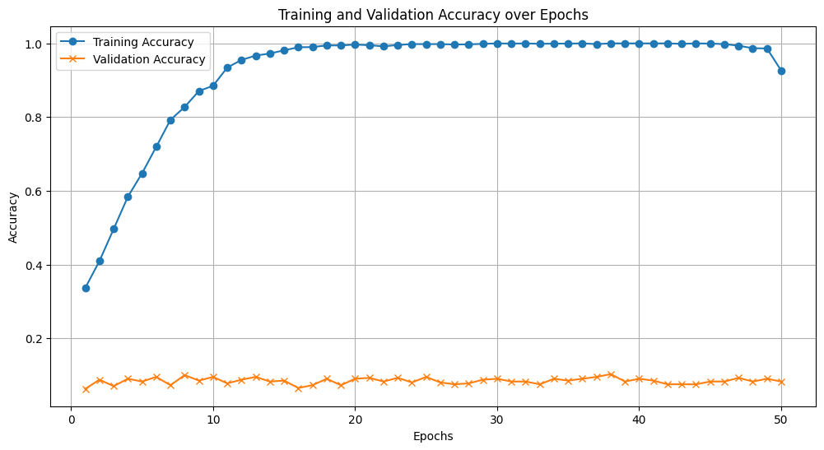
Challenges with Basic BiLSTM in Our Project
Overfitting Issues: Models too tailored to training data, poor validation performance.
BiLSTM Data Insights: High training accuracy vs. low validation accuracy.
Generalization Struggles: Inability to effectively interpret new, unseen data.

Slide 16
Transition to Transformer Model
Decision Point: Pivot from LSTM variants to a different model architecture.
Transformer Model Consideration: Due to success in sequence modeling tasks.
Transformers Advantage; Excelling in understanding sequences.
Self-Attention Mechanism: Ability to weigh importance of different parts of input.
Parallel Processing: Faster and more efficient than sequential processing of LSTMs.
Advanced Feature Capturing: Better at capturing nuances in complex sequential data like ASL.
Scalability and Flexibility: More adaptable to different types of sequential data.

Slide 17
Model - Transformer

Slide 18
Data Pre-Processing
Mark Wijkhuizen’s Transformer Model Data Pre-Processing:
MediaPipe Parquet File → 3D Tensor (Frame, KeyPoint, Landmark Value)
Frame: 64 Frame
Data File Frame < 64: Padding | Data File Frame > 64: Downsampling
KeyPoint:
MediaPipe Tracking Landmark Keypoints:
Face: 468 + Left Hand: 21 + Right Hand: 21 + Pose: 33 = 542 Landmarks Keypoints
Lip: 40 + Dominant Hand: 21 + Dominant Side Pose (Arm and Shoulder): 5 = 66 Landmarks Keypoints
Landmark Value: [X, Y, Z] value from MediaPipe Tracking: 3
MediaPipe Parquet File → 3D Tensor (64, 66, 3)

Slide 19
Transformer Model
Mark Wijkhuizen’s Custom Transformer Model:
Attention Mechanism
Scaled_Dot_Product function use Softmax layer → selectively ignore and pay less attention to certain part of the input such as padding or irrelevant frames
Embedding Layer
LandmarkEmbedding Class is used to embed the Landmarks.
Embedding Class is used for positional embedding.
Encoder Only

Slide 20
Conclusion

Slide 21
Models Benchmark
Model Name | Trained Signs | Accuracy | Precision | Recall | F1
LSTM | 250 | 0.48 | 0.49 | 0.48 | 0.48
Bidirectional LSTM | 250 | 0.09 | 0.08 | 0.08 | 0.09
Transformer | 250 | 0.71 | 0.74 | 0.71 | 0.71

Slide 22
ASL Gesture Detection
High Overall Accuracy: Transformer model achieved an impressive F1 score of 0.71, showcasing its high accuracy in interpreting ASL.
Exceptional Performance on Certain Signs: Demonstrated superior performance with F1 scores above 0.90 for signs like "airplane," "apple," and "owl."
Balanced Precision and Recall: Maintained a balanced performance with a weighted precision and recall both at 0.71, indicating consistent model reliability.
Scalable and Adaptable Framework: Methodology, utilizing pre processing, MediaPipe, LSTM, and Transformer models, provides a scalable and reusable framework that can be efficiently adapted for various other gesture recognition applications beyond ASL interpretation.

Slide 23
Demonstration

Slide 24
Demo

Slide 25
Contributions
Paul Parks
EDA, LSTM development, research, training, and testing.
Bin Lu
EDA, Mark Wijkhuizen’s Transformer Model interpretation, implementation, and testing
Eyoha Girma
EDA, LSTM-Bidirectional development, research, training, and testing
Jeremy Cryer
EDA, Model Exploration, Report construction and formatting.

Slide 26
Source
https://github.com/p-parks/AAI-521_FinalProject_Team2

