Slide 1


Bath Soap Consumer segmentation
Prerak Kalpeshkumar Patel

Slide 2
Brand Equity
Sales growth
Brands can change customers’ actual experiences; they can change the taste of food or drink, the excitement of driving a car, the comfort felt in a coffee shop, and the visual appeal of diamond jewelry
Profit enhancement
Benefits that drive sales growth also can enhance a firm’s profitability by reducing costs or allowing the firm to charge higher prices for its products
Loyalty effects
Strong brand makes customers more loyal, which often provides the largest barrier to competitive entry

Slide 3
True Loyalty Matrix
True loyalty: when both attitudinal and behavioral loyalty are high; positive feelings and actions
Spurious loyalty: customers buy but have ambivalent or negative feelings; at the first convenient opportunity they will switch
Latent loyalty: customers express positive attitudes but fail to actually buy a firm’s products. Often due to a lack of local purchase access or prices beyond their means
Behavioral Loyalty (repeat purchases)
High
Low
True Loyalty
high levels of both attitudinal and behavioral loyalty
Latent Loyalty
positive attitudes but does not buy the firm’s products
High
Attitudinal Loyalty (strong positive feelings)
Spurious Loyalty
buys products but has ambivalent or negative feelings
No Loyalty
no positive feelings and no purchases
Low

Slide 4

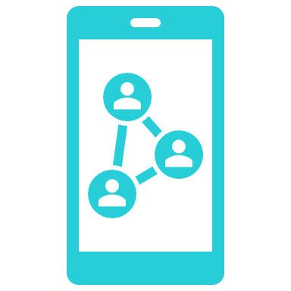




Ideas for loyalty program
Reward Feedback
Encourage your customers to give feedback on Loyalty Programs. A simple reward for sharing their opinion goes a long way from there.
Be Social
Create an exclusive coupon code for social followers to make them feel special and encourage them to become brand advocates.
Keep it fresh
Trying to keep your loyalty programs fresh and engaging by offering special limited offers as well redeeming points.
Invest in good loyalty program
A loyalty program software is the core platform that will track and manage the loyalty program.
Align the program with a brand persona
If your brands built around “Best Value” and “Lowest Price”, the focus on offering cashbacks and discounts. For premium customer segment we can opt for experimental reward

Slide 5




Thank you
Email Address:
ppatel95@kent.edu
Contact Number:
+1(330)666-1514
Kent State University
Master of Science in Business Analytics

