Slide 1
STUDENT - FACULTY ONLINE INTERACTION

Slide 2

GAYATRI VIDYA PARISHAD
COLLEGE OF ENGINEERING FOR WOMEN
Department of Computer Science & Engineering
P.
Team Members:
P. PUJITHA(13JG1A0574)
V. LALITHA(13JG1A05B6)
VARDHANA(13JG1A0597)
SIREESHA(13JG1A0566)
PROJECT GUIDE
Dr. M. BHANU SRIDHAR
Associate Professor

Slide 3
CONTENTS:
Abstract
Existing System
Problems with existing system
Proposed System
Description
Functional Requirements
Non-Functional Requirements
UML Diagrams
Screenshots
Conclusion
References

Slide 4
ABSTRACT:
This project aims to develop a student-teacher interaction through a college website. The primary challenge is to achieve coordination between student-faculty, faculty-parent and also provide a platform for discussion on specified issues provided by the faculty member.
Online discussion forum use is linked to both student and faculty engagement in related areas.
Live chat feature make communication easy between teachers and student. It also reduce the hesitation from students.

Slide 5
EXISTING SYSTEM:
A website with well-informative content in it, creates a picture of credibility for that college. The college websites also contain information about the head of departments as well as other teaching and office staffs.
Necessary information including eligibility criteria, admission procedure, admission date, library facilities, sports activities, learning infrastructure, arrangement of extra-curricular programs, availability of application forms and several other important details are found in the website.

Slide 6
PROBLEMS WITH EXISTING SYSTEM:
Reliability:
The information on current websites might be unreliable if not updated on regular basis.
No interaction:
It may be difficult to reach the communication between student-faculty and parent-faculty.
Crashes and uptime:
A website that crashes is no good to anyone. This is a serious disadvantage for a website. If the website is constantly crashing or unavailable then users will not be able to find the information in the website and could miss out the important matters.

Slide 7
PROPOSED SYSTEM:
It is proposed to bridge the gap between the website and the chat application.
The chat application embedded in the website provides a rich set of features to accelerate the online communication between student and faculty.
With the online chat solution on the website, students and parents can interact with their respective supporting faculty in the way they prefer.
This website contains a forum which is an online discussion site where people can hold conversations in the form of posted messages.

Slide 8
DESCRIPTION:
Student-faculty interaction helps to achieve coordination between student-faculty, faculty-parent and also provides a platform for discussion on specified issues provided by the faculty member.
Forum:
It allows the students to openly discuss topics of interest to them. For example, encourage them to discuss things like trending technologies and academic related topics.
Chat:
Students may want to clarify their doubts on various aspects, assignment submissions and more.

Slide 9
FUNCTIONAL REQUIREMENTS:
The Student-Faculty Interaction is a Peer-to-Peer and Client-Server chat system that works on the internet.
The users of the system shall be able to:
Register to the system by providing:
A valid username
College ID
Password
Department name
Whether he/she is a faculty or a student
Log in to the system, by providing:
College ID
A valid password

Slide 10
NON- FUNCTIONAL REQUIREMENTS:
The system provides user friendly Graphical User Interface.
Hardware Requirements: Personal Computer with
RAM : 256MB
Hard disk : 40GB
Processor : Intel Processor i5
CD Drive : 40 X Samsung
Monitor : 15’
Software Requirements:
Operating System : Windows
Language : PHP.
Tools : XAMPP, Sublime Text Editor

Slide 11
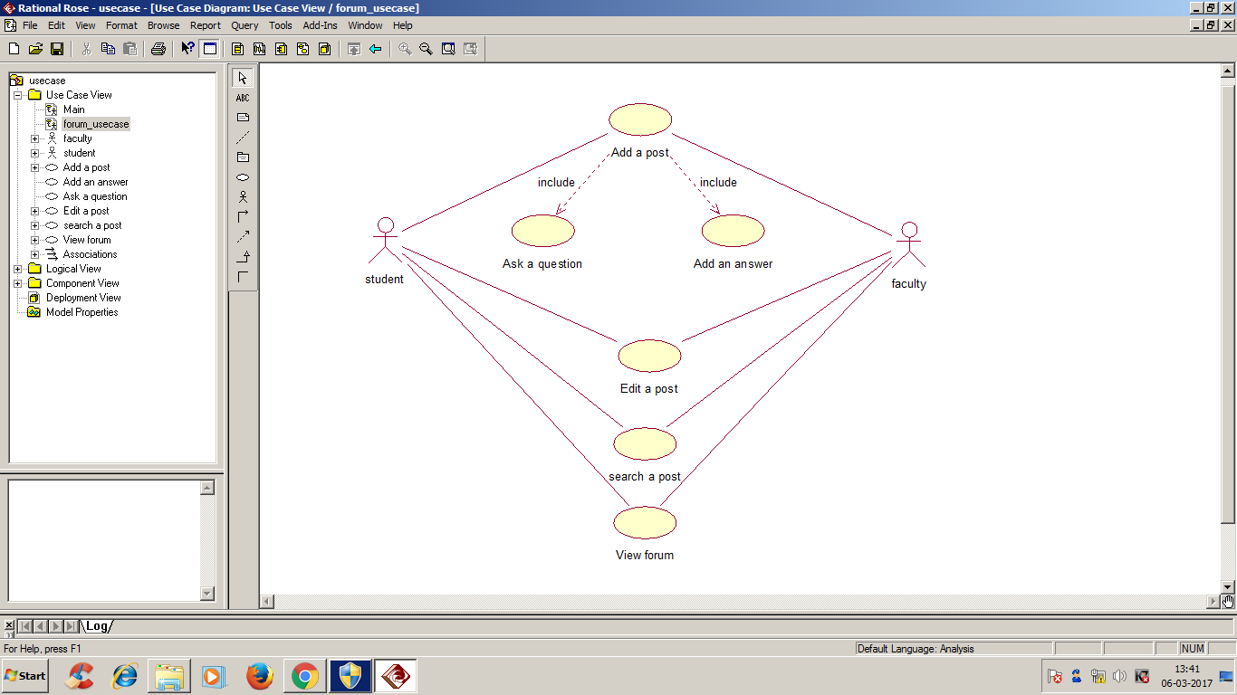
UML DIAGRAMS:
USE-CASE DIAGRAM FOR FORUM:

Slide 12
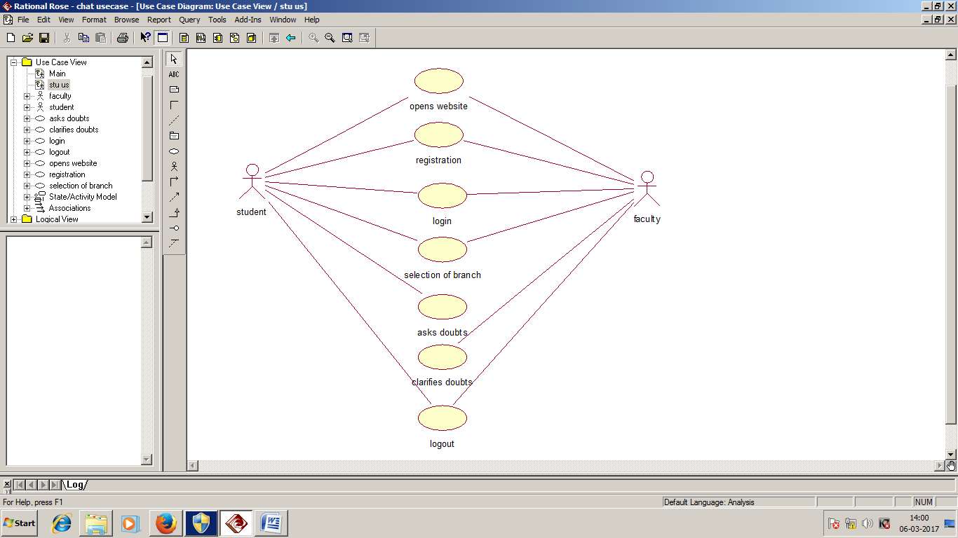
USE CASE DIAGRAM FOR CHAT:

Slide 13
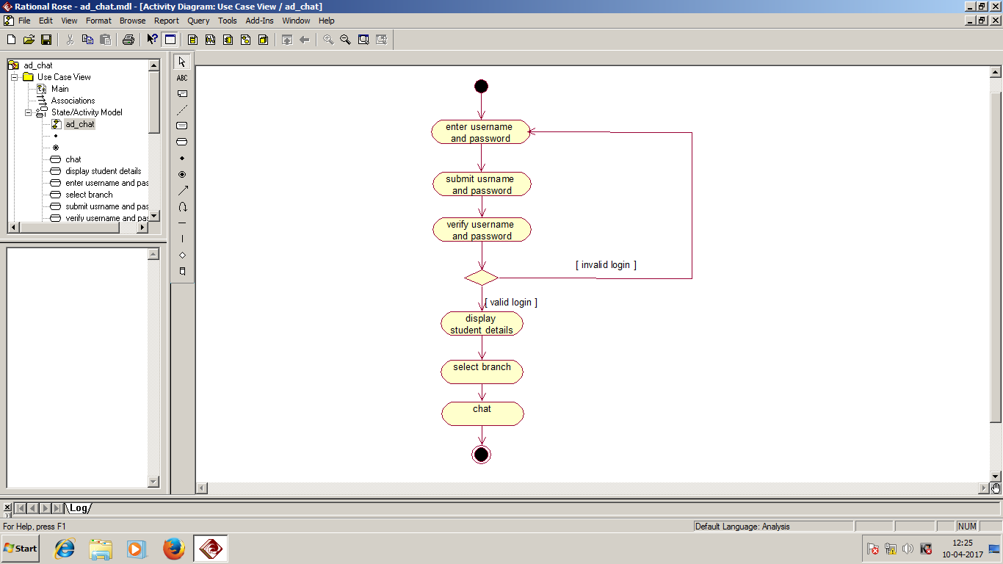
ACTIVITY DIAGRAM FOR CHAT :

Slide 14
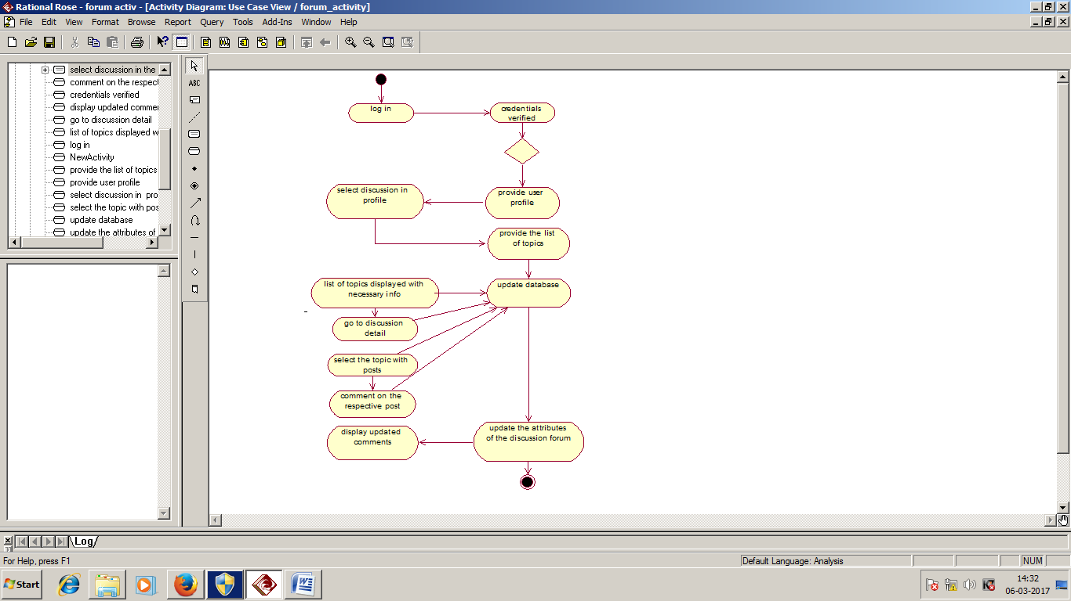
ACTIVITY DIAGRAM FOR FORUM:

Slide 15
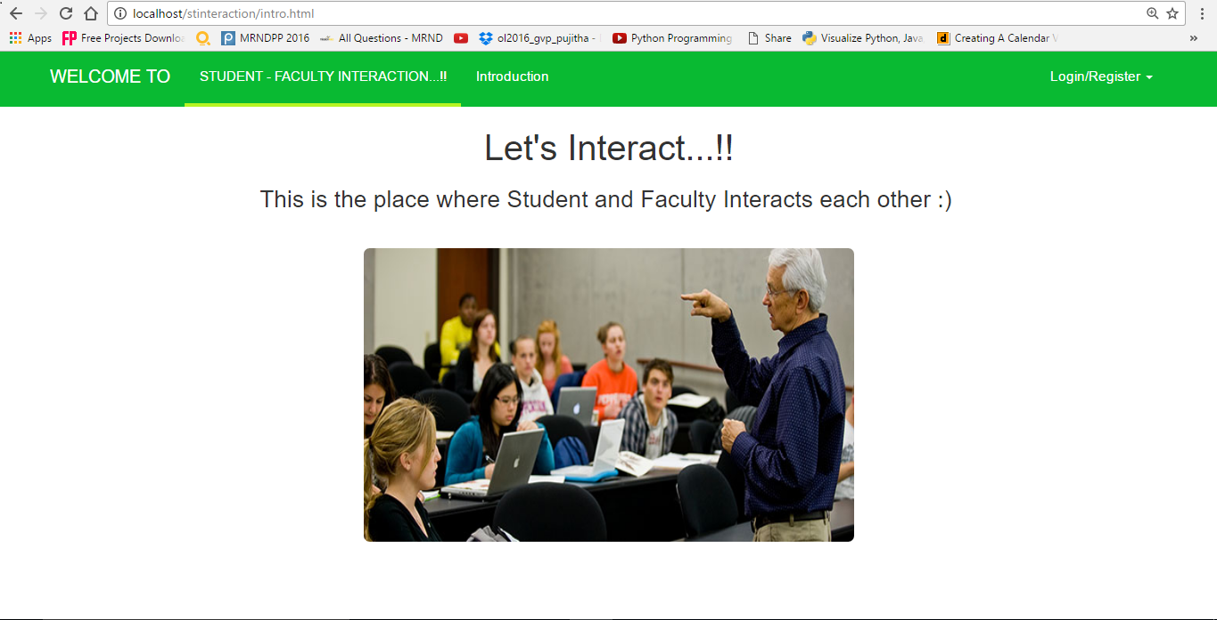
INTRODUCTION PAGE:

Slide 16
REGISTRATION PAGE:

Slide 17
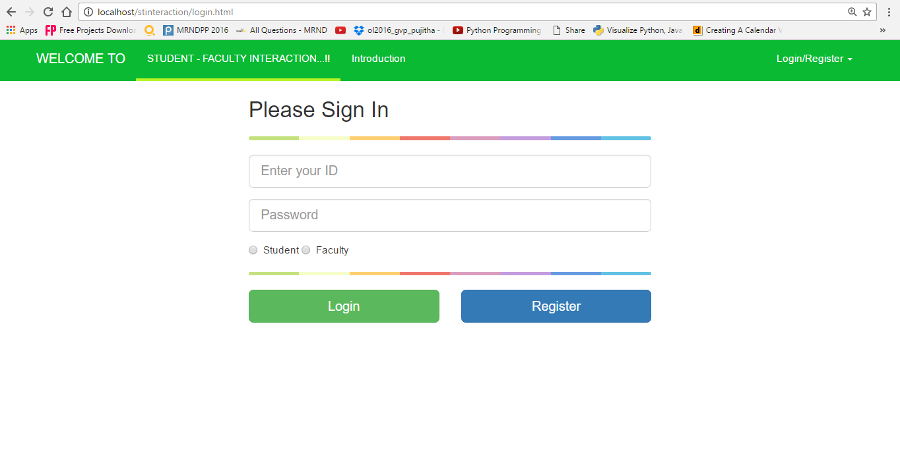
LOGIN PAGE:

Slide 18
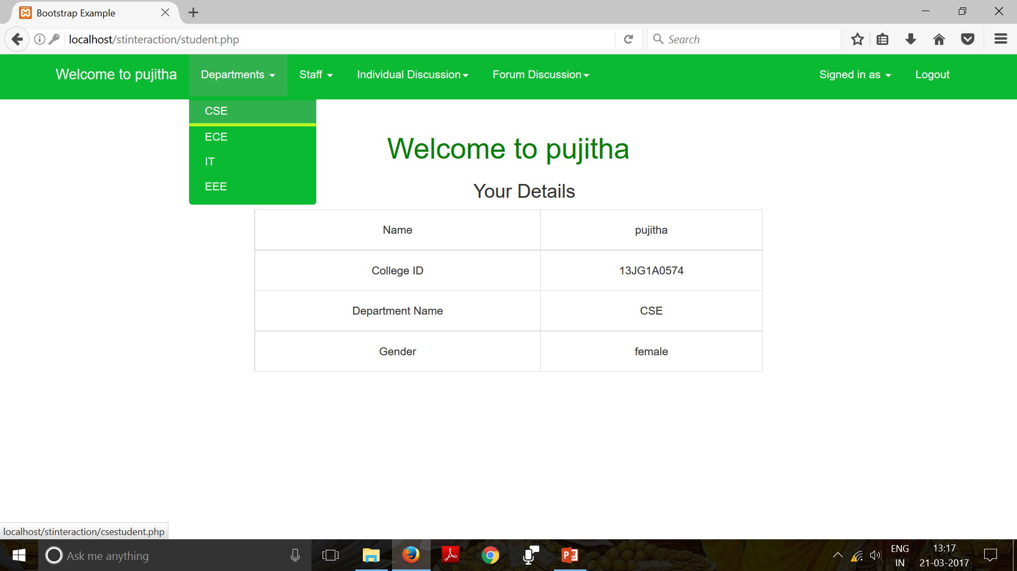

Slide 19
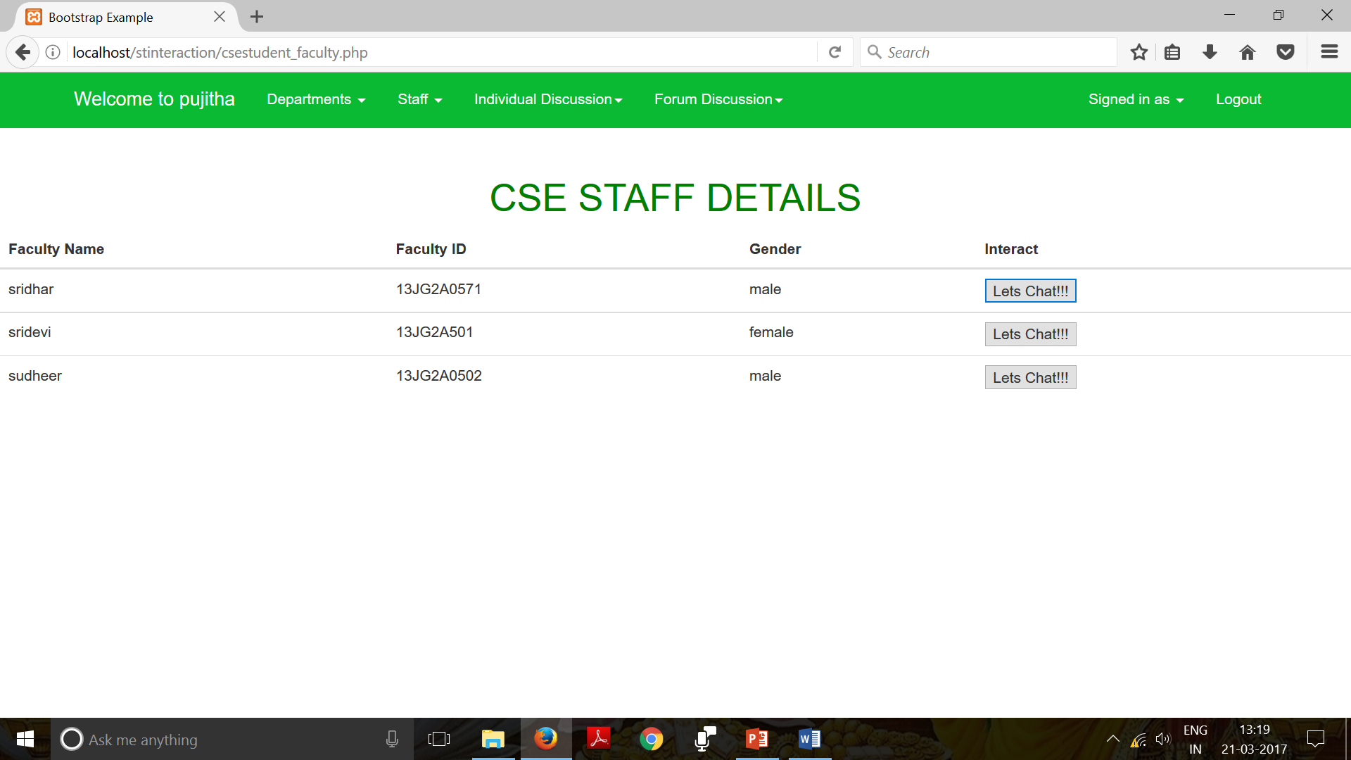

Slide 20
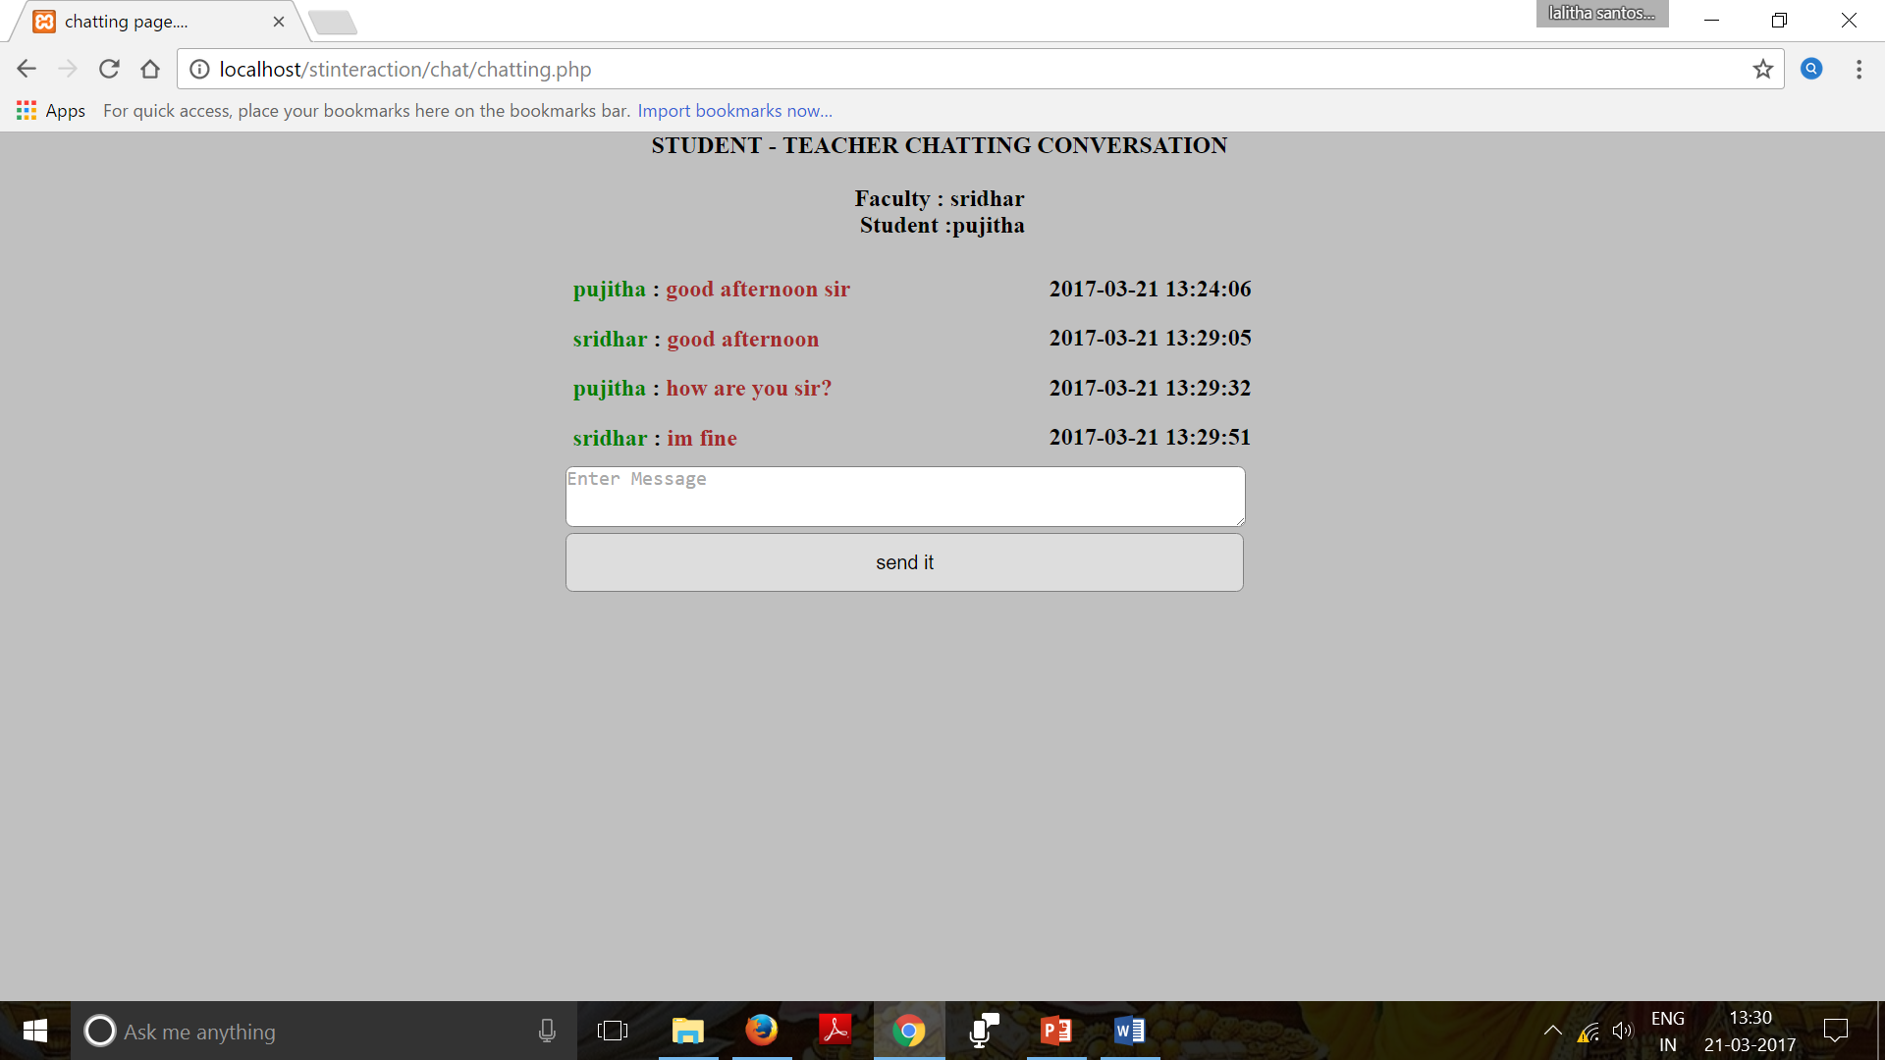

Slide 21
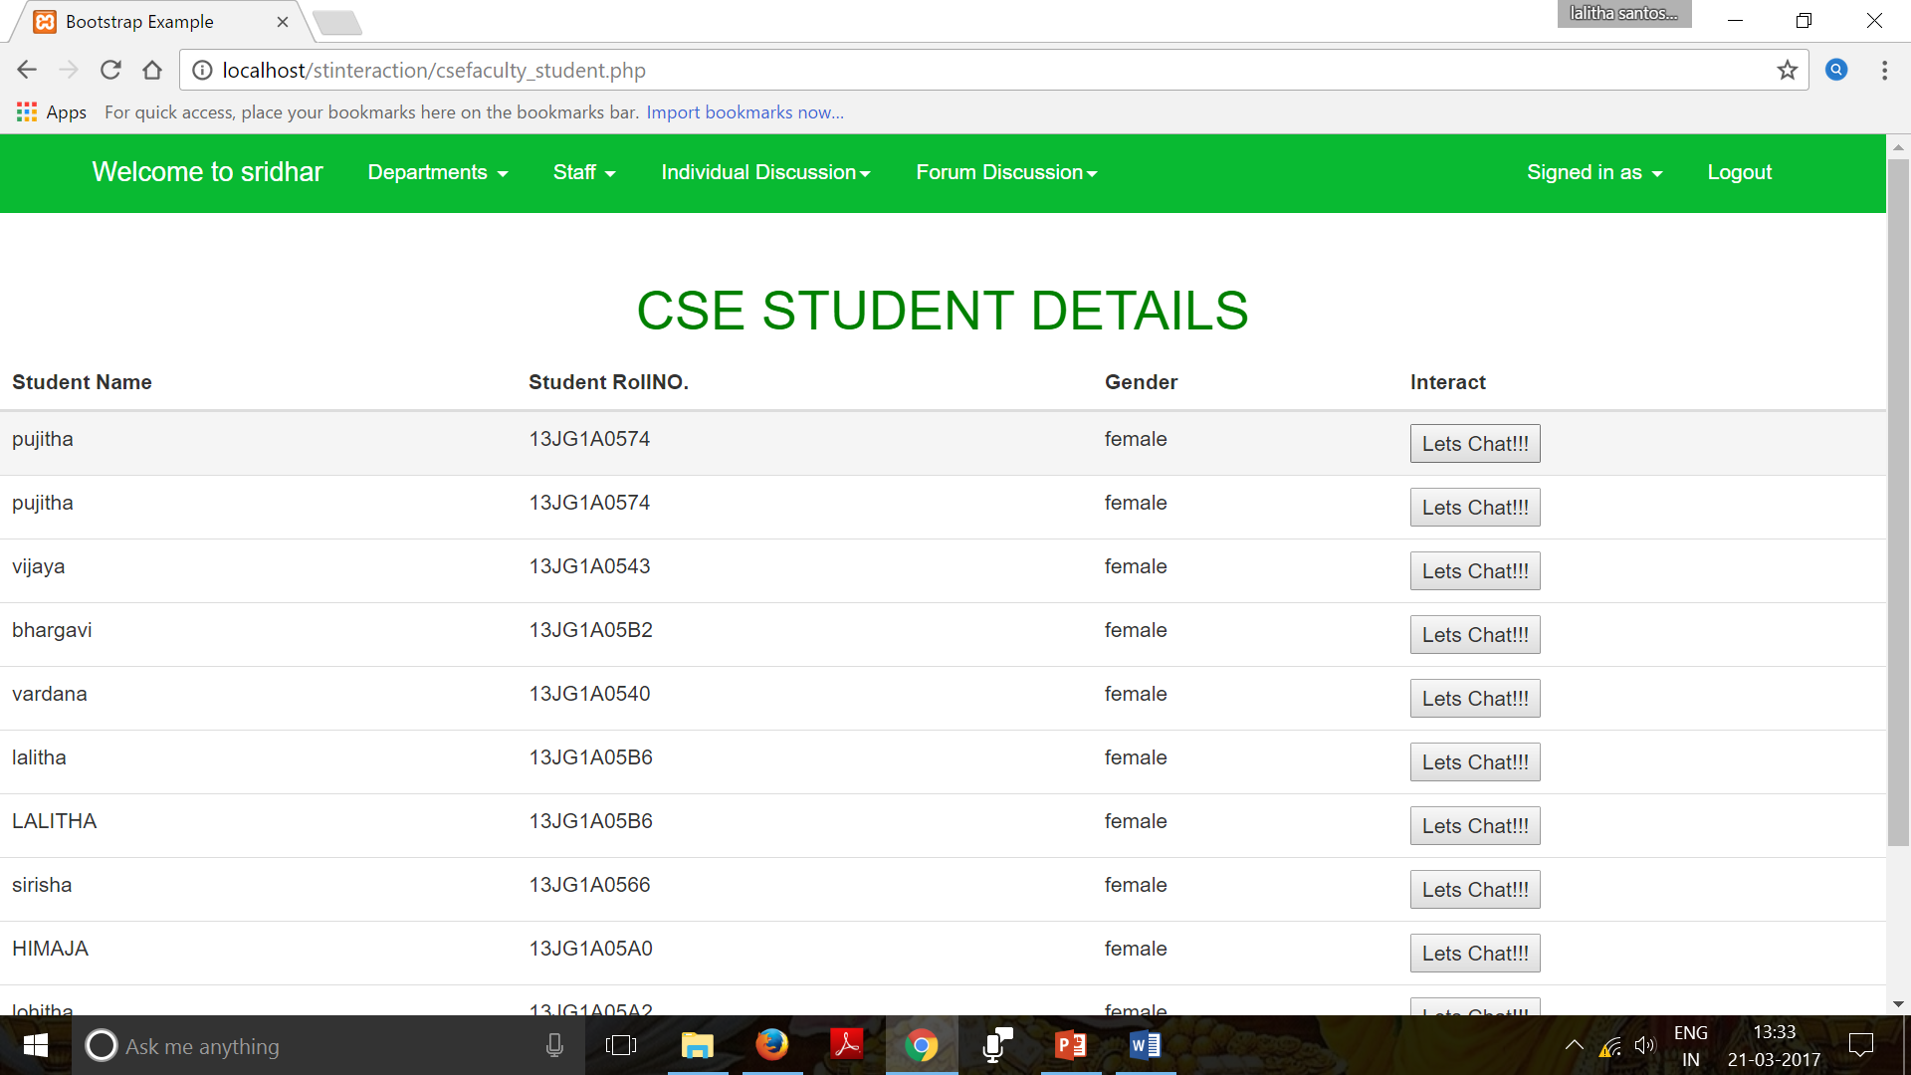

Slide 22
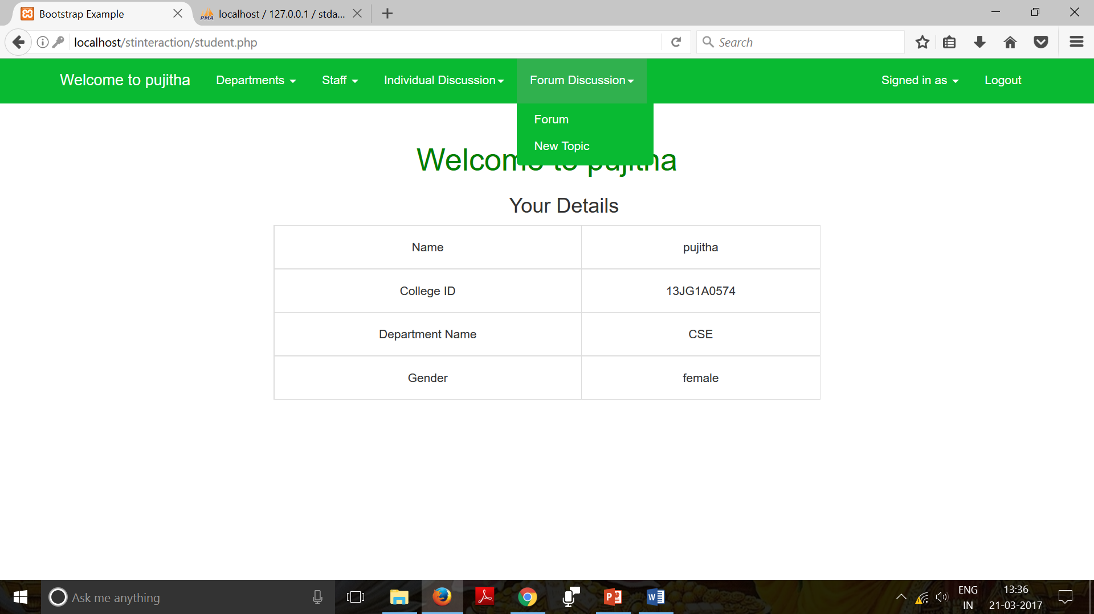

Slide 23
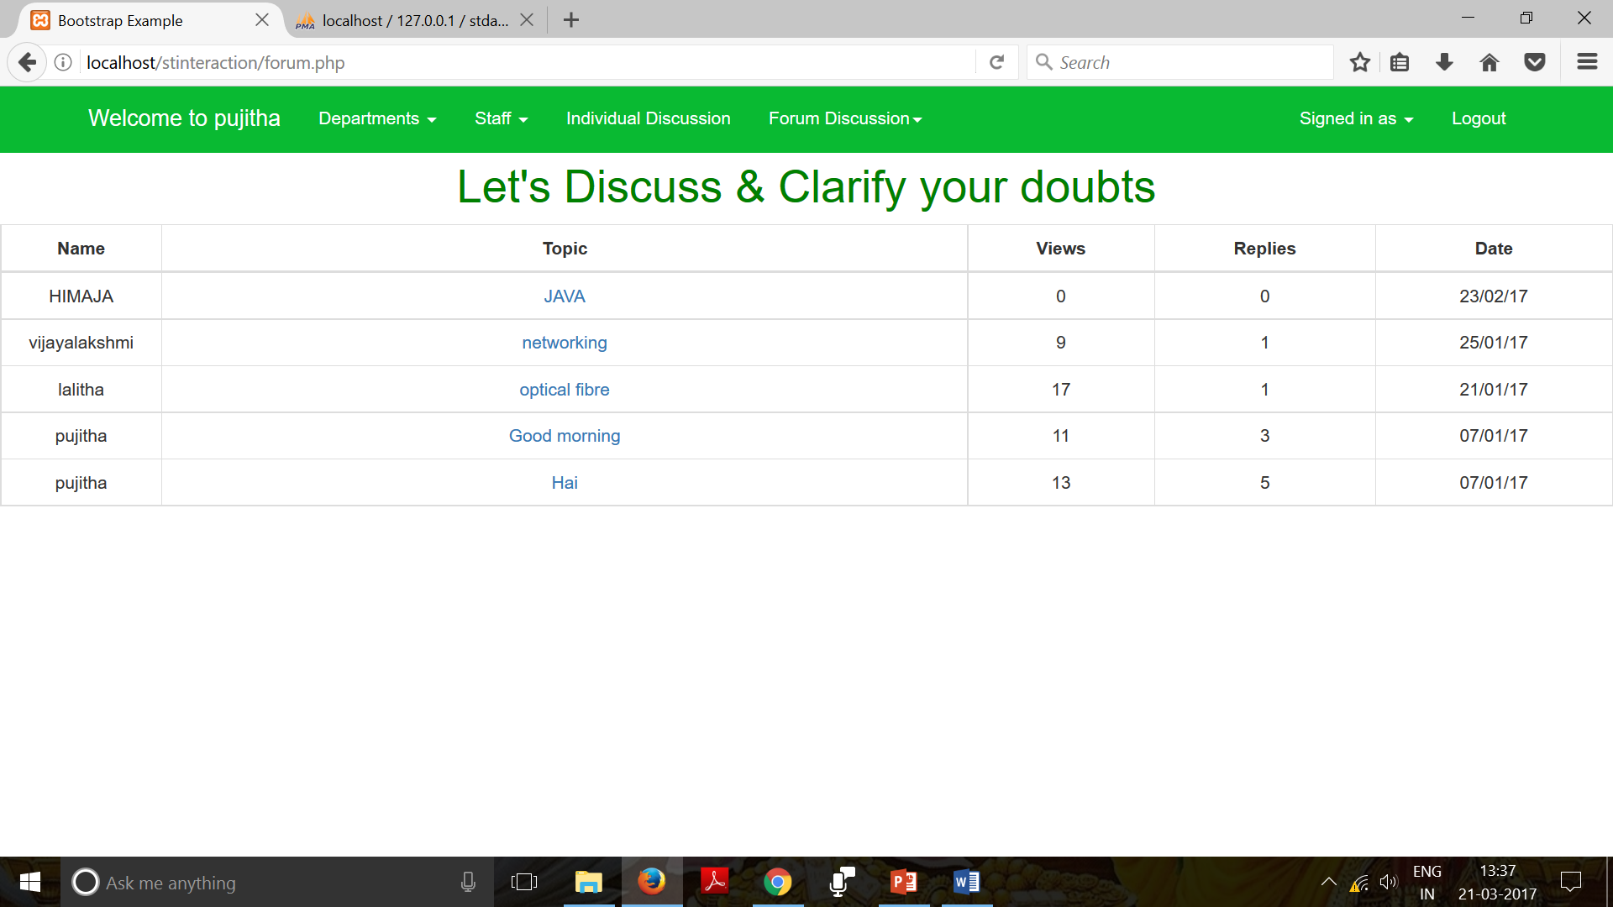

Slide 24
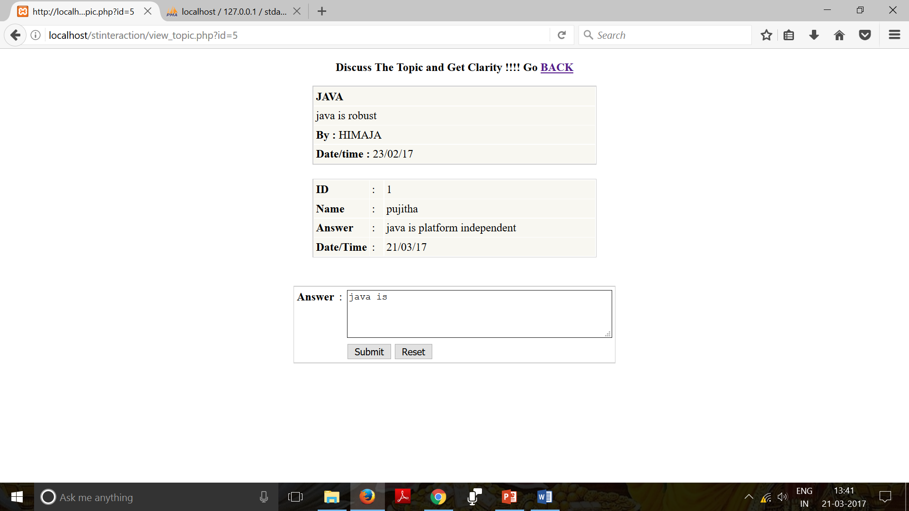

Slide 25
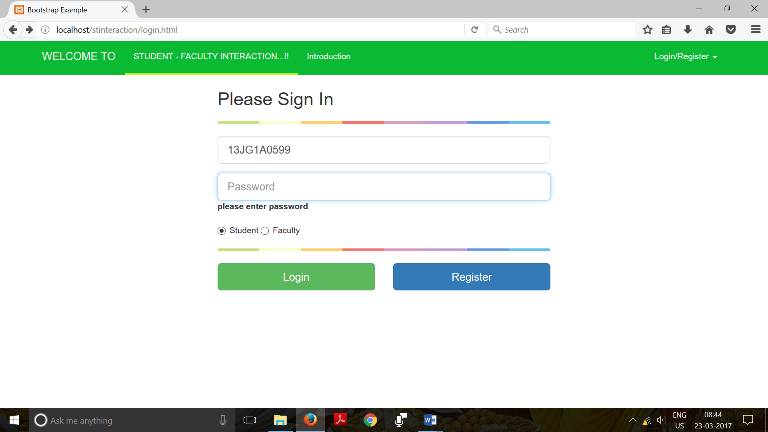
TEST CASE 1
S.NO | INPUT GIVEN | EXPECTED OUTPUT | OBTAINED OUTPUT | RESULT (PASS/FAIL)
1 | Login with User name | Does not navigate to Student page | Does not navigate to Student page | Pass

Slide 26
CONCLUSION:
In this project, we have proposed a student-faculty interaction through a college website. The primary challenge is to achieve coordination between student-faculty, faculty-parent and also provide a platform for discussion on specified issues provided by the faculty member.
The forum application embedded in the website provides a rich set of features to accelerate the online communication between students and faculty.
With online chat solution on the website, students and parents can interact with their respective supporting faculty in the way they prefer.

Slide 27
REFERENCES:
http://www.w3schools.com/php/default.asp
Jennifer C. Richardson, Ph.D, “EXAMINING SOCIAL PRESENCE IN ONLINE COURSES IN RELATION TO STUDENTS' PERCEIVED LEARNING AND SATISFACTION”, JALN Volume 7, Issue 1, 2003.
https://www.rit.edu/academicaffairs/tls/course-design/teaching-elements/instructor-to-student
https://www.youtube.com/watch?v=alcXy8bPJ4c&list=PLU4yvac0MJbJL8uU778XmlWwY0yrcQAFm

Slide 28


