Slide 1
struct Partition {
string name; /* Name of the Partition */
unsigned long duration; /* Duration of the Partition */
unsigned long period; /* Period of the Schedule */
unsigned long offset; /* Offset of the Partition */
};
struct Clock {
string name; /* Name of the Embedded Node */
int value; ; /* Current value of the Clock */
int next_tick; /* Next clock tick */
vector<Partition> schedule; /* Temporal Partition Schedule*/
};

Slide 2
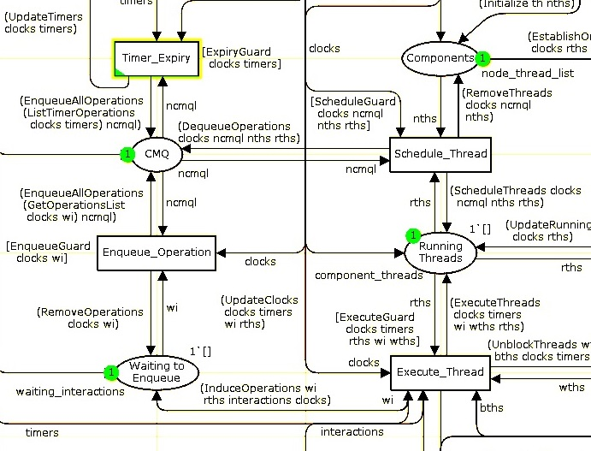

Slide 3
Long-Running
Operation (LRO)
Suspend LRO
Resume LRO
Maximum checkpoint distance

Slide 4
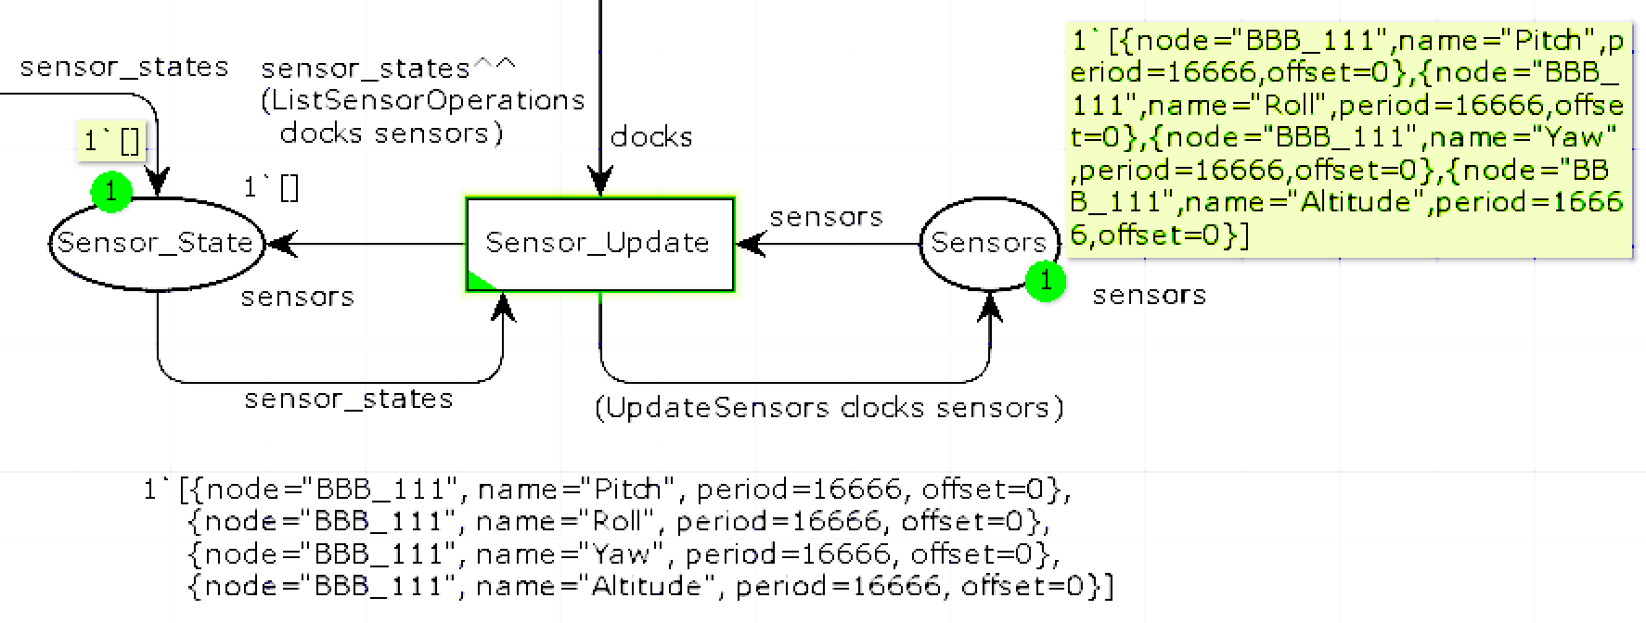
Execute_Thread

Slide 5

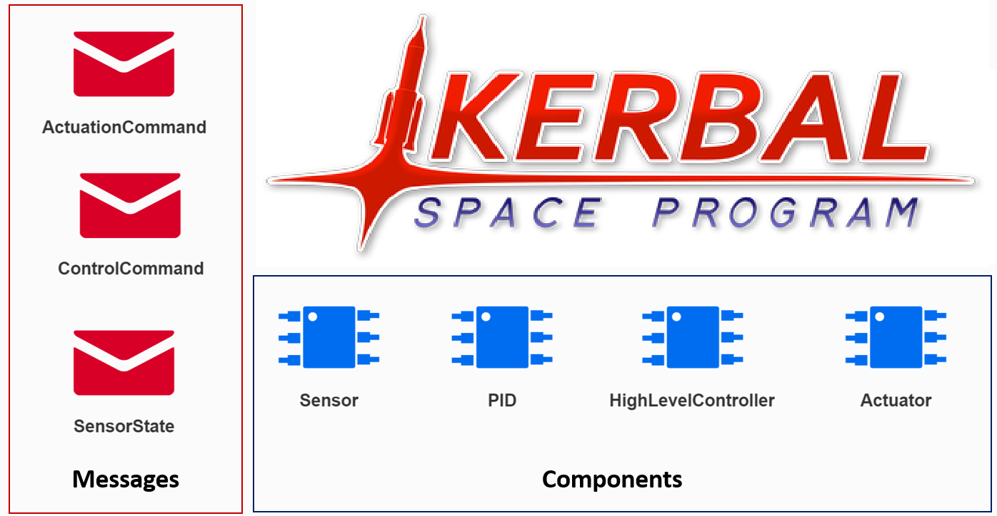
kRPC Interface Layer

Slide 6
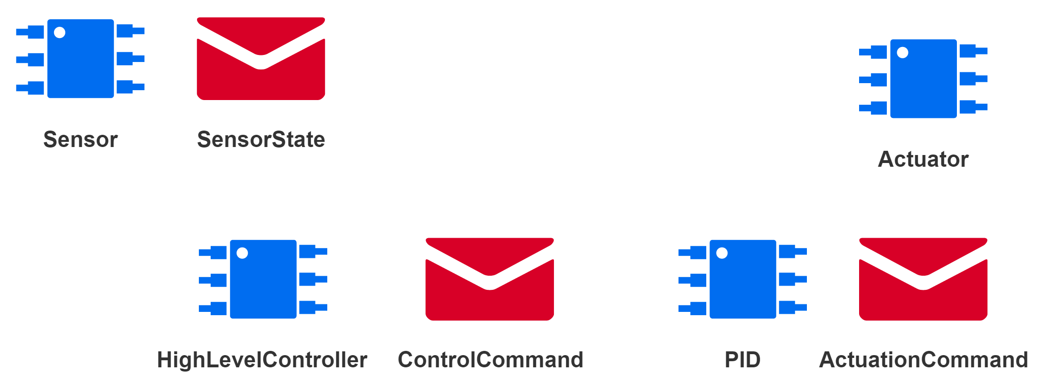
Sensor I/O component
Actuator I/O component
High-level Control Logic
Low-level PID Control Logic

Slide 7


