Slide 1
Colored Petri net-based Modeling and Schedulability Analysis of Component-based Applications
Pranav Srinivas Kumar
Vanderbilt University
2014.02.05

Slide 2
Premise:
Applications are built using component building blocks – The structure is established using our modeling language.
We know the component interfaces, wiring, Interaction patterns and business logic.
Problem Statement:
Will all of the component operations of an application complete before the specified deadlines?

Slide 3
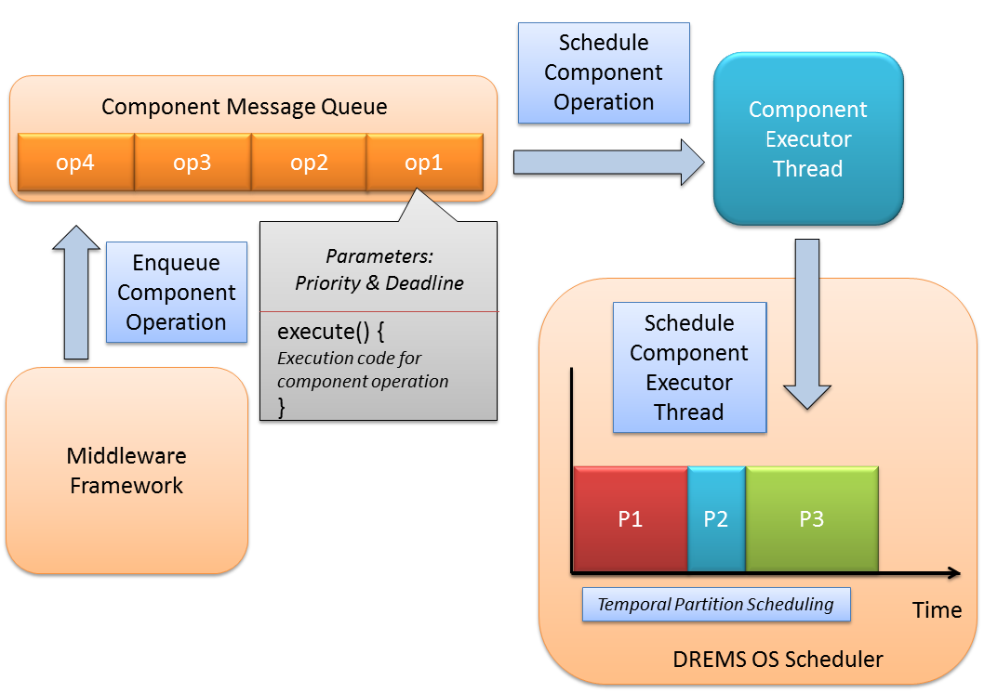
The Big Picture

Slide 4
Basic Petri nets
Transition
Place
P1
P2
P2
T
P1
T
Output arc
Input arc
(a) Before transition firing
(b) After transition firing

Slide 5
Colored Petri nets
Place
String_Place
Int_Place
“F”
6
Colored token
Type: string
Colored token
Type: int
<string>
<int>
Transition
<string, int>
String_Int_Place

Slide 6
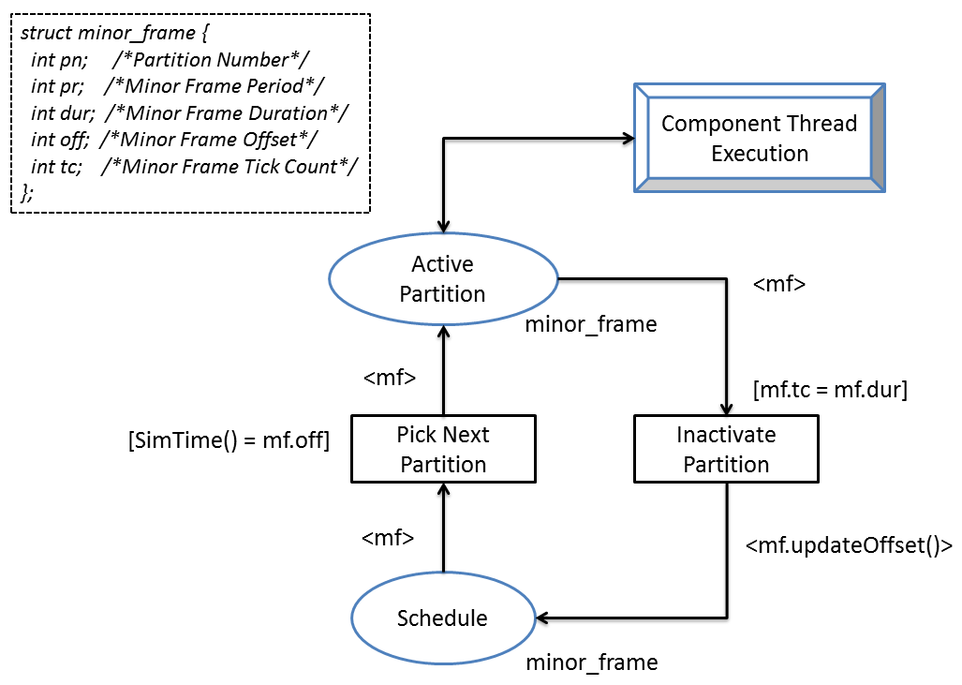
Temporal Partition Scheduling

Slide 7
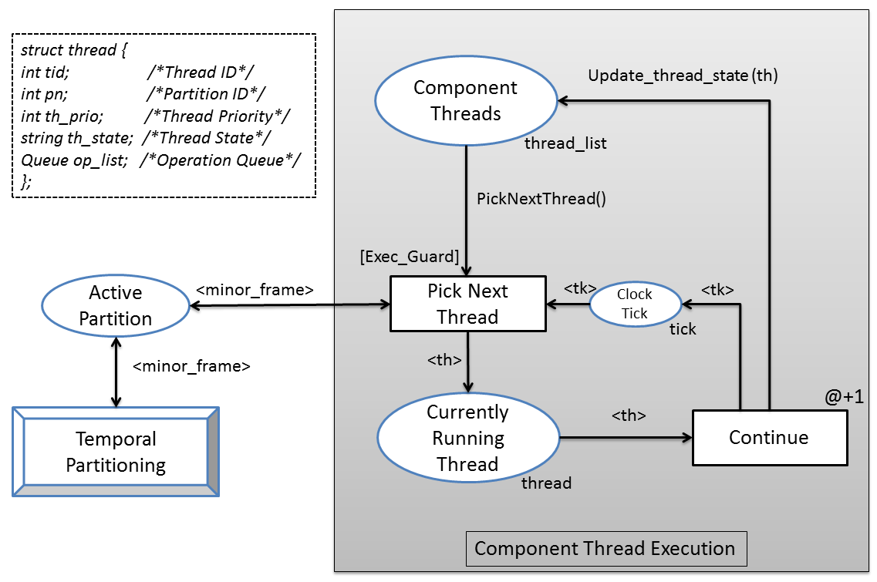
Component Thread Execution

Slide 8

Sample Scenario 1: RMI interaction between components
[Deadline Violation]
TIMER_OP
RMI_OP
RMI Query time
1 clock tick
Remote Method
[3 clock ticks]
Waiting for response
Process response
1 clock tick
Client Component
Server Component

Slide 9
Sample Scenario 2: RMI interaction between components
[Deadlock]
TIMER_OP
RMI to server
[1 clock tick]
RMI_OP
Blocked on server
RMI to client
[1 clock tick]
Time to process response
[1 clock tick]
Blocked on client
RMI_OP
Time to process response
[1 clock tick]
Remote Method
[2 clock ticks]
Server Component
Client Component

