Slide 1
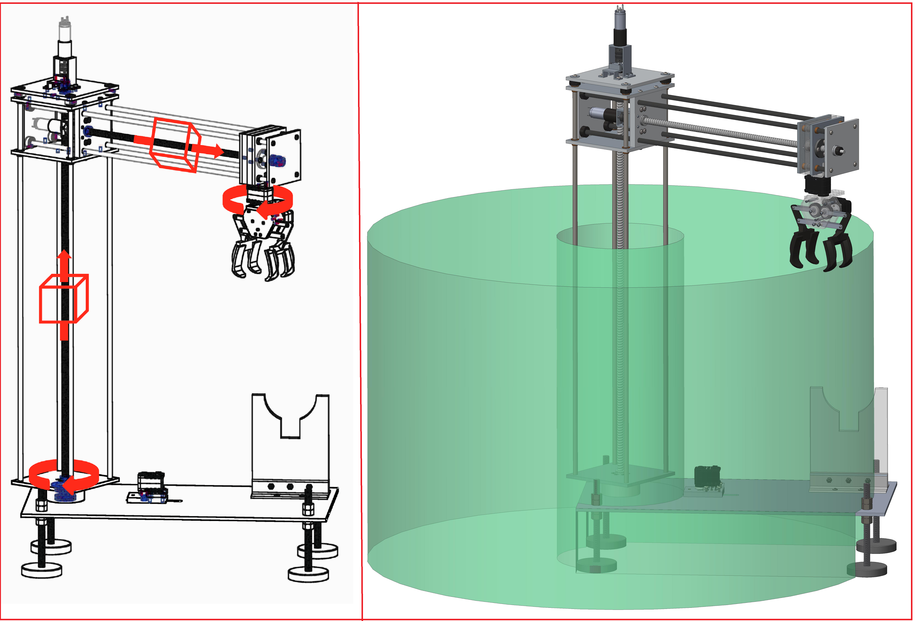
Vertical
Actuation Motor
25.5” tall
19.5” radial reach
Adjustable leveling
Rocket stand
Base rotation system
Lead-screw Linear Actuation
Cylindrical Workspace
Radial
Actuation Motor
Aluminum Carriage
Gripper
Base Rotation
Aluminum Base

