Slide 1
Integrated Analysis of Temporal Behavior of Component-based Distributed Real-time Embedded Systems
Pranav Srinivas Kumar and Gabor Karsai
Vanderbilt University/ISIS
Supported by Supported by USAF/AFRL under Cooperative Agreement # FA8750-13-2-0050
Supported by DARPA under contract # NNA11AB14C

Slide 2
Introduction
The need for design-time schedulability analysis and verification:
Hard Real-time Systems must meet operational deadlines, that constrain the amount of time permitted to elapse between a stimulus provided to the system and a response generated by the system
Delayed responses and missed deadlines can cause catastrophic effects on the function of the system
Goal: Complete model-based development toolchain: modeling, analysis, synthesis, operations, maintenance

Slide 3
Problem Statement
Many of the existing schedulability analysis tools are not directly applicable to all system designs
Domain-specific properties such as arbitrary component interaction patterns, distributed deployment, and time-varying networks make this problematic
The classic thread-based concurrency model is too low-level and too generic
Hard to analyze and use
Restrictive, yet useful concurrency and component models are needed for which dedicated analysis tools can be developed

Slide 4
Contributions
[Based on previous work: DREMS component model]
An approach for modeling the operational behavior of each component in an application
The model uses a sequence of timed steps that are executed by the operations
Improvements to a CPN-based modeling approach enabling better analysis performance and scalability
Relies on heuristics that manage time variables and state space data structures efficiently
Advanced state space analysis techniques applied to reduce analysis time on medium-to-large systems

Slide 5
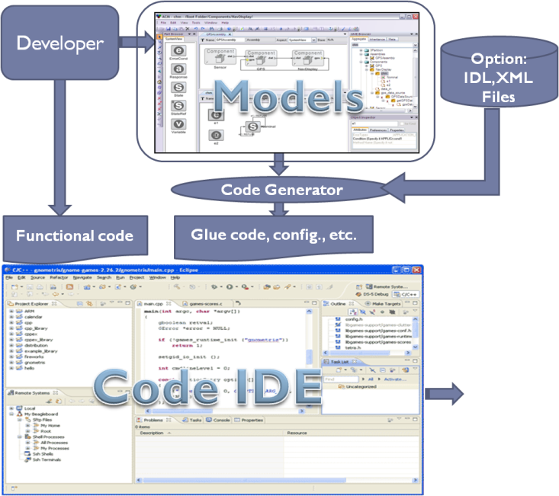
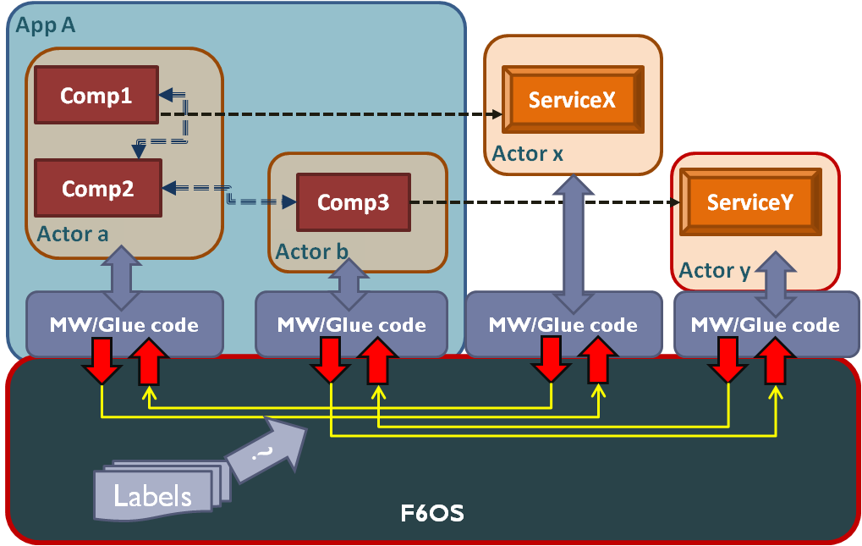
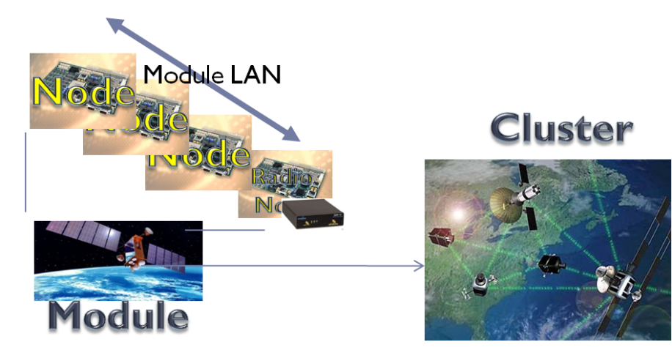
DREMS
Distributed REaltime Managed Systems [DREMS] consists of:
A software platform, consisting of an OS and middleware
A software toolchain, for modeling applications
Software Platform
Model-driven
Development
OS
1. Software toolchain for modeling, synthesis, analysis, and verification
2. Software platform with support for resource sharing, security, and fault tolerance
Deployment
Notes:
We developed:
-Extensions/restrictions to an existing operating system (Linux)
-A (lightweight?) middleware layer for CBSE
-A modeling tool for designing and generating tedious parts
Why?
-Platforms reduce complexity and increase reliability by providing reusable technological building blocks
-Model-driven tools automate tedious parts of development and provide an analysis framework

Slide 6
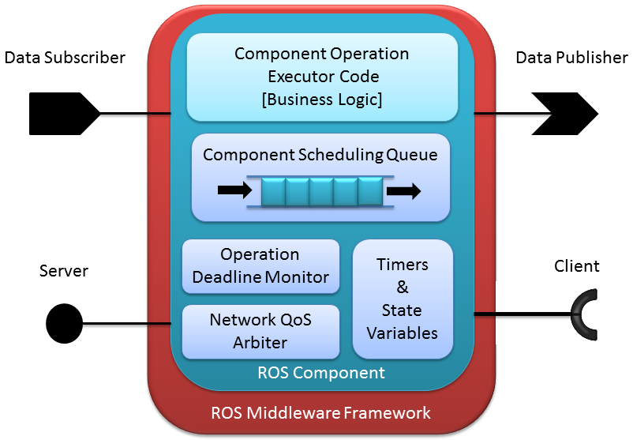
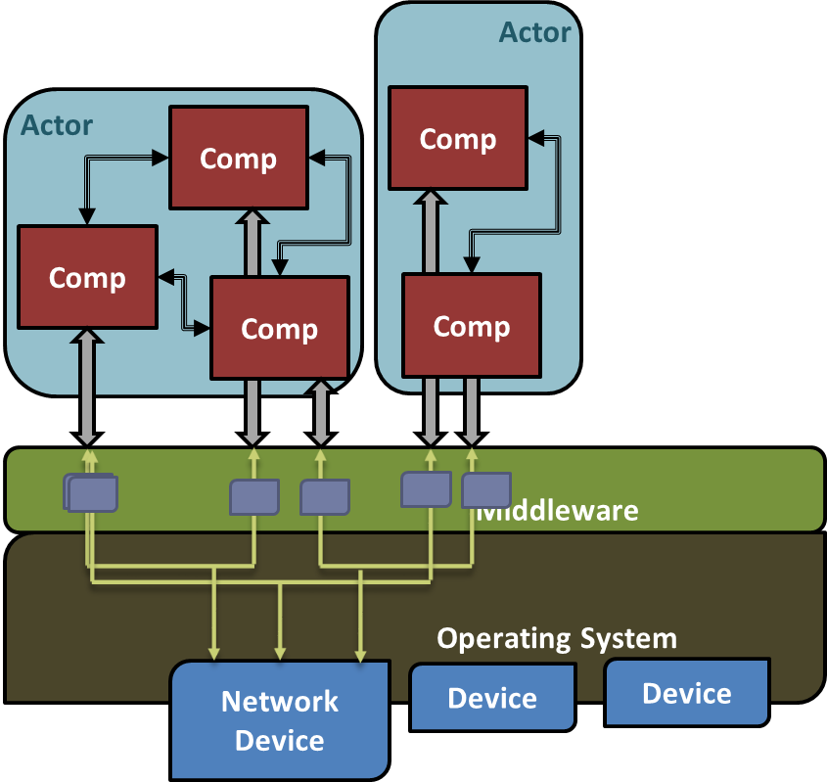
Target Architecture: DREMS
Developed for a class of distributed real-time embedded systems
Remotely managed
Satisfy timing requirements
Software Infrastructure
Design-time: Modeling and Analysis Tools
Run-time: Well-defined Component Model
Rapid Prototyping and Code Generation Features

Slide 7
Hierarchical Scheduling
Component level
DREMS Applications are built by assembling Components
Component interfaces expose operations that can be invoked
Components interact via RMI/AMI and pub/sub interactions
Operation requests are handled using a per-component message queue
Scheduling Policy for requests: Non-preemptive Priority FIFO
EDF and FIFO policies are planned
Single executor thread per component handles requests
Operating System level
Components are grouped into processes
Processes are assigned to ARINC-653 style temporal partitions: fixed length, periodic intervals of the CPU’s time

Slide 8
Colored Petri Nets
Graphical Modeling/Analysis Tool [cpntools.org]
Tokens contain values of data types called colors
Powerful modeling concepts are facilitated by token colors
Heterogeneous data structures such as records with arbitrary number of fields
Tokens can be inspected, modified and manipulated by transitions and arc bindings
Component properties such as thread priority, port connections and real-time requirements are encoded into a single color token
Earlier work: CPN model (templates) for the DREMS component model + timing analysis via CPN tools

Slide 9
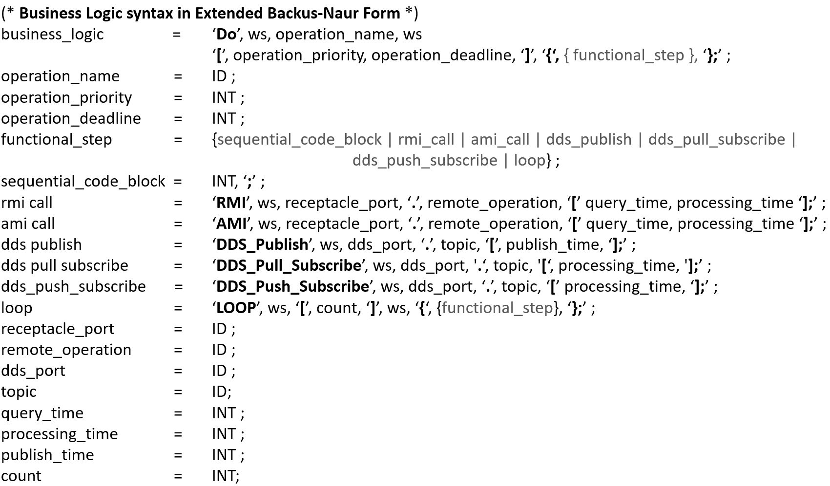
Modeling Temporal Behavior
A simple textual language for representing the temporal behavior of a component operation.
Fixed, worst-case behavior (no data dependency)

Slide 10
Analysis Improvements: Handling Time
Explicit modeling of time as an integer-valued clock color token in CPN
Modeling the OS scheduler clock this way allows for easy extensions to its data structure to support
Intermediate time stamps and internal state variables
Adding temporal partitioning and other prioritization schemes
Reduces the total number of colors required by the complete model
Chosen a time quantum is 1 msec (per typical 1KHz scheduler in Linux)

Slide 11
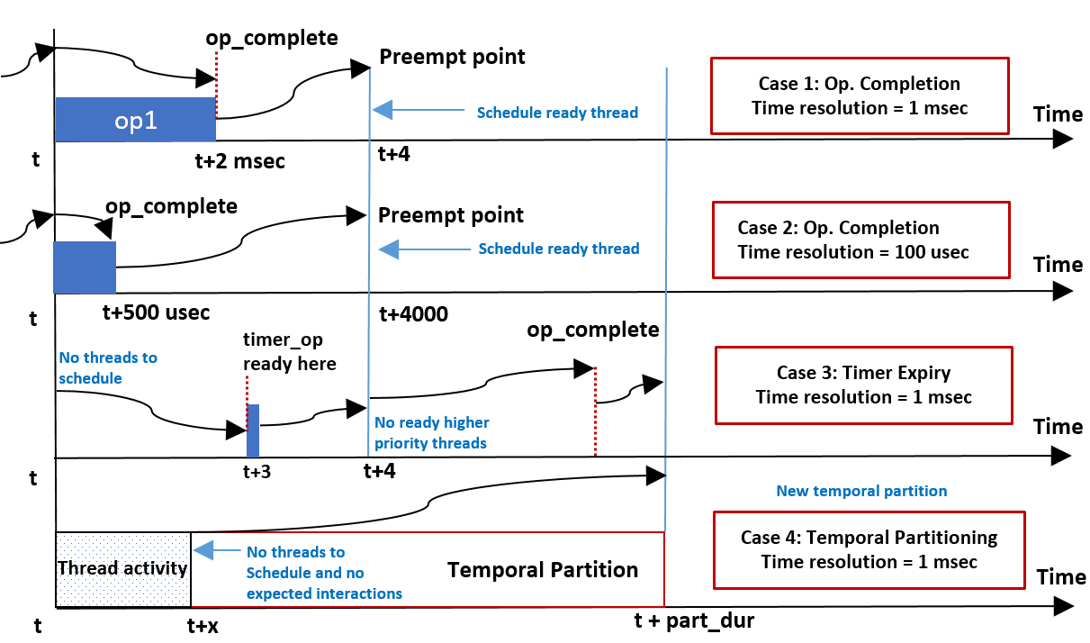
Smarter Handling of Time Progression
Fast-forward time up to the next relevant event (DEVS approach)

Slide 12
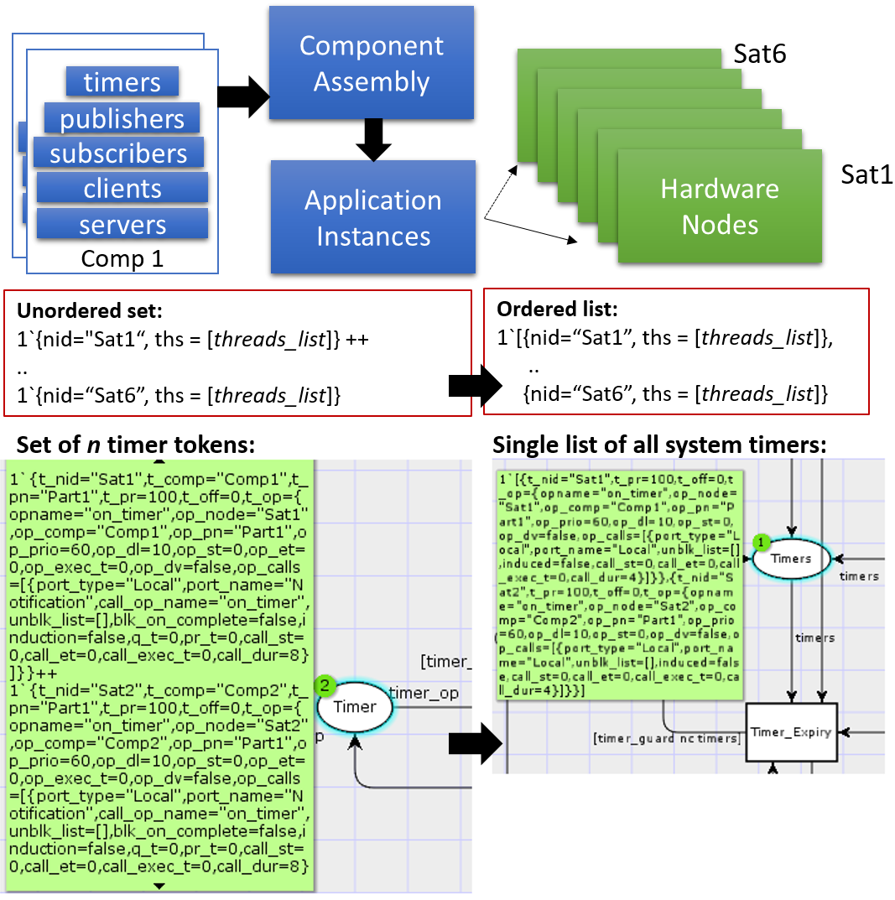
Analysis Improvements: Distributed Deployment
Early models of distributed deployments included a unique token per CPN place for each hardware node in the scenario
Lead to non-determinism in transition bindings
Employ structural reduction
Merge hardware node tokens into a single list of tokens instead of an unassociated grouping of node tokens
Simultaneous events happen in all nodes at the same time
Reduces the resultant state space and dramatically improves scalability

Slide 13
Advanced State Space Methods
Compute all reachable states of the modeled system
Derive a directed graph representing the state space: the tree of possible executions that the system can take from an initial state
Usage:
Verify behavioral properties such as lack of queue overflows, deadline violations and deadlocks
Derive counter examples if a property is violated
Potential for state space explosion
Needs advanced memory management methods to make state space analysis efficient

Slide 14
Advanced State Space Methods
In order to easily apply advanced state space reduction techniques, we use a tool called ASAP
Sweep line method
Discard generated states on-the-fly by performing verification checks during generation time
Any state that does not violate system properties is deleted
100 interacting components in 10 computing nodes:
Using CPN Tools built in state space generation:
20 hyperperiods of activity → 36 minutes on a typical laptop
Using ASAP and on-the-fly verification
Less than 10 minutes to perform deadlock checks on the deployed system

Slide 15
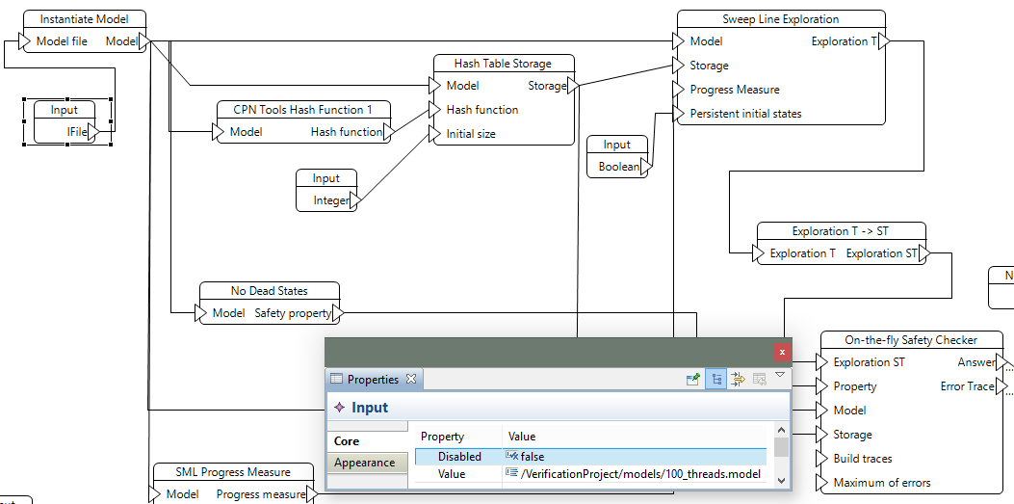
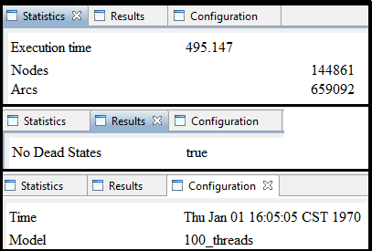
Advanced State Space Methods
ASAP screenshot:

Slide 16
Future Work
DREMS component communication is facilitated by a time-varying network
Bandwidth provided by the system predictably fluctuates between a minimum and maximum (e.g. due to orbital period)
Currently we assume worst-case network delay
Work in progress: capturing the network profile (network performance overt time) of a deployment
Investigating the utility of this approach on fault-tolerant and self-adaptive systems
Integration with a run-time resilience engine
Checking for timing anomalies before settling on a reconfiguration strategy

Slide 17
Conclusions
DREs running time-critical applications must satisfy strict timing requirements to operating safely
To reduce design and integration complexity, component-based design models are increasingly being used
Appropriate analysis models are required to study the structural and behavioral complexity of such designs
Model-based development tools integrated with analysis tools and code generation offer an integrated solution: what is analyzed is the same what runs in the executing system
Access:
https://drems.isis.vanderbilt.edu – complete system
Github: rosmod project – next generation based on ROS

Slide 18
Thank You

Slide 19
Overview and Outline
Distributed Real-time Managed Cyber-Physical Platforms
Distributed Applications
Challenges
Layered architecture for building a distributed software platform for these systems
Overview of the DREMS platform, a prototype implementation.
Example

Slide 20
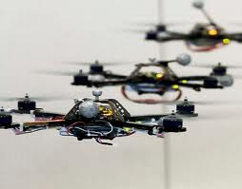
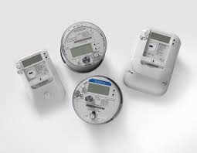
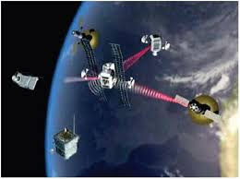
Distributed Real-time Managed Cyber-Physical Platforms 1/2
Built not as a single use, single function network, but as networked (wireless) platforms that can be used by many, possibly concurrent users
Physical configuration/topology affects the available computational resources.
Physics imposes timing constraints on the computational and communication activities.
Critical system software is required to verifiably meet the design requirements.

Slide 21
Distributed Real-time Managed Cyber-Physical Platforms 2/2
Applications span multiple nodes, for reasons related to the availability of resources:
some nodes may have sensors,
some may have actuators,
some may have computing,
some may have storage resources.
Applications must be architected to rely on loosely interacting components.

Slide 22
Challenges
Remote deployment and configuration
Resilient operation requirements
Share applications from different vendors and users with different privileges.
Information sharing/ leakage between applications must be controlled under an overall system security policy
Performance isolation is critical
One application should not be able to affect the functionality or performance of another application
The absence of strong performance isolations will also result in security problems

Slide 23
Layered architecture approach
Watchdog timers reset the platform upon deadlock or critical failures.
Robust Networking
support time-constrained and real-time communications with guarantees
Provides updates on channel bandwidth and expected latency map.
support multiple traffic classes natively
Provide protection against external interference
Support link level encryption

Slide 24
Trusted Computing Base: Operating System
Support for multiple critical levels of computation tasks
Scheduling policies that provide verifiable guarantees for the timeliness of task execution.
Strict isolation between applications of different criticality levels.
Multiple critical levels of communication networks
Different traffic classes.
Reduction in covert channels of communication.
Real-time support for communication.
Fault tolerant clock synchronization across nodes over wireless network is required
Confidentiality, Integrity and Authenticity guarantees for communication (require cryptography devices)
Mandatory access control and multi-level security may be required.
Rich and extensible capability model
Control what platform services can be used by an application
Support for easy migration of application processes between nodes without affecting other applications

Slide 25
Trusted Computing Base: Platform Services
Privileged runtime software actors are required for system level tasks
Deployment Management
Fault tolerant application deployment and configuration.
Mission management
Activate/Deactivate applications based on events/passage of time.
Fault Management
Restore mission/system functionality without external intervention
Resource Management
implement a dynamic resource allocation policy, where applications can dynamically request and release resources, and the service honors or rejects these requests while maximizing system utility

Slide 26
Middleware
Well defined interaction patterns, e.g.
Point to point
Pub/Sub
Provide abstractions to configure and use the different traffic classes and the quality of service information provided by the networking layer
Support for store and forward for non-real-time communication flows.
Support for multiple levels of security at the middleware level.

Slide 27
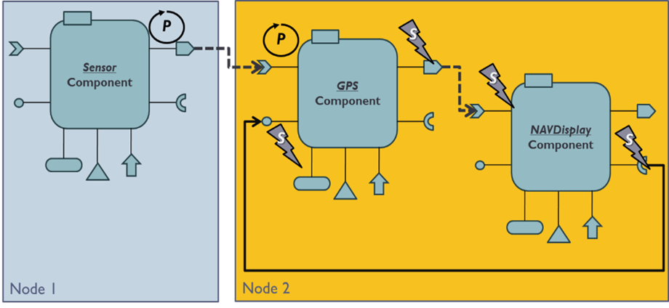
Robust Software Component Model and Development Tools
Clearly delineate computational aspect from communication aspect.
Precise scheduling model for the operations.
Support for security policies. Should also provide fault management, including anomaly detection, diagnosis and fault mitigation.
Prevent technology lock-in:
Support for different programming languages
Should not require any particular middleware implementation.
Support for integrated development tools that reduce the time to develop and integrate new applications into the system.

Slide 28
Preliminary Results: DREMS toolchain and platform

Slide 29
DREMS
Distributed REaltime Managed System. DREMS consists of:
A software platform, consisting of an OS and middleware
A software toolchain, for modeling applications
Software Platform
Model-driven
Development
OS
1. Software toolchain for modeling, synthesis, analysis, and verification
2. Software platform with support for resource sharing, security, and fault tolerance
Deployment
Notes:
We developed:
-Extensions/restrictions to an existing operating system (Linux)
-A (lightweight?) middleware layer for CBSE
-A modeling tool for designing and generating tedious parts
Why?
-Platforms reduce complexity and increase reliability by providing reusable technological building blocks
-Model-driven tools automate tedious parts of development and provide an analysis framework

Slide 30
Operating System
Supports actor concept.
Resource sharing is strictly monitored and controlled.
Fine-grained capability model that controls access to different system services.
All interactions among actors are via ‘secure transport’.
Part of the Trusted Computing Base that enforces the MLS/MAC security policies.
OS
Real-time scheduling model that supports mixed-criticality systems.
System (platform Actors – uses simple priority scheduling)
Application (uses temporal partitioning)
Best effort (uses CFS)
Temporal partitioning. Each partition is temporally separated from others.
Notes:
-Implements low-level services:
--Scheduler support for temporal partitioning
--Secure transport
--Resource management
-Operating system implemented as extensions to Linux (scheduler, new system calls)
-Also made restrictions to Linux (removed BSD sockets)
-Modified C library

Slide 31
Secure Transport
The secure transport mechanism enforces the following:
Actors write messages only to endpoints.
Endpoints and flows are configured only by trusted platform Actors; used by regular Actors.
Enforces mandatory access control for the messages.
Supports both UDP and SCTP protocols.
All messages must have an label assigned by the sending actor.
The messages can go to a destination if and only if the destination has a label that dominates the label of destination.
ENDPOINT E_{A}
ENDPOINT E_{B}
ACTOR A
ACTOR B
FLOW F
MESSAGE M
Notes:
Actors can only communicate using message exchange.
They never communicate directly; instead, they reference local endpoints through which messages are sent and received (an endpoint is similar to a socket).
Endpoints are corrected by “flows” (similar to a pipe) through which messages are transferred. A flow is a connectionless logical association between endpoints.
Endpoints and flows are created only by trusted platform Actors.
By exchanging messages over local endpoints instead of directly addressing Actors, senders and receivers are decoupled: senders don’t know what flows are connected to an endpoint. This allows, for instance, a flow connecting a client to a failed server to be switched to an alternate server transparently.
Network labels are logical entities. They’re defined by assigning labels to NIC. The OS checks whether the labels of the destination endpoint are compatible with the label of the incoming message.
Not implemented yet: using IP sec.
ST supports SCTP and UDP (SCTP errors are reported back to sender).
Labels of network must be a subset of the labels of the nodes.

Slide 32
Component-Based Distributed Applications
Apps are architected as one or more actors that share information via secure messaging.
Actors encapsulate components, with well-defined interaction semantics.
Clearly delineate computational aspect from communication aspect.
Utilizes connectors for adapting to different middleware implementations.
Component work is divided into operations which are scheduled one at a time.
The business logic code written by developers is free from any synchronization code, which is one of the common mistakes made by developers.
Provides different scheduling policies for operations: First-In First-Out, Priority, Earliest Deadline First.
Notes:
Presented in ISORC 2013.

Slide 33
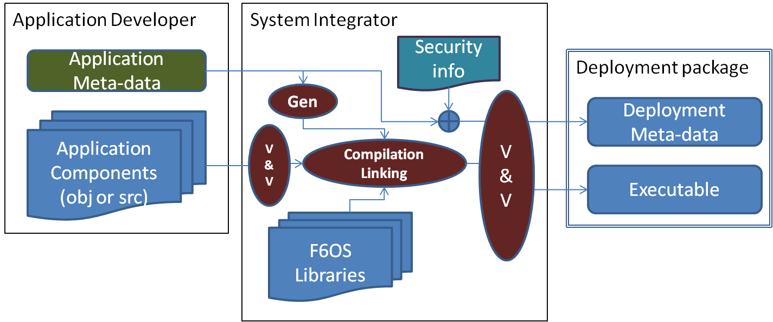
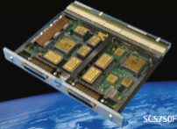
Development and Integration Environment
Designer creates architectural models for actors and components, and their interactions
Models are annotated with resource needs, names for security labels, pre/post-conditions, invariants, etc.
Software generator tools produce skeleton/glue code for the application modules
Conventional development environment is used to supply algorithmic parts
Option: import code generated by code generators, like Matlab/Real-time Workshop
System integrator verifies and assembles complete software suite
Check information flows for policy violations
Perform admittance tests by checking application communication requirements against expected network resource profile
libraries
Notes:
A modeling environment eases the burden on application developers and system integrators.
Developers can:
-Define component interfaces
-Specify resource limits and parameters on Actors
-Compose assemblies of components to form Actors and Applications
Platform configuration, glue code and deployment information is then automatically generated.

Slide 34
Example

Slide 35

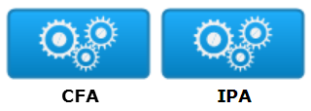
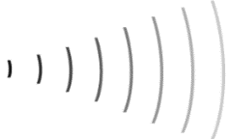

Example: DREMS Orbital Satellite Platform 1/2
Software Bundle on each satellite
Sat 3
Sat 2
Application | Software Components | Partition
Cluster Flight Application (CFA) | Orbital Maintenance | Temporal Partition 1
 | Trajectory Planning | System
 | Module Proxy | System
 | Command Proxy | System
Image Processing Application (IPA) | Image Processing Component (4 on each) | Temporal Partitions 2 & 3
Ground Network
Sat 1
Cluster Leader
Platform management actors on each satellite provide the capability to configure, deploy and manage the applications and their actors.
These actors seamlessly share the CPU with the deployed applications.
DESIGN-TIME MODELING
RUN-TIME DEPLOYMENT/MANAGEMENT

Slide 36
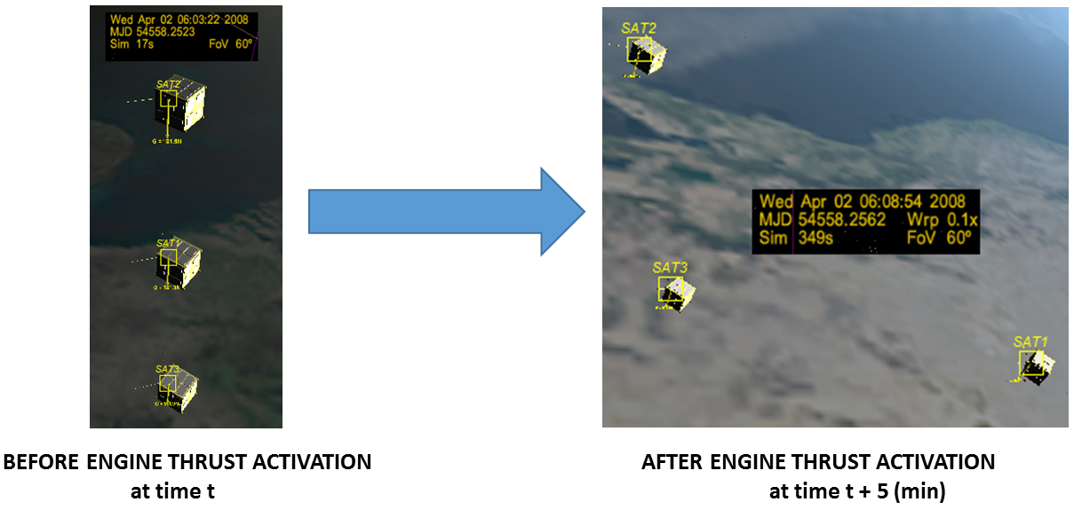
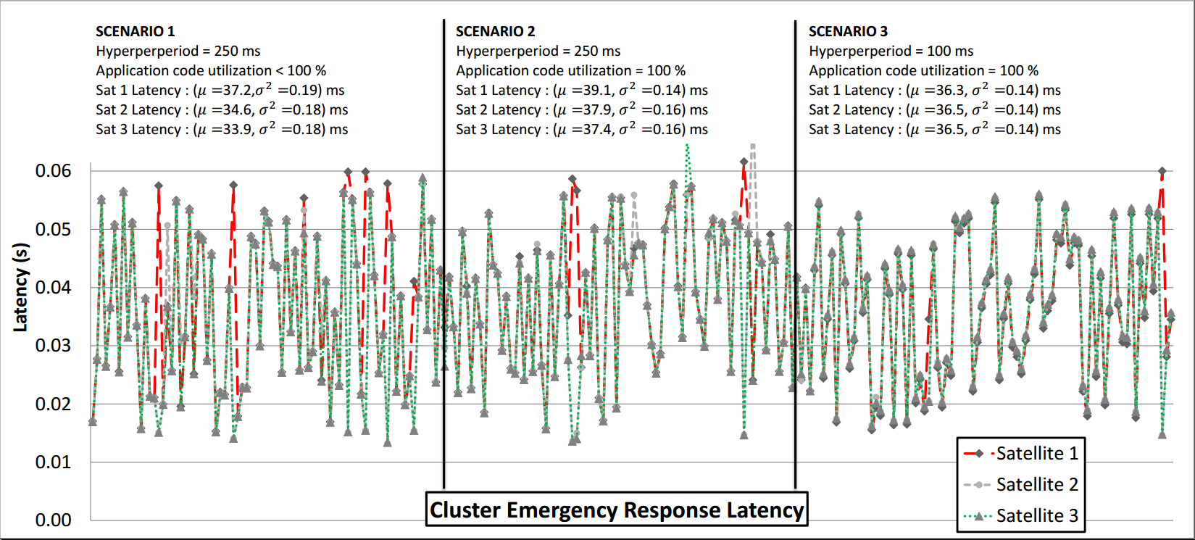
Example: DREMS Orbital Satellite Platform 2/2
The applications were deployed on the platform.
Demo integrates the physics model.
It shows how a critical flight application can be assembled from components using the development tools.
It shows that the image processing application does not affect the CFA response time.
The demo shows that the critical flight application is not affected image processing application

Slide 37
Summary
Distributed and managed cyber-physical systems pose requirements that go further than traditional DRE systems.
Security, performance isolation, and loose coupling among distributed application are key requirements.
The physics of the platform affect the availability of both computation and communication resources
A layered architecture that builds upon the guarantees provided by the layer below was described.
A prototype platform called DREMS was also discussed.
Please visit: http://www.isis.vanderbilt.edu/DREMS for more details.

