Slide 1
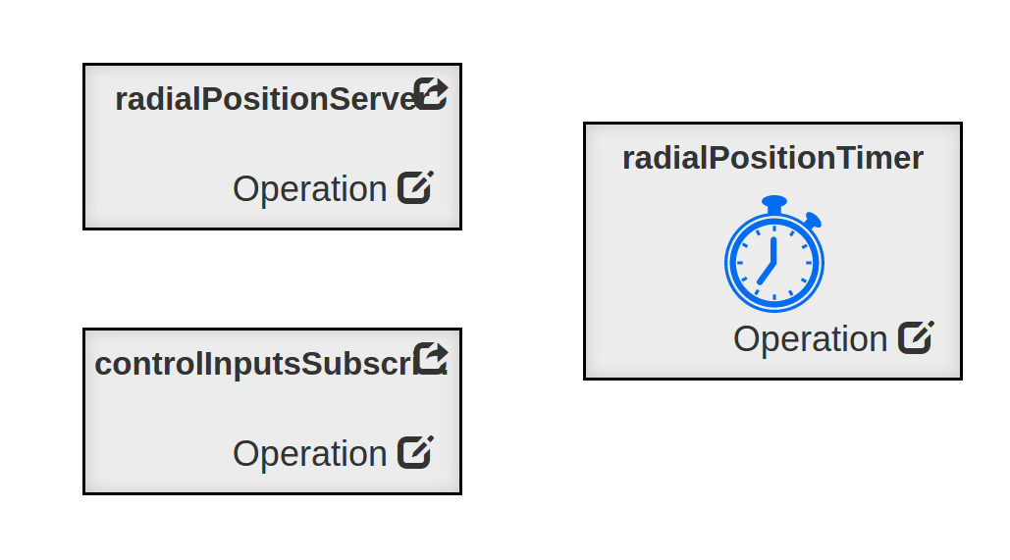
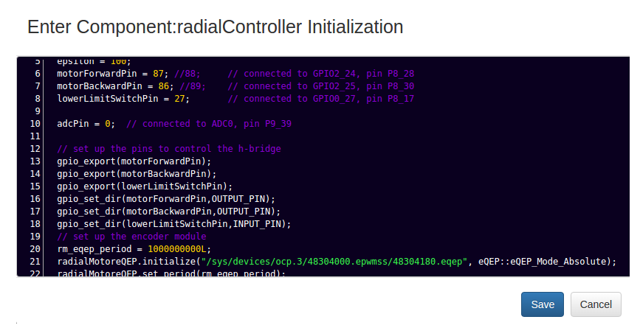
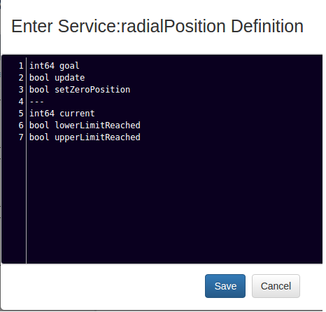
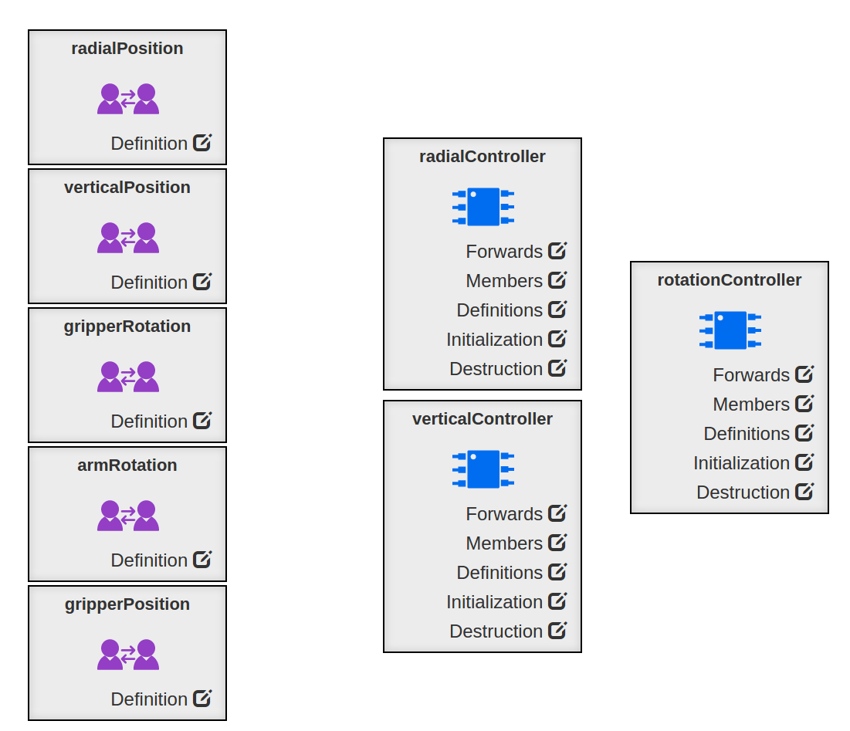
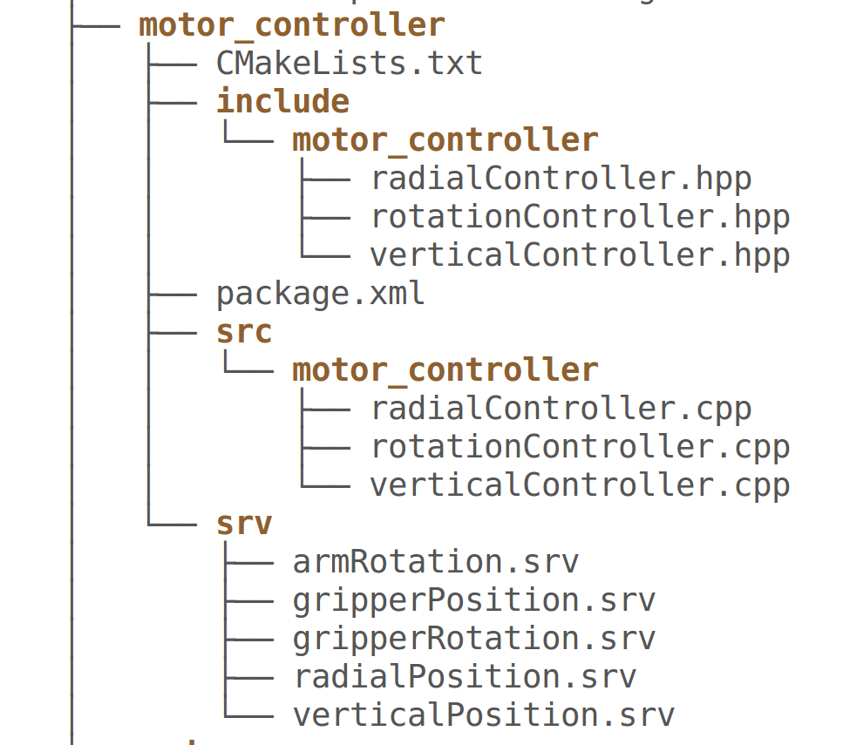
radialController Component Ports and Timers
Initialization Function for the radialController Component
Service Definitions
Motor Controller Package - Generated Code
Component Definitions
Definition of radialPosition service

Slide 2


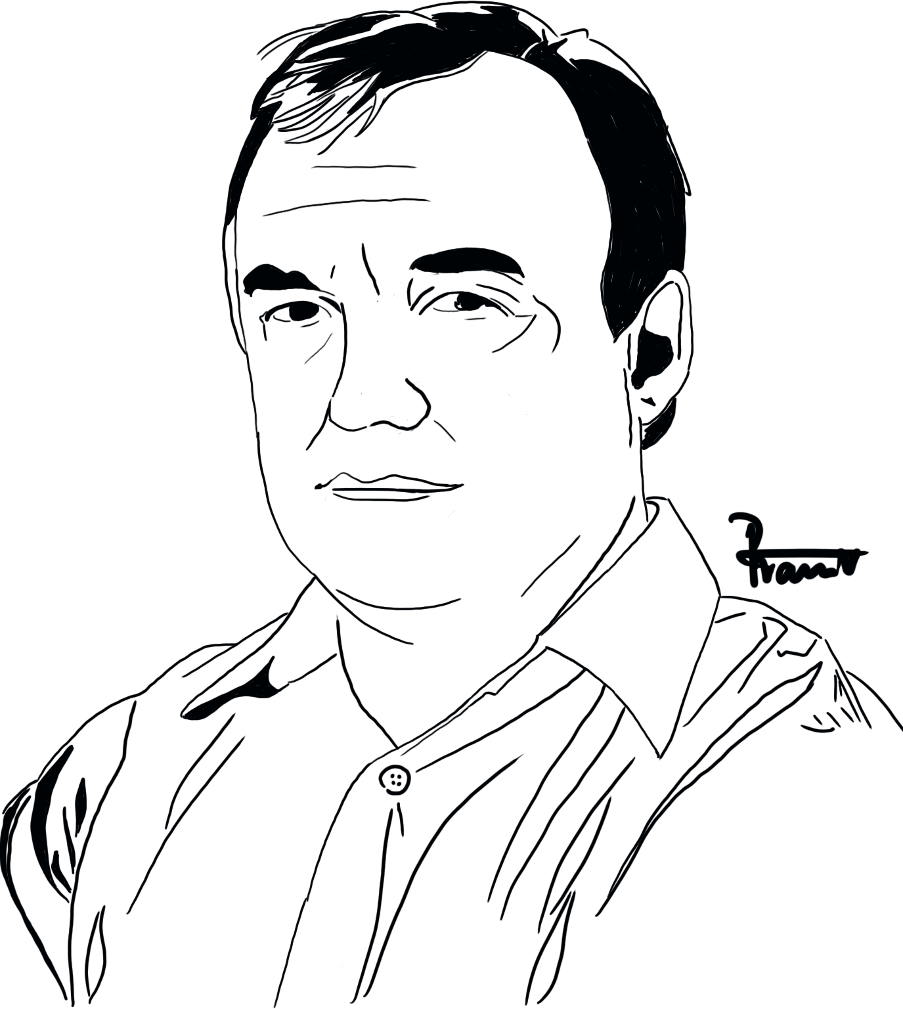

NOTICE

Slide 3
radialControl
ControlInputs
Subscriber
RadialPosition
Client
High-level
Control
VerticalPosition
Client
RadialPosition
Server
ArmState
Publisher
ControlInputs
Subscriber
ControlInputs
Susbcriber
ArmRotation
Client
verticalControl
GripperRotation
Client
VerticalPosition
Server
GripperPosition
Client
GetSample State_client
SampleState
Publisher
GetPayloadState_client
ArmRotation
Server
rotationControl
PayloadState
Publisher
GripperRotation
Server
GripperPosition
Server
ArmState
Subscriber
ControlInputs
Subscriber
PayloadState
Subscriber
User Input Control
userDisplay
CaptureImage
Client
SampleState
Subscriber
SampleProcessed
Subscriber
PayloadProcessed
Subscriber
Sample
Processed
Publisher
GetSample State_server
SampleState
Susbcriber
PayloadState
Susbcriber
ControlInputs
Susbcriber
GetPayload State_server
Camera
CaptureImage
Server
CaptureImage
Client
ControlInputs
Subscriber
PayloadBay
Processed
Publisher
Image
Processor

Slide 4
Is Rocket PayloadBay Open?
Open PayloadBay
START
NO
YES
Is the AGSE Initialized?
Reach Maximum Height
NO
Reach Minimum Radial Distance
YES
Is the Sample detected in camera feed?
Close Gripper & Start Camera Feed
NO
Search Next Quadrant for Sample
YES
Record Sample Position & Orientation
Are the PayloadBay Markers detected?
Record PayloadBay Position & Orientation
YES
NO
Search Next Quadrant for PayloadBay
Move and Orient Gripper to Sample
Close Gripper to Grab Sample
Move and Orient Gripper to PayloadBay
Drop Sample in bay and close bay
STOP

