Slide 1


Subscribers
Publishers
Component Operations
(Business Logic)
Component Operation Queue
Component Executor Thread
Servers
Clients
Timers
State Variables

Slide 2
t_{sched}
Execution of Timer Operation
Remote Request Processed
Timer Operation Enqueued
Timer Operation begins execution
Service Request from Remote Component
Server Operation Executes

Slide 3




Inheritance
Containment
Set Association
Pointer

Slide 4












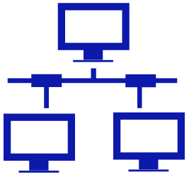






SOFTWARE MODELS
COMPONENT LIBRARIES
Packages
Services
Components
Hosts
cross-compile
Messages
Libraries
EXPERIMENT MODELS
Experiments
Nodes
Hosts
map
HARDWARE MODELS
Systems
Network
Users
DEPLOYMENT MODELS
DEPLOYMENT ARTIFACTS
Runtime
Mapping
Nodes
Node XMLs
<?xml version="1.0"?>
<node name=‘’Node_1">
<component_instance name=“comp_1">
<library name="libComp_1.so"/>
<scheduling_scheme setting=“PFIFO"/>....
</component_instance>
…
</node>
Component
Instances

Slide 5
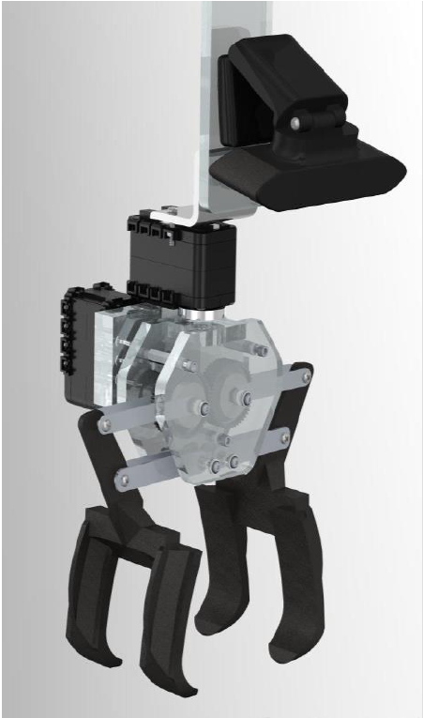

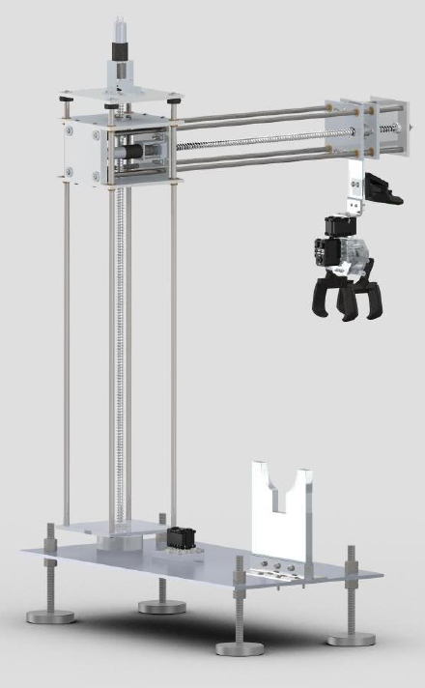
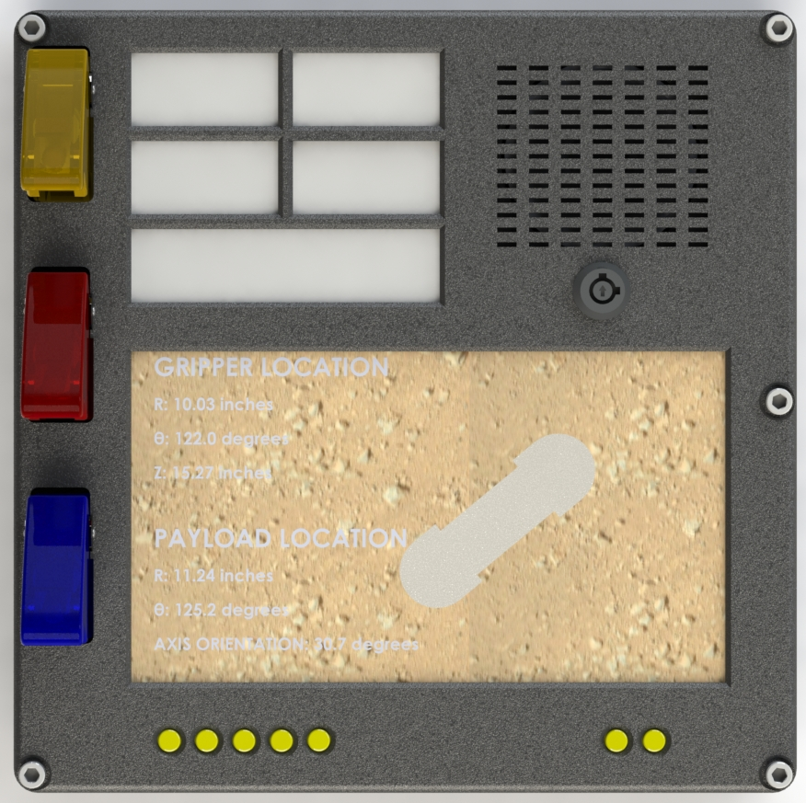
Host: NVIDIA Jetson TK1 Development Board
Image Grabber
High-level Path Planner
Image Processor
Robot Operating System
Communication Layer
Host: Beaglebone Black
Host: Beaglebone Black
User Input Panel
Motor Control & Acquisition

Slide 6
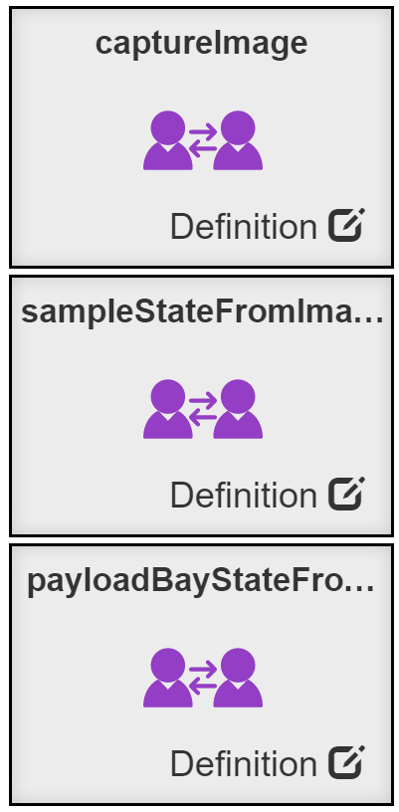
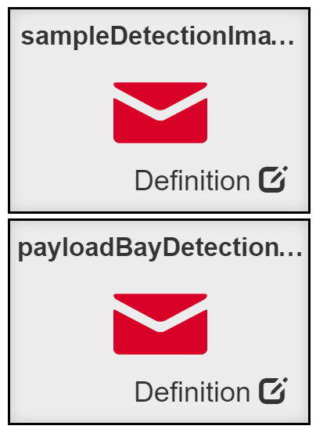
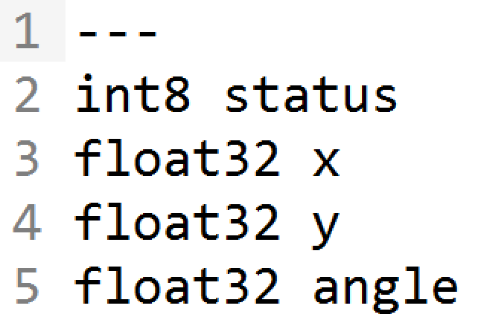
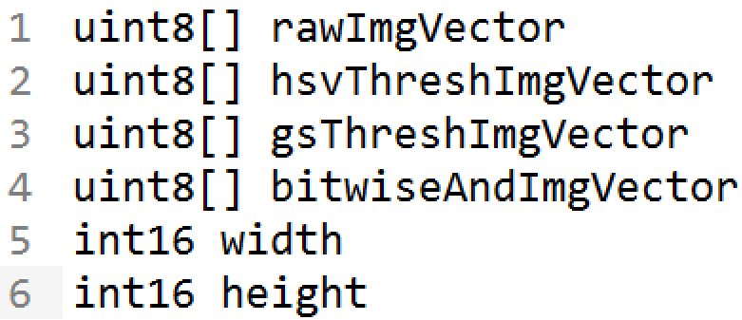
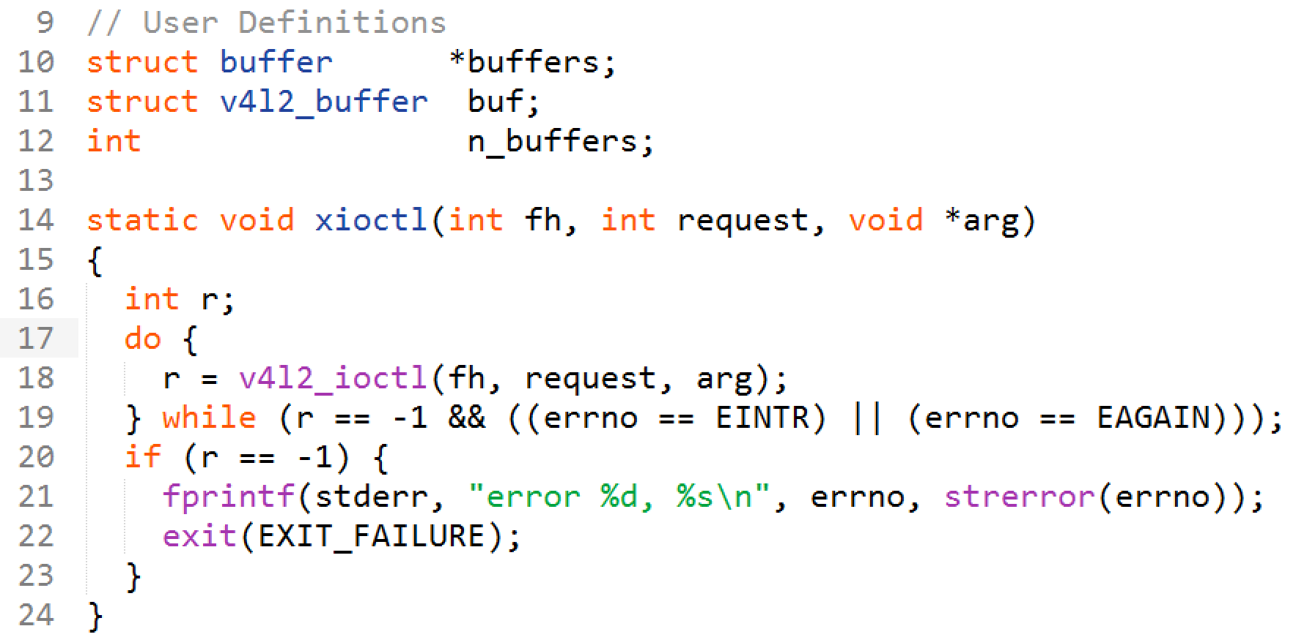
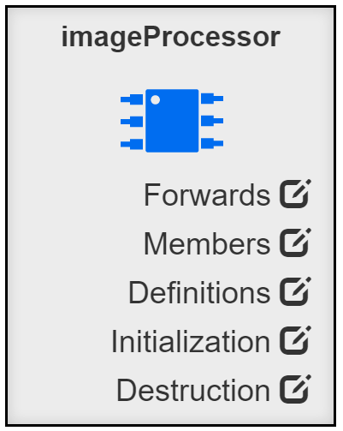
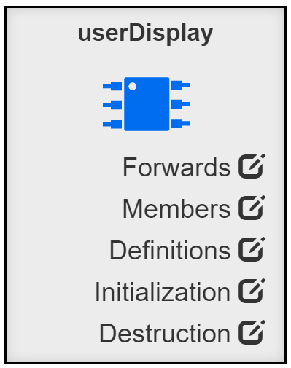
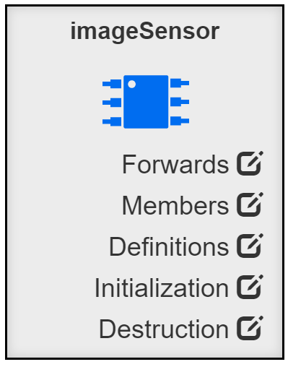

Slide 7

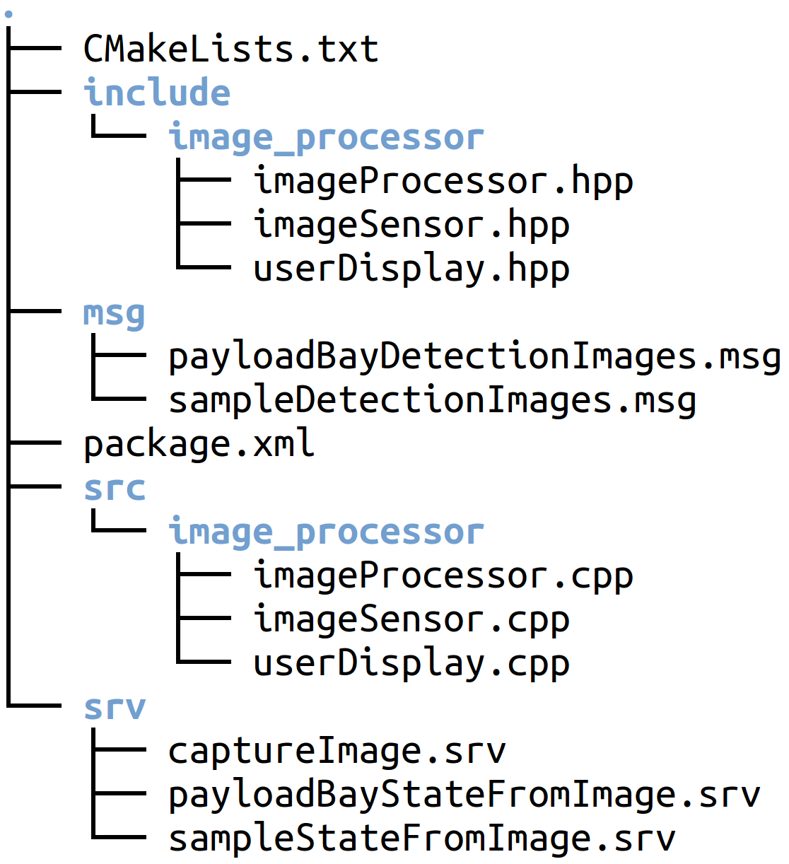

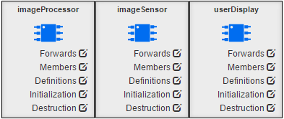

Generated
Documentation
Generated
Source Tree

Slide 8
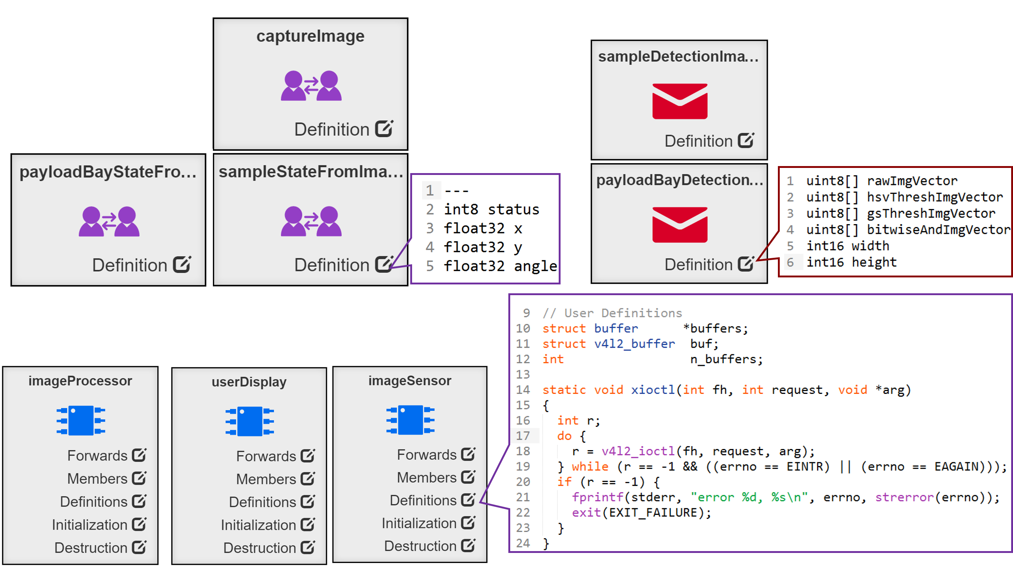
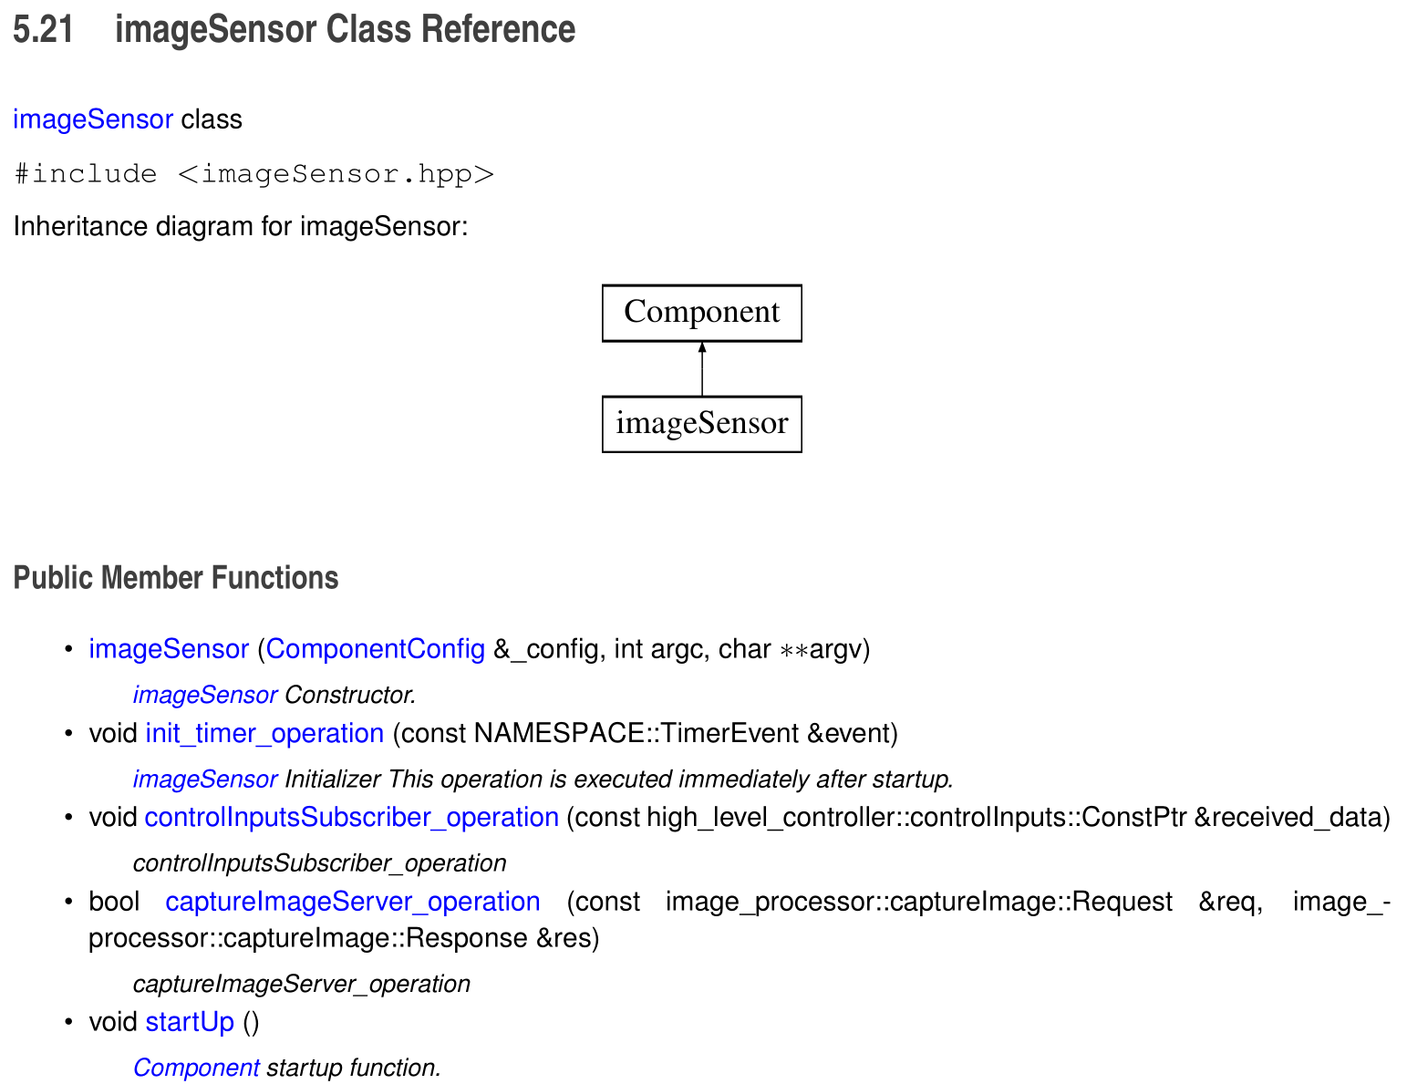
Service
Definitions
Message
Definitions
Generated
Documentation
Component Definitions
Generated
Source Tree

