Slide 2
Hardware: NVIDIA Jetson TK1 Development Board
Camera Image Grabber
Periodic Image Processing
Path Planning State Machine
Camera Image Grabber
Periodic Image Processing
Path Planning State Machine
Robot Operating System - Communication Layer
Hardware: Beaglebone Black
Hardware: Beaglebone Black
User Input Panel
Motor Control & Actuation
User Input Panel
Motor Control & Actuation

Slide 3
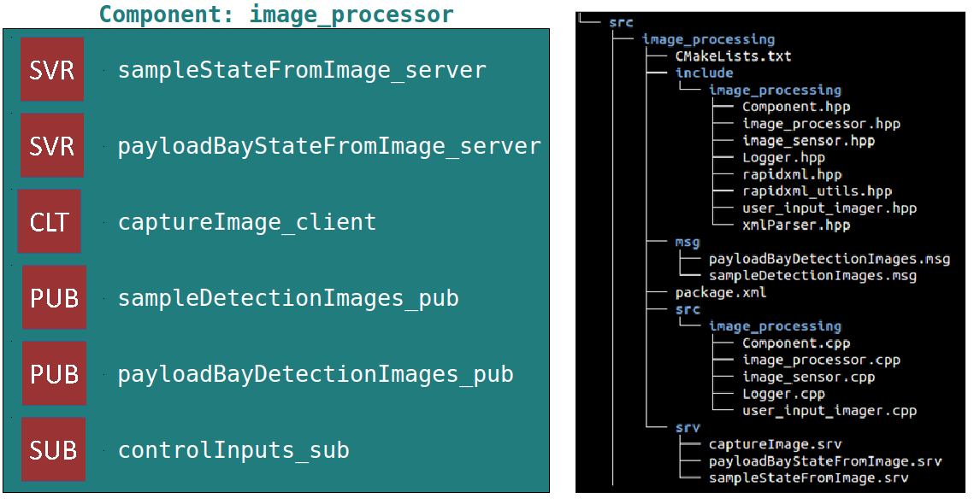

Slide 4
ROSMOD Model
Component Libraries
Hardware_1
ROS Workspace
Node_1
Comp_1
libComp_1.so
Comp_1 instance
Comp_2 instance
MSG
Comp_2
SRV
Node Executable
Comp_3
node_main
Hardware_2
Node_2
Deployment Model
Node-specific XMLs
Comp_3 instance
Node_1
Node_2
node_1.xml
node_1.xml
Model-driven Development
Build system Artifacts
Deployed ROS Nodes

Slide 5
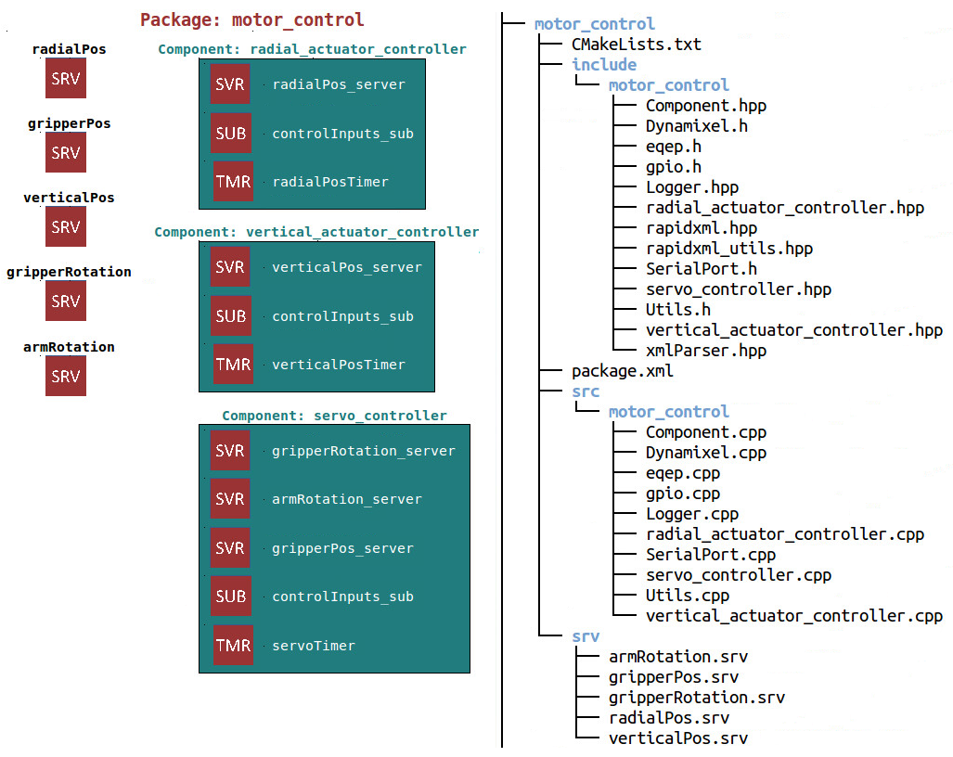
ROSMOD Software Model

Slide 6
Subscriber
ROSMOD Component
Publisher
ROSMOD Component
Component Callbacks/Operations
[Business Logic]
Timers & State Variables
DREMS Component
Component Callbacks/Operations
[Business Logic]
Timers & State Variables
Component Callbacks/Operations
[Business Logic]
Timers & State Variables
Component Operations Scheduler
Component Operations Scheduler
Component Operations Scheduler
Component
Executor
Thread
Message Queue
Component
Executor
Thread
Message Queue
Component
Executor
Thread
Message Queue
Server
Client
Callback Deadline
Monitoring
Network QoS Arbiter
Callback Deadline
Monitoring
Network QoS Arbiter
Callback Deadline
Monitoring
Network QoS Arbiter

