Slide 1
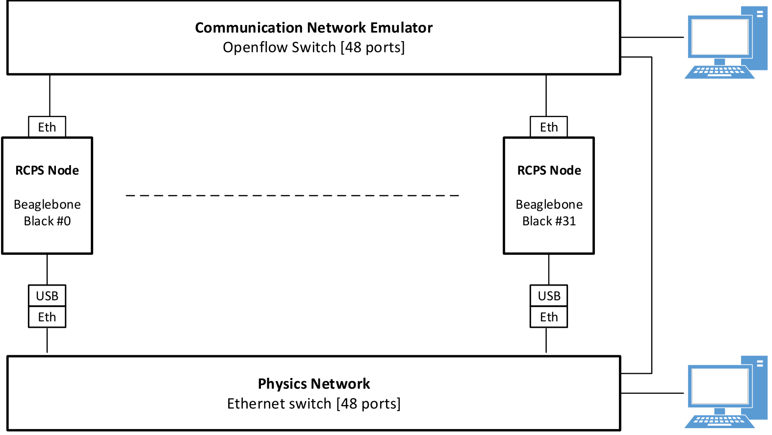
Development and Control
Physics Simulators

Slide 2
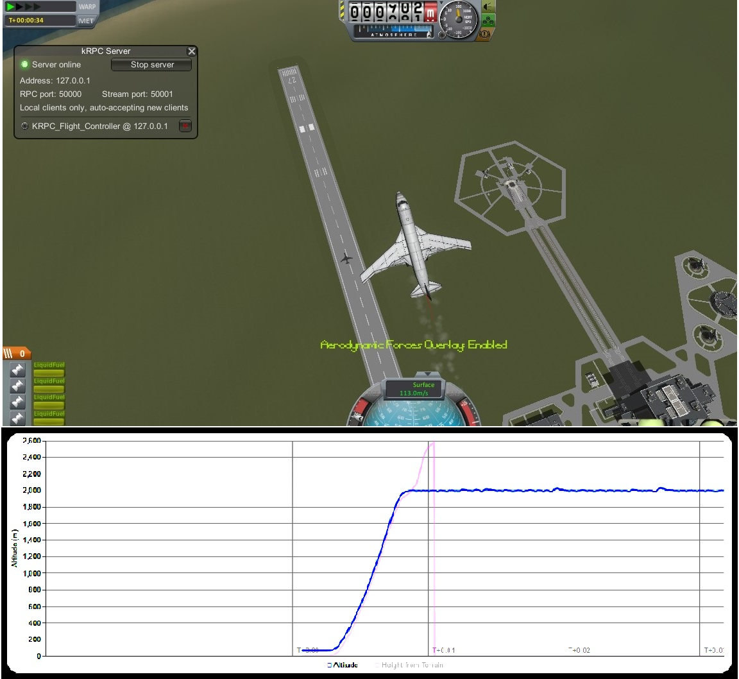
Altitude Profile
Cruising Altitude: 2000 m

