Slide 1




Integrated Analysis of Temporal Behavior of Component-based DRE Systems
Authors: Pranav Srinivas Kumar and Gabor Karsai
Institute for Software-Integrated Systems
Presented by: Dr. Gabor Karsai

Slide 2
Introduction
Real-time Systems must meet operational deadlines.
Deadlines constrain the amount of time permitted to elapse between a stimulus provided to the system and a response generated by the system.
Delayed responses and missed deadlines can cause catastrophic effects on the function of the system.
This is the primary motivation for design-time schedulability analysis and verification.

Slide 3
Problem Statement
Many of the existing schedulability analysis tools are not directly applicable to all system designs.
Domain-specific properties such as component interaction patterns, distributed deployment and time-varying networks.
The classic thread-based concurrency model is too low-level and too generic
Hard to analyze and use.
Restrictive, yet useful concurrency models are needed for which dedicated analysis tools can be developed.

Slide 4
Contributions
An Approach for modeling the operational behavior of each component in an application
The model uses a sequence of timed steps that are executed by the operations.
Improvements to a CPN-based modeling approach enabling better analysis performance and scalability.
Relies on heuristics that manage time variables and state space data structures efficiently.
Advanced State space analysis techniques applied to reduce analysis time on medium-to-large systems.

Slide 5
Target Architecture: DREMS
Developed for a class of distributed real-time embedded systems
Remotely managed
Strict timing requirements
Software Infrastructure
Design-time: Modeling and Analysis Tools
Run-time: Well-defined Component Model
Rapid Prototyping and Code Generation Features

Slide 6
Hierarchical Scheduling
Component level
DREMS Applications are built by assembling Components.
Component interfaces expose operations that can be invoked.
Operation requests are handled using a message queue.
Scheduling Policy for Requests: Non-preemptive Priority FIFO.
Single executor thread per component handles requests.
Operating System level
Components are grouped into processes
Processes are assigned to ARINC-653 styled temporal partitions.
Temporal partitions: Fixed periodic intervals of CPU’s time.

Slide 7
Colored Petri Nets
Graphical Modeling Tool
Tokens contain values of data types called colors.
Powerful modeling concepts made available by token colors.
Heterogeneous data structures such as records with arbitrary number of fields.
Tokens can be inspected, modified and manipulated by transitions and arc bindings.
Component properties such as thread priority, port connections and real-time requirements are encoded into a single color token.

Slide 8
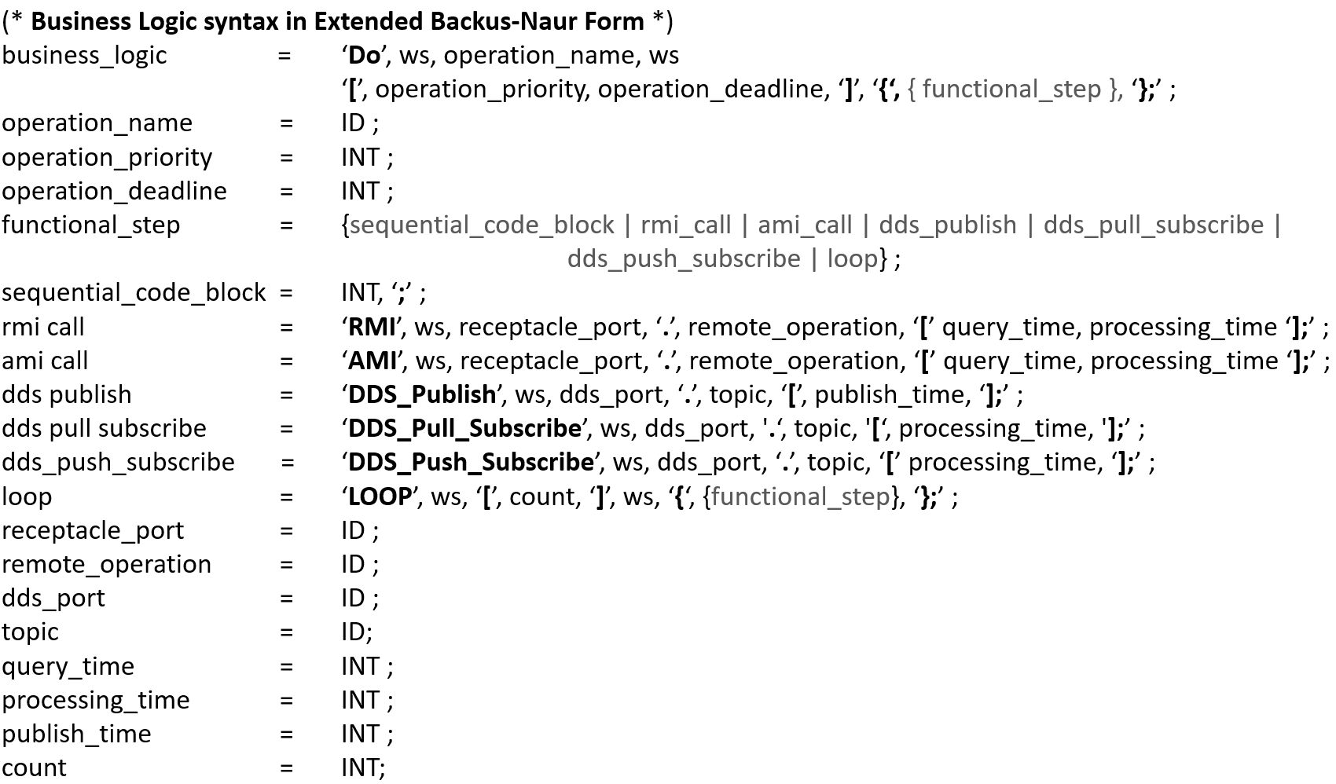
Modeling Temporal Behavior

Slide 9
Analysis Improvements: Handling Time
Explicit modeling of time as an integer-valued clock color token in CPN.
Modeling the OS scheduler clock this way allows for easy extensions to its data structure:
Intermediate time stamps & internal state variables
Adding temporal partitioning and other prioritization schemes.
Reduces the total number of colors required by the complete model.
We have chosen a time quantum of 1 msec.
Typical 1KHz scheduler in Linux

Slide 10
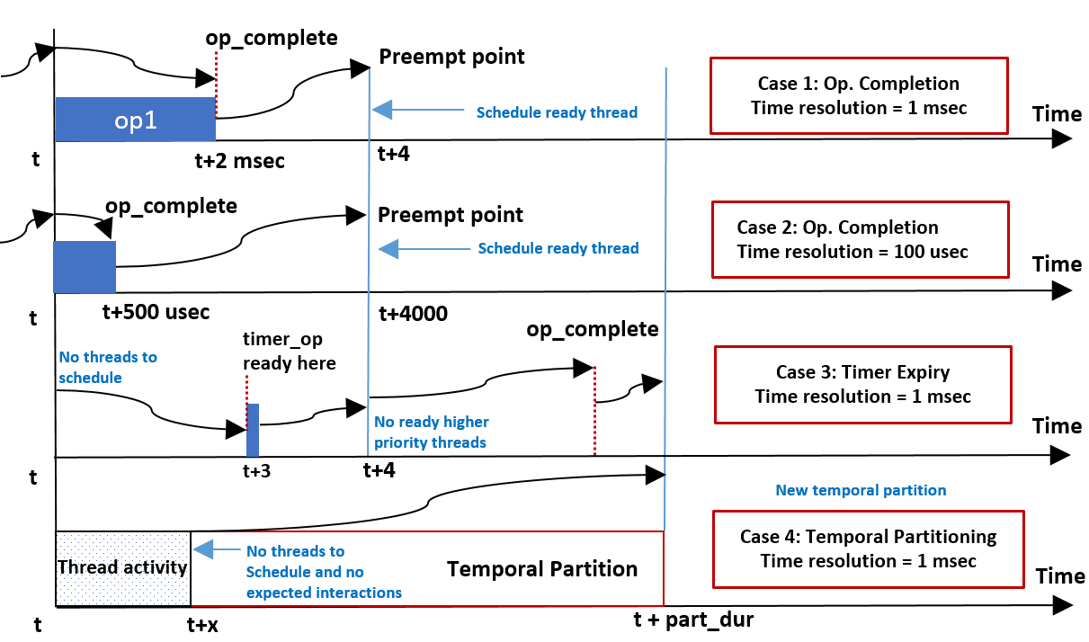
Smarter Time Progression

Slide 11
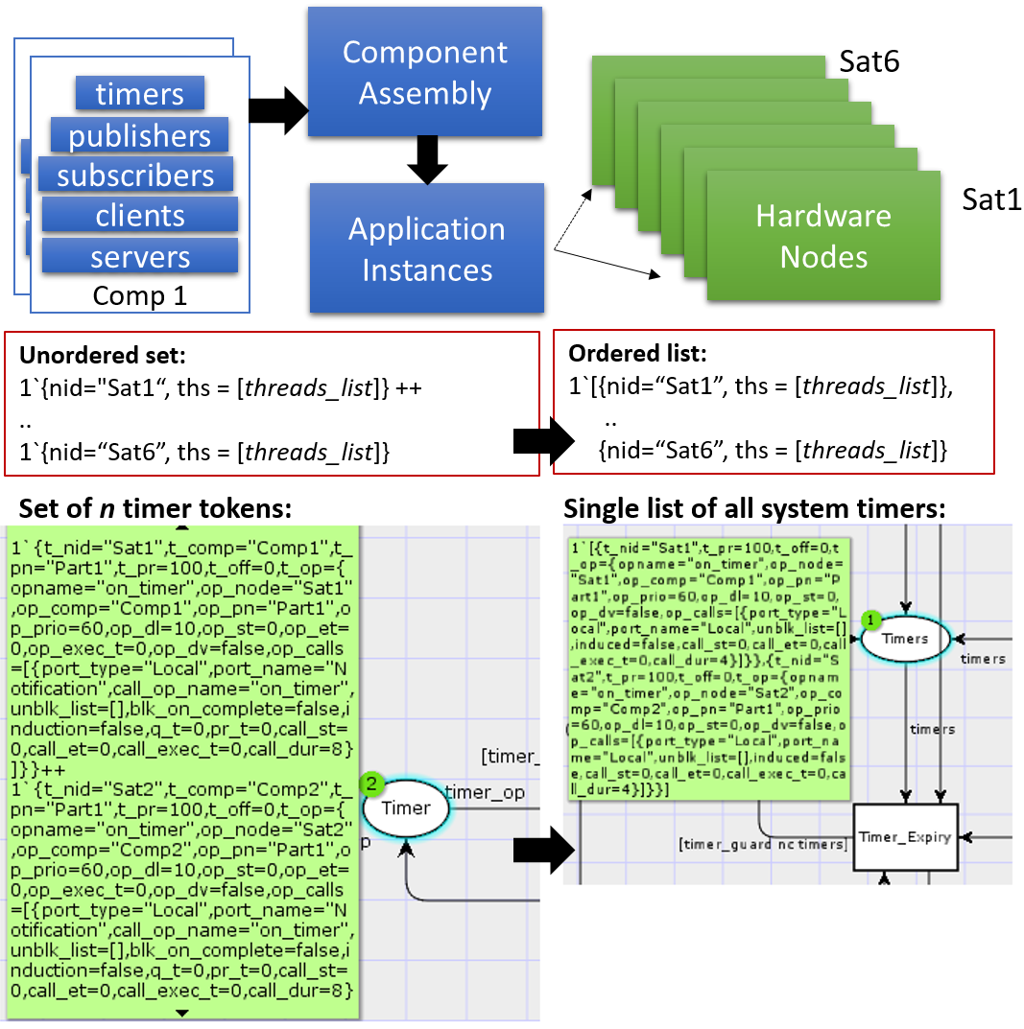
Analysis Improvements: Distributed Deployment
Early models of distributed deployments included a unique token per CPN place for each hardware node in the scenario.
Non-deteminism in transition bindings.
We employ a structural reduction
Merge hardware node tokens into a single list of tokens instead of an unassociated grouping of node tokens.
Reduces the resultant state space & dramatically improves scalability.

Slide 12
Advanced State Space Methods
Compute all reachable states of the modeled system
Derive a directed graph called the state space.
Tree of possible executions that the system can take from an initial state.
Verify behavioral properties such as queue overflows, deadline violations and deadlocks.
Derive counter examples.
State space explosion problem!
Needs advanced memory management methods to make state space analysis efficient.

Slide 13
Advanced State Space Methods
In order to easily apply advanced state space reduction techniques, we use a tool called ASAP.
Sweep line method
Discard generated states on-the-fly by performing verification checks during generation time.
Any state that does not violate system properties is deleted.
100 interacting components in 10 computing nodes:
Using CPN Tools built in state space generation:
20 hyperperiods of activity → 36 minutes on a typical laptop
Using ASAP and on-the-fly verification
Less than 10 minutes to perform deadlock checks on the deployed system

Slide 14
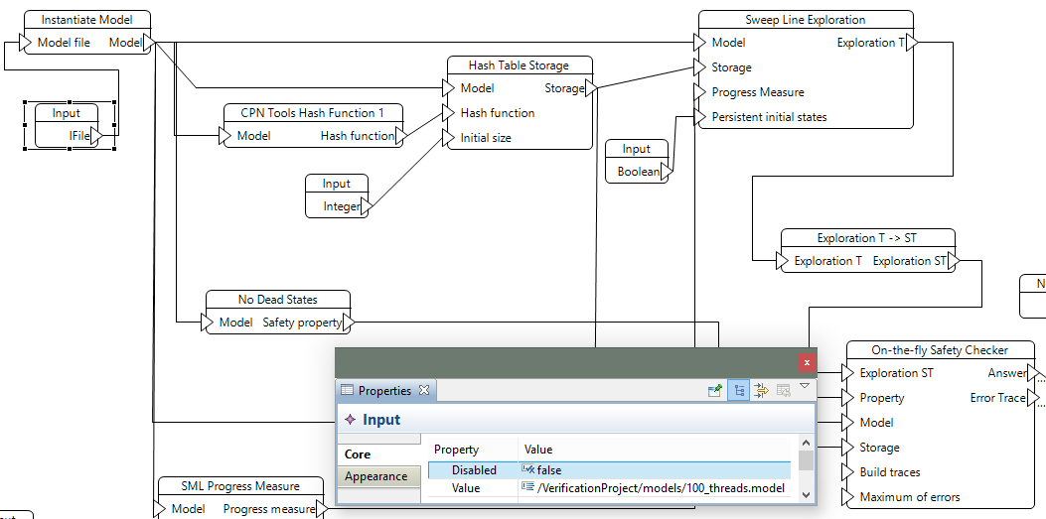
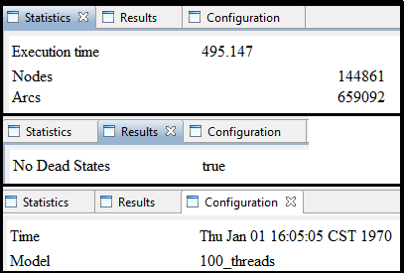
Advanced State Space Methods

Slide 15
Future Work
DREMS component communication is facilitated by a time-varying network.
Bandwidth provided by the system predictably fluctuates between a min. and max. during an orbital period.
Currently we assume worst-case network delay.
We are working on capturing the network profile of a deployment.
Investigating the utility of this approach on fault-tolerant and self-adaptive systems.
Integration with a run-time resilience engine
Checking for timing anomalies before settling on a reconfiguration strategy.

Slide 16
Conclusions
Mobile DREs running mixed criticality applications must satisfy strict timing requirements to operating safely.
To reduce design and integration complexity, component-based design models are increasingly being used.
Appropriate analysis models are required to study the structural and behavioral complexity of such designs.

Slide 17
Thank You

