Slide 2
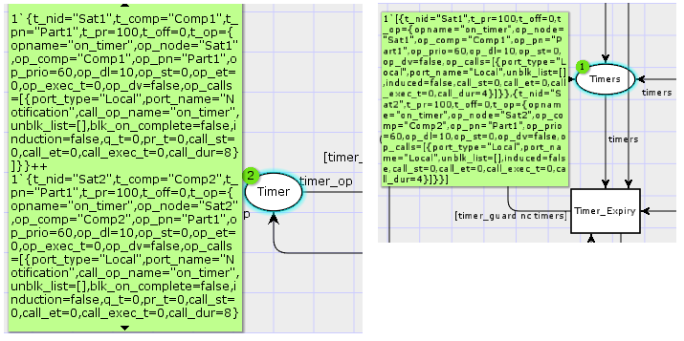
Component-based App
Sat6
DREMS Application
DREMS Application
DREMS Application
DREMS Application
DREMS Application
Application
Instance
Hardware
Nodes
Sat1
Unordered set:
1`{nid="Sat1“, ths = [threads_list]} ++
1`{nid=“Sat2”, ths = [threads_list]} ++
..
1`{nid=“Sat6”, ths = [threads_list]}
Ordered list:
1`[{nid=“Sat1”, ths = [threads_list]},
{nid=“Sat2”, ths = [threads_list]},
..
{nid=“Sat6”, ths = [threads_list]}

Slide 3
Component
Assembly
Comp 1
Sat6
Comp 1
DREMS Application
timers
timers
DREMS Application
publishers
DREMS Application
publishers
DREMS Application
subscribers
DREMS Application
subscribers
Hardware
Nodes
Sat1
clients
Application
Instances
clients
servers
servers
Unordered set:
1`{nid="Sat1“, ths = [threads_list]} ++
..
1`{nid=“Sat6”, ths = [threads_list]}
Ordered list:
1`[{nid=“Sat1”, ths = [threads_list]},
..
{nid=“Sat6”, ths = [threads_list]}
Set of n timer tokens: Single list of all system timers:

Slide 5
op_complete
Preempt point
Schedule ready thread
Case 1: Op. Completion
Time resolution = 1 msec
Time
t
op1
t+2 msec
t+4
op_complete
Preempt point
Case 2: Op. Completion
Time resolution = 100 usec
Schedule ready thread
Time
t
t+500 usec
timer_op
ready here
t+4000
op_complete
No threads to
schedule
Case 3: Timer Expiry
Time resolution = 1 msec
No ready higher priority threads
Time
t
t+3
t+4
New temporal partition
No threads to
Schedule and no expected interactions
Case 4: Temporal Partitioning
Time resolution = 1 msec
Temporal Partition
Thread activity
Time
t
t+x
t + part_dur

