Slide 1
Timing Analysis of PLEXIL Plans
Pranav Srinivas Kumar
Dr. Gabor Karsai
Institute for Software Integrated Systems
Vanderbilt University

Slide 2
PLEXIL
PLEXIL is a language for representing plans for automation, as well as technology for executing these plans on real or simulated systems
Applications: Robotics, control of unmanned vehicles, simulation involving intelligent software agents etc.
The language can represent branches, loops, time- and event- driven activities, concurrent activities, sequences, and temporal constraints.
Accompanying PLEXIL is an executive which implements the language and provides interfaces to controlled systems as well as decision support systems from which plans may be sent.
Sourceforge: http://plexil.sourceforge.net/wiki/index.php/Main_Page

Slide 3
PLEXIL Plans
A PLEXIL plan consists of a tree of nodes
Internal nodes are control nodes – a hierarchical node with children
Leaf nodes are action nodes – a node that can perform an assignment, command or library call (some action)
Each node in the PLEXIL plan can characterized by a set of local variables, conditions, and actions
Conditions e.g. start condition, invariant condition etc. constrain the execution of PLEXIL nodes
PLEXIL plan execution is purely reactive – When an event arrives, the PLEXIL executive identifies the subset of executable nodes and executes all these node synchronously

Slide 4
Informal Execution Semantics
Execution of PLEXIL plans proceeds in discrete time steps called macro steps
All external events are processed in the order of arrival i.e. the event queue follows a first-in first-out scheme
An external event and all its cascading effects are processed before the next event is processed (run-to-completion semantics)
A macro step of execution consists of a number of micro steps
Each micro step corresponds to the parallel synchronous execution of atomic steps of execution of the individual plan nodes
In addition to the conditions on each PLEXIL node, a specific node can execute only if its parent node can execute

Slide 5
Timing Properties Integration
PLEXIL nodes in a plan are characterized by conditions and actions
PLEXIL nodes do not contain any temporal properties e.g. time taken to perform a condition check, time taken for a value look up etc.
Temporal properties need to be integrated as part of a PLEXIL plan design in order to perform design-time timing analysis
The following are the timing properties considered for modeling PLEXIL plan execution in a formal domain such as Colored Petri nets (CPN)
Minimum and Maximum inter-arrival times of events
WCET of commands/assignments/library calls in action nodes
WCET of environment variable “look ups”
WCET of condition checks on each node

Slide 6
Colored Petri Nets
A Colored Petri net (CPN) is a high-level Petri net
A CPN consists of a finite set of places, transitions, and arcs
Places can contain tokens of complex data types called colors
Transition can fire when all its input places have the necessary tokens
An input place is one that has an outgoing arc connecting with the transition
When a transition fires tokens are removed from input places and placed in output places of the net
Transitions typically represent the occurrence of an event
Input places to the transition can represent pre-conditions to an event
Output places from a transition can represent post-conditions of an event

Slide 7
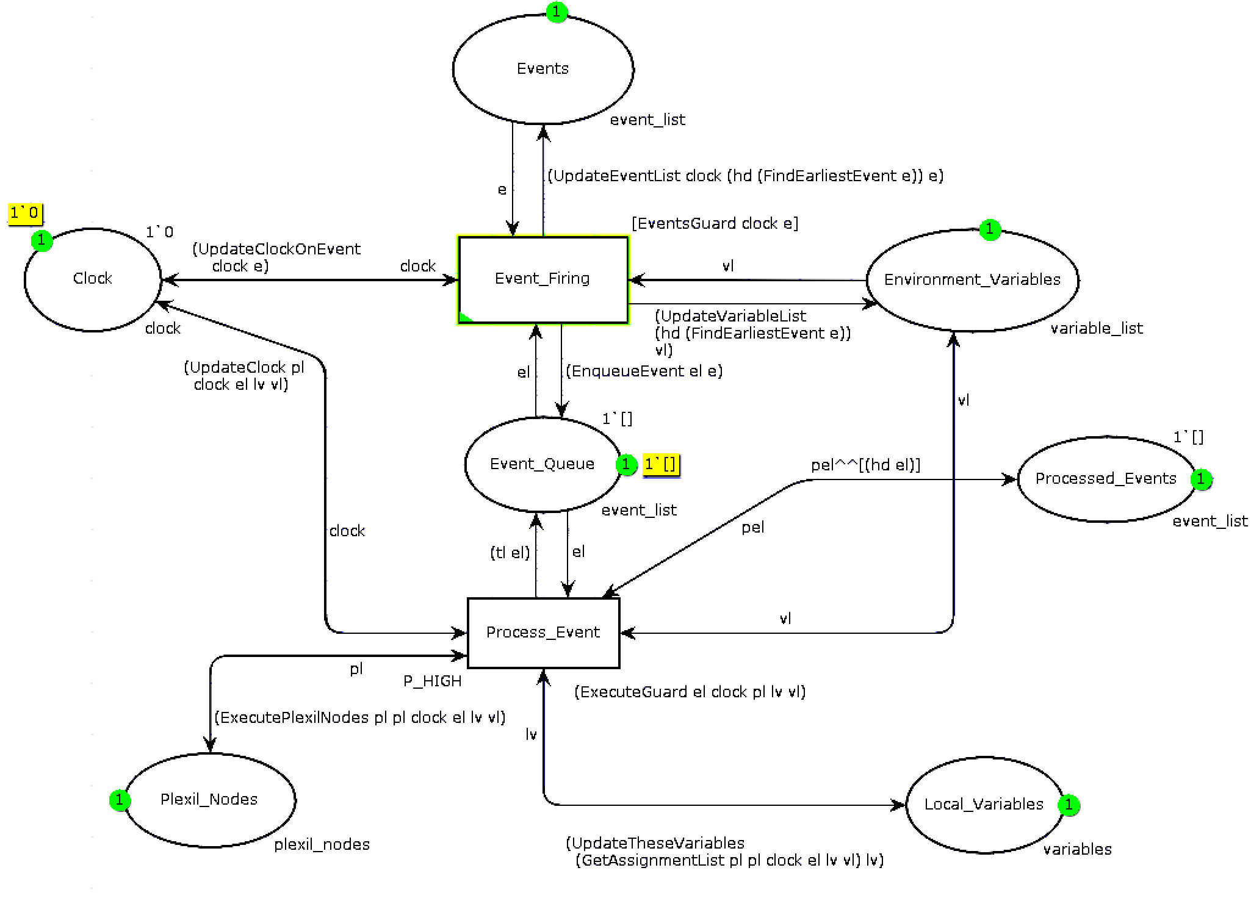
PLEXIL Execution in CPN

Slide 8
PLEXIL Analysis in CPN
The Analysis CPN consists of a set of places that represent different aspects of a PLEXIL plan execution e.g. events, local variables, environment variables, global clock, PLEXIL plan etc.
The transitions represent state transitions of tokens held by the places e.g. when an event fires, an event token is removed from the Events place and placed in Event_Queue place
PLEXIL plan execution is encoded in the transition Process_Event
When an event arrives in the Event_Queue, the transition Process_Event becomes capable of firing
Process_Event fires by removing this event from the queue and executing all PLEXIL nodes in the plan that can execute i.e. the node’s conditions evaluate to true
Using this model, a state space is generated and analyzed

Slide 9
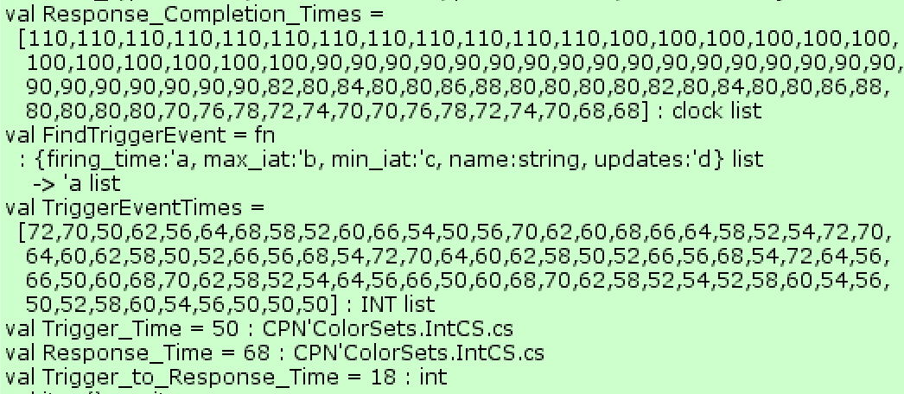
Worst-case Trigger-to-Response Time
By annotating PLEXIL plans with timing properties e.g. WCET of commands, lookups etc., the temporal behavior of each PLEXIL node during runtime events can be analyzed
Using the arrival time of an event as a trigger, and the completion time of a PLEXIL node execution as the corresponding response, a worst-case trigger-to-response time is estimated

