Slide 1







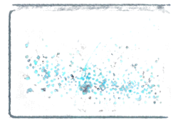
VitalTwins
Mechanistic PK/PD & Multimodal
Predictive Clinical Twins
SpO
Closing the trust gap between
unseen signals and clinical decisions.
TEAM CTRL win
Parth Kulkarni
Happiest Health Digital Twin Challenge 2026

Slide 2


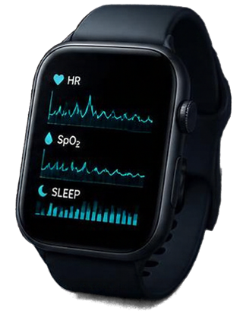

The Clinical Problem
EHR DATA
WEARABLE DATA
THE TRUST GAP
EHR records and wearable signals live in separate worlds.
There may be an early warning window before symptoms.
Clinicians need physiological explainability, not black boxes.
Today, trust is the missing link.
UNSEEN SIGNALS?

Slide 3


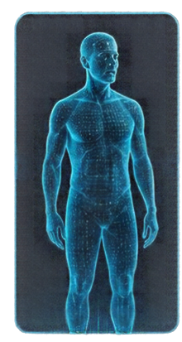

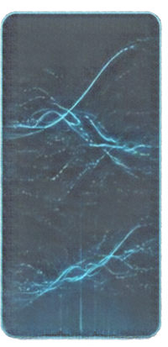




From Risk Scores to a Digital Twin
PHYSICAL
PATIENT
SYNCHRONISED
VIRTUAL REPLICA
PK/PD
SHADOW TWIN
P4
COMPANION
A living model of the patient,
updated in sync with real life.
Reflects both baseline
and day-by-day changes.
Explore what-ifs in a safe sandbox—insight only, not prescriptions.
Patient-centred guidance,
built for calm, informed decisions.
COUNTERFACTUAL SIMULATION IN A SANDBOX—NOT PRESCRIBING NOT CLINICALLY VALIDATED

Slide 4




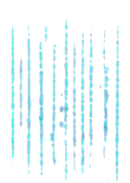


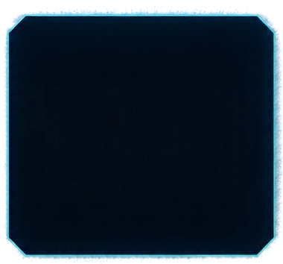






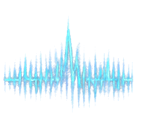



System Architecture &
Fusion Pipeline
XAI
explanable
insights
SYNTHETIC EHR
structured clinical data
RISK
STATUS
patient-level
risk assessment
XGBOOST MODEL
interoperable
clinical data
FUSION ENGINE
FHIR R4
multimodal integration
& risk inference
48-HOUR WEARABLE STREAM
continuous biosignals
SIMULATOR
what-if scenario
exploration
TEMPORAL STRESS
EVALUATOR
RED
ESCALATION
real-time
risk escalation

Slide 5


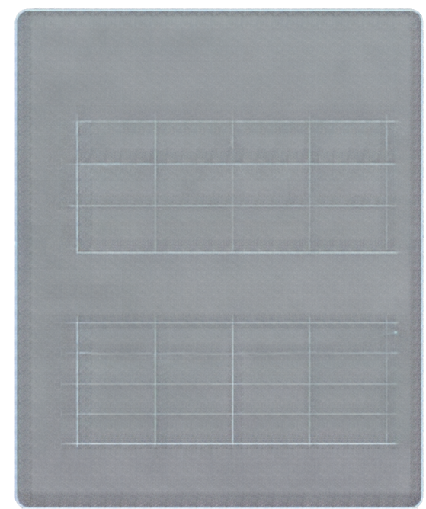

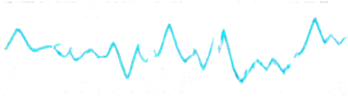


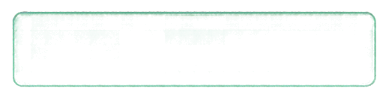


Synthetic Sandbox & Fusion Math
PAT_001 EXAMPLE
FUSION EQUATION
500
HRV (ms)
RISK = w1+HRV + w2+RHR + w3+ACT + w4+SLEEP + w5+SpO2
synthetic profiles
120
80
48-hour
40
RISK STATES
hourly wearable stream
0
RHR (bpm)
GREEN
stable
low concern
multimodal features
80
heart rate variability
resting heart rate
activity
sleep
oxygen saturation
60
YELLOW
watch
moderate concern
40
20
0
RED
act
high concern
0h
12h
24h
36h
48h
SYNTHETIC SANDBOX RESULTS AND INVESTIGATIONAL SIMULATIONS
NOT CLINICALLY VALIDATED OR PRESCRIBING GUIDANCE.

Slide 6









PK/PD Shadow Twin
mechanistic models. regimen scenarios. safety guardrails.
BATEMAN PK MODEL
HILL PD MODEL
12-HOUR IN-SILICO COMPARISON
F·D·ka
C(t) = _______ (e-kt – e-k*)
Vd (ka – k)
Emax · CY
E(C) = _______ (EC50 + CY
Metoprolol
25 mg
Metoprolol
50 mg
plasma concentration
bioavailability
dose
absorption rate
elimination rate
volume of distribution
pharmacodynamic effect
maximum effect
concentration for 50% effect
hill coefficient
Ivabradine
5 mg
Amiodarone
200 mg
BRADYCARDIA
GUARDRAIL
model flags low heart rate risk
across simulated regimens
SIMULATION ONLY
not clinically validated. not treatment advice.

Slide 7
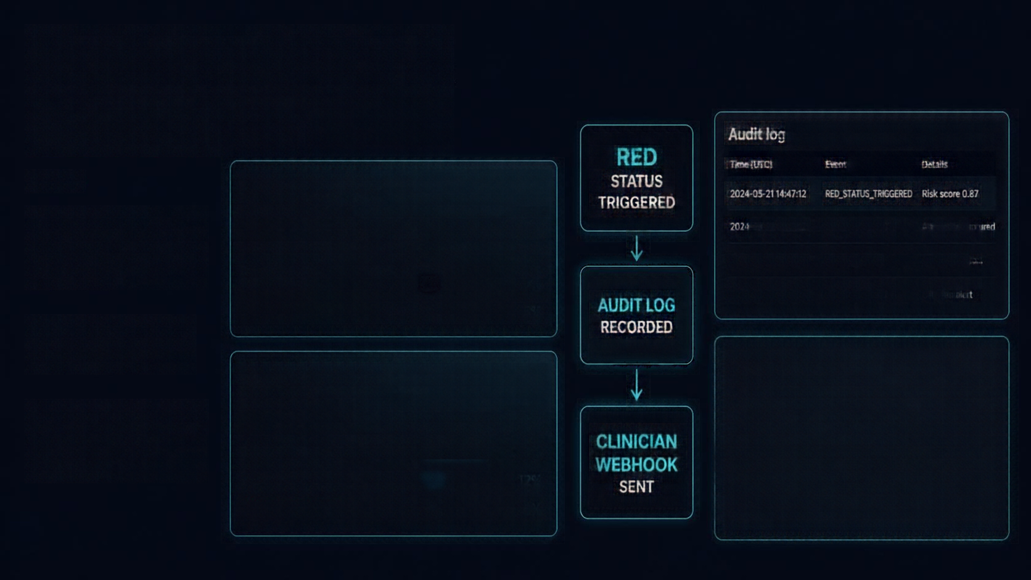


















Explainability & Escalation
Audit log
Time (UTC)
Event
RISK ATTRIBUTION
HOUR 10
2024-05-21 14:47:12
RED STATUS TRIGGERSD
Risk score 0.87
Risk drivers are transparent and shift over time.
Baseline deviation
68%
2024-05-21 14:47:12
RISK_SNAPSHOT
Attribution captured
BASELINE-LED EXAMPLE
HRV
18%
2024-05-21 14:47:13
AUDIT_LOGGED
Record ID 712c...
Activity
9%
2024-05-21 14:47:14
WEBHOOK_SENT
Clinician alert
SpO₂
5%
RED status initiates
audit logging.
Webhook payload
RISK ATTRIBUTION
HOUR 47
Clinicians are alerted via webhook in
real time.
46%
"patient_id"; "PT-12845"; "event"; "REDSTATUS TRIGGered", "risk_score"; 8 .87, "timestamp"; "2024-05-21T14:47:122"; "reason"; "riskthresholdExceeded"; "action"; "reviewRequired"
HRV
HRV AND
BASELINE CONTRIBUTIONS
Baseline deviation
34%
Activity
12%
SpO₂
8%

Slide 8
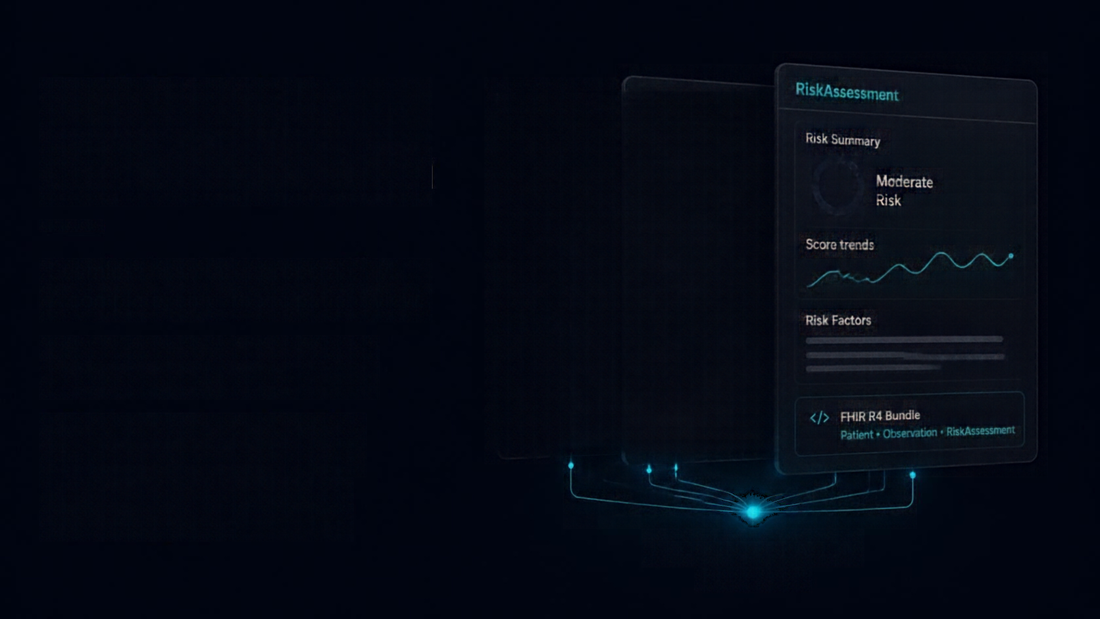

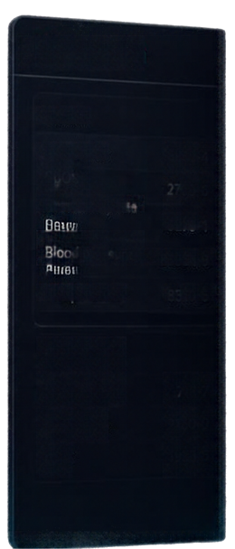
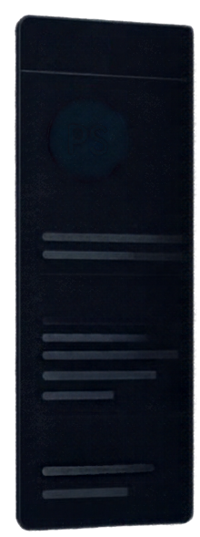








FHIR R4 &
P4 Companion
RiskAssessment
Patient
Observation
Vitals
Risk Summary
Heart rate
8867-4
Moderate
Risk
SpO₂
2708-6
Respiratory rate
Patient Summary
9279-1
Blood pressure
85354-9
Score trends
Seamless hospital interoperability.
A complete, empathetic patient view.
Demographics
Temperature
8310-5
Lab Results
Risk Factors
Unified Patient, Observation and
RiskAssessment bundle
Hemoglobin
718-7
Creatinine
2160-0
Encounters
CRP
1989-5
LOINC-coded observations for
standardized data exchange
</>
FHIR R4 Bundle
Patient • Observation • RiskAssessment
Future-ready integration with
ABDM ecosystem
ABDM INTEGRATION
Future target

Slide 9







Prototype Validation Metrics
94%
accuracy
0.995
ROC-AUC
15-hour
simulated lead time
26.4%
simulated risk reduction
<15 ms
latency
Synthetic sandbox results and investigative simulations. Not clinically validated. Not prescribing guidance.

Slide 10

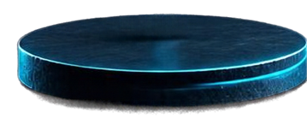
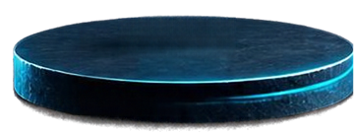
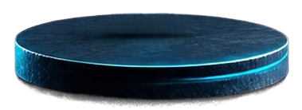


Roadmap to Clinical Translation
1
2
3
SYNTHETIC SANDBOX
LIVE WEARABLES
AND ECG MODELLING
ETHICS-APPROVED PROSPECTIVE PILOT
Proof of concept in
synthetic environments
Real-world signals
and advanced modelling
Governed deployment
in prospective settings

