Slide 1
Supervised Learning Classification
Day04
Ensemble Methods

Slide 2
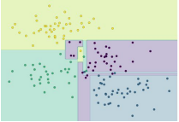
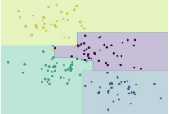
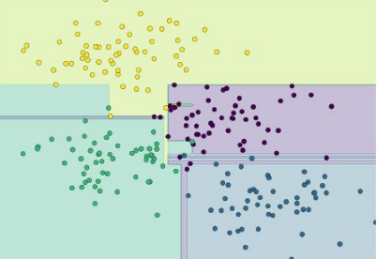
Ensemble Methods -
Train multiple weak predictors on a dataset such that they get slightly different results some learn some patterns better and others learn other patterns
Combine their predictions to get an overall better performance
The combined group of learners is call meta model
Meta models
Trained on slightly differ data
Combined result with better accuracy than individual models
Source: Python Data Science Handbook / Page 424

Slide 3
Ensemble Methods -
In some parts of the feature space, the different instances produce similar results for e.g. in the extreme regions
In regions where the data points from different classes overlap, the instances give different results
Thus by using information from all the instances, may give overall better result than individual instances

Slide 4
Ensemble Methods -
To ensure each learner gets to see slightly different data can be done in many ways
Random sampling with replacement (Bootstrapping / sampling with replacement)
By adjusting the weights assigned to each data point to force an instance to focus on certain data points more
Only Random Forest ensemble technique is designed only for decision Tree
For other ensemble methods, each instance in the meta model can be build out of different algorithm. For instance DecisionTree, Naïve Bayes, Support Vector Machine.

Slide 5
Prerequisites for effective ensemble:
The performance of an ensemble mostly depends on the individual performance of the classifiers present in the ensemble.
Two key requirements of the classifiers forming the ensemble are:
diversity of classifiers in nature - Similar classifiers usually make similar errors, so forming an ensemble with similar classifiers would not improve the classification rate
accuracy in the classifier predictions - presence of a poorly performing classifier may cause performance deterioration in the overall performance.

Slide 6
Two families of ensemble methods are usually distinguished:
Averaging methods, the driving principle is to build several estimators independently and then to average / vote their predictions. On average, the combined estimator is usually better than any of the single base estimator because its variance is reduced.
E.g. Bagging methods, Forests of randomized trees, ...
Boosting methods, base estimators are built sequentially and one tries to reduce the bias of the combined estimator. The motivation is to combine several weak models to produce a powerful ensemble. E.g. AdaBoost, Gradient Tree Boosting, ...

Slide 7
Ensemble Methods – Averaging method - Bagging (Bootstrap Aggregation) :
Designed to improve the stability (small change in dataset change the model) and accuracy of classification and regression models
It reduces variance errors and helps to avoid overfitting
Can be used with any type of machine learning model, mostly used with Decision Tree
Uses sampling with replacement to generate multiple samples of a given size. Sample may contain repeat data points
For large sample size, sample data is expected to have roughly 63.2% ( 1 – 1/e) unique data points and the rest being duplicates
For classification bagging is used with voting to decide the class of an input while for regression average or median values are calculate
Notes:
Bagging methods come in different flavours but mostly differ by the way they draw random subsets of the training set
When random subsets of the data set are drawn as random subsets of the samples, the algorithm is known as pasting
When samples are drawn with replacement, the method is known as Bagging (Bootstrap Aggregation)
When the random subsets of the dataset are drawn as random subsets of the features, then the method is known as random subspaces
When the base estimators are built on subsets of both samples and features, the method is called random patches
Source: Scikit-learn user guide, chapter 3, page 230
Expected number of data points in a bootstrap sample N. (1-(1-1/n)^n)
As N -> large number (1-(1 – 1/n)^n ) -> ( 1- 1/e) = 63.2

Slide 8
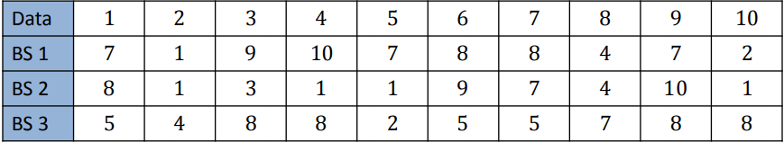
Ensemble Methods – Averaging method - Bagging (Bootstrap Aggregation) :
Multiple sample sets are created from the same data set using random function
Each sample data set is used to create a predictor
Source: http://www.utdallas.edu/~nrr150130/cs7301/2016fa/lects/Lecture_10_Ensemble.pdf

Slide 9
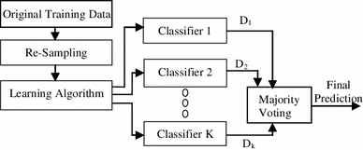
Ensemble Methods – Averaging method - Bagging (Bootstrap Aggregation) :
Re-sampling done for every classifier using a random function. For large n, 63.2% unique samples likely to be selected
Voting could be simple or weighted
Algorithm to generate classifiers. Could be Decision Tree, Naïve Bayes etc
K classifiers created in parallel and independently on respective training data
Source: https://link.springer.com/article/10.1007/s13721-013-0034-x

Slide 10
Ensemble Methods – Boosting Method – AdaBoosting :
Similar to bagging, but the learners are grown sequentially; except for the first, each subsequent learner is grown from previously grown learners
If the learner is a Decision Tree, each of the trees can be small, with just a few terminal nodes (determined by the parameter d supplied )
During voting higher weight is given to the votes of learners which perform better in respective training data unlike Bagging where all get equal weight
Boosting slows down learning (because it is sequential) but the model generally performs well

Slide 11
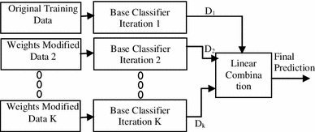
Ensemble Methods – Boosting method - AdaBoosting:
Training data from base data with focus on instances which were incorrectly classified by earlier model (if any)
Voting could be simple or weighted
K similar classifiers created in sequence with respective training data with focus on addressing the misclassified data, not the usual cost functions
It is called Adaptive Boosting as the weights are re-assigned to each instance, with higher weights to incorrectly classified instance
Source: https://link.springer.com/article/10.1007/s13721-013-0034-x

Slide 12
Ensemble Methods – Boosting Method – AdaBoosting :
Two prominent boosting algorithms are AdaBoost, short for Adaptive Boosting and Gradient Descent Boosting
In AdaBoost, the successive learners are created with a focus on the ill fitted data of the previous learner
Each successive learner focuses more and more on the harder to fit data i.e. their residuals in the previous tree

Slide 13
Ensemble Methods – Averaging Method – Gradient Descent Boosting :
Each learner is fit on a modified version of original data (original data is replaced with the x values and residuals from previous learner
By fitting new models to the residuals, the overall learner gradually improves in areas where residuals are initially high

Slide 14
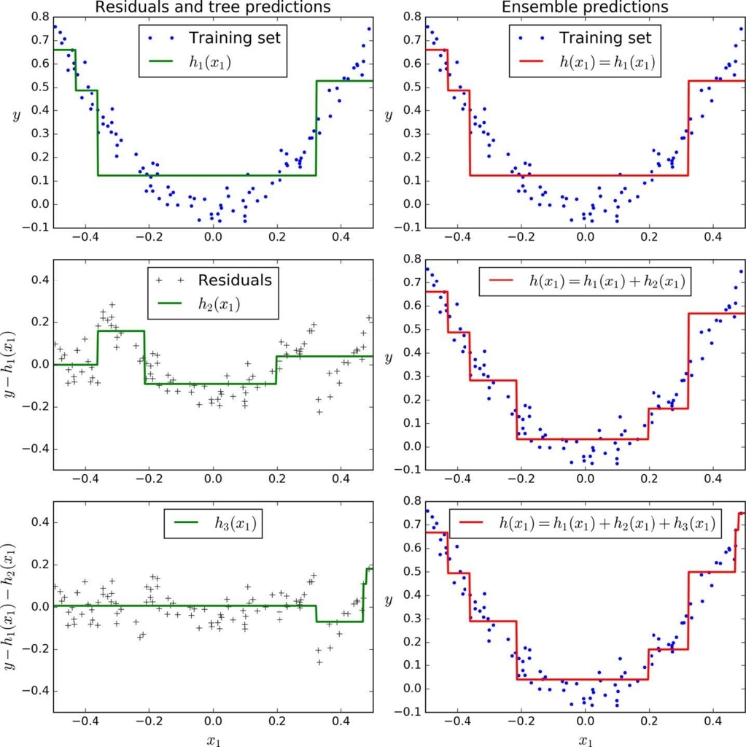
Ensemble Methods – Averaging Method – Gradient Descent Boosting :
First learner results in residuals (dots that fall above and below the surface. The result (red) is same as first classifier
Next classifier focuses on the residuals of the first classifier to reclassify them as correctly as possible
The combined effect of this surface and previous classifier surface is shown in red
The third learner focusses on the residuals of the previous classifier
The combine result of the new surface with the previous surface is shown in red

Slide 15
Ensemble Methods – Stacking:
Similar to bagging, but apply several different models to original data
The weights for each model is determined based on how well they perform on the given input data
Similar classifiers usually make similar errors (bagging), so forming an ensemble with similar classifiers may not improve the classification rate
Presence of a poorly performing classifier may cause performance deterioration in the overall performance
Similarly, even on presence of a classifier that performs much better than all of the other available base classifiers, may cause degradation in the overall performance
Another important factor is the amount of correlation among the incorrect classifications made by each classifier
If the consistent classifiers tend to misclassify the same instances, then combining their results will have no benefit
In contrast, a greater amount of independence among the classifiers can result in errors by individual classifiers being overlooked when the results of the ensemble are combined.

Slide 16
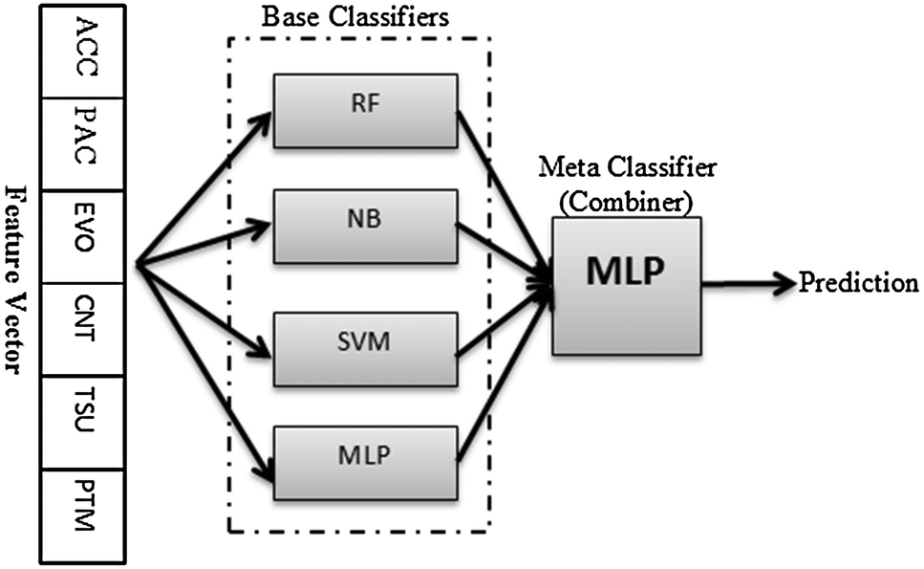
Ensemble Methods – Stacking:
Source: http://pubs.rsc.org/-/content/articlelanding/2014/mb/c4mb00410h/unauth#!divAbstract

Slide 17
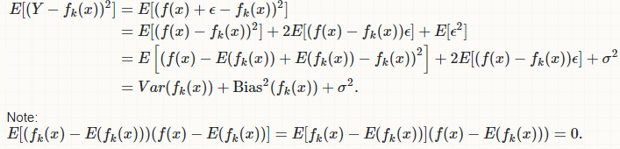
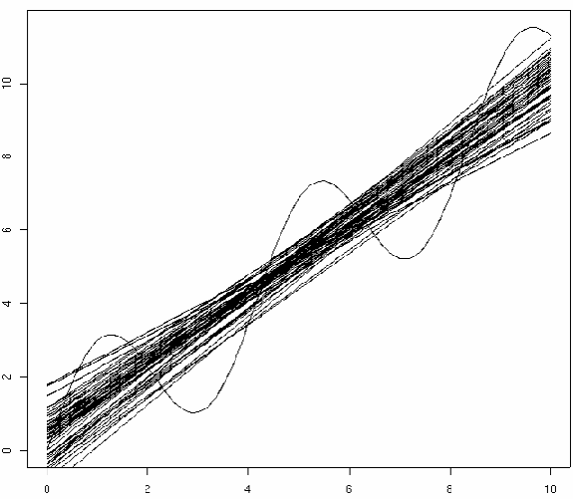
Bias Variance Decomposition
For each data point x, we have the observed value y and several predictions y suppose K (number of lines)
Compute the average prediction h.
Estimate bias as ( h – y)
Estimate variance as
Σ k (y k – h ) 2/(K – 1)
Assume noise is 0

