Slide 1
Numpy_Introduction
Ndarray, a fast and space-efficient multidimensional array.
Standard mathematical functions for fast operations on entire arrays of data without having to write loops
Useful for
Fast vectorized array operations for data munging and cleaning, subsetting and filtering, transformation any kinds of computations
Common array algorithms like sorting, unique, and set operations
Efficient descriptive statistics and aggregating/summarizing data

Slide 2
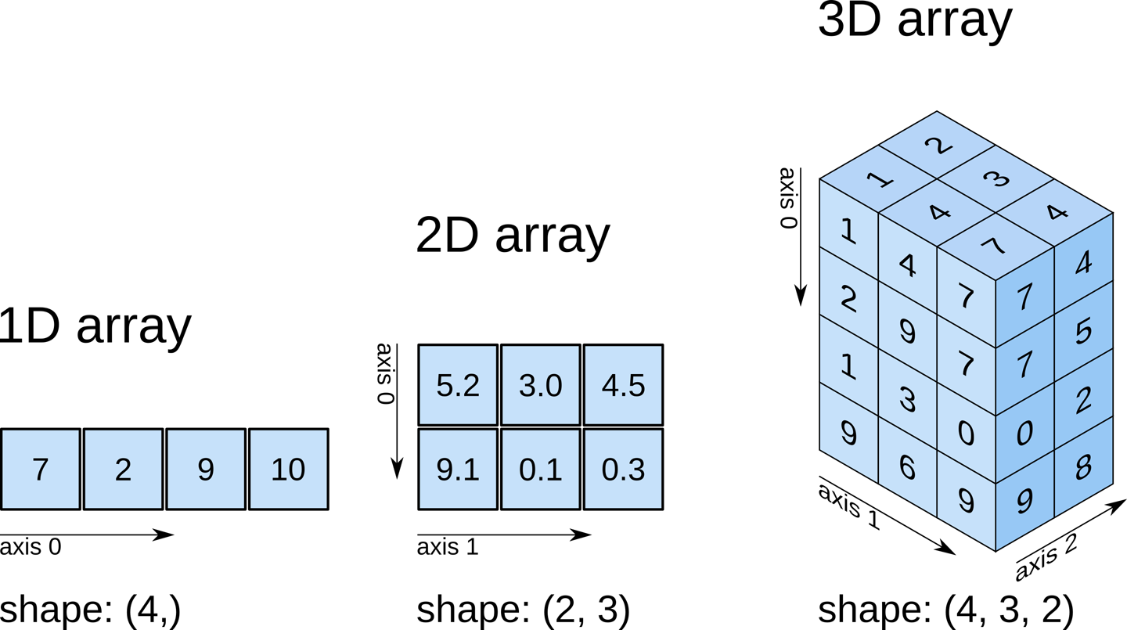
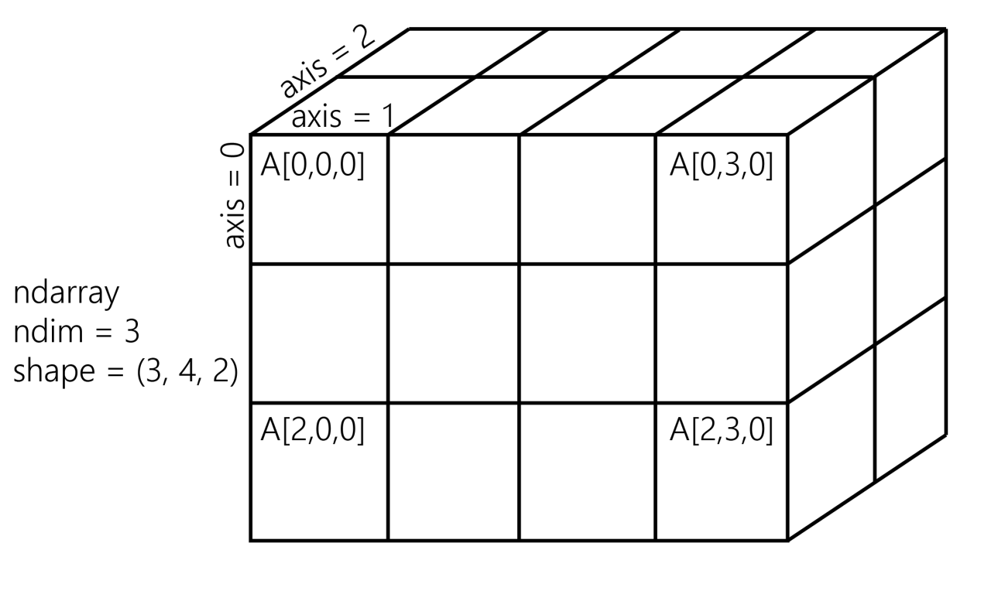
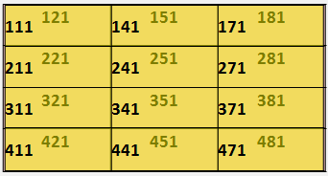
Numpy_Axis

Slide 3
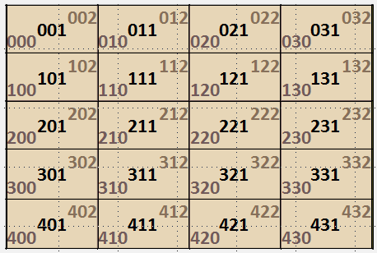
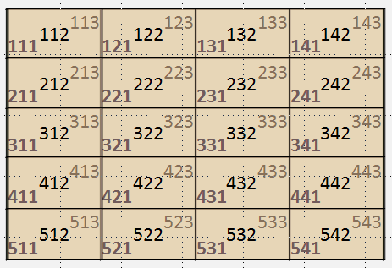
Numpy_3D

