Slide 1
Customer Churn Prediction Analysis

Slide 2
1
Introduction
2
Problem Statement
3
Exploratory Data Analysis (EDA)
4
Hypothesis
7
Suggestions and Conclusion

Slide 3
Introduction
Understanding customer churn is vital for sustaining business growth and profitability.
The client is a prominent service provider offering three distinct packages: low, medium, and high.
Significant challenges with customer retention are present across all segments.
Customer attrition poses a risk to overall business performance.
Specific trends of churn have been observed, particularly among certain service packages.
Budget-conscious customers on the low package are more price-sensitive.
Premium customers on the high package have higher expectations for service quality.
The client has collected valuable customer feedback that has not yet been fully analyzed.
A thorough analysis of customer behavior and feedback is needed to uncover underlying reasons for churn.
Examination of Annual Recurring Revenue (ARR) data will help assess the financial impact of customer attrition across service packages.
The goal is to identify actionable insights to improve customer retention and enhance overall business performance.

Slide 4
Problem Statement
Understanding Customer Churn
Our client is experiencing a significant challenge with customer churn across their service offerings, which include low, medium, and high packages. The key issues are as follows:
High Churn Rates: A noticeable percentage of customers are discontinuing their subscriptions, leading to revenue loss and instability.
Segment-Specific Concerns: It is unclear which service package low, medium, or high is experiencing the highest churn rates, making it difficult to target retention efforts effectively.
Customer Feedback Insights: While customer feedback data is available, it has not been thoroughly analyzed to identify common pain points or dissatisfaction factors contributing to churn.
Financial Impact: The churn is affecting the company’s Annual Recurring Revenue (ARR), and understanding the financial implications is crucial for strategic planning.
Objective: The client seeks to analyze customer churn to identify at-risk segments, understand the reasons behind customer attrition, and develop targeted strategies to improve retention and enhance overall customer satisfaction.

Slide 5
Exploratory Data Analysis (EDA)
Overview of EDA Process
In our Exploratory Data Analysis (EDA), we conducted a comprehensive examination of the customer data to uncover patterns and insights related to churn. This process involved the following steps:
Data Analysis: We analyzed the dataset to understand customer demographics, service usage, and churn rates across different service packages.
Hypothesis Generation: Based on our initial analysis, we formulated several hypotheses regarding the factors influencing customer churn.
Hypothesis Testing: We tested these hypotheses using statistical methods and visualizations to validate our assumptions and gain deeper insights into customer behavior.

Slide 6
Hypothesis
Changes in Annual Recurring Revenue (ARR) are positively correlated with customer chum rates, with a decrease in ARR associated with an increase in chum
The type of industry in which a customer operates significantly influences churn rates, with certain industries exhibiting higher chum tendencies than others
3. Customer with high tenure are more likely to churn compared to those with less tenure rate
4. A lower Customer Satisfaction Score (CSAT) is predictive of increased customer churn, indicating that dissatisfied customers are more likely to Churn
5. A lower Net Promoter Score (NPS) is associated with higher churn rates, suggesting that customers who are less likely to recommend the product are more likely to discontinue their use
6. When the customer facing billing issue are more likely to churn
7. Customers with access to a limited number of products or features are more likely to chum compared to those with a broader product offering
8. Customers with low seat utilization tales more likely to experience higher chum rates compared to those with optimal seal utilization
9. Customers with sales assisted are less likely to churn
10. The type of Region in which a customer belongs to are more significantly churn, with certain regions exhibiting less chum tendencies

Slide 7
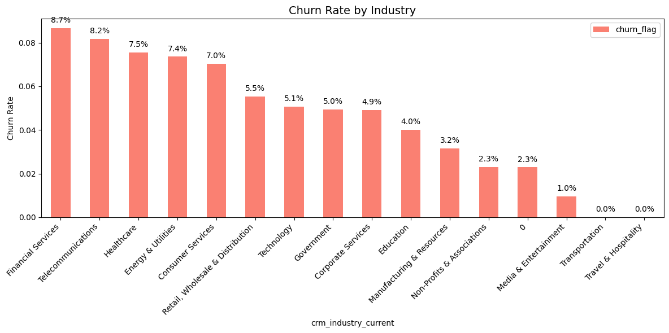
Hypothesis on Churn Rate Analysis

Slide 8
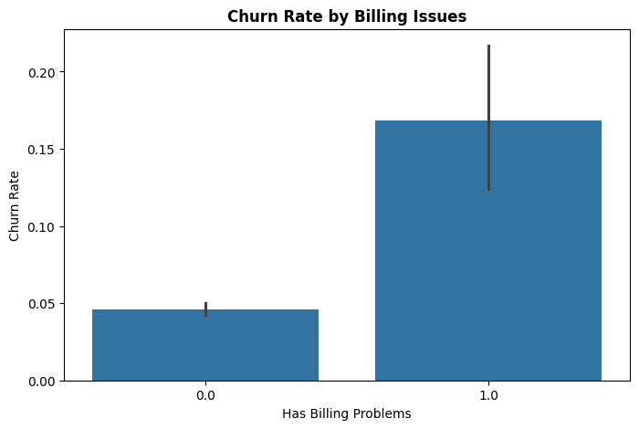
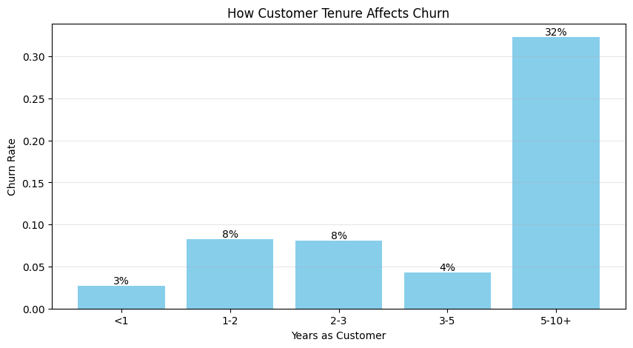
Hypothesis on Billing Issue and Customer Tenure
Customers with Billing issue are more likely to churn Customer with high tenure are more likely to churn

Slide 9
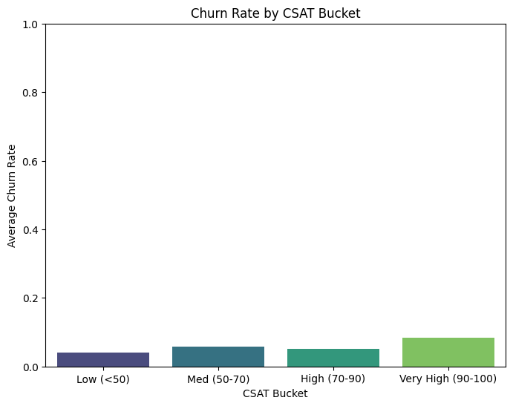
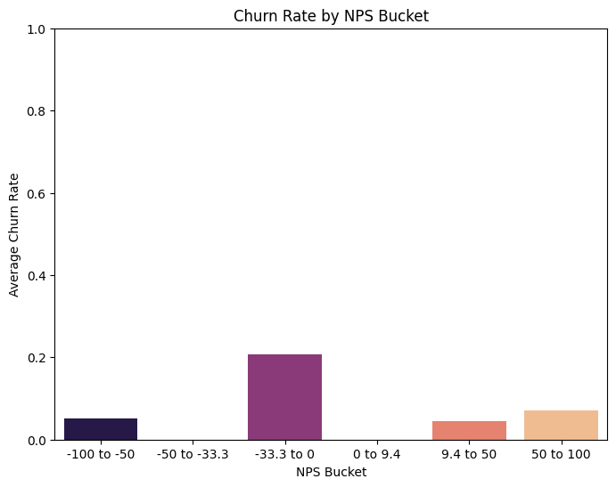
Hypothesis on CSAT and NPS Score
Customers with Low CSAT Score are more likely to churn
Customers with Low NPS Score are more likely to churn

Slide 10
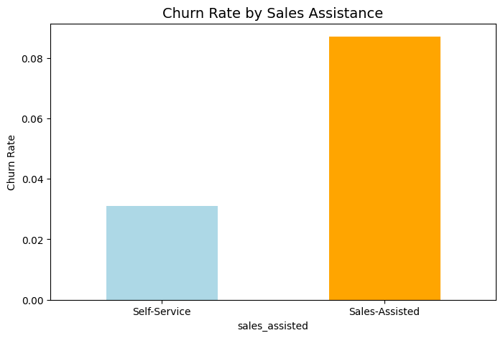
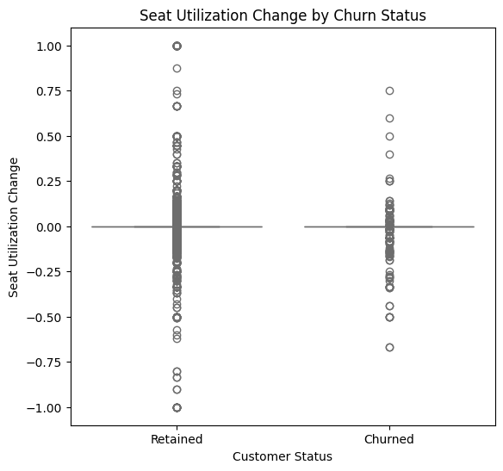
Hypothesis on Sales assisted and Seat Utilization
Customers with Sales assisted are more likely to churn Customer with Less Seat Utilization are more likely to churn

Slide 11
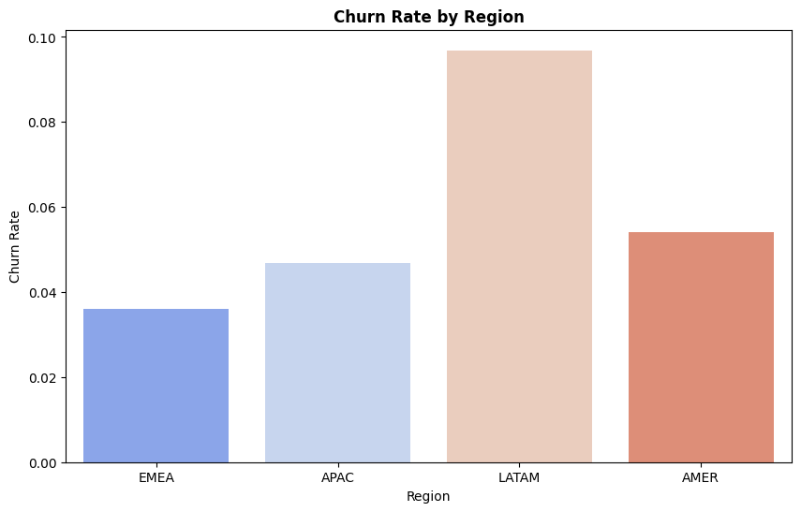
Hypothesis on Regions
Based on regions are more likely to churn

Slide 12
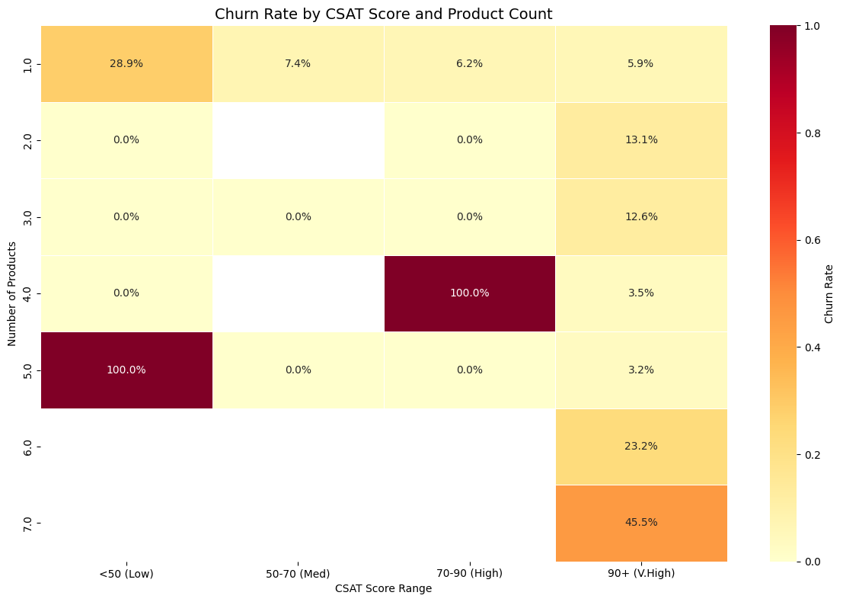
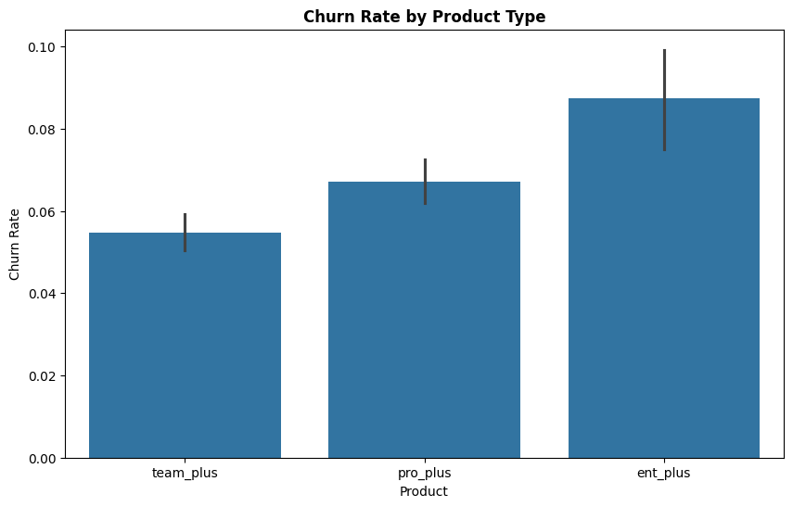
Hypothesis on Product Type and CSAT Score
Customers with Less CSAT Score and High Product usage are
more likely to churn
Customers with Higher Version of Product Tier are more
likely to churn

Slide 13
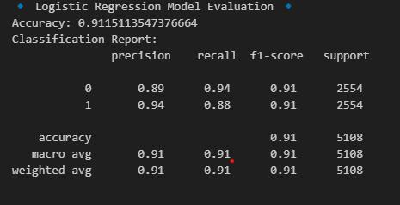
Model Evaluation

Slide 14
Suggestions
1. Monitor ARR Trends: Regularly track changes in Annual Recurring Revenue (ARR) to identify early signs of potential churn and take proactive measures to address customer concerns.
2. Engage Long-Term Customers: Implement targeted engagement initiatives for customers with high tenure, such as personalized communication and loyalty rewards, to enhance their experience and reduce churn.
3. Improve Customer Satisfaction: Focus on enhancing the Customer Satisfaction Score (CSAT) by addressing common pain points and soliciting feedback to make necessary improvements.
4. Boost Net Promoter Score (NPS): Encourage customer advocacy by improving service quality and addressing issues that lead to dissatisfaction, thereby increasing the likelihood of recommendations.
5. Resolve Billing Issues: Streamline billing processes and provide clear communication to minimize billing issues can reduce customer retention.
6. Expand Product Offerings: Consider offering a broader range of products or features to customers, as those with limited access are more likely to churn.
7. Optimize Seat Utilization: Monitor and encourage optimal seat utilization among customers, providing training or resources to help them maximize the value of their subscriptions.
8. Regional Strategies: Analyze churn patterns by region and develop targeted retention strategies for areas with higher churn tendencies, focusing on local customer needs and preferences.
9. Industry-Specific Strategies: Develop tailored retention strategies for industries with higher churn tendencies, focusing on understanding their unique needs and challenges.

Slide 15
Thank You

