Slide 1
Welcome
To
Open Source Propaganda
(OR...)

Slide 2

_{Mujhe}Hackerman Banadopls
Fest!

Slide 3


Slide 4
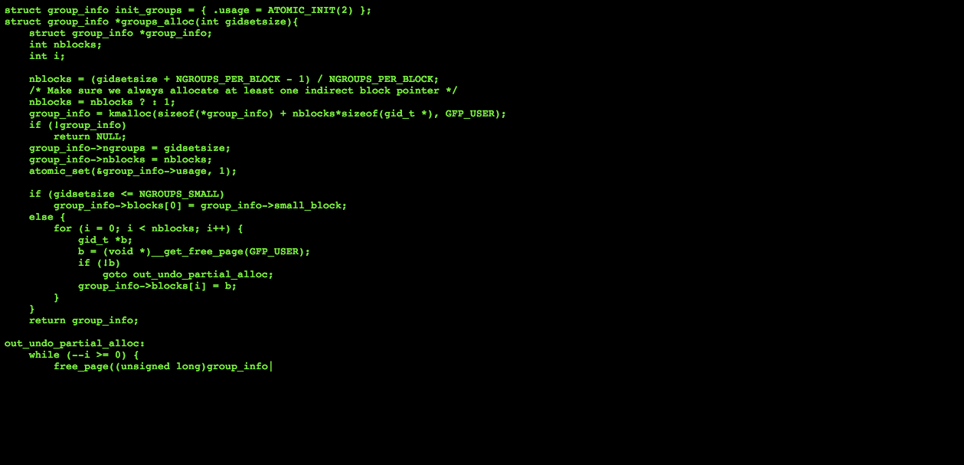
^{Why Linux?}
                _{if ( software == free) {}
                _{use = software;}
                _{karma++;}
                }

Slide 5

But so are many other things.
Why specifically Linux?

Slide 6

Because it’s also OPEN SOURCE.

Slide 7

Wait, aren’t they the same thing? Huh?

Slide 8
So, why Linux?
Here’s the simple version:
It is Free / Libre (and) Open Source Software.
Which means….
  Anyone can see the code, modify the code, essentially make their OWN linux. Yes, you can, too, if you want.
  It also means…
    Thousands Millions of developers working together for the most optimized results.
    Equal number of security analysts inspecting the code for maintaining next to no inherent security vulnerabilities.
    And lastly:
      NO WINDOWS UPDATES.

Slide 9


So, in essence...
Me, / comfy af /, using linux
at 120 binaries per second
You running windows
at 120 updates
per second

Slide 10
The Not So Simple Version
Freedom to choose:
  Desktop Environments
  Window Managers
  C standard Libraries (libc)
  Flavours / Distributions which come prepackaged with unending combinations of the above and below
  Modules / Drivers (Open Source or Proprietary)
  Filesystems
  Shells (command interpreters)

Slide 11
Don’t believe me? Try visiting: https://www.reddit.com/r/unixporn
Don’t understand what those things are?
We’ll get there. Stay with.

Slide 12

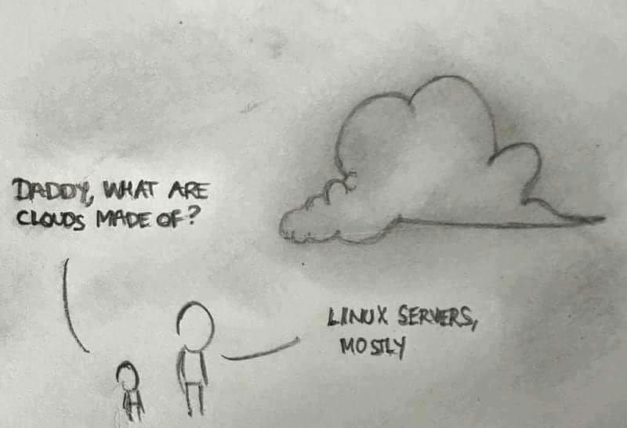
Now, what is this Linux everybody is talking about?

Slide 13
It is an operating… ?

Slide 14
Well, that is partly correct. Actually, Linux is just a kernel.
What is a kernel?
It’s the beating heart of your operating system. It is the software layer that communicates with the hardware; talks to them in incomprehensible binary and keeps ordering them around for some reason.

Slide 15
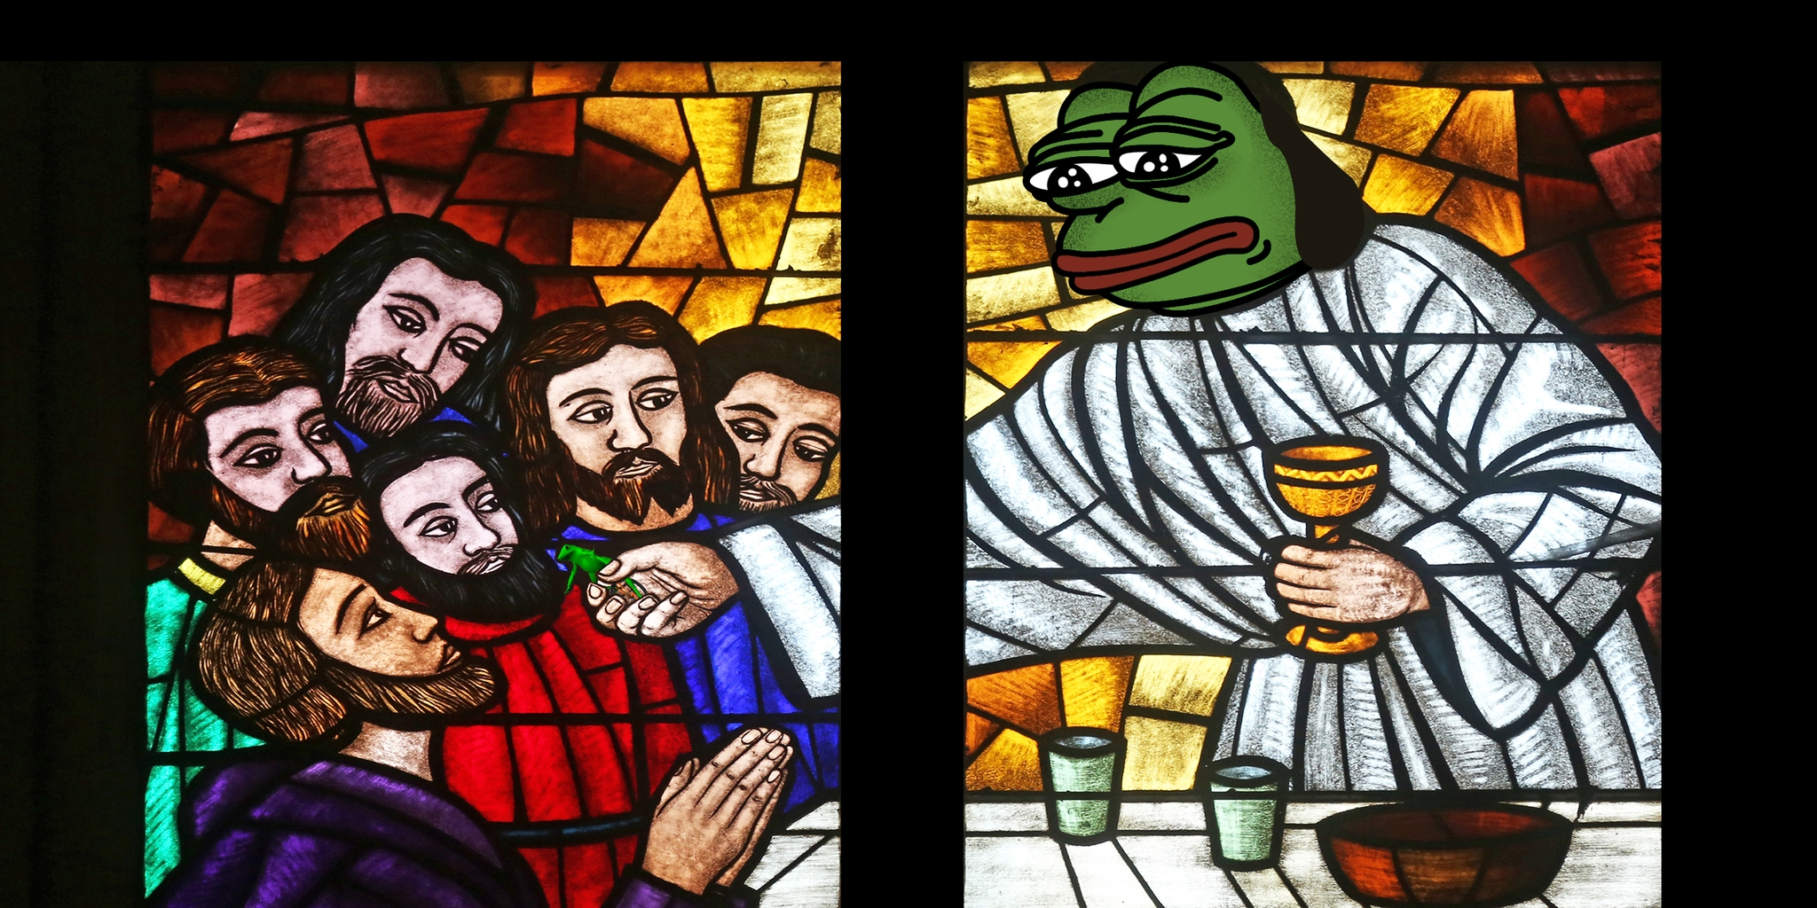
your 2000$ GPU, CPU and RAM
Linux Peppermint Christ, our lord
and saviour

Slide 16
What will Linux not make you?

Slide 17
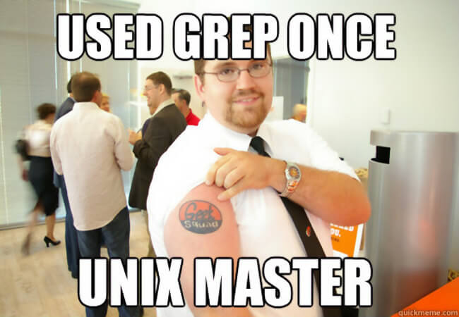
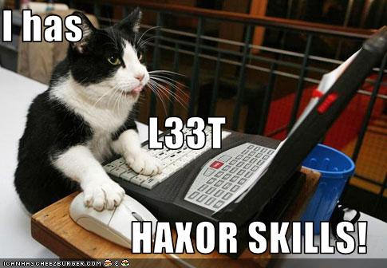
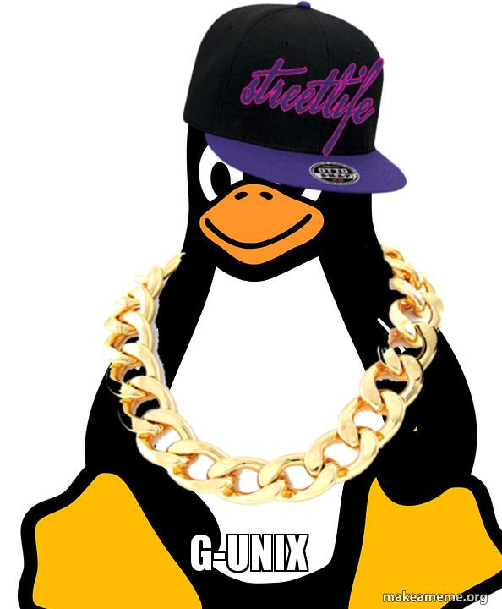
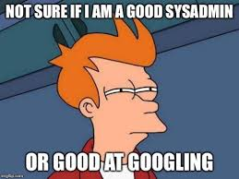

Slide 18
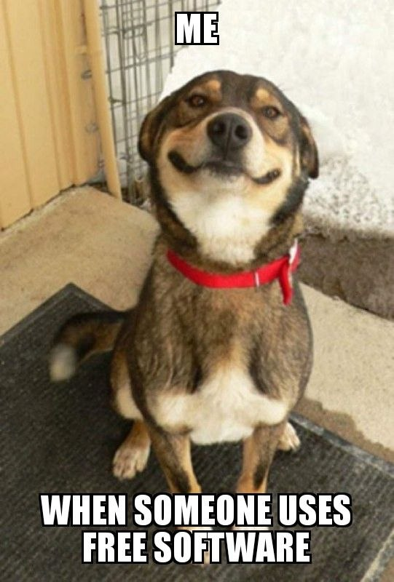
But Linux will:
Let you very well know that you must understand code in order to write it.
Teach you great code practices through debugging.
Get you acquainted with the environment before you start using it.
Make you follow a bottom-up approach in almost everything but only if you want to.
Make you, if not a programmer, if not a debugger; a very proud user of free / libre open source software.

Slide 19

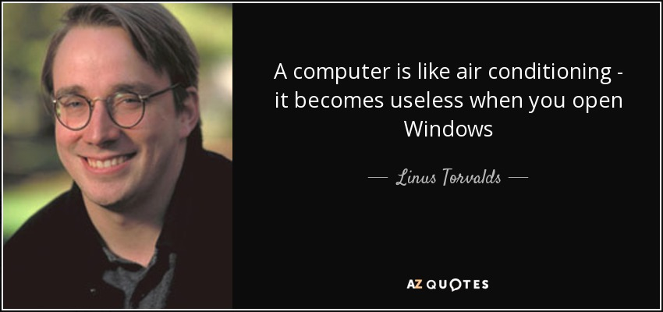
Here’s to
Master
Linus

