Slide 1
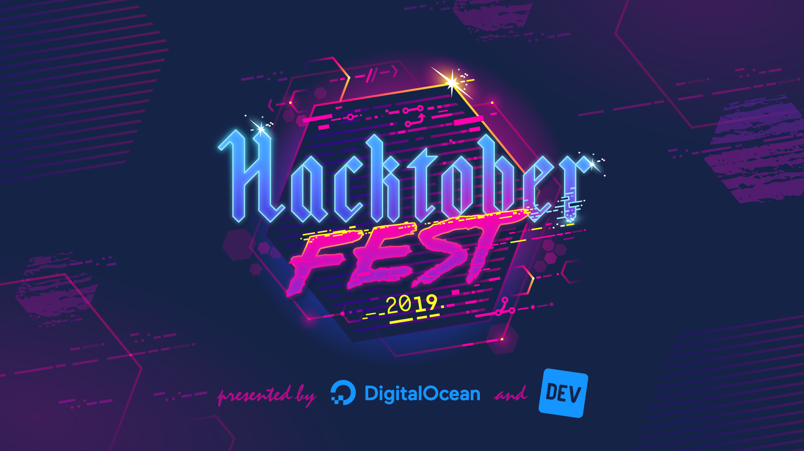

Slide 2

Introduction

Slide 3
What is Software?
- Software is a collection of instructions that enable the user to interact with a computer, its hardware, or perform tasks.
- Without software, most computers would be useless.
- For example, without your Internet browser software, you could not surf the Internet or read this page. Without an operating system, the browser could not run on your computer. The picture shows a Microsoft Excel box, an example of a spreadsheet software program.
- That game you play or the app which you use to listen to music is also a software.

Slide 4
What is Software development?
- Software development is the process of conceiving, specifying, designing, programming, documenting, testing, and bug fixing involved in creating and maintaining applications, frameworks, or other software components.
- Software development is a process of writing and maintaining the source code, but in a broader sense, it includes all that is involved between the conception of the desired software through to the final manifestation of the software, sometimes in a planned and structured process.
- Therefore, software development may include research, new development, prototyping, modification, reuse, re-engineering, maintenance, or any other activities that result in software products.

Slide 5
There are
1. Proprietary s/w : Proprietary software, also known as closed-source software, is a non-free computer software for which the software's publisher or another person retains intellectual property rights—usually copyright of the source code, but sometimes patent rights.
2. Free and Open Source s/w : People can modify and share because its design is publicly accessible. Open source projects, products, or initiatives embrace and celebrate principles of open exchange, collaborative participation, rapid prototyping, transparency, meritocracy, and community-oriented development.

Slide 6
What is version control?
- Version control, also known as revision control or source control, is the management of changes to documents, computer programs, large web sites, and other collections of information.
- Changes are usually identified by a number or letter code, termed the "revision number", "revision level", or simply "revision". For example, an initial set of files is "revision 1". When the first change is made, the resulting set is "revision 2", and so on.
What is distributed version control?
- In software development, distributed version control (also known as distributed revision control) is a form of version control in which the complete codebase, including its full history, is mirrored on every developer's computer.
- This enables automatic management branching and merging, speeds up of most operations (except pushing and pulling), improves the ability to work offline, and does not rely on a single location for backups.

Slide 7
What is Git?
- Git is a distributed version-control system for tracking changes in source code during software development.
- It is designed for coordinating work among programmers, but it can be used to track changes in any set of files.
- Its goals include speed, data integrity, and support for distributed, non-linear workflows.
Are there other version control systems?
Yes, subversion,mercurial are some of the other version control systems.

Slide 8
What is GitHub?
- GitHub offers all of the distributed version control and source code management (SCM) functionality of Git as well as adding its own features. It is a cloud based git service.
- It provides access control and several collaboration features such as bug tracking, feature requests, task management, and wikis for every project.
- GitHub offers plans for free, professional, and enterprise accounts. Free GitHub accounts are commonly used to host open source projects.

Slide 9
Is GitHub, the only cloud based Git service?
NO, there are many other cloud based Git services such as :
- Assembla
- Bitbucket
- Beanstalk
- CloudForge
- Codebase
- GitLab
- Microsoft Visual Studio team services

Slide 10
To create interest in open source software development, there are many summer/winter programs for students to get started with. You can find it all over here:
https://github.com/tapaswenipathak/Open-Source-Programs
Now, to brief about some of the programs such as GsoC, Outreachy, Open Mainframe Project, Linux Foundation Networking Internships, Hyperledger program, Julia Summer of Code, SOCIS, etc.

Slide 11
What's Hacktoberfest?
Hacktoberfest — brought to you by DigitalOcean in partnership with DEV — is a month-long celebration of open source software. Maintainers are invited to guide would-be contributors toward issues that will help move the project forward, and contributors get the opportunity to give back to both projects they like and others they've just discovered. No contribution is too small — bug fixes and documentation updates are valid ways of participating.
Can't make it to this event?
Hacktoberfest is virtual and open to participants from around the globe.
Sign up to participate today at https://hacktoberfest.digitalocean.com .

Slide 12
Rules and Prizes :
1. First, sign up on the Hacktoberfest site at https://hacktoberfest.digitalocean.com .
2. To qualify for the official limited edition Hacktoberfest shirt, you must register and make four pull requests between October 1-31.
3. Pull requests can be to any public repo on GitHub, not just the ones with issues labeled Hacktoberfest.
4. If a maintainer reports your pull request as spam or behavior not in line with the project’s code of conduct, you will be ineligible to participate.
5. Connect with other Hacktoberfest participants by using #hacktoberfest on your social media platform of choice.
6. New to DigitalOcean? Receive USD $50 in infrastructure credit at https://do.co/hacktoberfest50 .

Slide 13
Let’s get some work done now.
Go to
https://github.com/p-society/hacktoberfest_newbies/blob/master/get_started.md
And let’s get you started with the fun.
Since, today you will be doing 2 pull requests here. It will be easy for all of you to get a t-shirt as you have to do only 2 more pull requests.

Slide 14
Thank You!!
Caution : Do not stop contributing to open-source.

