Slide 1

Rating prediction project

Slide 2
AGENDA
Introduction​
Problem Statement
Business Goal
Technical Requirement
Exploratory Data Analysis (EDA)
Data Description
Visualization
Data Pre-Processing
Build Model
Saved Best Model
Summary​

Slide 3
Introduction
We have a client who has a website where people write different reviews for technical products. Now they are adding a new feature to their website i.e. The reviewer will have to add stars(rating) as well with the review. The rating is out 5 stars and it only has 5 options available: 1 star, 2 stars, 3 stars, 4 stars, 5 stars.
Now they want to predict ratings for the reviews which were written in the past and they don’t have a rating. So, we have to build an application which can predict the rating by seeing the review.
We have two phase:
1) Data Collection Phase: Scrape at least 20000 rows of data or more data from multiple websites.
2) Model Building Phase: After collecting the data, we need to build a machine learning model.
Before model building do all data preprocessing steps involving NLP. Try different models with different hyper parameters and select the best model.

Slide 4
Business Goal
People use multiple websites for shopping, like: Amazon, Flipkart etc. So, from these websites had to scrap all reviews and process them using Natural Language Processing to predict ratings for the reviews which were written in the past and they don’t have a rating by building an application (Machine Learning Project).

Slide 5
Technical Requirements
This project contains two phases:
1) Data Collection Phase: Scrape the reviews and ratings as data of two websites: Amazon and Flipkart
2) Model Building Phase: After collecting the data, we need to build a machine learning model. Before model building do all data preprocessing steps involving NLP. Try different models with different hyper parameters and select the best model.
Follow the complete life cycle of data science. Include all the steps like:
1. Data Cleaning
2. Exploratory Data Analysis
3. Data Preprocessing
4. Model Building
5. Model Evaluation
6. Selecting the best mode

Slide 6
Exploratory Data Analysis (EDA)
Checked Top 5 rows of dataset
Checked Total Numbers of Rows and Column
Checked All Column Name
Checked Data Type of All Data
Checked for Null Values of both dataset
Checking if "-" values present in dataset or no
Checked total number of unique value
Checked Information about Data
Dropped irrelevant features
Handled NULL values
Handled duplicate values

Slide 7


Data Description of Train Data-set
The dataset contains 53363 records (rows) and 4 features (columns).
After removal of irrelevant feature, and also after pre-processing, we remains with 49239 records (rows) and 4 features (columns).

Slide 8
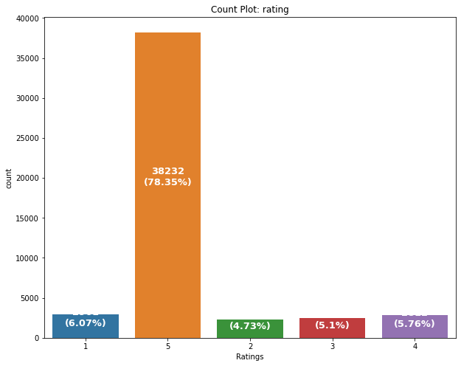
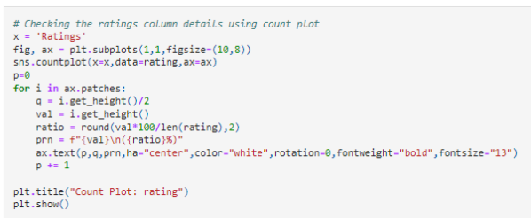

Data Visualization

Slide 9
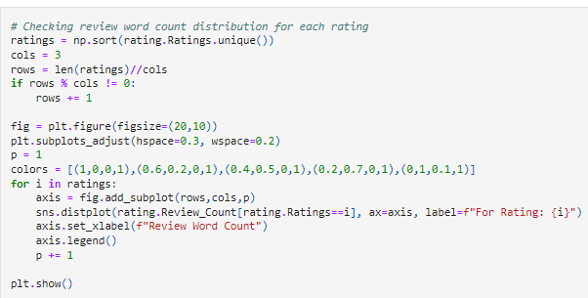
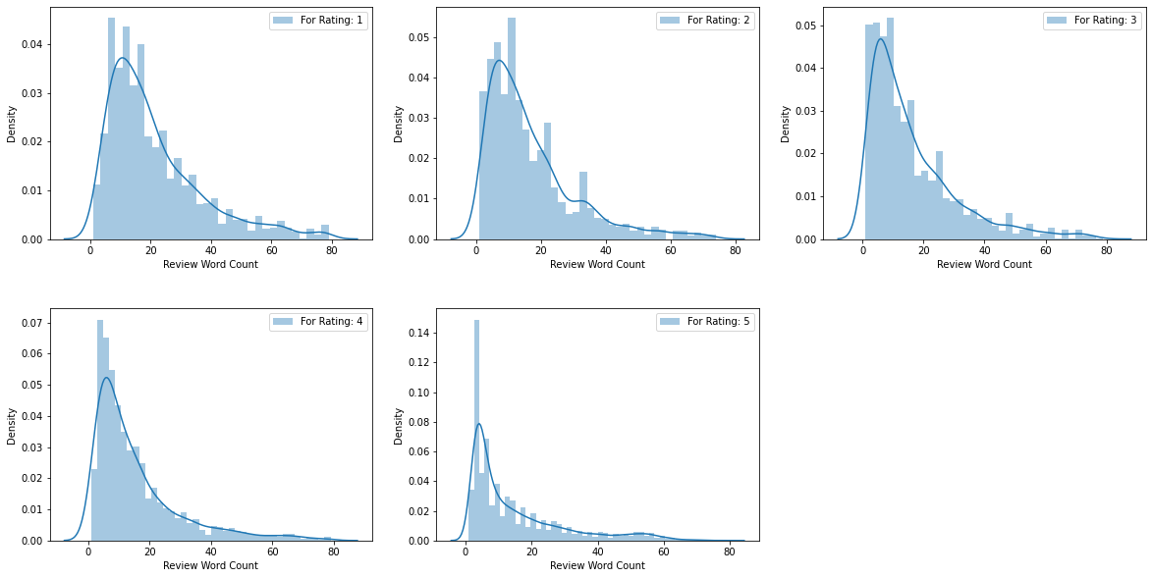
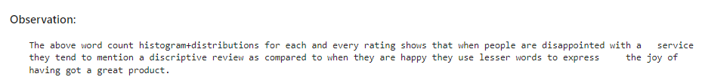

Slide 10
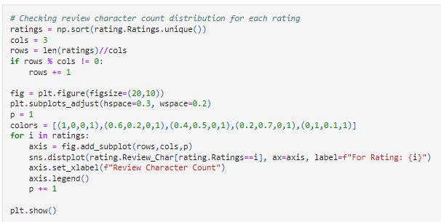
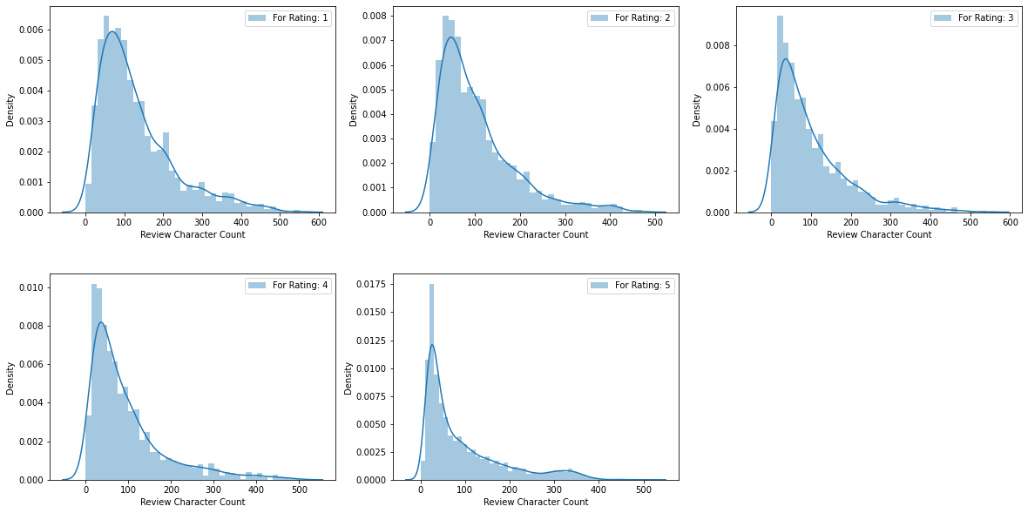

Slide 11
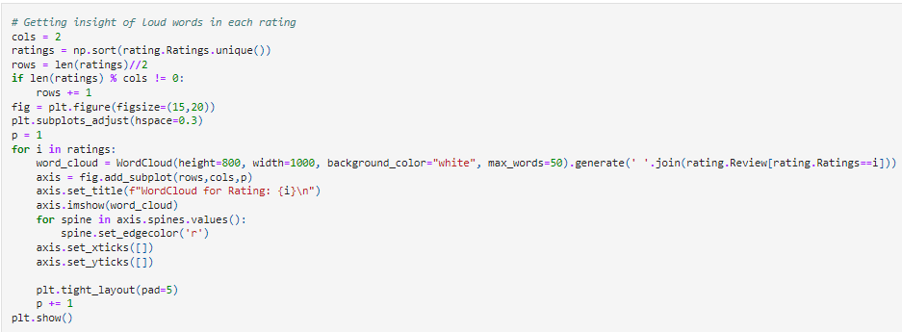
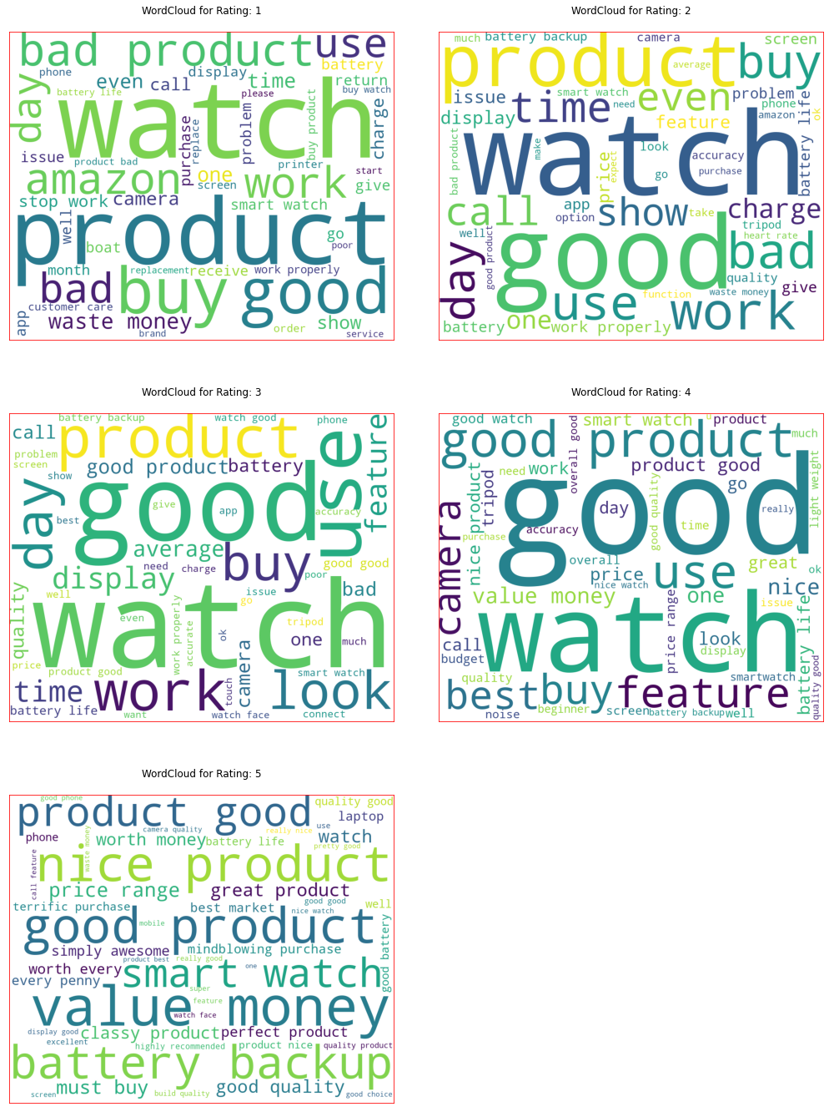
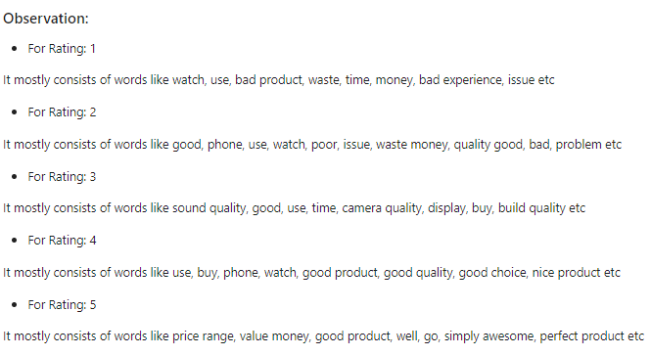

Slide 12
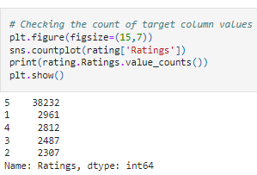
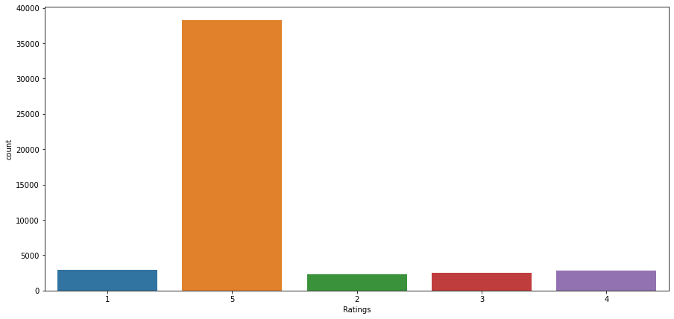
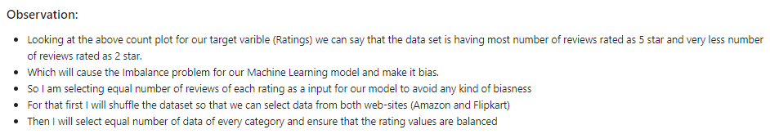

Slide 13
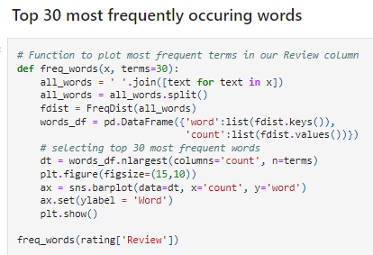
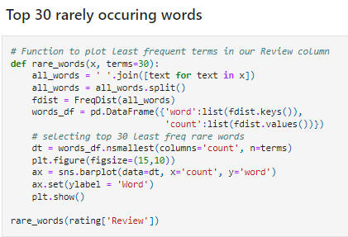
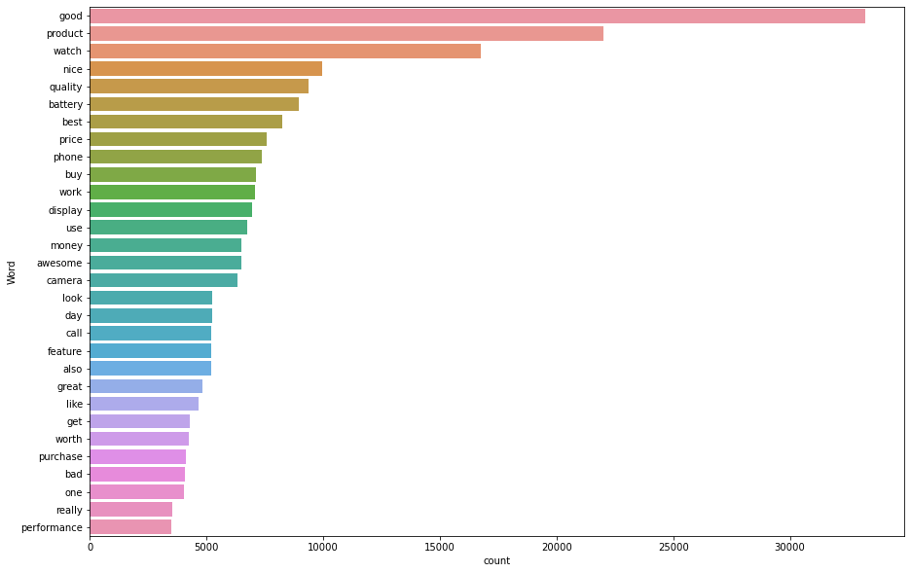
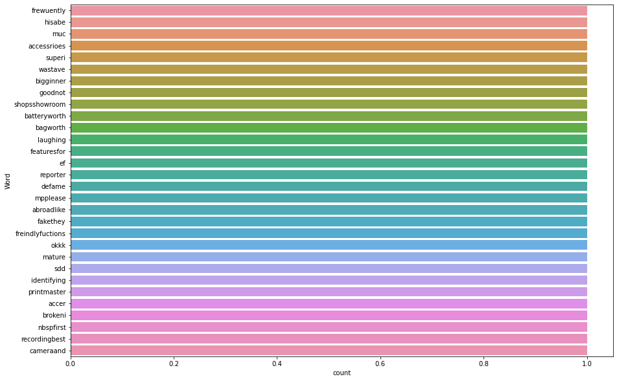

Slide 14

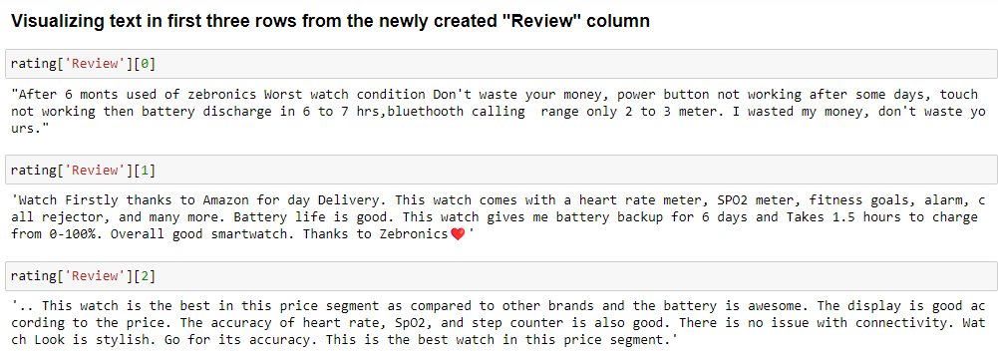
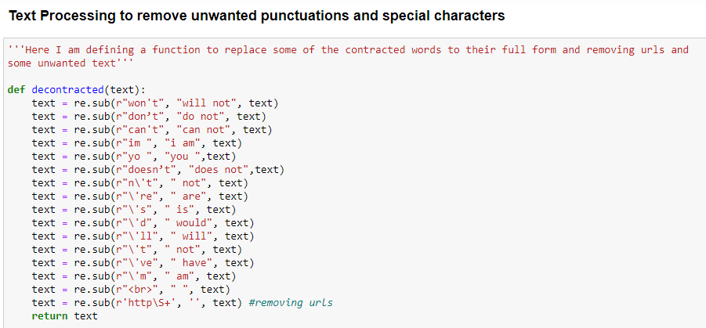
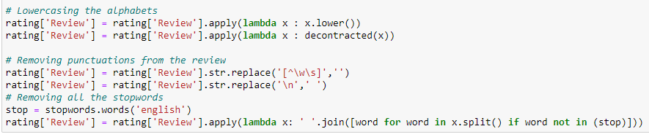

Slide 15


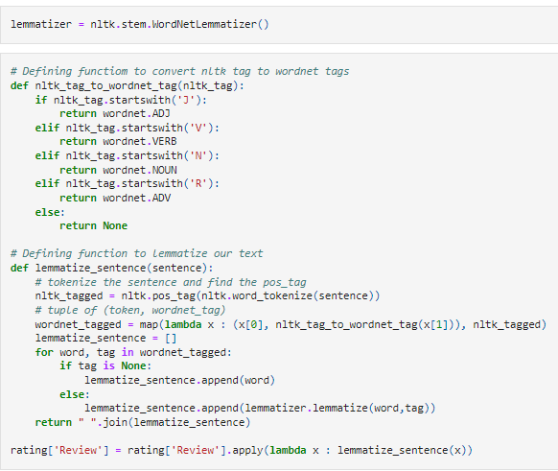
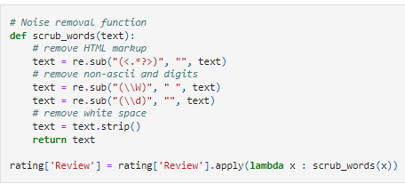

Slide 16


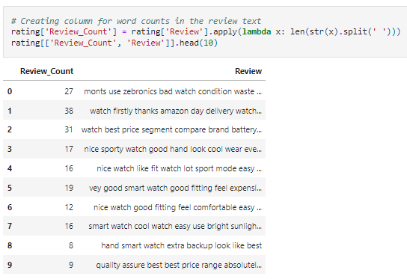
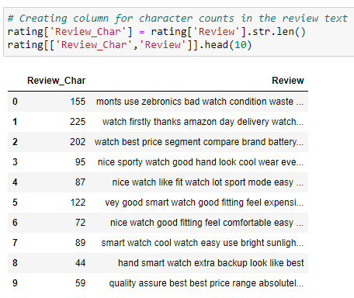

Slide 17
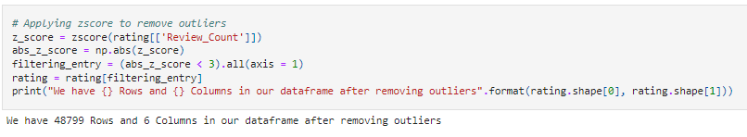
Removing Outliers

Slide 18
Hardware and Software Requirements and Tools Used
Hardware used:
Processor: 11th Gen Intel(R) Core (TM) i3-1125G4 @ 2.00GHz 2.00 GHz
System Type: 64-bit OS
Software used:
Anaconda for 64-bit OS
Jupyter notebook

Slide 19
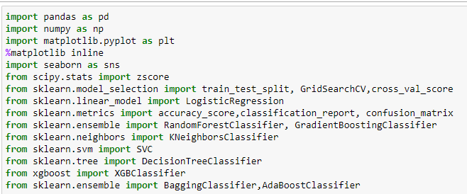
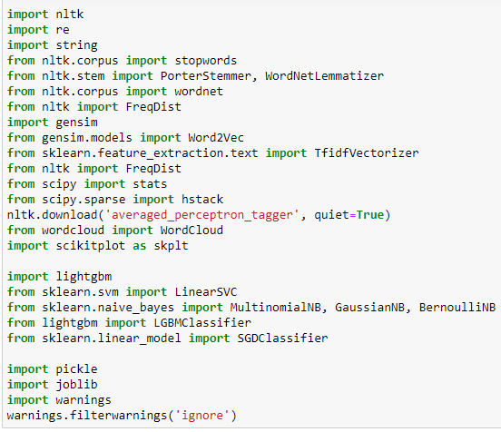
Tools, Libraries and Packages used:

Slide 20
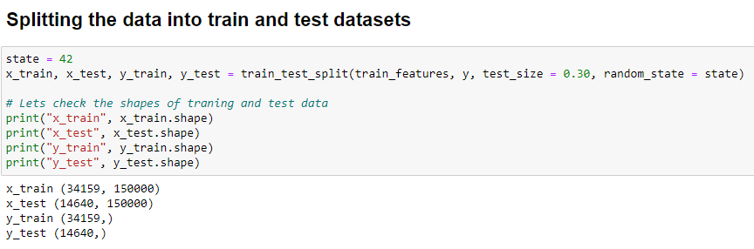
Testing of Identified Approaches (Algorithms)
Logistic Regression
Linear Support Vector Classifier
Bernoulli NB
Multinomial NB
SGD Classifier
LGBM Classifier
XGB Classifier

Slide 21
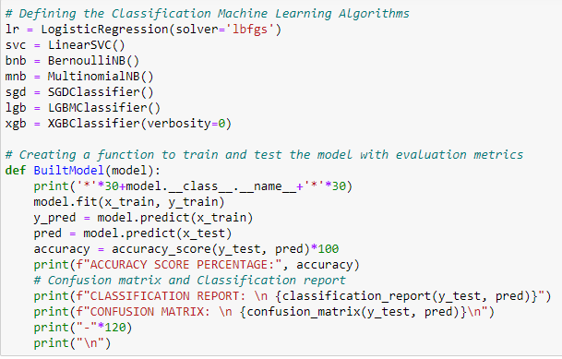


Slide 22
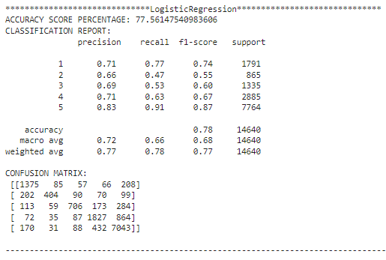
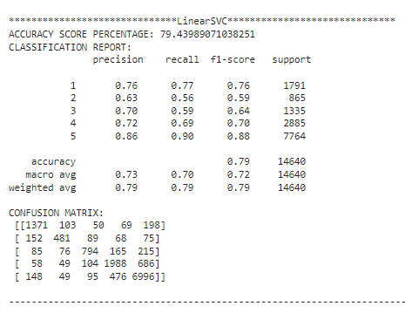

Slide 23
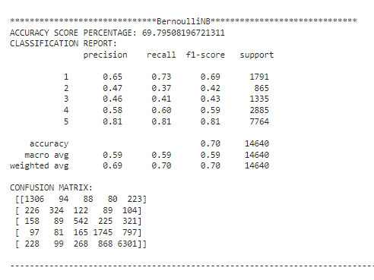
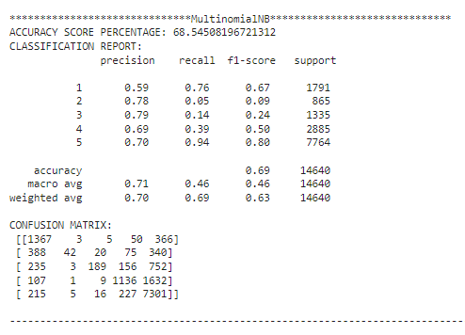

Slide 24
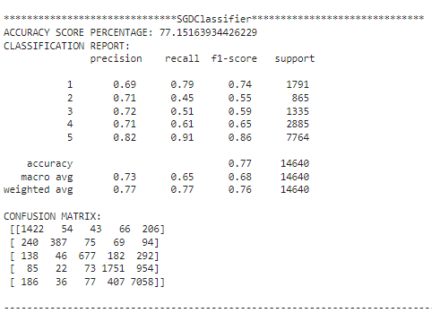
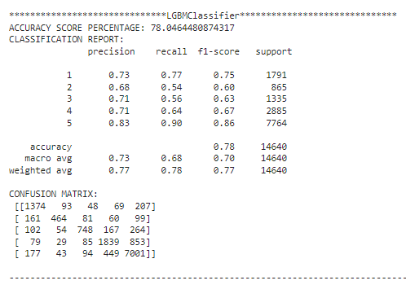

Slide 25
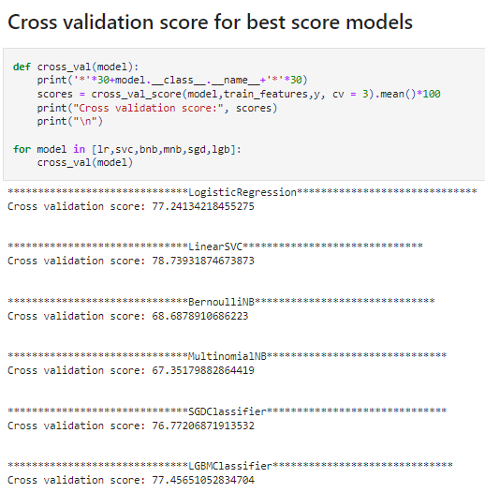

Slide 26
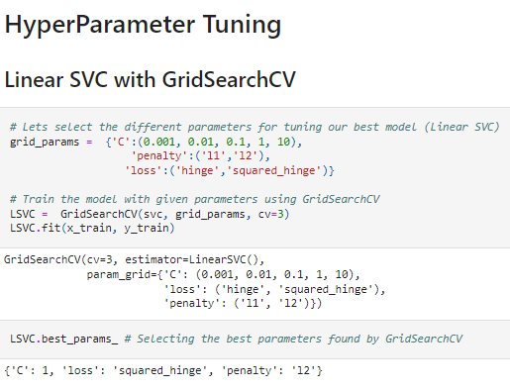

Slide 27
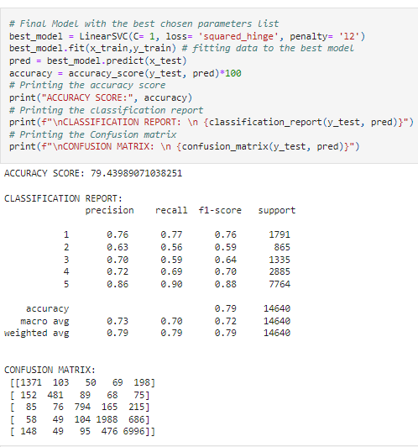

Slide 28
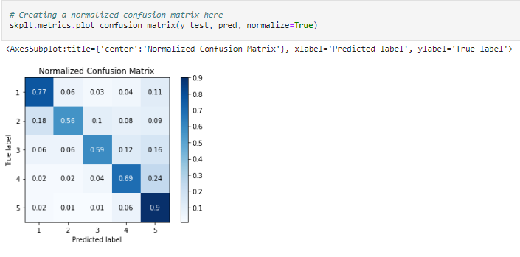

Slide 29

Final Procedure: 1. Saving the model

Slide 30
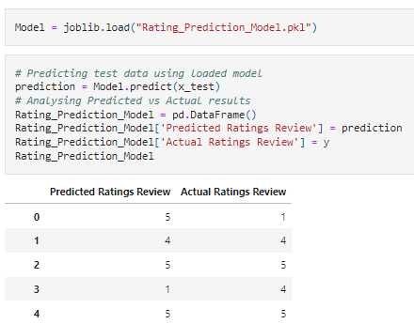
2. Comparing Actual and Prediction

Slide 31

3. Saving the model in CSV format

Slide 32
SUMMARY
In this project we have collected data of reviews and ratings for different products from amazon.in and flipkart.com. Then we have done different text processing for reviews column and chose equal number of texts from each rating class to eliminate problem of imbalance. By doing different EDA steps we have analyzed the text.
We have checked frequently occurring words in our data as well as rarely occurring words. After all these steps we have built function to train and test different algorithms and using various evaluation metrics we have selected Linear-SVC for our final model.
Finally, by doing hyperparameter tuning we got optimum parameters for our final model. And finally, we got improved accuracy score for our final model.

Slide 33
THANK YOU
Prepared by: Pankaj Suryawanshi
SME Name: Mohd Kashif

