Slide 1
WildFire
Jessica Oberg
Peter Swantek
Xin Qu
Paul Duszak
Terry Schmidt
Tony Sarles

Slide 2
Goals
G1
Users should be able to utilize the sensor and collect and upload readings of hazardous particulates
G2
Consumers should be able to receive data and warnings from the collected readings

Slide 3
Glossary
Hazardous Particulates: Compounds detected by the application that are potentially harmful to the user’s health
Sensor: WaspMote board
The App: May Refer to web or mobile user facing app
Personal Device: Smart phone or tablet

Slide 4
Use Cases

Slide 5
Case 1: Operation in Hazardous Situations
Related Goals:G1, G2
Primary Actors:
Rescue workers (or other persons) who are regularly exposed to potentially hazardous particulates.
Precondition
Rescue worker has sensors connected to app
Rescue worker has the app installed on their personal device
Sensors are reading data
Postcondition
Sensors are off
Main Success Scenario
1. Sensors relay correct information to database
2. Worker is notified of hazardous conditions

Slide 6
Case 2: Normal Operation (Pedestrian/Citizen)
Related Goals:G2
Primary Actors:
Citizens who are concerned about the changing quality of the air in their everyday commutes. People who have a mobile phone containing the app and sensors and are continuously recording data.
Precondition
User may have sensors connected to app
User has application installed on their personal device
Sensors are reading data
Postcondition
User gets a measurement on the local air quality
Sensors are turned off
Data output from sensors was successfully recorded
Main Success Scenario
1. Sensors are able to generate accurate readings
2. App records correct information, successfully sends to the database
3. User is notified of potential hazardous conditions and general
environmental quality

Slide 7
Case 3: Data Collection for Environmental Research
Related Goals: G2
Primary Actors:
Researchers monitoring certain environmental conditions over time
Precondition
Researcher is able to connect to the database
Database contains accurate environmental data
Postcondition
Database connection terminated
Database integrity intact
Main Success Scenario
Researcher/User able to successfully extract required information from database

Slide 8
User Interface

Slide 9
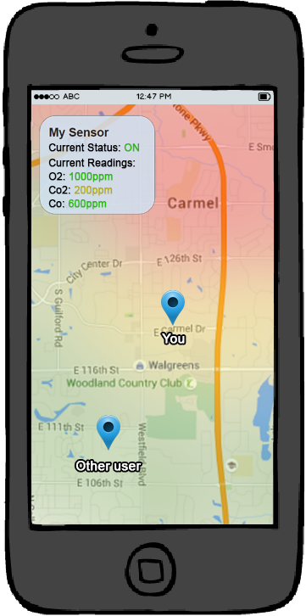
Mobile

Slide 10
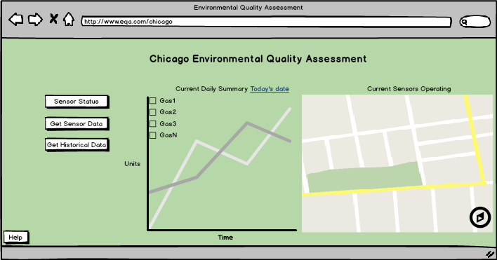
Desktop

Slide 11
FMECA

Slide 12
Process Step
Users should be able to utilize the sensor to collect and upload readings of hazardous particulates
Consumers should be able to receive data and warnings from the collected readings
User
Consumer

Slide 13
Potential Failure Mode
Sensors do not read particulate counts
Sensors read inaccurate particulate counts
Collection database is down
Device fails to send warning signal
App receives incorrect warning
User
Consumer

Slide 14
Potential Failure Effect
A user may enter an unsafe area and become exposed to harmful material, negatively affecting their health
Annoyed researcher
A user may enter an unsafe area and become exposed to harmful material, negatively affecting their health
Annoyed user
User
Consumer

Slide 15
Severity
Sensors do not read particulate counts
Sensors read inaccurate particulate counts
Collection database is down
10
10
10
User

Slide 16
Severity
Device fails to send warning signal
App receives incorrect warning
10
4
Consumer

Slide 17
Potential Causes
Sensors do not read particulate counts
Sensors read inaccurate particulate counts
Collection database is down
Sensor hardware failure, improper sensor programming
User

Slide 18
Potential Causes
Device fails to send warning signal
App receives incorrect warning
No reception / data in area
Consumer

Slide 19
Occurence
Sensors do not read particulate counts
Sensors read inaccurate particulate counts
Collection database is down
3
7
5
User

Slide 20
Occurence
Device fails to send warning signal
App receives incorrect warning
4
3
Consumer

Slide 21
Current Process Controls
Manufacturer guarantee on parts integrity

Slide 22
Detectability
Sensors do not read particulate counts
Sensors read inaccurate particulate counts
Collection database is down
7
10
1
User

Slide 23
Detectability
Device fails to send warning signal
App receives incorrect warning
1
1
Consumer

Slide 24
RPN
Sensors do not read particulate counts
Sensors read inaccurate particulate counts
Collection database is down
210
700
50
User

Slide 25
RPN
Device fails to send warning signal
App receives incorrect warning
40
12
Consumer

Slide 26
Action Recommended
Regular preventive maintenance
Regular validation intervals

