Slide 1
WildFire
Paul Duszak Jessica Oberg
Xin Qu
Tony Sarles
Terry Schmidt
Peter Swantek

Slide 2




Technology Used
Microsoft Azure
Web services
Node.js
Web server
Backend API
Sequelize
Object-Relational Model for Node.js
Using instead of SQL to set up database schema
MySql
The flavor of SQL we decided to use for this project
Libelium WASPMOTE
The hardware

Slide 3
Hardware
Waspmote
Open source sensor platform
Modular architecture: Allows for using only desired modules or sensors
Gas Sensor Board
Integrates into the Waspmote, designed to monitor environmental parameters
Allows inclusion of sensors (up to 6) that will measure different gases to allow for quantification of an area's air quality

Slide 4
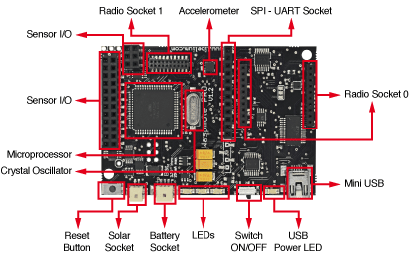
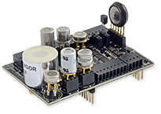
Hardware (cont.)
Waspmote Gas Sensor Board and Sensors

Slide 5
Interface With Hardware
Program is developed and uploaded to the Waspmote
Initial setup
Will only execute one time
Turn on Gas Board, initialize individual sensors
Main loop
Portion of the program that will loop continuously
Will perform data gathering and transmission here
Turn everything off and go to sleep for determined amount of time

Slide 6
Interface With Hardware (cont.)
Our current set up
Turn on the Gas Sensor Board
Initialize each sensor that will be used for measurement
Our current loop
Let sensors warm up before taking measurements
Gather the raw data that is output by each sensor (output is a voltage)
Convert the raw voltage output from each sensor into an actual gas concentration (parts per million, ppm)
Package the data and transmit to our mobile app to be ultimately pushed to our web server
Put the board to sleep, wake up after a determined time to perform another loop

Slide 7
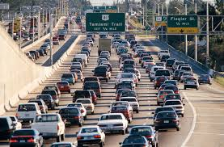
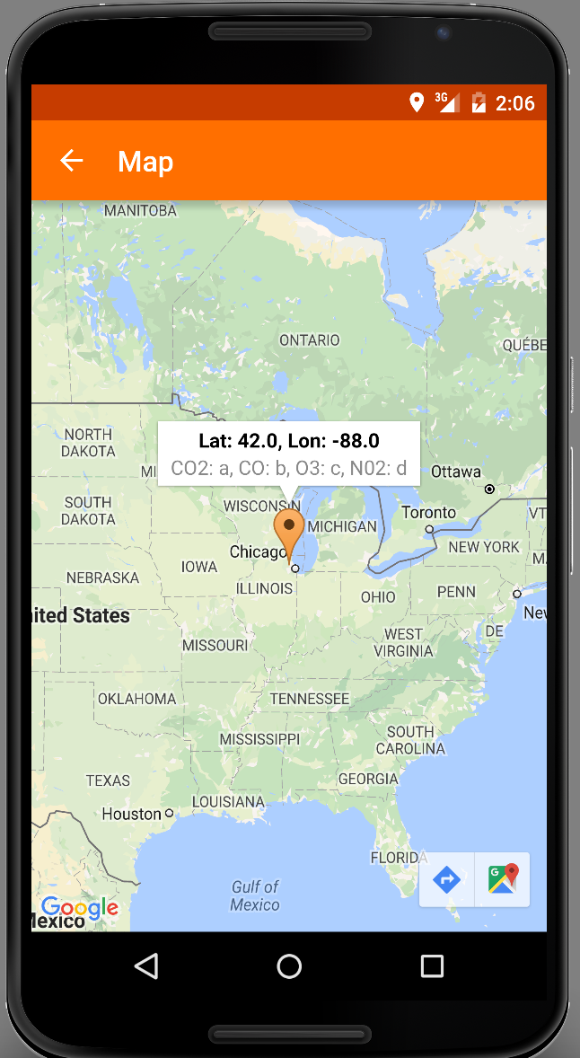




Interface With Hardware (cont.)

Slide 8
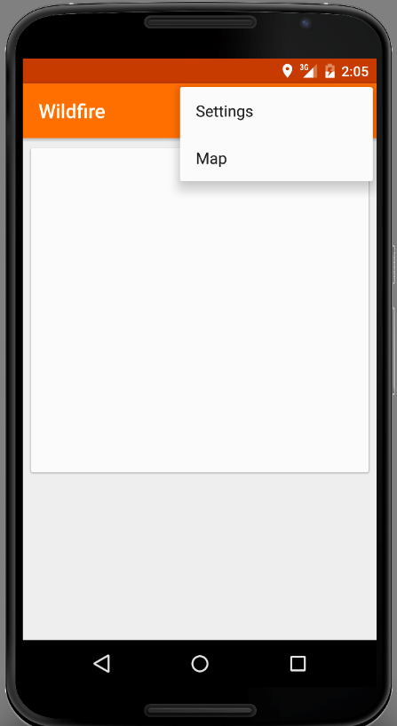
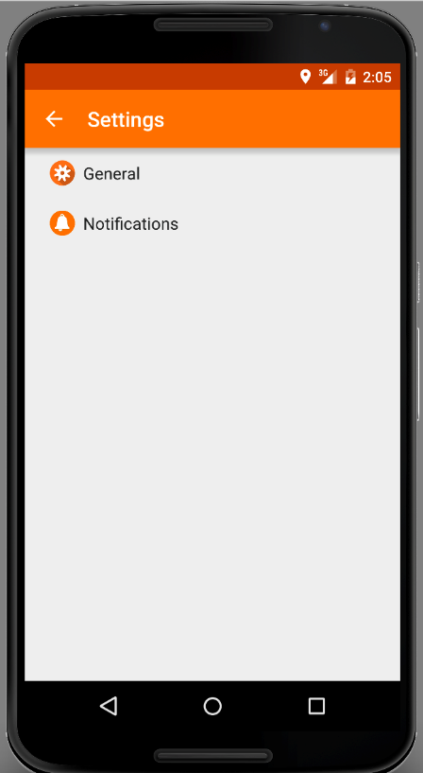

Android Interface

Slide 9
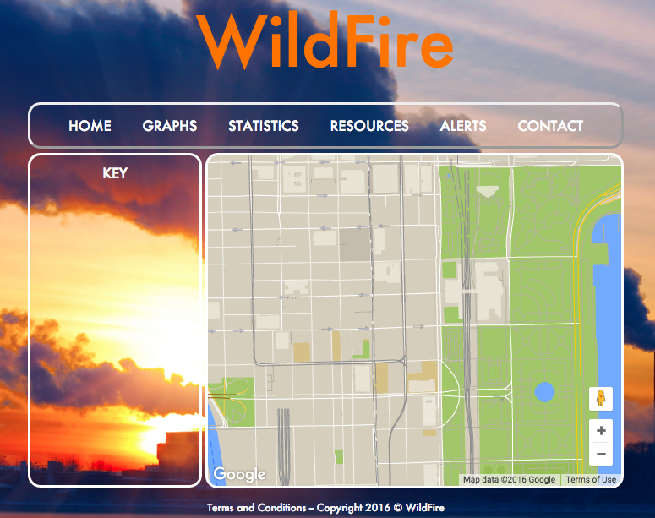
Web Interface

Slide 10
Next Steps & Challenges
Upcoming development goals
Currently have 2 gas sensors: Carbon Dioxide (CO2) and Carbon Monoxide (CO); will be integrating additional sensors for Ozone (O3) and Nitrogen Dioxide (NO2)
Add Bluetooth functionality for communication with a mobile phone/device
Current challenges
Initializing sensors with correct parameters, somewhat trial and error
Optimizing the time of sensor warmup and sleep cycle
Deriving equations to convert raw sensor data to a meaningful gas concentration
Certain gas concentrations may be below the respective sensor's sensitivity level

Slide 11
Next Steps & Challenges
Upcoming development goals
Add user account functionality to secure API endpoints and increase accountability
Connect android application to web API
Integrate web map and Android app
Current challenges
Two separate code bases for web map and android map → double work load
PHP and MySQL queries will be rewritten in javascript

