Slide 1
GNN start

Slide 2
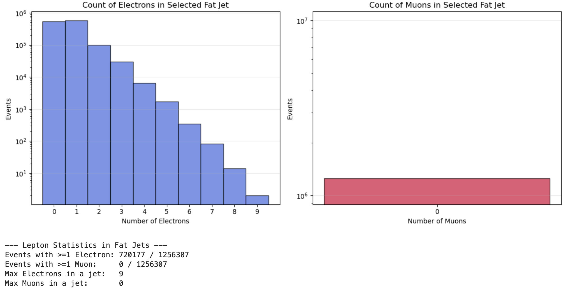
Feel like the lepton is not considered in the fat jet constituent

Slide 3
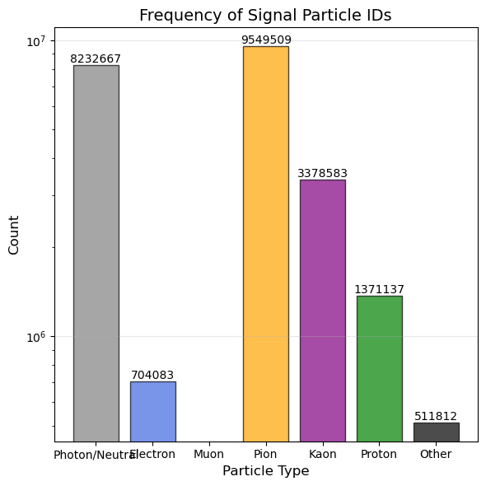
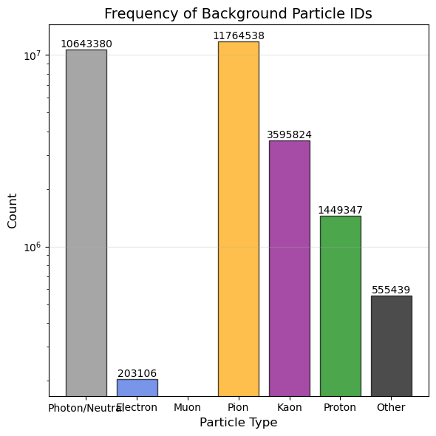

Slide 4
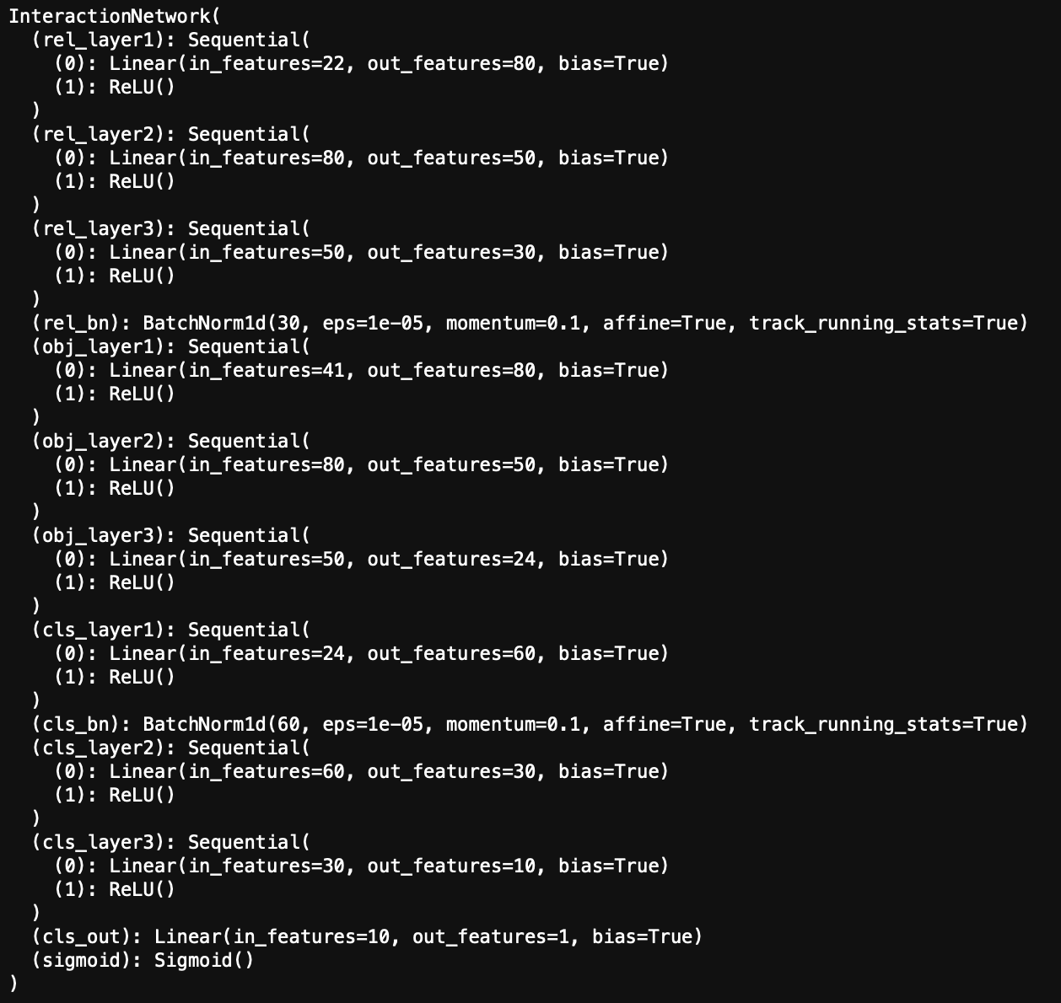
Short Q: Batch Size / LR?
How to make training faster?

Slide 5
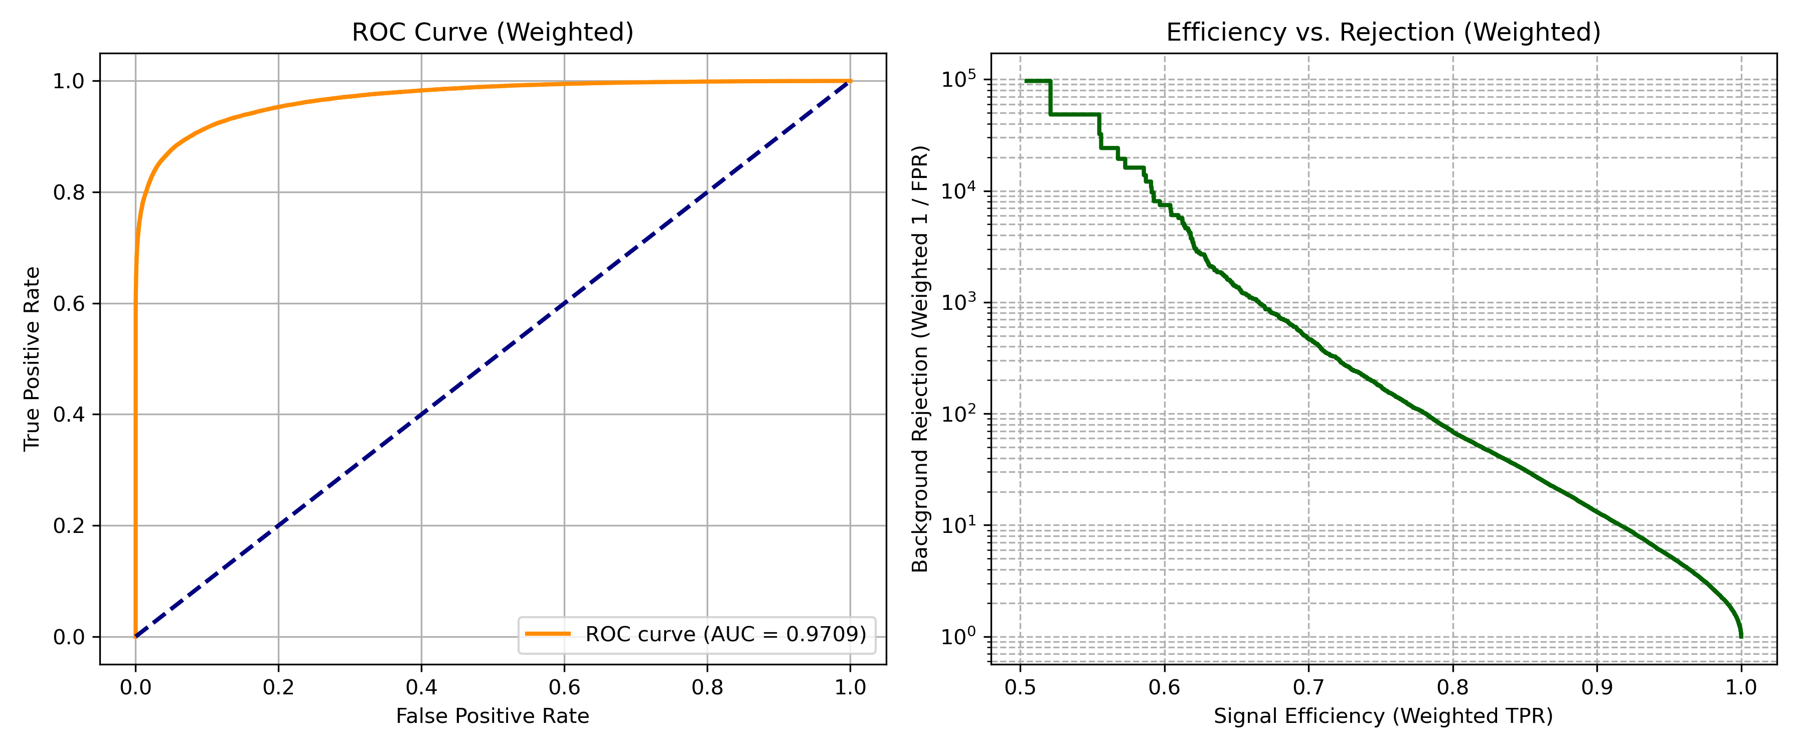
No weight when training/no dr<1 req

Slide 6
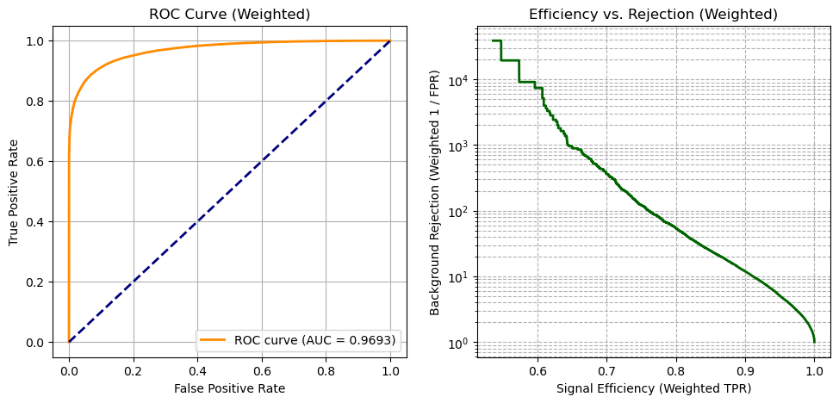
With dr<1 req & weight when training

Slide 7
Next step: Integrate into DNN?

