Slide 1
Have Done:
1. Preprocessed dataset (break into multiple flat csvs based on particle type (i.e. generator, lepton, jets, fat jets, fat jet constituents)
2. treated eta discrepancy
3. built a DNN using a lepton, a jet and and 2 fat jets(with fjc count) (can be easily updated)

Slide 2
To Do:
1. Truth particle matching: Higgs in signal inside fat jet
2. add preselection criteria: lepton within dR < 1 of fat jet / and some pt cut(? Not now)
Should this be considered into the model evaluation?
3. decide input structure (how many jets/fat jets? Leading jet or subleading jet? Etc…)
4. constituents: top 5 constituents (pt eta dphi) / maybe try throwing in more
5. met: just use pt / phi of the neutrino
6. separate electron / muon

Slide 3
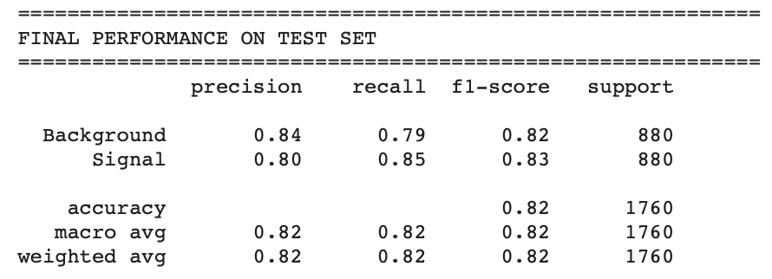
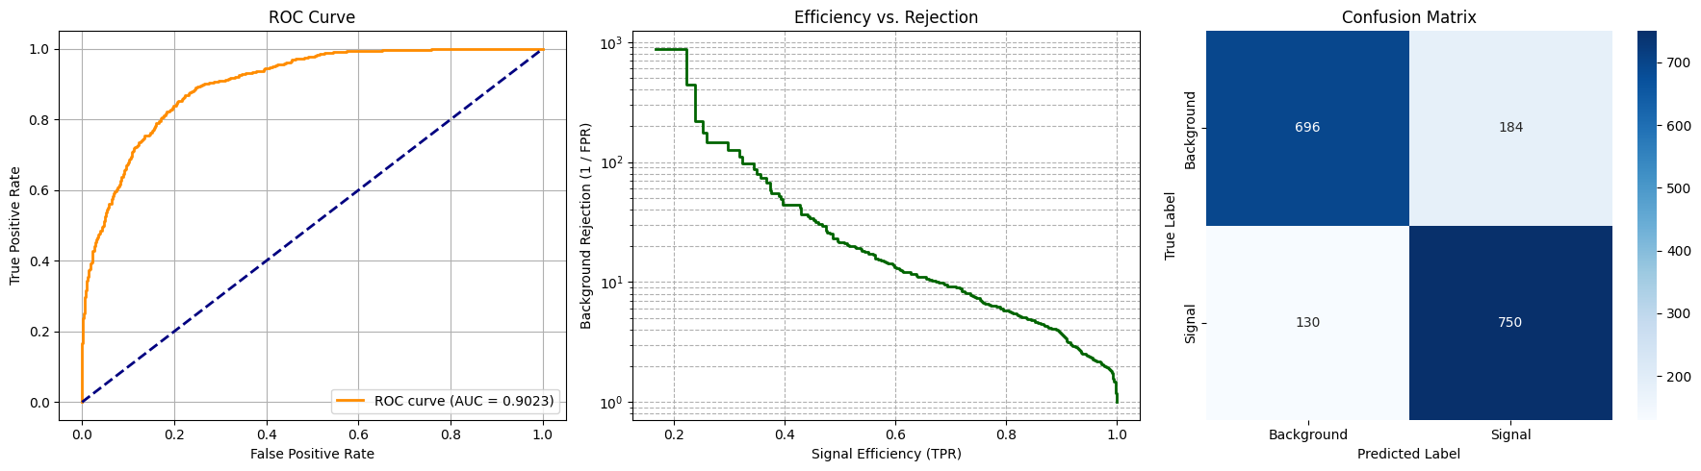
Model performance
Input size 19: first layer 128

Slide 4
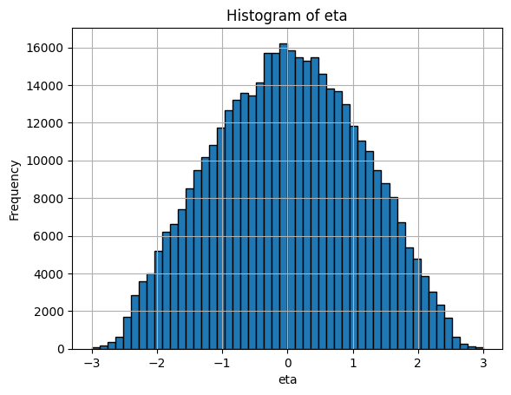
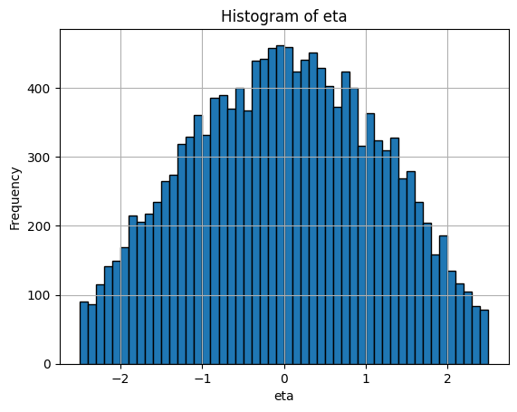
Eta check
Fjc eta distribution
Fj eta distribution

