Slide 1

Java 9

Slide 2
Hello!
My name is
Dawid Maksylewicz
Contractor / Java / full-stack dev
Working remotely
Contact at:
dawid.maksylewicz@gmail.com

Slide 3
Agenda
jigsaw
REPL
API changes
Other

Slide 4
“Java 9 is about how we package and deploy our code”
Venkat
Notes:
Java 8 was all about how we changed the way we write our code

Slide 5
jigsaw
std libs modularized (rt.jar ~65mb / 4500 classes / 94 modules)
java.base
jlink
different versions of a class (within a single jar)
enhanced jar tool & jre (for multi-release-jars)
Notes:
-no more classpath hell
-no jre, no tools.jar, no rt.jar
-java.base -> String, java.lang, Class
-jlink is the linker tool and can be used to link a set of modules, along with their transitive dependencies, to create a custom modular run-time image
-new linking phase between compile-time and run-time
-modularity aspects of Java 9 include application packaging, modularizing the JDK itself, and reorganizing source code into modules
-application modules
-automatic modules (jars on module path, exports everything, imports everything)
-unnamed modules (jars on classpath, without name can’t be required, exports everything, imports everything on demand)
-platform modules
-java --describe-module java.sql

Slide 6
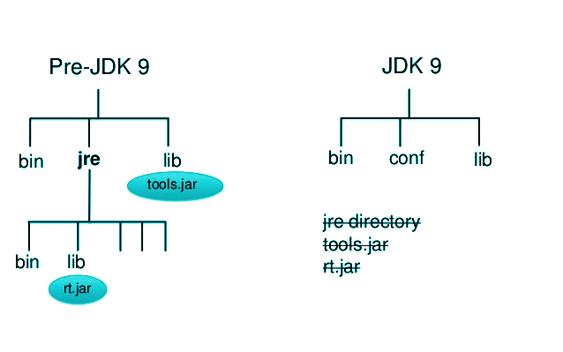
jigsaw

Slide 7
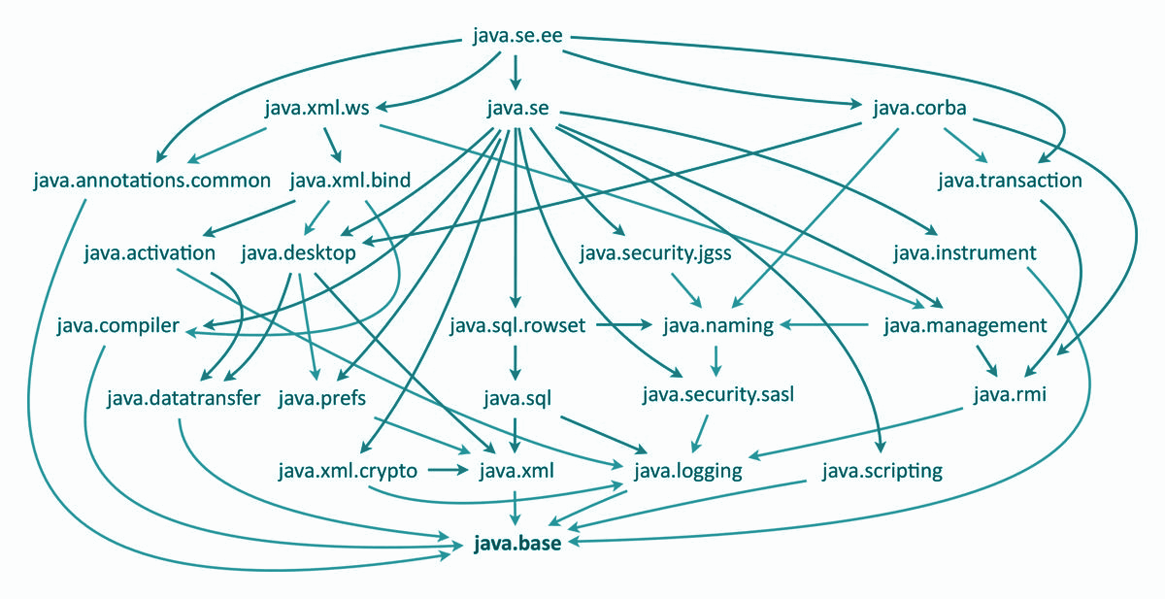
jigsaw

Slide 8
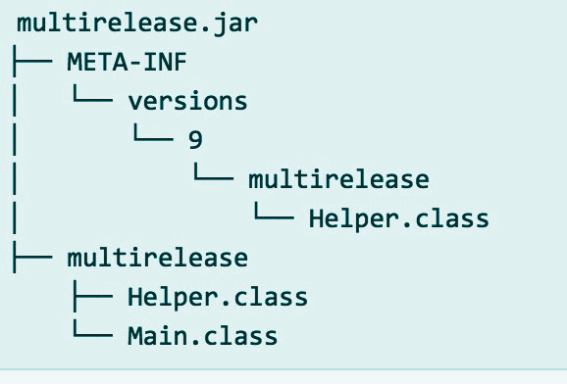
jigsaw

Slide 9
jshell / REPL
native support
commands: /vars /methods /list /edit helloWorld
Notes:
-/help intro
-/list
-/list all
-/int x = 1
-/edit x

Slide 10
API changes
encapsulation
jdeps -jdkinternals your.jar
Notes:
- every public class can be accessed by any other public class on the classpath
- open: java.*, javax.*, com.sun.*, some jdk.*
- closed: sun.*
- compatibility / frameworks & internal API
- --add-exports & --add-opens & --permit-illegal-access - will be illegal to use after Java9

Slide 11
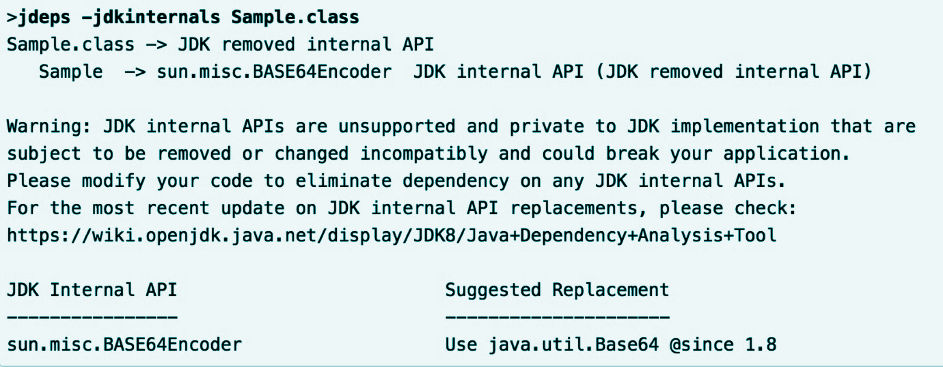
API changes cd...

Slide 12
Other
factory methods for list, set, maps
takeWhile / dropWhile in streams
stream of Optional
faster parallel Files.lines()
deprecation (forRemoval, since)
Notes:
- immutable instances, 0 - 10 elements overload, varargs
- like skip / limit (unordered streams)

Slide 13
Other cd...
underscore
private interface methods
support for reactive streams
Unicode (java 7 -> 2.834 characters, java 8 -> 7.716 characters)
share string & char[] across different JVMs
process API
Notes:
- better control & management of operating system processes
- new methods to handle PIDs, process names and states, ability to enumerate JVMs and processes

Slide 14
Other cd...
Eclipse Oxygen / IntelliJ IDEA 2017.3
Glassfish 5.0 (not supported by Eclipse) / Payara 5 / Wildfly 11
Gradle 4.2.1
Notes:
- better control & management of operating system processes
- new methods to handle PIDs, process names and states, ability to enumerate JVMs and processes

Slide 15
Summary
jigsaw
REPL
API changes
Other

Slide 16
Thanks! Any q?

