Slide 1
BT5153 Group 14
Resume-to-Job Matching for Candidate Ranking
Project presentation
From screening bottleneck to a practical ranking recommendation
Phang Beng Keong (A0028103X)
Phua Zhuo Wei (A0234313U)
Sakthi Ram (A0156203R)
Liu Yuandong (A0297814N)
Notebook-first refactor with one main review artifact and a full end-to-end evaluation pipeline.

Slide 2
Problem and Motivation
Recruiters often read many resumes for each opening, so first-pass screening is slow and inconsistent.
A ranking system is useful only if it surfaces relevant candidates early, stays understandable, and behaves consistently under simple perturbations.
This project compares a lexical retriever, a dense semantic model, and a local LLM reranker rather than assuming that the most complex model is automatically the best choice.
BT5153 Group 14 | 2

Slide 3
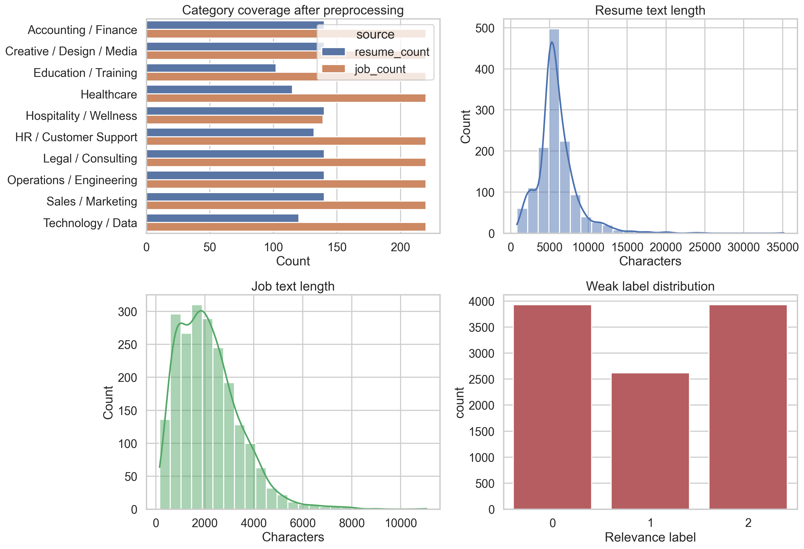
Data Overview
Dataset foundation
Constructed benchmark
Processed resumes: 1,309
Processed jobs: 2,119
Labeled pairs: 10,472
Weak labels: 3,927 positives, 2,618 partials, 3,927 negatives
Interpretation
The labels are weakly supervised rather than recruiter-annotated.
That makes the benchmark reproducible, but it also favours methods that align with explicit lexical and category overlap.
BT5153 Group 14 | 3

Slide 4
Methodology Overview
Step 1: clean raw resume and job text, mask direct identifiers, and normalise each record into a shared category system.
Step 2: construct weakly supervised resume-job pairs with labels 0, 1, and 2.
Step 3: evaluate TF-IDF and SBERT on the full held-out test set.
Step 4: rerank a lexical shortlist with a local LLM across the full held-out test split using a compact JSON prompt.
Step 5: compare quality, significance, runtime, interpretability, and perturbation-based fairness signals.
BT5153 Group 14 | 4

Slide 5
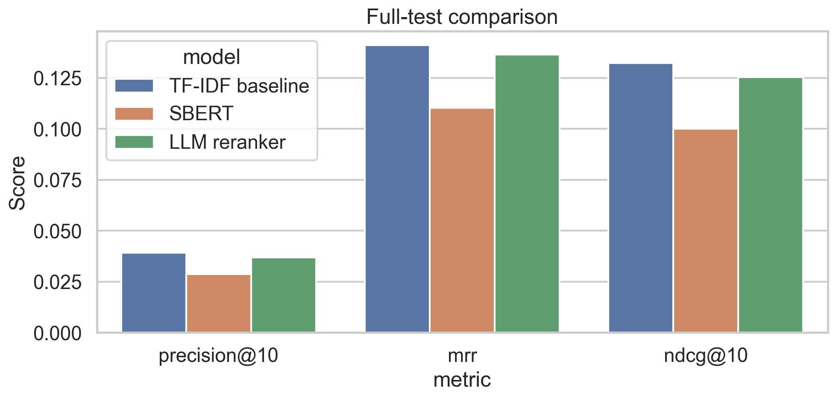
Results on the Full Test Split
What changed
TF-IDF remains first on precision@10 (0.039) and NDCG@10 (0.132).
The full-test LLM run is second (0.037, 0.125) and now clearly ahead of SBERT (0.029, 0.100).
Reading
The simple lexical baseline is still the full-coverage winner.
The LLM improves substantially over SBERT, but it still does not displace TF-IDF as the best default first-stage ranker.
BT5153 Group 14 | 5

Slide 6
Full-Test Significance
The full-test bootstrap results show that the LLM significantly outperforms SBERT across precision@10, MRR, and NDCG@10.
TF-IDF still holds a small but measurable advantage over the LLM on precision@10 and NDCG@10.
The MRR gap between TF-IDF and the LLM is not statistically significant.
The right reading is that the LLM is now a stronger second-stage option, not the new first-stage winner.
Key full-test deltas
TF-IDF - LLM precision@10 delta: 0.002
TF-IDF - LLM NDCG@10 delta: 0.007
SBERT - LLM NDCG@10 delta: -0.025
BT5153 Group 14 | 6

Slide 7
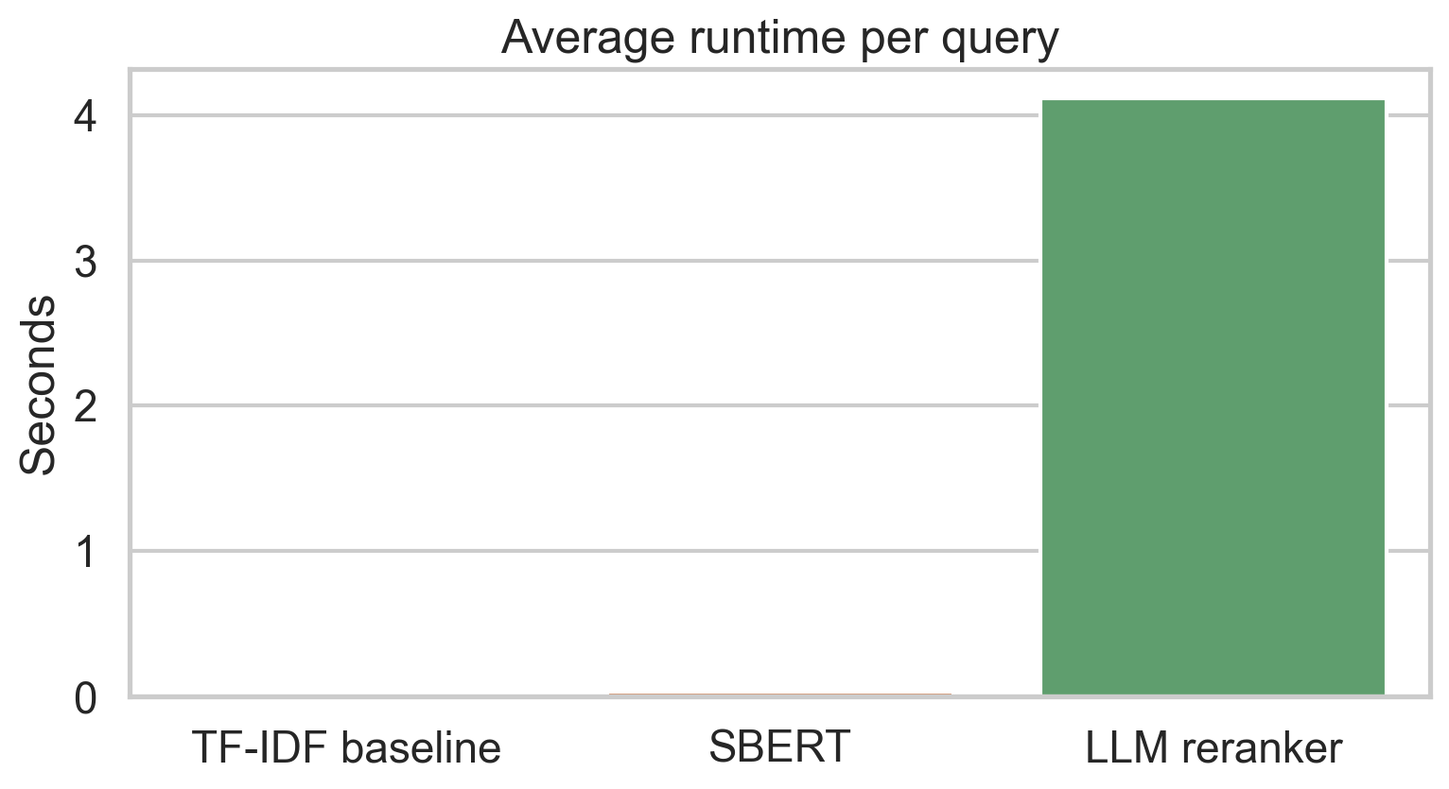
Runtime Trade-Off
Operational reading
TF-IDF averages 4.3 ms per query.
SBERT averages 34.6 ms per query in this run.
The LLM reranker averages 4.1 s per query across all 823 held-out jobs.
That gap is large enough to change the deployment recommendation.
BT5153 Group 14 | 7

Slide 8
Interpretability
TF-IDF
SBERT
LLM
Shared skills: accounting, auditing, legal_research, payroll. Top lexical evidence: accounting, finance, accounting finance, financial.
Shared skills: cooking, logistics, manufacturing. Largest score drops after removal: cooking, logistics, manufacturing.
lexical_fallback
BT5153 Group 14 | 8

Slide 9
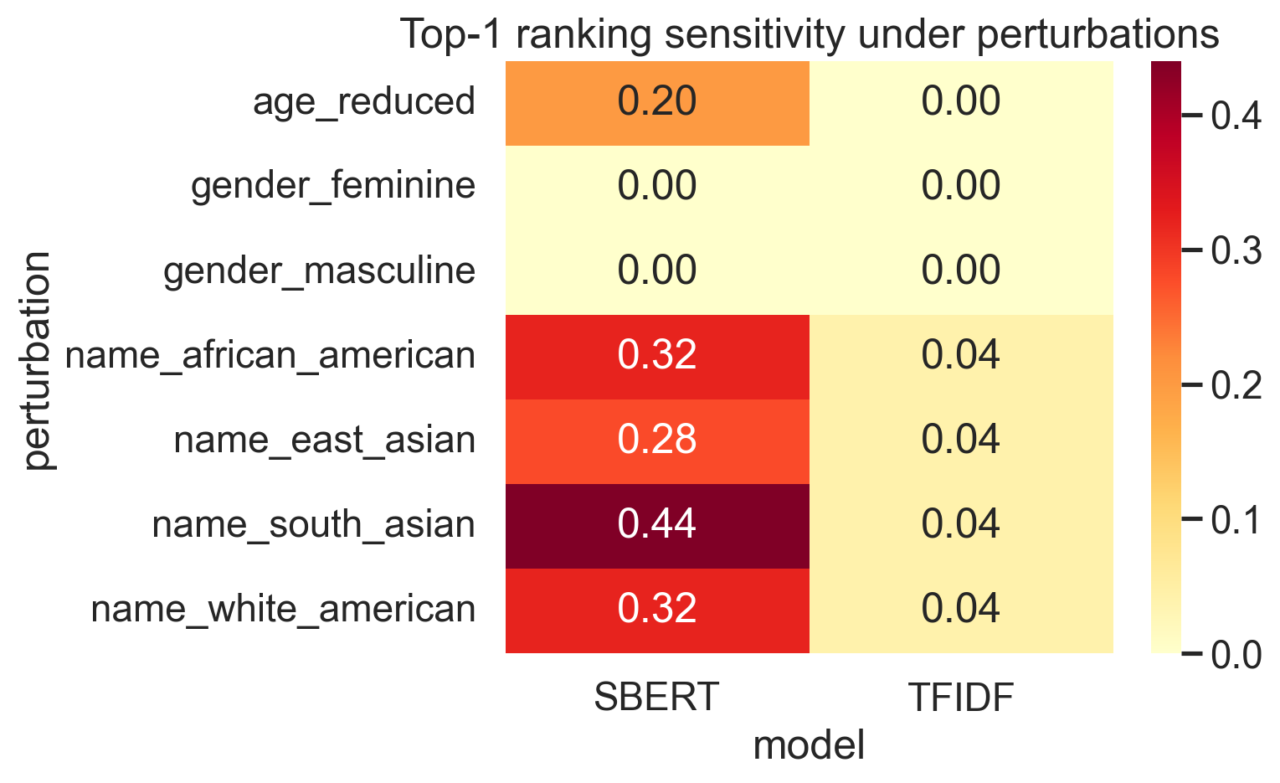
Fairness and Robustness
TF-IDF is more stable overall, with mean top-1 change rate 2.3%.
SBERT is more sensitive under the perturbation probes, with mean top-1 change rate 22.3%.
These checks should be read as perturbation-based stability tests rather than a full fairness certification.
BT5153 Group 14 | 9

Slide 10
Business Recommendation
Recommended default
Selective LLM use
Governance need
Use TF-IDF as the first-pass ranking engine.
It remains the strongest full-test model with NDCG@10 0.132 while staying fast and transparent.
Use the local LLM reranker only after shortlist generation.
It reaches full-test NDCG@10 of 0.125, clearly ahead of SBERT but still slightly behind TF-IDF.
Keep explanation outputs and perturbation checks in the workflow.
In a hiring context, interpretability and monitoring are part of the system, not optional extras.
BT5153 Group 14 | 10

Slide 11
Conclusion
The project does not support a simple 'more complex is better' conclusion. The more defensible recommendation is to keep TF-IDF as the operational baseline and treat LLM reranking as a selective second-stage enhancement.
TF-IDF is the strongest full-coverage model in the current benchmark.
SBERT does not justify its extra complexity on this weakly supervised setup.
The LLM reranker is promising, but still too slow and too narrowly validated to become the default ranking engine.
The final contribution is best read as a comparative BT5153 project under weak supervision, not as a production-ready hiring product.
BT5153 Group 14 | 11

