Slide 1
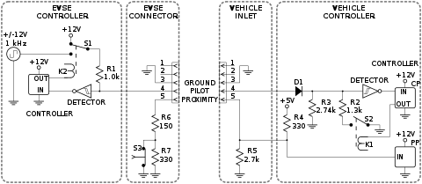
gnd
B+
10mm^2 cable
B+
OBC
gnd
95mm^2 cable
200A FUSE
L
L1
B-
10mm^2 cable
B-
N
95mm^2 cable
200A FUSE
L2
B+
OBC
gnd
L
B-
N
L3
Is it OK for all OBC to share the same fuses? Or does each OBC require its own set of fuses?
OBC
gnd
B+
L
B-
N
Proximity Pilot PP (CC)
Control Pilot CP
CANBus
PP/CC and CP lines are connected to one of the OBC units only
OBC monitors CC/PP and CP lines according to IEC62196 and detects the plug state and allowable charging current. This information is then communicated over the CANBus to the vehicle control system (VCU).

