Slide 1
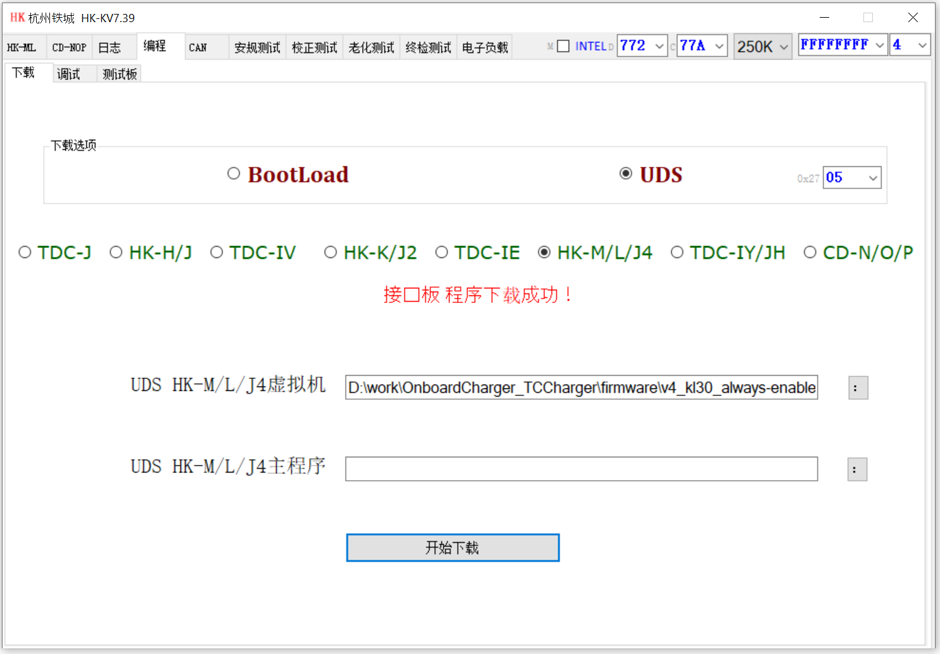
Configurations for TC Charger OBC

Slide 2

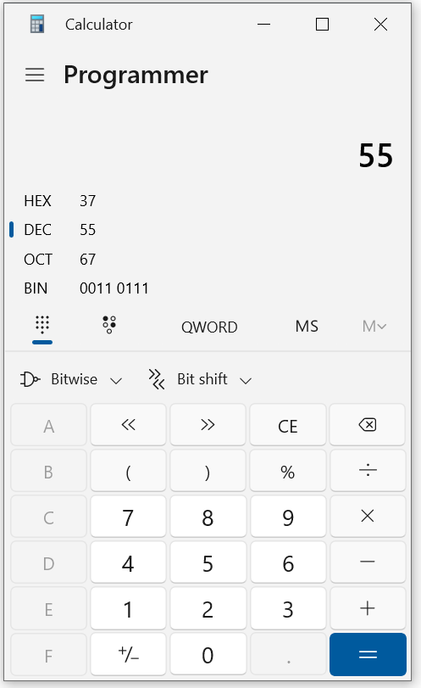
Calculating password for TCCharger flashing program
1. Get the minute of system time
2. Convert from the minute (as decimal) to binary
3. Getting 4 x least significant bits as password

