Slide 1
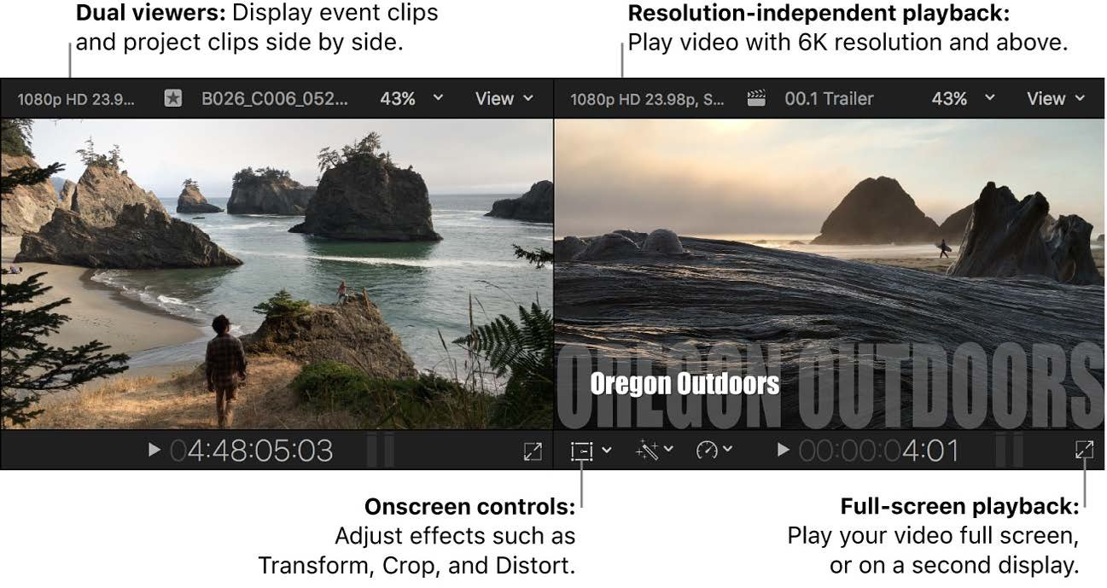
Final Cut Pro in 30 Days
MY LEARNING PLAYBOOK · FCP 12.4
Learn FCP, make Shorts and long videos fast, and upload to YouTube every day. Your go-to reference for the month.
Screenshots: Final Cut Pro User Guide for Mac (Apple)

Slide 2




How to use this book
1 · Learn
2 · Do
3 · Check
4 · Publish
Watch one 10–20 minute video lesson on the day’s topic.
Copy the steps in FCP straight away with your own footage.
Read only the manual pages listed on the day’s page.
Use the new skill in today’s upload. Publishing is practice.
EVERY DAY PAGE HAS
A goal · the steps · a “Try it” task · today’s upload · key shortcuts · manual pages · a screenshot · a My notes box. Type what you learned into My notes each day, and by Day 30 this book becomes your own Final Cut Pro manual.

Slide 3

Learn from video, look things up in the manual
Video lessons
User Guide (manual)
Slides or presentations
Use to LEARN
Use to LOOK THINGS UP
Use only for SUMMARIES
Shows real mouse and keyboard movement
Easiest way to learn the timeline and trimming
10–20 minute lessons fit your daily plan
Most accurate and always up to date
Read only the pages for today’s topic
Search it when you’re stuck (Help menu)
Can’t show how an edit is done
Fine for a shortcut cheat sheet
This book is your summary and notes

Slide 4
Your 30 days at a glance
1
Days 1–7
2
Days 8–14
3
Days 15–21
4
Days 22–30
Core editing
Speed and polish
Creative tools
Real-time daily workflow
Learn the interface and the basic edit: import, cut, audio, captions, export.
Work faster with shortcuts and templates, and make your clips look and sound better.
Masks, keying, tracking, multicam, music sync and thumbnails.
Batch your work, manage your library, repurpose content and read analytics.
UPLOAD
UPLOAD
UPLOAD
UPLOAD
One simple vertical Short every day (15–60 sec)
Shorts daily, plus your first long video (3–6 min) on Day 14
A Short every day, plus long videos on Days 18 and 21
A Short daily, plus a long video every 2–3 days

Slide 5
Your free month: Apple Creator Studio
6
26.6
M-chip
apps included: Final Cut Pro, Motion, Compressor, Pixelmator Pro, Logic Pro, MainStage
minimum macOS version for FCP 12.4 (p. 6)
Apple silicon needed for Generate Captions (U.S. English only, p. 385)
MAKE THE MOST OF THE TRIAL
Make thumbnails in Pixelmator Pro (Share > Send Frame to Pixelmator Pro, p. 828)
Use the extra downloadable titles, transitions and generators (p. 18)
Cancel or change it in Final Cut Pro > Manage Subscriptions. You keep access until the billing period ends (p. 18)
Decide on Day 30 whether to continue

Slide 6





Day 0: set up before you start
Verify your channel
Pick one format
Make folders
youtube.com/verify unlocks videos over 15 min and custom thumbnails.
For example “1 tip in 45 seconds”. A repeatable format makes daily uploads realistic.
Footage · Music · Graphics · Exports. Keep the same structure every week.
Copyright-safe music
Shoot on your phone
Keep a clip stock
Download tracks from the YouTube Audio Library.
4K or 1080p at 30 fps. Apple’s Final Cut Camera app works with FCP (p. 42).
Have 5–10 spare clips ready so you never start from zero.

Slide 7

Where to learn
FREE
FREE
FCP User Guide
Built-in demo project
Help > Final Cut Pro Help, or support.apple.com/guide/final-cut-pro. Start with p. 7–15.
Practise on Apple’s footage before your own (p. 19).
FREE · YOUTUBE
FREE · YOUTUBE
Ripple Training
Dylan Bates (The Final Cut Bro)
Clear, structured FCP lessons and “what’s new” videos.
Practical tips, workflows and shortcuts.
FREE · YOUTUBE
PAID · OPTIONAL
Primal Video
Apple Pro Training Series
Beginner FCP guides plus YouTube growth advice.
Official Peachpit book with practice media. LinkedIn Learning is another option.

Slide 8
Core editing
WEEK 1 · DAYS 1–7
UPLOAD TARGET
One simple vertical Short every day (15–60 sec)
Learn the interface and the basic edit: import, cut, audio, captions, export.
END-OF-WEEK CHECK
You can make a 30-second captioned Short in under 45 minutes
Day 1 Meet the Final Cut Pro interface
Day 2 Import, organise and create a vertical project
Day 3 Add clips to the magnetic timeline
Day 4 Cut and trim like a pro
Day 5 Clean, balanced audio
Day 6 Titles and automatic captions
Day 7 Export and upload to YouTube

Slide 9
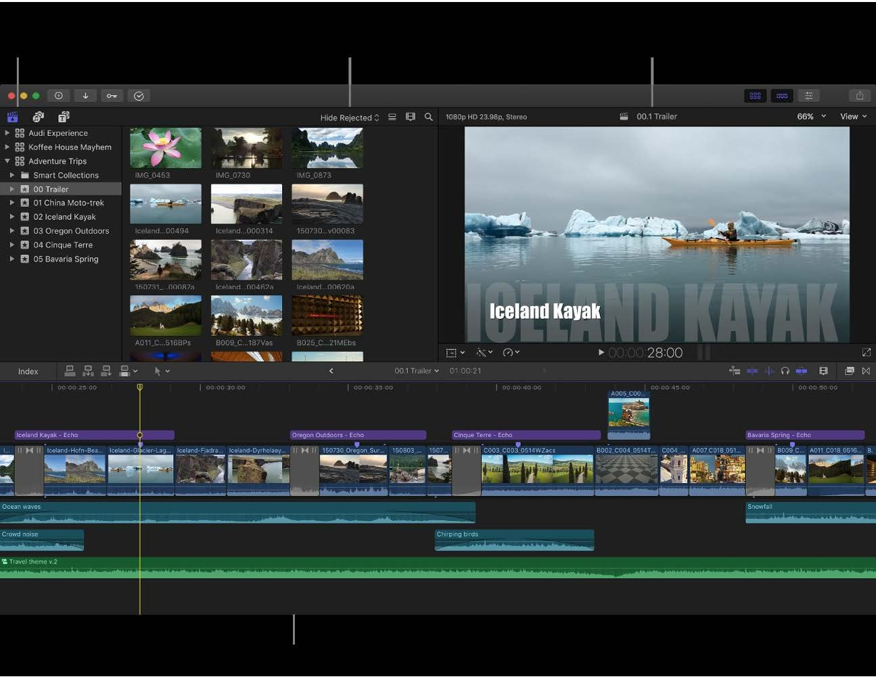

Meet the Final Cut Pro interface
DAY
1
Know where everything lives before you edit anything.
LEARN: STEP BY STEP
Open FCP and create a library (File > New > Library)
Find the four main areas: browser, viewer, timeline, inspector
Open the demo project (p. 19) and play it with the Spacebar
Show or hide the inspector with Cmd+4 and the Libraries sidebar with Cmd+1
From the FCP User Guide, p. 14
TRY IT
WATCH ON YOUTUBE
▶ Final Cut Pro Tutorial: Step-By-Step For Beginners (2025) – Primal Video
＋ Final Cut Pro Tutorial for Beginners – COMPLETE Guide
Skim the demo footage by moving the pointer over clips, then play the timeline.
MY NOTES
PUBLISH TODAY
KEY SHORTCUTS
MANUAL PAGES
Click here and type what you learned today…
Short: a talking-head intro to your channel
Space · Cmd+4 · Cmd+1
p. 7–19

Slide 10
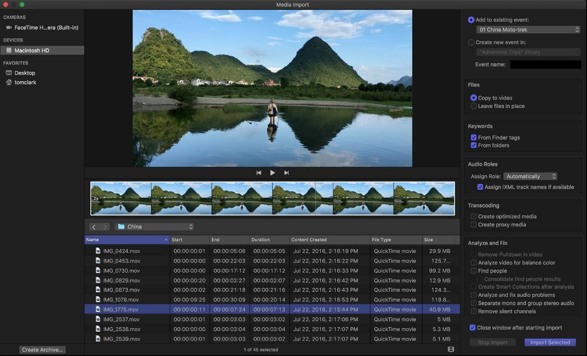
Import, organise and create a vertical project
DAY
2
Get footage in, keep it tidy, and set up a 9:16 timeline.
LEARN: STEP BY STEP
Import with Cmd+I, or drag files from Finder into an event
Mark good takes as Favourite (F) and add keywords
New project (Cmd+N) > Use Custom Settings
Set the resolution to Vertical 1080×1920 at 30 fps for Shorts
From the FCP User Guide, p. 21
TRY IT
WATCH ON YOUTUBE
▶ Vertical Videos in Final Cut Pro: Reels, TikTok & Shorts
＋ FCP Masterclass: Import, Organize, and Edit Like a Pro
Import 10 clips, favourite your 3 best, and create a project called “Short-Template”.
MY NOTES
PUBLISH TODAY
KEY SHORTCUTS
MANUAL PAGES
Click here and type what you learned today…
Short
Cmd+I · Cmd+N · F
p. 21–38, 89, 120–127

Slide 11
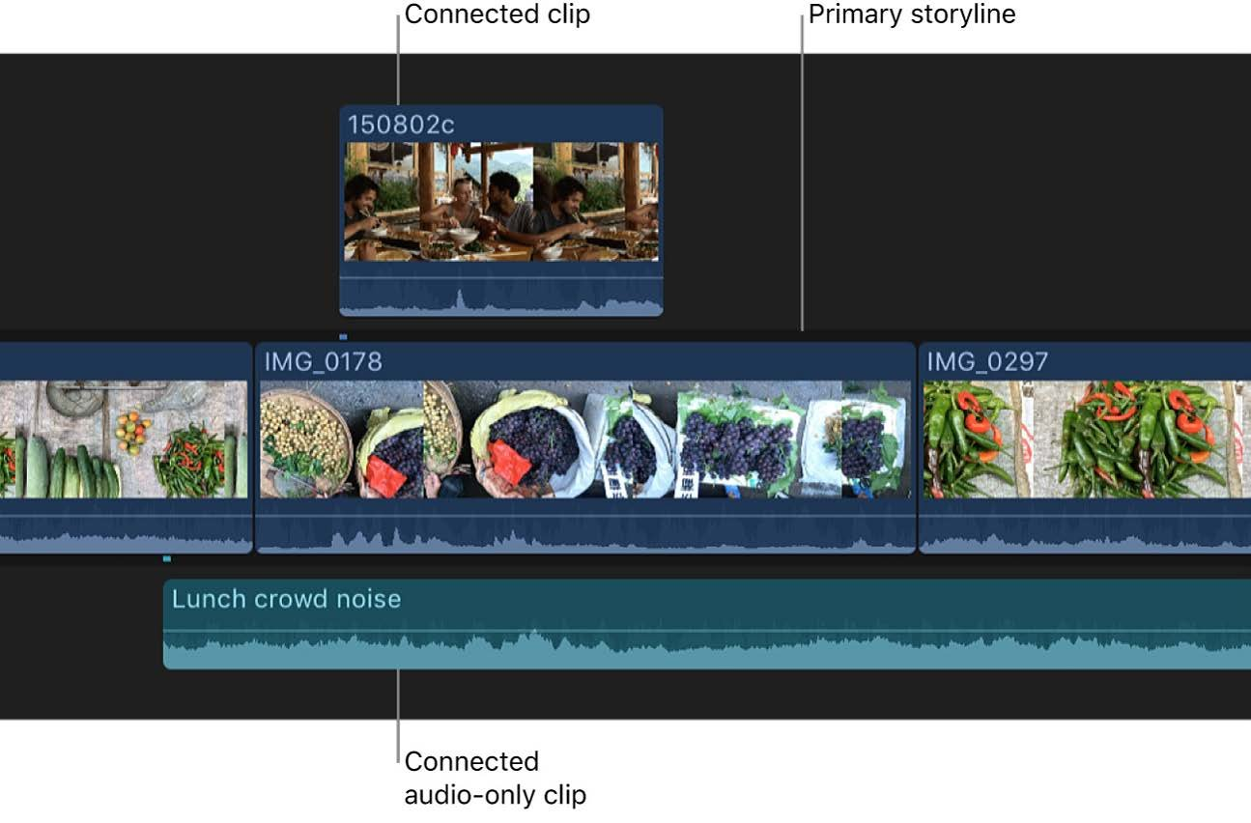
Add clips to the magnetic timeline
DAY
3
Build a rough cut with the four basic edit types.
LEARN: STEP BY STEP
E appends the selection to the end of the timeline
W inserts at the playhead; D overwrites
Q connects B-roll above the main storyline
Use I and O to choose only part of a clip before you add it
From the FCP User Guide, p. 137
TRY IT
WATCH ON YOUTUBE
▶ Complete Guide To Final Cut Pro's Magnetic Timeline
＋ Beginner Tutorial: Edits – Connect, Insert & Append
Make a 30-second rough cut using only the keyboard: I, O, E, W, Q.
MY NOTES
PUBLISH TODAY
KEY SHORTCUTS
MANUAL PAGES
Click here and type what you learned today…
Short
E · W · Q · D · I · O
p. 70, 136–155

Slide 12
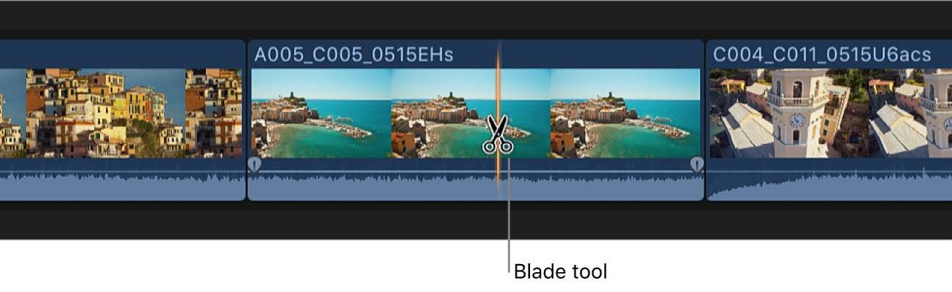
Cut and trim like a pro
DAY
4
Tighten pacing with jump cuts and precise trims.
LEARN: STEP BY STEP
Cmd+B cuts at the playhead; B switches to the Blade tool
Opt+[ and Opt+] trim a clip’s start or end to the playhead
Use the Trim tool (T) for roll, slip and slide edits
Play with J, K, L; tap L twice for double speed
From the FCP User Guide, p. 169
TRY IT
WATCH ON YOUTUBE
▶ How to do Ripple, Roll, Slip and Slide Edits in Final Cut Pro
＋ How To Trim in FCP with Ripple, Roll, Slip and Slide
Remove every pause and “um” from a 1-minute talking clip.
MY NOTES
PUBLISH TODAY
KEY SHORTCUTS
MANUAL PAGES
Click here and type what you learned today…
Short with tight jump cuts
Cmd+B · Opt+[ · Opt+] · T
p. 162–187

Slide 13
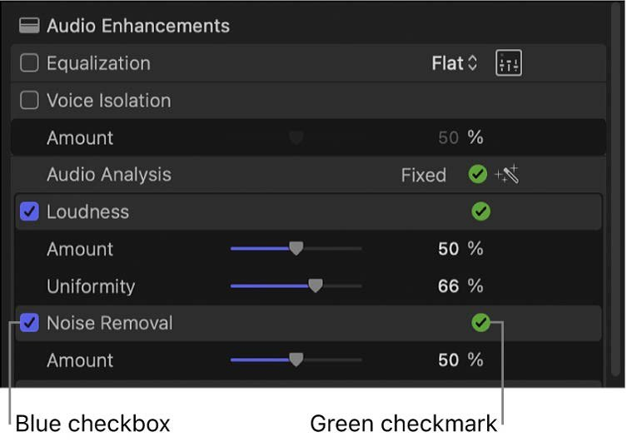
Clean, balanced audio
DAY
5
Good sound matters more than good picture.
LEARN: STEP BY STEP
Drag the volume line on a clip to set its level
Drag the fade handles at the edges for smooth fades
Inspector > Audio > Voice Isolation removes background noise
Opt+Cmd+A runs Enhance Audio; keep music around −20 dB under voice
From the FCP User Guide, p. 277
TRY IT
WATCH ON YOUTUBE
▶ How to CLEAN UP Audio in Final Cut (Voice Isolation)
＋ How to Mix Voice and Music in Final Cut Pro
Add music under your voice and fade it in and out.
MY NOTES
PUBLISH TODAY
KEY SHORTCUTS
MANUAL PAGES
Click here and type what you learned today…
Short with music under the voice
Opt+Cmd+A · Ctrl+S
p. 220–251, 276–278

Slide 14
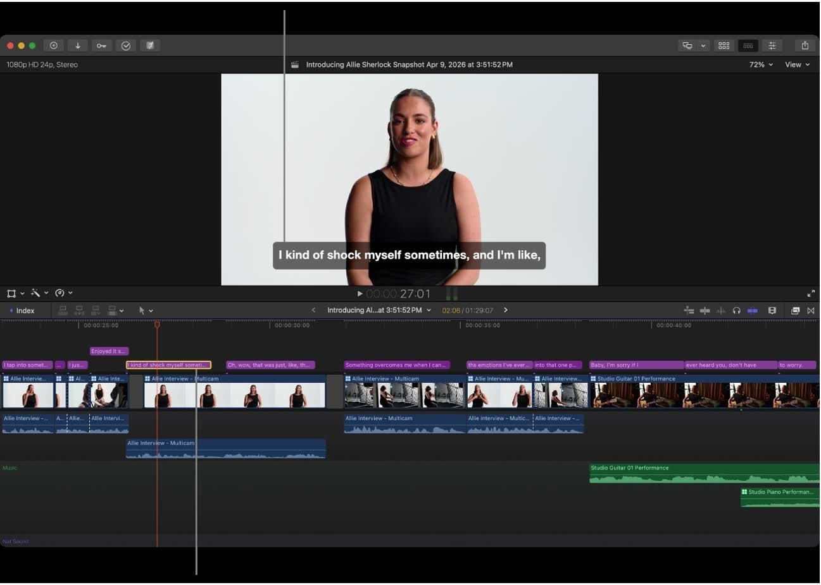
Titles and automatic captions
DAY
6
Most Shorts are watched without sound, so add captions.
LEARN: STEP BY STEP
Ctrl+T adds a basic title; Ctrl+Shift+T a lower third
Select speech clips, then press Shift+Cmd+S (Generate Captions > Subtitles)
Edit the text in the inspector and fix any wrong words
Captions need an Apple silicon Mac and U.S. English (p. 385)
From the FCP User Guide, p. 385
TRY IT
WATCH ON YOUTUBE
▶ Final Cut Pro • Complete Guide To Transcribe To Captions
＋ How To Add The Default Title Or Lower Third in FCP
Generate captions for a Short and restyle them big and bold.
MY NOTES
PUBLISH TODAY
KEY SHORTCUTS
MANUAL PAGES
Click here and type what you learned today…
Short with captions
Ctrl+T · Shift+Cmd+S
p. 287, 355, 385–387

Slide 15
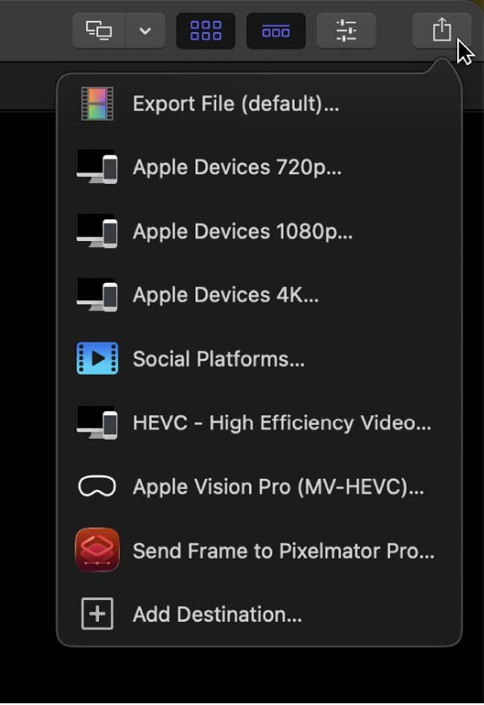
Export and upload to YouTube
DAY
7
Finish the loop: from timeline to YouTube.
LEARN: STEP BY STEP
Click the Share button > Social Platforms (p. 894)
For Shorts, turn on Burn in captions
Choose Multi-pass for quality, or Single-pass for speed
Upload the file in YouTube Studio and add #Shorts
From the FCP User Guide, p. 806
TRY IT
WATCH ON YOUTUBE
▶ BEST Export Settings for YouTube for 2026 (Final Cut Pro)
＋ Export in FCP for YouTube, Instagram, TikTok (Beginner)
Export and upload today’s Short, then review the whole week.
MY NOTES
PUBLISH TODAY
KEY SHORTCUTS
MANUAL PAGES
Click here and type what you learned today…
Short, plus a review of your week
Cmd+E (default share)
p. 806–810, 894

Slide 16
Speed and polish
WEEK 2 · DAYS 8–14
UPLOAD TARGET
Shorts daily, plus your first long video (3–6 min) on Day 14
Work faster with shortcuts and templates, and make your clips look and sound better.
END-OF-WEEK CHECK
A Short takes under 30 minutes using your template
Day 8 Keyboard shortcuts and the Command Editor
Day 9 Transitions and effects
Day 10 Speed ramps, holds and freeze frames
Day 11 Transform, crop and Smart Conform
Day 12 Colour basics: Enhance Light and Color
Day 13 Compound clips and your Short template
Day 14 Roles, markers and YouTube chapters

Slide 17
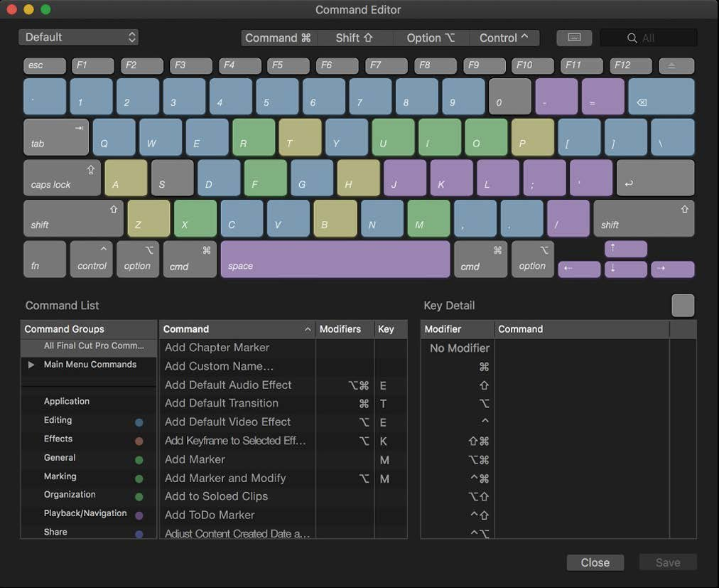
Keyboard shortcuts and the Command Editor
DAY
8
Editing speed comes from your hands, not the mouse.
LEARN: STEP BY STEP
Open the Command Editor with Opt+Cmd+K
Click a key to see what it does; search for any command
Learn the tools: A select, B blade, T trim, P position, R range
Shift+Z fits the timeline; Cmd+ + and Cmd+ − zoom
From the FCP User Guide, p. 924
TRY IT
WATCH ON YOUTUBE
▶ 100 Shortcuts every FCP Editor MUST KNOW
＋ 10 Final Cut Shortcuts That Will Double Your Editing Speed
Edit today’s Short without touching a menu.
MY NOTES
PUBLISH TODAY
KEY SHORTCUTS
MANUAL PAGES
Click here and type what you learned today…
Short
Opt+Cmd+K · Shift+Z · A B T P R
p. 897–928

Slide 18
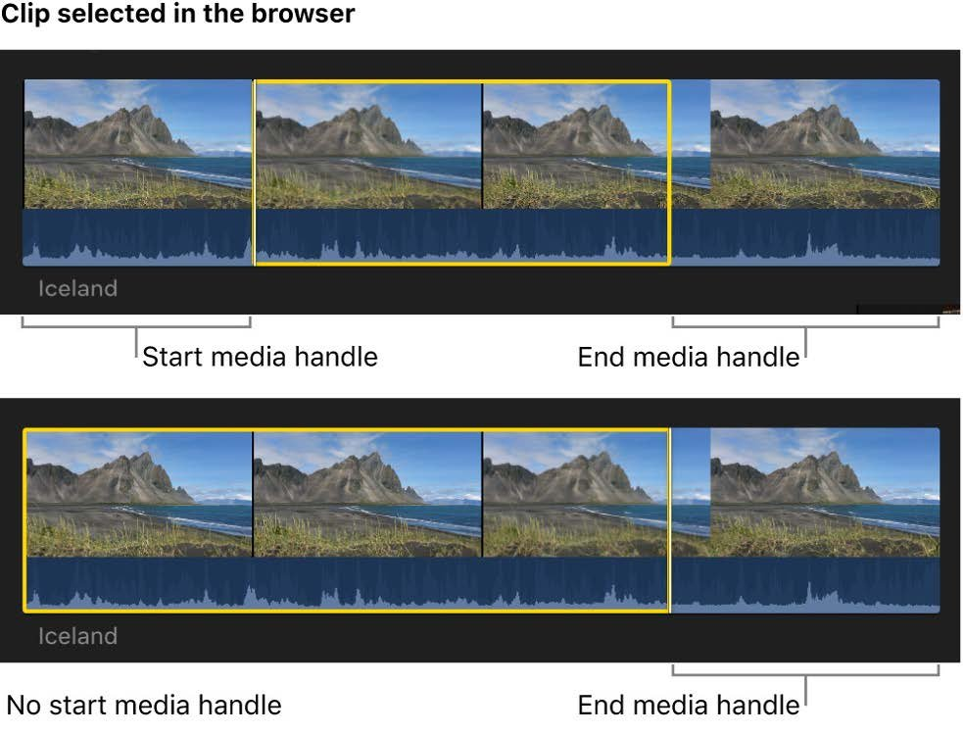
Transitions and effects
DAY
9
Use effects on purpose, not everywhere.
LEARN: STEP BY STEP
Cmd+T adds the default Cross Dissolve
Ctrl+Cmd+5 opens the Transitions browser; Cmd+5 opens Effects
Drag an effect onto a clip, then adjust it in the inspector
Rule: one transition style per video, used rarely
From the FCP User Guide, p. 390
TRY IT
WATCH ON YOUTUBE
▶ How to Add Transitions in Final Cut Pro
＋ Final Cut Pro 11 Creative Effects and Mask Transitions
Try 5 transitions, then keep only the one that fits your style.
MY NOTES
PUBLISH TODAY
KEY SHORTCUTS
MANUAL PAGES
Click here and type what you learned today…
Short
Cmd+T · Cmd+5 · Ctrl+Cmd+5
p. 388–400, 418

Slide 19
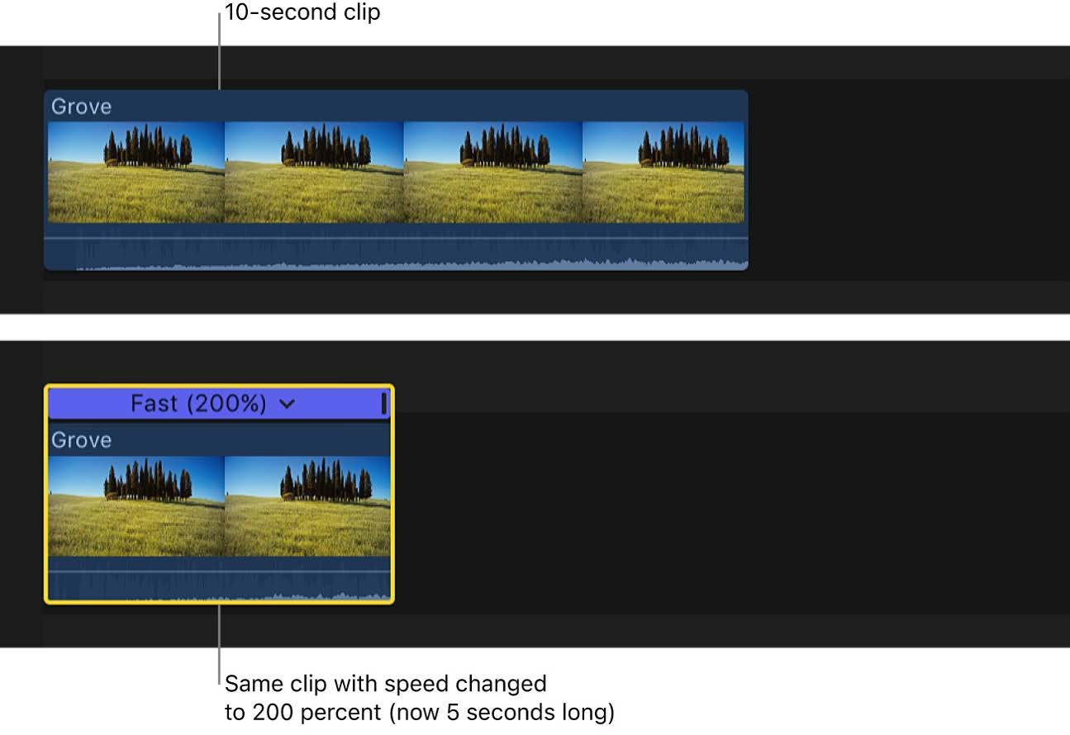
Speed ramps, holds and freeze frames
DAY
10
Speed changes add energy to Shorts.
LEARN: STEP BY STEP
Cmd+R shows the retime editor above a clip
Choose Slow, Fast or Custom from the retime menu
Shift+H adds a 2-second hold; Opt+F makes a freeze frame
Shift+N returns a range to normal (100%) speed
From the FCP User Guide, p. 559
TRY IT
WATCH ON YOUTUBE
▶ Retiming in Final Cut Pro (every option in the menu)
＋ How to Speed Ramp in Final Cut Pro
Make a speed ramp: normal → fast → slow-motion on the key moment.
MY NOTES
PUBLISH TODAY
KEY SHORTCUTS
MANUAL PAGES
Click here and type what you learned today…
Short with a speed ramp
Cmd+R · Shift+H · Opt+F · Shift+N
p. 151, 558–574

Slide 20
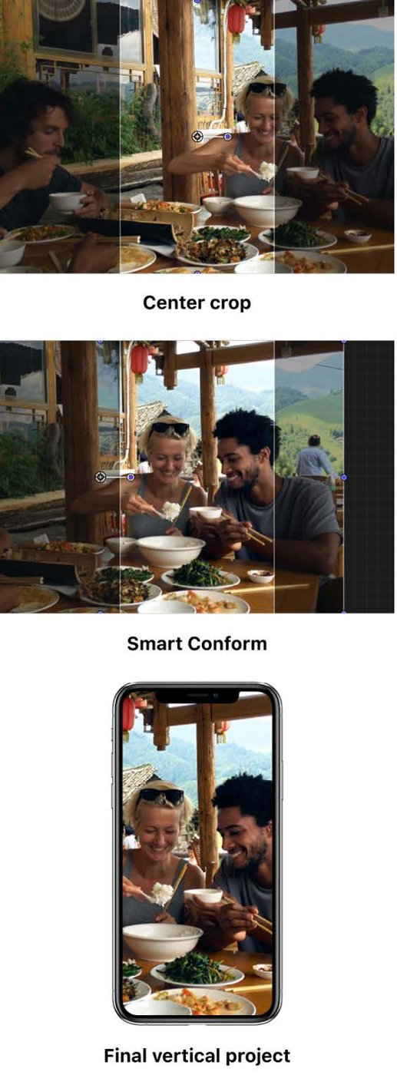
Transform, crop and Smart Conform
DAY
11
Reframe horizontal footage for vertical video.
LEARN: STEP BY STEP
Use Transform in the viewer to move, scale and rotate
Crop or use Ken Burns for slow zoom movement
Select horizontal clips in a vertical project > Modify > Smart Conform
Adjust Transform > Position if a face is still off-centre
From the FCP User Guide, p. 405
TRY IT
WATCH ON YOUTUBE
▶ Create Vertical Videos FASTER with Smart Conform
＋ FCP for Social Media: Smart Conforming, Titles + more
Turn a horizontal clip into a vertical Short with Smart Conform.
MY NOTES
PUBLISH TODAY
KEY SHORTCUTS
MANUAL PAGES
Click here and type what you learned today…
Short made from horizontal footage
Shift+T (transform)
p. 401–405

Slide 21
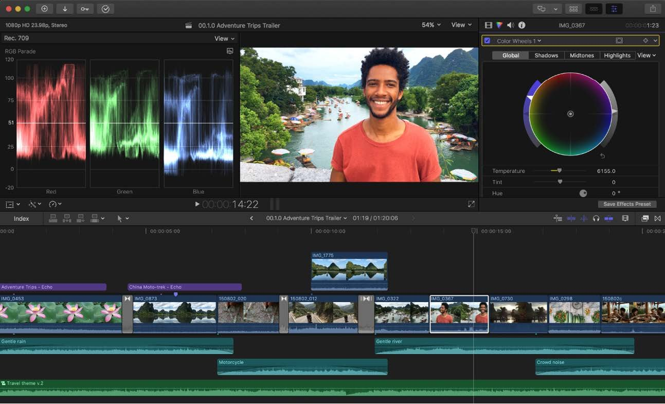
Colour basics: Enhance Light and Color
DAY
12
Make every clip look clean and consistent.
LEARN: STEP BY STEP
Ctrl+Opt+Cmd+O applies Enhance Light and Color
Opt+Cmd+B turns Balance Color on or off
Opt+Cmd+M matches colour between two clips
Cmd+6 opens the Color inspector for fine tuning
From the FCP User Guide, p. 708
TRY IT
WATCH ON YOUTUBE
▶ Final Cut Pro 11 – Enhance Light and Color Tutorial
＋ Color Correction & Grading in FCP in Under 60 Minutes
Fix one dark clip and one too-blue clip, then match them.
MY NOTES
PUBLISH TODAY
KEY SHORTCUTS
MANUAL PAGES
Click here and type what you learned today…
Short
Ctrl+Opt+Cmd+O · Opt+Cmd+M · Cmd+6
p. 708–715, 746–749

Slide 22
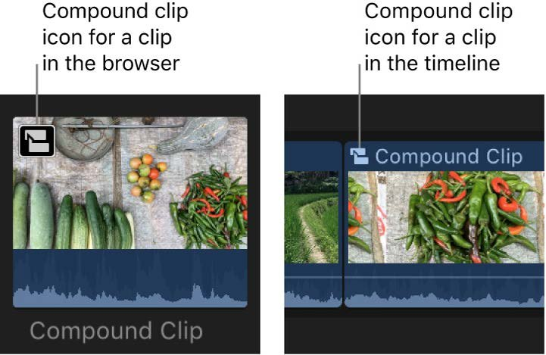
Compound clips and your Short template
DAY
13
Build once and reuse every day.
LEARN: STEP BY STEP
Select clips and press Opt+G to make a compound clip
Build a template: hook title, caption style, music, end card
Duplicate the project for each new Short (Cmd+D in the browser)
Save a favourite title style so it’s always one click away
From the FCP User Guide, p. 505
TRY IT
WATCH ON YOUTUBE
▶ How to Create & Use Compound Clips in Final Cut Pro
＋ Final Cut Pro in Under 5 Minutes: Building Title Templates
Build your “Short-Template” project and make today’s Short from it.
MY NOTES
PUBLISH TODAY
KEY SHORTCUTS
MANUAL PAGES
Click here and type what you learned today…
Short made from your template
Opt+G · Cmd+D
p. 504–512

Slide 23
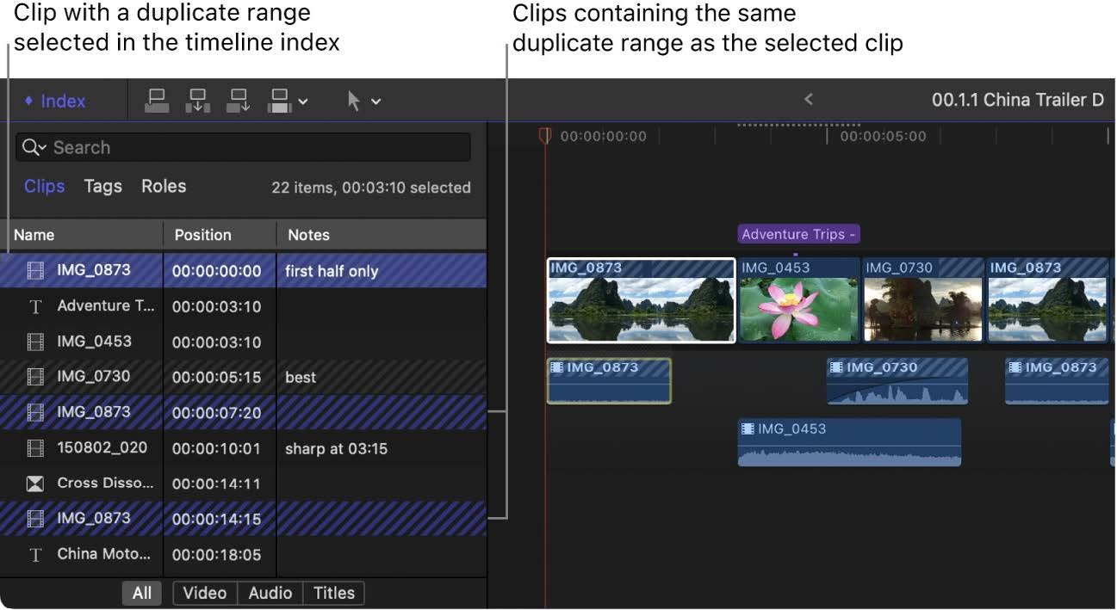
Roles, markers and YouTube chapters
DAY
14
Organise longer videos and add chapters.
LEARN: STEP BY STEP
M adds a marker; press M again to rename it
Change a marker to a chapter marker for YouTube chapters
Roles colour-code clips: dialogue, music, effects
Use the timeline index to find and hide roles
From the FCP User Guide, p. 205
TRY IT
WATCH ON YOUTUBE
▶ How To Create A Chapter Marker In Final Cut Pro
＋ Chapter markers → timecodes for YouTube descriptions
Edit a 3–6 minute video with at least 3 chapter markers.
MY NOTES
PUBLISH TODAY
KEY SHORTCUTS
MANUAL PAGES
Click here and type what you learned today…
First long video
M · Opt+M
p. 205–209, 478

Slide 24
Creative tools
WEEK 3 · DAYS 15–21
UPLOAD TARGET
A Short every day, plus long videos on Days 18 and 21
Masks, keying, tracking, multicam, music sync and thumbnails.
END-OF-WEEK CHECK
You can use one creative effect per video without looking it up
Day 15 Green screen and Magnetic Mask
Day 16 Object tracking
Day 17 Better audio: effects, voiceover, crossfades
Day 18 Multicam and stabilisation
Day 19 Adjustment clips, LUTs and video scopes
Day 20 Edit to the beat and animate
Day 21 Thumbnails and B-roll storytelling

Slide 25
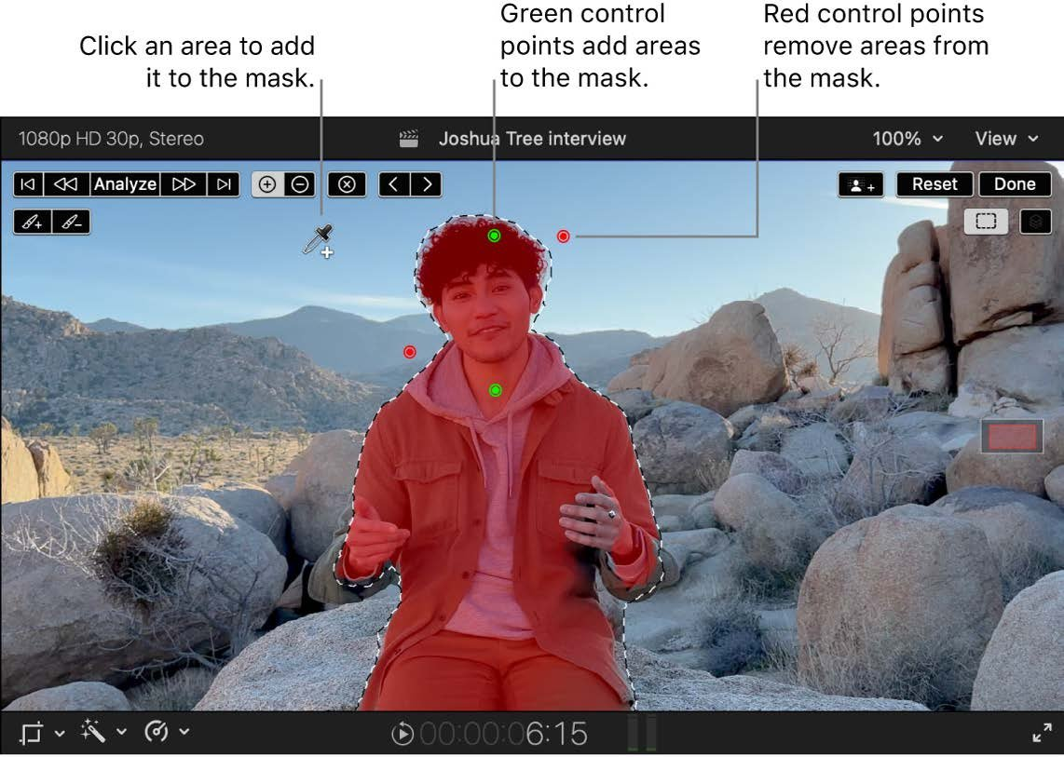
Green screen and Magnetic Mask
DAY
15
Put yourself anywhere, with or without a green screen.
LEARN: STEP BY STEP
Drag the Keyer effect onto a green-screen clip
Place the background clip below as the main storyline
Use Magnetic Mask to cut out a person without a green screen
Refine the edges with the mask’s add and remove points
From the FCP User Guide, p. 646
TRY IT
WATCH ON YOUTUBE
▶ Final Cut Pro 11 • Complete Guide To The Magnetic Mask
＋ FCP Green Screen Tutorial for Beginners (Keyer)
Put yourself in front of a different background.
MY NOTES
PUBLISH TODAY
KEY SHORTCUTS
MANUAL PAGES
Click here and type what you learned today…
Short
Cmd+5 (Effects)
p. 623–677

Slide 26
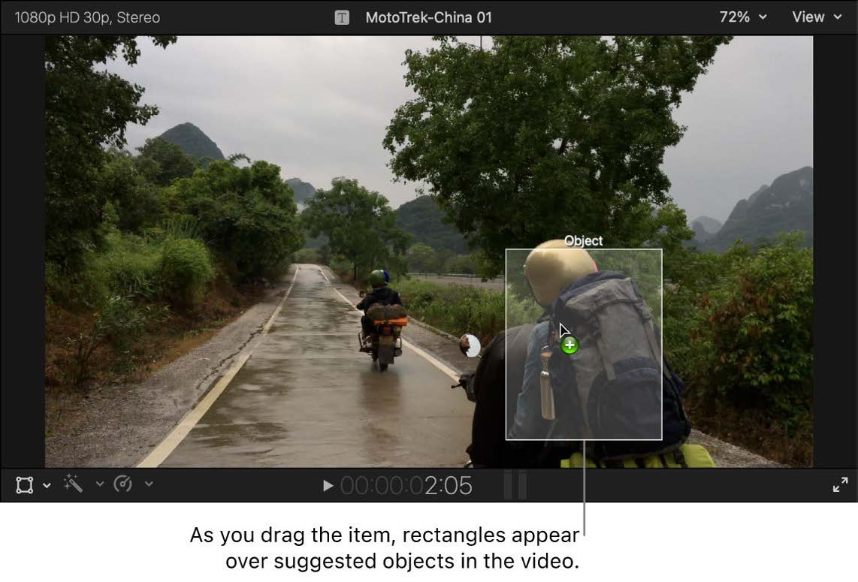
Object tracking
DAY
16
Make text or graphics follow something that moves.
LEARN: STEP BY STEP
Add a title or image above the moving clip
Open the tracker and drag it onto the object in the viewer
Click Analyze and let FCP follow the object
Fix any drift with tracking keyframes (p. 703)
From the FCP User Guide, p. 697
TRY IT
WATCH ON YOUTUBE
▶ Object Tracking in FCP – Text Follow a Moving Object
＋ Final Cut Pro Text Object Tracking Tutorial
Attach a name label to a moving person or car.
MY NOTES
PUBLISH TODAY
KEY SHORTCUTS
MANUAL PAGES
Click here and type what you learned today…
Short
—
p. 693–707

Slide 27
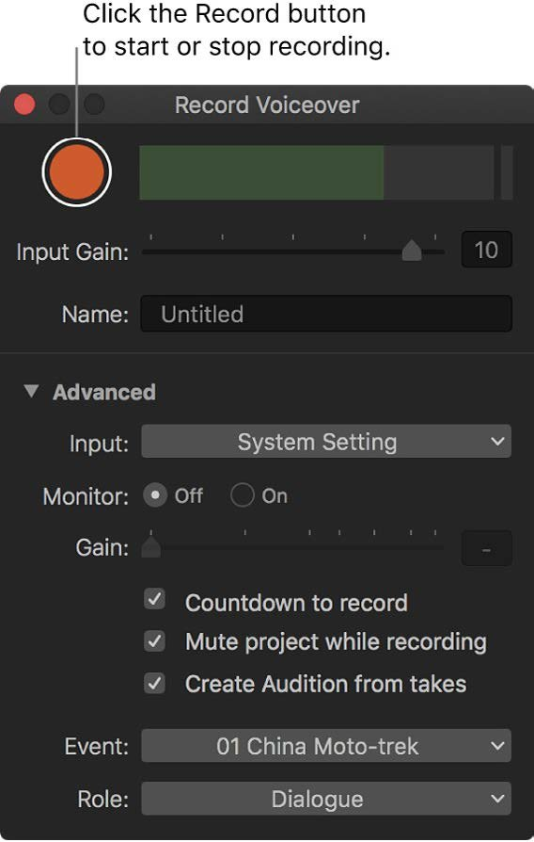
Better audio: effects, voiceover, crossfades
DAY
17
Make your voice clear and confident.
LEARN: STEP BY STEP
Opt+Cmd+8 opens Record Voiceover; Opt+Shift+A starts recording
Add EQ and compression from the Audio effects
Opt+T adds a crossfade at the selected audio edit
Shift+Cmd+M matches audio between clips
From the FCP User Guide, p. 232
TRY IT
WATCH ON YOUTUBE
▶ How to Record Your Voice-over In Final Cut Pro
＋ How I Process Voice Audio for YouTube
Record a voiceover over B-roll, then clean it up.
MY NOTES
PUBLISH TODAY
KEY SHORTCUTS
MANUAL PAGES
Click here and type what you learned today…
Short
Opt+Cmd+8 · Opt+T · Shift+Cmd+M
p. 232, 248, 261–275

Slide 28
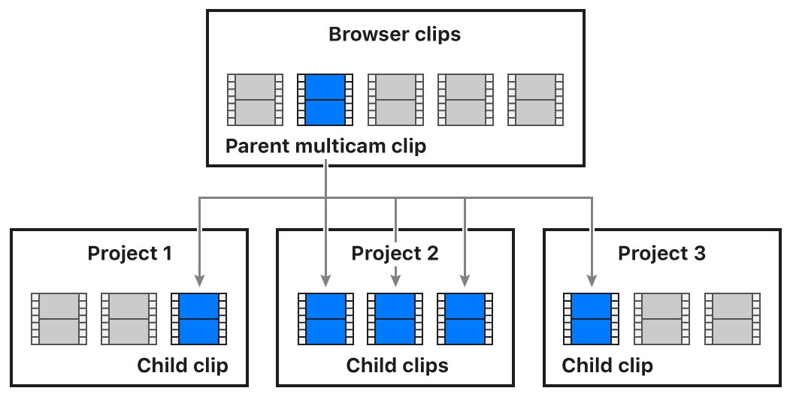
Multicam and stabilisation
DAY
18
Edit two cameras as easily as one.
LEARN: STEP BY STEP
Select the angles > New Multicam Clip; FCP syncs them by audio
Open the angle viewer and switch angles while it plays
Press 1, 2, 3 to cut to that angle
Stabilise shaky shots in the Video inspector
From the FCP User Guide, p. 514
TRY IT
WATCH ON YOUTUBE
▶ Multicam Editing Tutorial on Final Cut Pro
＋ 3 Ways You Can Stabilize Video in Final Cut Pro
Film with your phone and webcam at once, then cut between them.
MY NOTES
PUBLISH TODAY
KEY SHORTCUTS
MANUAL PAGES
Click here and type what you learned today…
Long video
1 · 2 · 3 (angles)
p. 213–219, 513–541

Slide 29
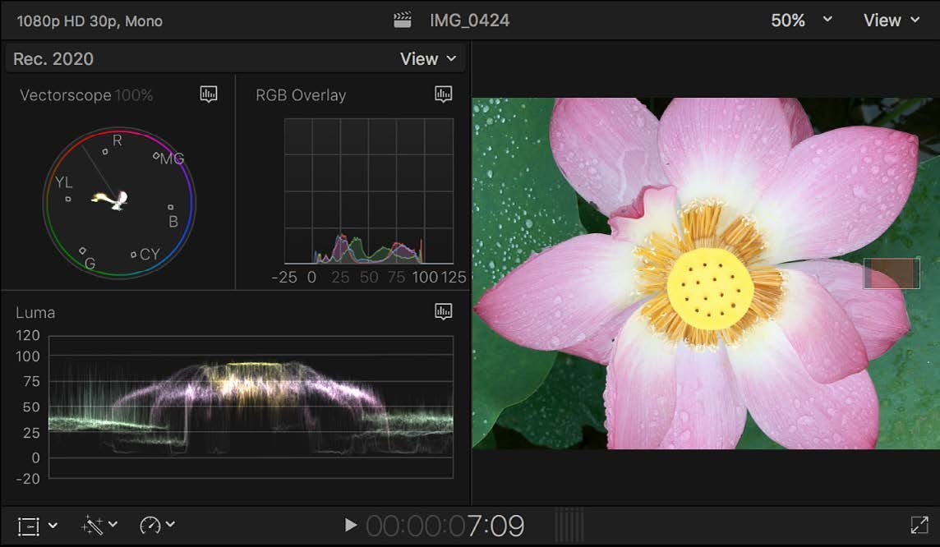
Adjustment clips, LUTs and video scopes
DAY
19
Give your channel a consistent look.
LEARN: STEP BY STEP
Add an adjustment clip over your whole edit for one look
Apply a LUT or Custom LUT effect for a style
Cmd+7 shows the video scopes to check exposure
Keep skin tones natural (on the vectorscope skin-tone line)
From the FCP User Guide, p. 791
TRY IT
WATCH ON YOUTUBE
▶ How to Use Adjustment Layers in Final Cut Pro 11
＋ How to correctly use LUTs – 3 methods you must know
Create one colour look and save it as a preset.
MY NOTES
PUBLISH TODAY
KEY SHORTCUTS
MANUAL PAGES
Click here and type what you learned today…
Short
Cmd+7
p. 449, 783–800

Slide 30
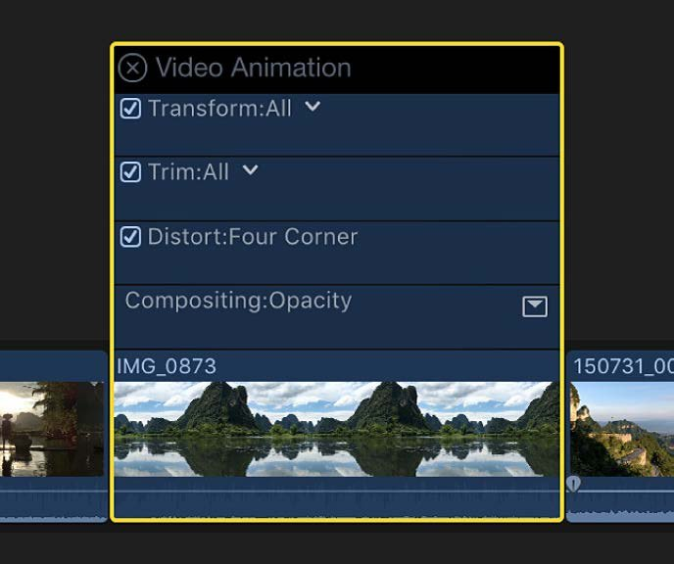
Edit to the beat and animate
DAY
20
Sync cuts to music and add movement.
LEARN: STEP BY STEP
Select the music clip and press Opt+B for Beat Detection
Snap cuts to the beat grid with snapping on (N)
Add keyframes in the inspector to animate position or scale
Use generators for backgrounds and shapes
From the FCP User Guide, p. 468
TRY IT
WATCH ON YOUTUBE
▶ Beat Detection Explained (Final Cut Pro 12)
＋ How to Use Keyframes to Animate Objects in FCP
Cut a 15-second montage exactly on the beat.
MY NOTES
PUBLISH TODAY
KEY SHORTCUTS
MANUAL PAGES
Click here and type what you learned today…
Music-synced Short
Opt+B · N
p. 210–214, 451, 467

Slide 31
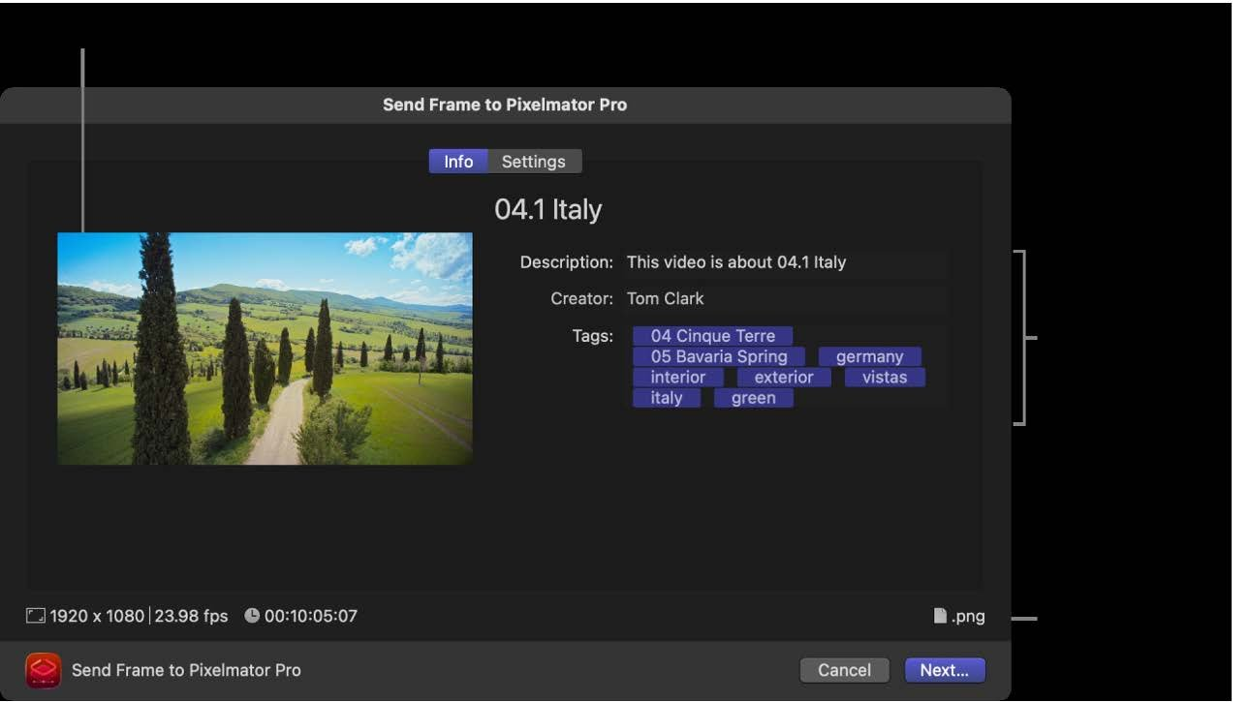
Thumbnails and B-roll storytelling
DAY
21
The thumbnail decides whether people click.
LEARN: STEP BY STEP
Share > Send Frame to Pixelmator Pro for thumbnails
Or add the Save Current Frame destination (p. 894)
Big face, 3–4 words, high contrast
Cover every jump cut with B-roll that shows what you say
From the FCP User Guide, p. 828
TRY IT
WATCH ON YOUTUBE
▶ Show-Stopping YouTube Thumbnails with Pixelmator Pro
＋ Youtube Thumbnail Creation In Apple Pixelmator Pro
Make 2 thumbnail options and pick the clearer one.
MY NOTES
PUBLISH TODAY
KEY SHORTCUTS
MANUAL PAGES
Click here and type what you learned today…
Long video
Cmd+E
p. 828, 894–895

Slide 32
Real-time daily workflow
WEEK 4 · DAYS 22–30
UPLOAD TARGET
A Short daily, plus a long video every 2–3 days
Batch your work, manage your library, repurpose content and read analytics.
END-OF-WEEK CHECK
Shoot, edit and upload a Short in under 30 minutes
Day 22 Batch day: shoot 5 Shorts at once
Day 23 Edit fast with your template
Day 24 Library management, proxies and backups
Day 25 Turn one long video into three Shorts
Day 26 Faster exports and YouTube SEO
Day 27 Read your analytics and fix your hooks
Day 28 Speed challenge: Short in under 30 minutes
Day 29 Make your best long video
Day 30 Review and plan the next month

Slide 33

Batch day: shoot 5 Shorts at once
DAY
22
Batching is how daily uploads stay sustainable.
LEARN: STEP BY STEP
Write 5 hooks (the first line of each Short)
Set up light and mic once, then film all 5
Import into one event; add a keyword for each Short
Rate the best take of each with F
Batching is how daily uploads stay sustainable.
TRY IT
WATCH ON YOUTUBE
▶ How to Batch Content for YouTube Shorts: Record, Edit, Upload
＋ How I Batch Film 4 Videos in 1 Day (Behind the Scenes)
Finish the day with 5 Shorts filmed and organised.
MY NOTES
PUBLISH TODAY
KEY SHORTCUTS
MANUAL PAGES
Click here and type what you learned today…
Short
Cmd+I · F
p. 21–38, 89

Slide 34
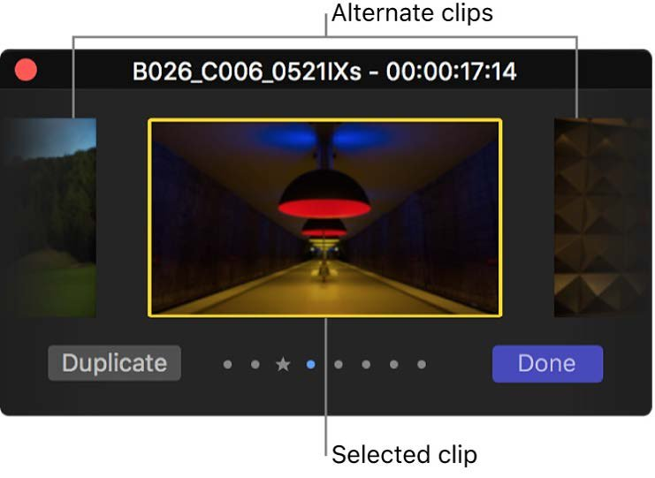
Edit fast with your template
DAY
23
Target: 15 minutes per Short.
LEARN: STEP BY STEP
Duplicate the template project for each Short
Use auditions (Cmd+Y) to compare takes quickly
Use the precision editor (Ctrl+E) for perfect cuts
Set a timer and stop at 15 minutes
From the FCP User Guide, p. 551
TRY IT
WATCH ON YOUTUBE
▶ Master Auditioning in Final Cut Pro for Perfect Takes
＋ How to Use Control-E (Precision Editor) for Perfect Edits
Edit 3 of yesterday’s Shorts with a timer running.
MY NOTES
PUBLISH TODAY
KEY SHORTCUTS
MANUAL PAGES
Click here and type what you learned today…
Short
Cmd+Y · Ctrl+E
p. 547–557

Slide 35
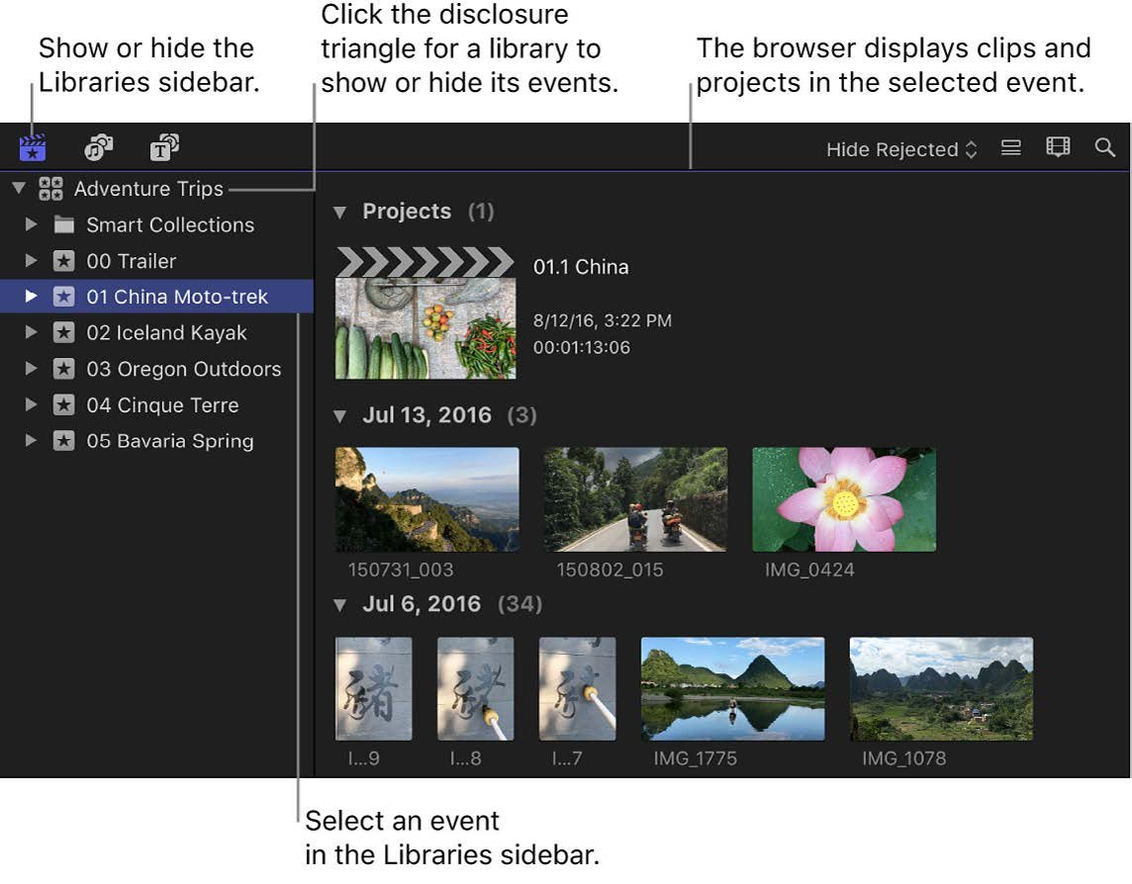
Library management, proxies and backups
DAY
24
Keep FCP fast and your work safe.
LEARN: STEP BY STEP
Create proxy media for smoother editing of 4K files
Delete render files you don’t need to free disk space
Consolidate media so the library contains everything
Back up the library to an external drive weekly
From the FCP User Guide, p. 868
TRY IT
WATCH ON YOUTUBE
▶ Edit faster in Final Cut using proxy media
＋ How To Delete Render Files in Final Cut Pro (2026)
Clean up your library and check your free disk space.
MY NOTES
PUBLISH TODAY
KEY SHORTCUTS
MANUAL PAGES
Click here and type what you learned today…
Short
—
p. 850–876

Slide 36
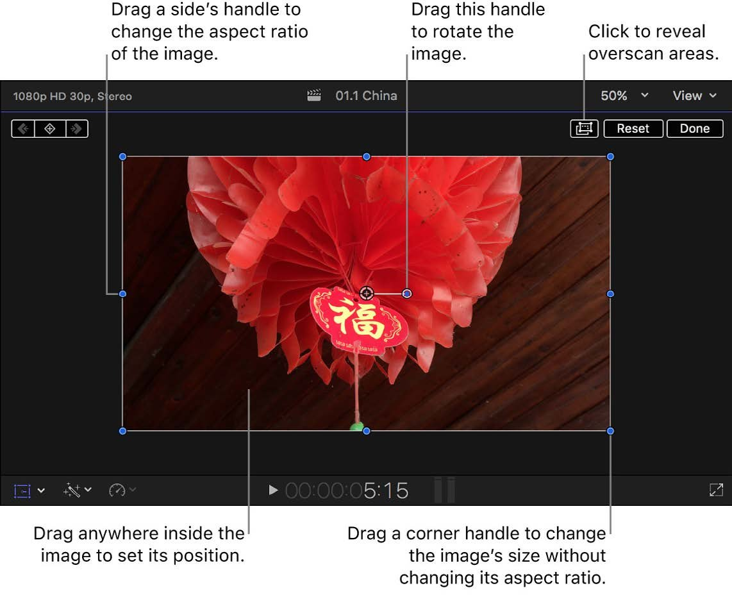
Turn one long video into three Shorts
DAY
25
Get more content from every recording.
LEARN: STEP BY STEP
Select the long project > Duplicate Project As (p. 123)
Choose a vertical format for the copy
Use Smart Conform to reframe each clip
Cut the 3 best 30–60 second moments
From the FCP User Guide, p. 403
TRY IT
WATCH ON YOUTUBE
▶ Final Cut Pro: Turn Any Video into a Vertical Reel or Short
＋ How to Duplicate Your Project in Final Cut Pro
Make 3 Shorts from your Day 14 or Day 21 video.
MY NOTES
PUBLISH TODAY
KEY SHORTCUTS
MANUAL PAGES
Click here and type what you learned today…
Short (repurposed)
Cmd+D
p. 122–123, 404

Slide 37
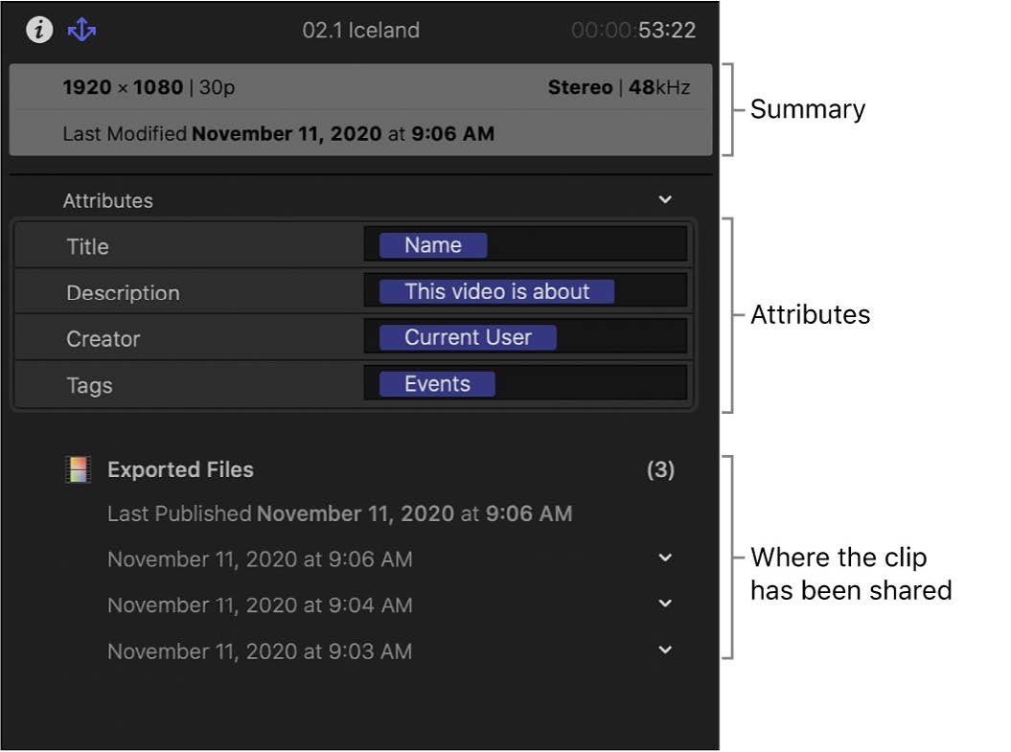
Faster exports and YouTube SEO
DAY
26
Spend less time waiting and more time being found.
LEARN: STEP BY STEP
Turn on Allow export segmentation for faster H.264 exports
Batch-share several Shorts at once (p. 833)
Title: keyword first and under 60 characters
Schedule uploads in YouTube Studio for a consistent time
From the FCP User Guide, p. 848
TRY IT
WATCH ON YOUTUBE
▶ YouTube SEO Settings 2025
＋ How to Rank YouTube Videos – Small & New Channels
Export 3 Shorts in one batch and schedule them for 3 days.
MY NOTES
PUBLISH TODAY
KEY SHORTCUTS
MANUAL PAGES
Click here and type what you learned today…
Short (scheduled)
Cmd+E
p. 833, 843, 848

Slide 38

Read your analytics and fix your hooks
DAY
27
Let your audience tell you what works.
LEARN: STEP BY STEP
YouTube Studio > Analytics > Content > Shorts
Check average view duration and the swipe-away rate
Find the second where viewers leave, and cut there next time
Rewrite your 3 weakest hooks
Let your audience tell you what works.
TRY IT
WATCH ON YOUTUBE
▶ Viewed to Swiped Away Ratio in YouTube Shorts (MUST KNOW)
＋ How To Increase Swipe Rate In YouTube Shorts
Re-edit one Short with a stronger first 2 seconds.
MY NOTES
PUBLISH TODAY
KEY SHORTCUTS
MANUAL PAGES
Click here and type what you learned today…
Short
—
—

Slide 39

Speed challenge: Short in under 30 minutes
DAY
28
Prove your workflow end to end.
LEARN: STEP BY STEP
Start a timer before you film
Shoot, import, edit, caption and export
Upload with title, description and #Shorts
Write down which step was slowest
Prove your workflow end to end.
TRY IT
WATCH ON YOUTUBE
▶ Final Cut Pro Just Made It EASY To Edit YouTube Shorts
＋ EDIT FASTER IN FINAL CUT PRO
Total time under 30 minutes. Note your time here.
MY NOTES
PUBLISH TODAY
KEY SHORTCUTS
MANUAL PAGES
Click here and type what you learned today…
Short
Your fastest shortcuts
—

Slide 40

Make your best long video
DAY
29
Use every skill from the month in one video.
LEARN: STEP BY STEP
Plan: hook, 3 main points, call to action
Multicam or B-roll, captions, chapters, colour look
Clean audio with a music bed and crossfades
Custom thumbnail made in Pixelmator Pro
Use every skill from the month in one video.
TRY IT
WATCH ON YOUTUBE
▶ My Final Cut Pro Video Editing Workflow from Start to Finish
＋ How I Edit YouTube Videos (Final Cut Pro Tips & Tricks)
Publish the video you’re proudest of.
MY NOTES
PUBLISH TODAY
KEY SHORTCUTS
MANUAL PAGES
Click here and type what you learned today…
Long video
All of them
Whole guide

Slide 41

Review and plan the next month
DAY
30
Look back, then make a plan to keep going.
LEARN: STEP BY STEP
Watch your Day 1 and Day 29 videos one after the other
Update your template with what you’ve learned
Plan next month’s content calendar
Decide whether to keep Apple Creator Studio (p. 18)
Look back, then make a plan to keep going.
TRY IT
WATCH ON YOUTUBE
▶ Build a YouTube Content Calendar That Actually Works
＋ YouTube Creators: Optimize & Evolve Your Content (official)
Write your top 5 lessons from this month in the notes box.
MY NOTES
PUBLISH TODAY
KEY SHORTCUTS
MANUAL PAGES
Click here and type what you learned today…
Short
—
p. 16–18

Slide 42
Quick reference
REFERENCE
Daily workflow · export settings · shortcuts · feature finder · progress tracker. Come back here whenever you forget something.

Slide 43
Your daily 40-minute workflow
1
2
3
4
5
6
Shoot
Import
Edit
Polish
Export
Upload
10 min
2 min
15 min
5 min
3 min
5 min
Phone, vertical, good light, clip-on mic
AirDrop to Mac > FCP > keyword the clips
Duplicate template, cut, Generate Captions, music
Enhance Light and Color, Voice Isolation, hook title
Share > Social Platforms, captions burned in
YouTube Studio: title, #Shorts, schedule
Batch it: film 5 Shorts in one session (Day 22), edit a few at a time, and schedule them. You don’t have to make each one on the day it goes out.

Slide 44
Export settings cheat sheet
Setting | YouTube Short | Long video
Project format | Vertical 1080×1920 | 1920×1080 (HD) or 3840×2160 (4K)
Frame rate | Same as your footage (usually 30 fps) | Same as your footage
Length | Up to 3 minutes; 15–60 sec works best | Any length (over 15 min needs a verified account)
FCP destination | Share > Social Platforms (p. 894) | Social Platforms, or Export File for a master copy (p. 810)
Captions | Burn in captions (always visible) | Export as a separate caption file, or burn in
Compression | Single-pass (faster) | Multi-pass (better quality)
Speed tip | Allow export segmentation (p. 848) | Allow export segmentation; batch share (p. 833)
In YouTube Studio | Add #Shorts, hook in the title | Chapters from markers, custom thumbnail, end screen

Slide 45
Shortcuts: editing
Keys | What it does
Space | Play or pause
J / K / L | Reverse / stop / forward
I / O | Set range start / end
X | Select the whole clip range
E | Append to the end
W | Insert at playhead
Q | Connect above storyline
D | Overwrite
Keys | What it does
Cmd+B | Cut at playhead
Opt+[ / Opt+] | Trim start / end to playhead
A / B / T | Select / Blade / Trim tool
P / R | Position / Range tool
N | Snapping on or off
V | Enable or disable a clip
Shift+Z | Fit timeline to window
Cmd+Z | Undo

Slide 46
Shortcuts: audio, titles, colour, speed, export
Keys | What it does
Opt+Cmd+A | Enhance Audio
Shift+Cmd+M | Match audio
Ctrl+S | Expand audio
Opt+S | Solo clip
Ctrl+T | Add basic title
Ctrl+Shift+T | Add lower third
Shift+Cmd+S | Generate captions (subtitles)
Cmd+T | Default transition
Keys | What it does
Ctrl+Opt+Cmd+O | Enhance Light and Color
Opt+Cmd+M | Match colour
Cmd+7 | Video scopes
Cmd+R | Retime editor
Shift+H / Opt+F | Hold / freeze frame
M | Add marker
Opt+G | New compound clip
Cmd+E | Share to default destination

Slide 47
Feature finder: where is it in the manual?
Topic | Page
Interface and magnetic timeline | 9–15
Import media | 21–38
Organise (keywords, favourites) | 89
New / vertical project | 120–127
Add clips (E, W, Q, D) | 136–155
Trim and cut | 168–187
Markers and chapters | 205–209
Edit to the beat | 210–214
Stabilise shaky video | 216
Audio basics | 220–251
Voice Isolation / Enhance Audio | 276–278
Topic | Page
Titles | 287
Captions / Generate Captions | 355, 385
Transitions | 389–400
Transform, crop, Ken Burns | 401–403
Smart Conform | 404
Keyframe animation | 467
Roles | 478
Compound clips | 504
Multicam | 513
Retime / speed ramps | 558
Green screen keying | 623
Topic | Page
Masks / Magnetic Mask | 642
Object tracking | 693
Colour correction | 708
Enhance Light and Color | 746
LUTs | 783
Video scopes | 791
Social Platforms export | 894
Thumbnails (Pixelmator Pro) | 828
Proxies and media management | 850–862
Keyboard shortcuts | 897

Slide 48
30-day progress tracker
Type ✓ in a box when you’ve published that day.
1
2
3
4
5
6
7
8
9
10
11
12
13
14
15
16
17
18
19
20
21
22
23
24
25
26
27
28
29
30
Week 1: Core editing
Week 2: Speed and polish
Week 3: Creative tools
Week 4: Real-time daily workflow

Slide 49
Keep going
DAY 31 AND BEYOND
Keep one Short a day, plus one or two long videos a week
Each month, go deeper into one area: colour, sound or motion graphics
Reread your My notes boxes every Sunday
Use the feature finder whenever you forget something

