Slide 1
NanoGPTQ
Philipp Sepin
Notes:
Hi and welcome to my project presentation.

Slide 2
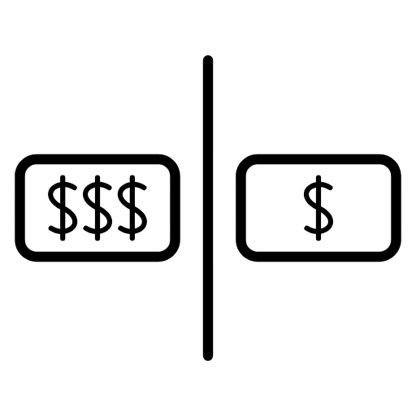
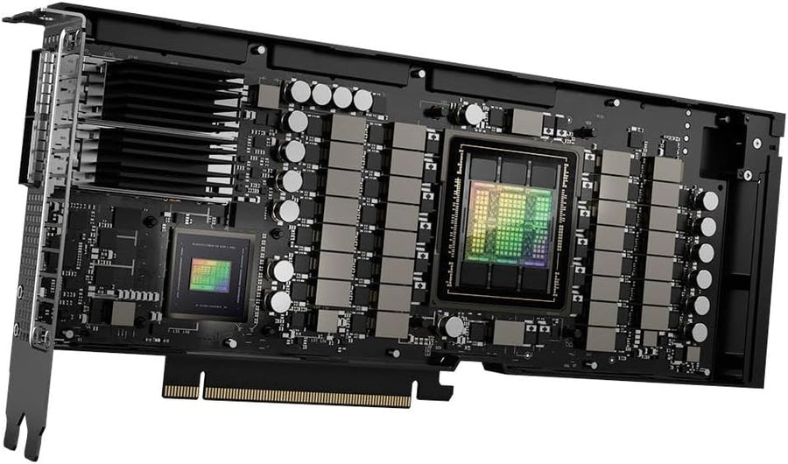
Large Language Models
Very powerful but very large
GPT-3 has 175 billion weights
Notes:
As all of you know, large language models are extremely powerful but also extremely large. GPT-3, released six years ago, already had 175 billion weights.

Slide 3
Large Language Models
Very powerful but very large
GPT-3 has 175 billion weights
Takes up around 700 GB in GPU memory with float32 weights
9 H100 GPUs needed
Notes:
When saved as 32-bit floats, these weights take up around 700 gigabytes. To run inference, we would need to load the entire model on GPUs, which would take 9 H100 GPUs. Now you may ask, is there any way to run such a large model on a single GPU?

Slide 4
Quantization
Changing float32 weights to int8 or int4
By naively rounding it to the next integer
Or more sophisticated algorithms like GPTQ
Notes:
The answer is quantization.
This technique reduces model weights from 32-bit floats to 8 or 4-bit integers. As you might expect, this reduces performance. We can either naively round weights, or use sophisticated techniques like GPTQ which adjust weights one after another to minimize error. All of this is done post-training.

Slide 5
Quantization
Changing float32 weights to int8 or int4
By naively rounding it to the next integer
Or more sophisticated algorithms like GPTQ
Only 1 H100 needed for running GPT-3 with int4 weights
Paving the way for faster inference with integer operations
Notes:
If we applied this to GPT-3, we could reduce the model size to around 80 gigabytes and run it on a single H100 GPU. This also paves the way for faster inference using integer operations.

Slide 6
What I did
Re-implemented a 2-3 M parameter transformer
Trained it on a 10 MB text dataset
float32 → int8
Notes:
So what did I do?
I re-implemented a small 2 to 3 million parameter autoregressive transformer from scratch, based on the NanoGPT implementation by Andrei Karpathy.
I trained it locally on my tiny notebook GPU for 11 hours on a dataset of short stories.

Slide 7
What I did
Re-implemented a 2-3 M parameter transformer
Trained it on a 10 MB text dataset
Implemented two quantization methods for int8
Quantization it using naive rounding
Quantization using GPTQ
float32 → int8
Notes:
I then implemented naive rounding and the GPTQ technique, quantizing my trained model to 8-bit integers to compare and evaluate the variants.

Slide 8
What I did
Re-implemented a 2-3 M parameter transformer
Trained it on a 10 MB text dataset
Implemented two quantization methods for int8
Quantization it using naive rounding
Quantization using GPTQ
Comparison, evaluation, demo, …
float32 → int8

Slide 9
Results
Model Variant | Perplexity (lower is better)
Baseline (float32) | 2.76
Naive Quantization (int8) | 2.78
GPTQ (int8) | 2.76
Notes:
So what were the results?
As you can see, the naive rounding technique resulted in a worse performing model. But using the GPTQ technique, we were able to gain back all the lost performance.

Slide 10
Results
Model Variant | Perplexity (lower is better) | Model size
Baseline (float32) | 2.76 | 31.9 MB
Naive Quantization (int8) | 2.78 | 2.9 MB
GPTQ (int8) | 2.76 | 2.9 MB
Notes:
As you can also see, the quantized models are 90% smaller than the baseline model. So using GPTQ we were able to greatly reduce the model size without losing any performance.

Slide 11
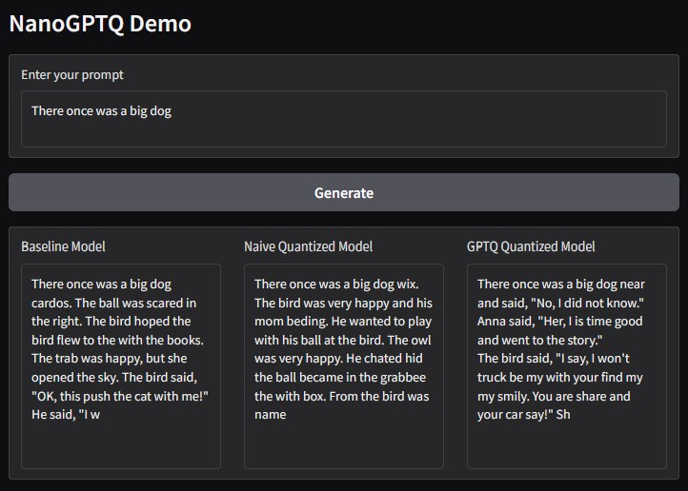
Demonstration
Notes:
Here is a small demo of the models responses given the prompt "There once was a big dog".
Clearly, 2-3 million parameters is not enough to generate high quality text, but the models are able to predict most words correctly and sometimes even predicted correct half sentences. But you might notice some slightly worse predictions from the naive quantized model.

Slide 12
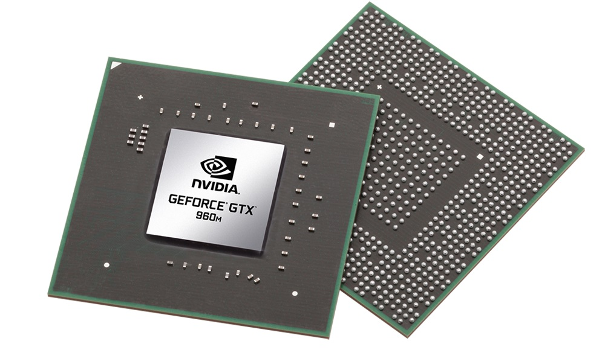

Insights
Re-implementing NanoGPT was difficult but insightful
Good exercise for anyone wanting to understand autoregressive transformers
Notes:
So what insights did I gain from this project?
Re-implementing an autoregressive transformer from scratch was quite difficult and also took quite some time. But it was a very valuable learning lesson and I can recommend this as an exercise to anyone wanting to deeply understand autoregressive transformers.

Slide 13
Insights
Re-implementing NanoGPT was difficult but insightful
Good exercise for anyone wanting to understand autoregressive transformers
Training a 2-3 M parameter model on a tiny notebook GPU was also difficult but insightful
Learned how to manage and balance expensive training runs
Notes:
Training a 2-3 million parameter model on my tiny notebook GPU was also quite challenging. Since a single training run took 11 hours, I was not able to retrain it multiple times if I would have been unhappy with the results. So I had to do a few tiny experimental training runs to find good hyperparameters and training settings before doing the actual training run.
So this was another valuable learning lesson on how to manage and balance training runs when you can only afford a single actual training run.

Slide 14
NanoGPTQ
Philipp Sepin
Notes:
Thank you for your attention.

