Slide 1
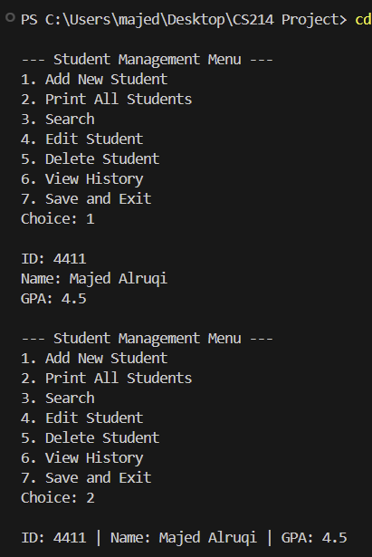
Student Management System
CS214 Project
Student data management using C++ data structures
Prepared by: Majed Tarahib Alruqi
University ID: 441109831
Section: 6013
Supervised by: Dr. Osamah Alzakan
GITHUB REPOSITORY
Linked List • Stack • Hash Table • File Handling
CS214 Project • Student Management System
1/8

Slide 2
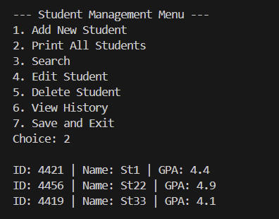
System Overview
Main Features
Goal
Build a simple C++ program to manage student records in memory and save them to a file when exiting.
• Add a new student
• Print all students
• Search by university ID
• Edit or delete a student
• View history, then save and exit
File Save / Load
←
Student
Record
→
Add / Edit / Delete
Recent History
Fast ID Search
CS214 Project • Student Management System
2/8

Slide 3
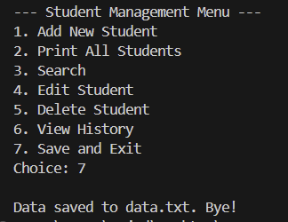
Program Flowchart
Program Execution Flow
Start
The program starts by reading the file, then keeps showing the menu until the user chooses to save and exit.
Load data.txt
Main Menu
User Choice?
1–5
Run Operation
+ Update History
6
View Recent
History
7
Save & Exit
After each operation, the program returns to the menu until the user selects Save and Exit.
CS214 Project • Student Management System
3/8

Slide 4
Linked List
Dynamic Student Storage
struct Node {
Student data;
Node* next;
};
Node* head = NULL;
Usage
• Stores student records in memory.
• Each node contains ID, Name, and GPA.
• Adding and deleting students does not require a fixed size.
ID
Name
GPA
ID
Name
GPA
ID
Name
GPA
NULL
head
→
→
→
Why We Chose It
A linked list is suitable when the number of students changes during runtime, so it is more flexible than a fixed array for this project.
CS214 Project • Student Management System
4/8

Slide 5
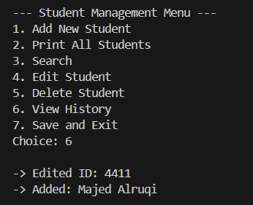
Stack
Operation History
LIFO
• Stores recent operations such as add, edit, and delete.
• Shows the latest operation first when View History is selected.
• Simple design with fast access to the most recent item.
Last-In, First-Out
Edited ID: 4411
Added: Majed Alruqi
Previous operation
struct MyStack {
string arr[10];
int top = -1;
void push(string msg) {
if (top < 9) arr[++top] = msg;
}
};
CS214 Project • Student Management System
5/8

Slide 6
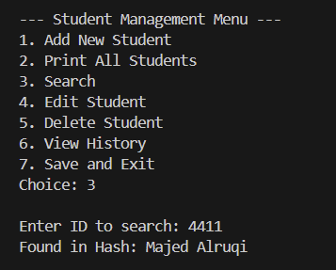
Hash Table
Fast Search by ID
Convert the university ID into an index in a fixed table using:
Idea
index = id % 20
0
1
2
3
4
5
6
7
8
9
10
11
12
13
14
15
16
17
18
19
4411 % 20 = 11
• Average search time is close to O(1).
• Faster than scanning every node in the linked list.
• Suitable for searching by ID.
If a collision occurs, the program moves to the next slot using Linear Probing.
CS214 Project • Student Management System
6/8

Slide 7
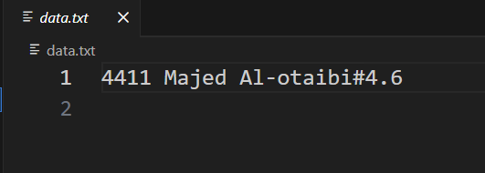
File Handling
Data Persistence
Data Persistence
• The program loads records from data.txt at startup.
• When Save and Exit is selected, records are saved back to the same file.
• The # separator splits the name from GPA, allowing names with spaces.
while (fIn >> id) {
fIn.ignore();
getline(fIn, name, '#');
fIn >> gpa;
}
fOut << id << " " << name
<< "#" << gpa << endl;
Format:
ID Name#GPA
CS214 Project • Student Management System
7/8

Slide 8
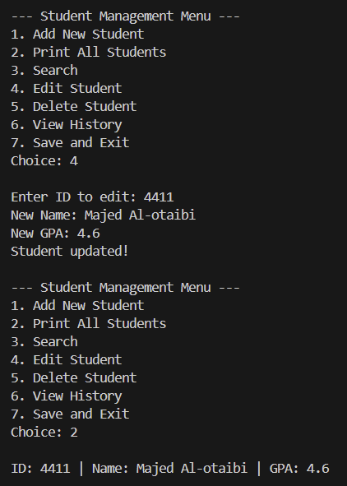
Demo Results
Demo Screenshots
Screenshots from the running program
Add Student
Print All
Edit
Search
History
Save & Exit
The program performs the main operations and saves changes to data.txt when exiting.
CS214 Project • Student Management System
8/8

